Slide 1
8 Radiophobia
Fear sells
Fission power safest
Metabolism
DNA, cellular repair
Evidence, ignored by authorities
Deadly evacuations unnecessary
Radiophobia policy, NRC, EPA
Educational video, book
Confounders, controls, p-hunting
Fission is in Fashion

Slide 2
Unfounded radiation fear is the ignored elephant in the room.
https://www.2lo.co.uk/Elephant-in-the-room/

Slide 3
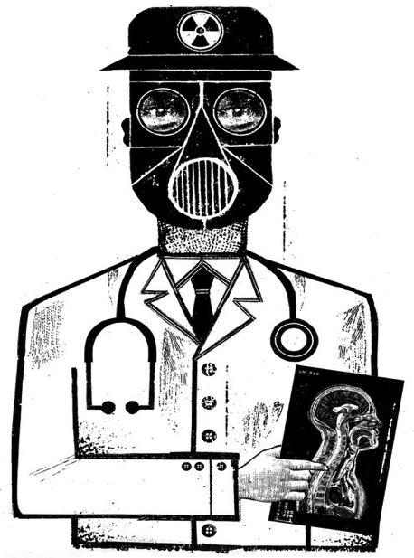
New York Times prints radiation scares.
“a 2009 study from the National Cancer Institute estimates that CT scans conducted in 2007 will cause a projected 29,000 excess cancer cases and 14,500 excess deaths over the lifetime of those exposed.”
https://www.nytimes.com/2014/01/31/opinion/we-are-giving-ourselves-cancer.html
Notes:
http://www.nytimes.com/2014/01/31/opinion/we-are-giving-ourselves-cancer.html
http://atomicinsights.com/ct-scans-save-lives/ response by scientists
http://www.ncbi.nlm.nih.gov/pubmed/26402399 value of CT
http://www.mayoclinicproceedings.org/cms/attachment/2037659391/2052032946/mmc1.pdf
http://www.mayoclinicproceedings.org/article/S0025-6196(15)00591-1/pdf

Slide 4
New York Times ignores the evidence.
Nghi Phan 2011 PhD thesis BIOLOGICAL EFFECTS AND CANCER RISK OF COMPUTED TOMOGRAPHY
Results from this research found that low-dose diagnostic CT scans do not increase risk and can, in fact, induce protective effects. …
…CT scans can increase longevity and reduce cancer risk
https://www.researchgate.net/publication/241814041_UNDERSTANDING_THE_BIOLOGICAL_EFFECTS_AND_CANCER_RISK_OF_MEDICAL_DIAGNOSTIC_COMPUTED_TOMOGRAPHY
Notes:
http://www.nytimes.com/2014/01/31/opinion/we-are-giving-ourselves-cancer.html
http://atomicinsights.com/ct-scans-save-lives/ response by scientists
http://www.ncbi.nlm.nih.gov/pubmed/26402399 value of CT
http://www.mayoclinicproceedings.org/cms/attachment/2037659391/2052032946/mmc1.pdf
http://www.mayoclinicproceedings.org/article/S0025-6196(15)00591-1/pdf

Slide 5
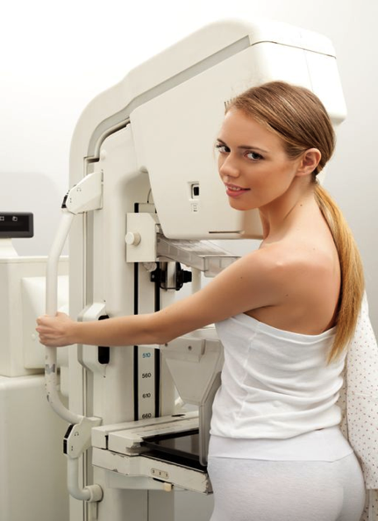
Radiation dose is the energy transferred to body tissue.
Example dose
X-ray mammography
2 mSv (millisievert)
= 0.002 Sievert
= 0.002 Gray (for X-rays)
= 0.002 joule per kilogram
= 0.002 watt-second per kg
Notes:
http://www.conciergeradiologist.com/mammogram-guidelines.html

Slide 6
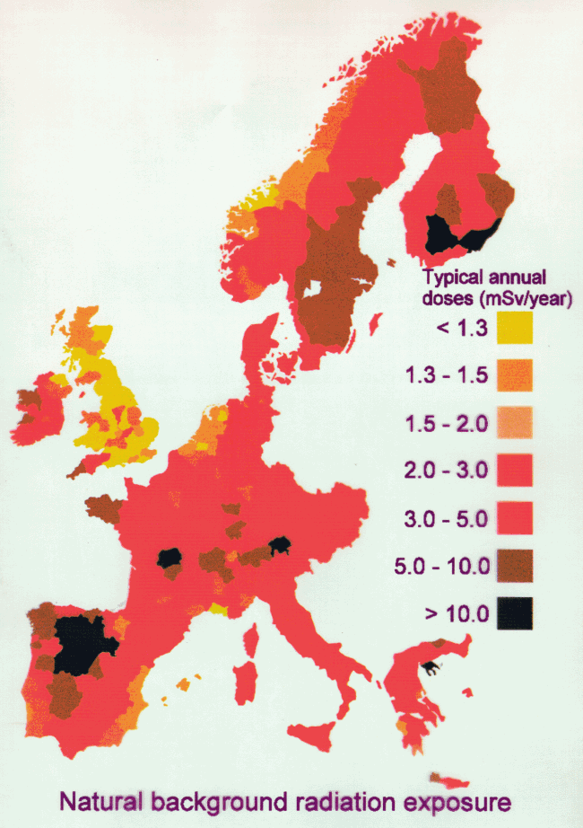
Natural background radiation dose rates are 1-10 mSv/year.
Sources
Radon
Cosmic rays
Food
Granite
Places Ave dose rate
US 3 mSv/y
Denver 4
Finland 7
Notes:
http://www.world-nuclear.org/info/Safety-and-Security/Radiation-and-Health/Naturally-Occurring-Radioactive-Materials-NORM/
http://en.wikipedia.org/wiki/Ramsar,_Mazandaran

Slide 7
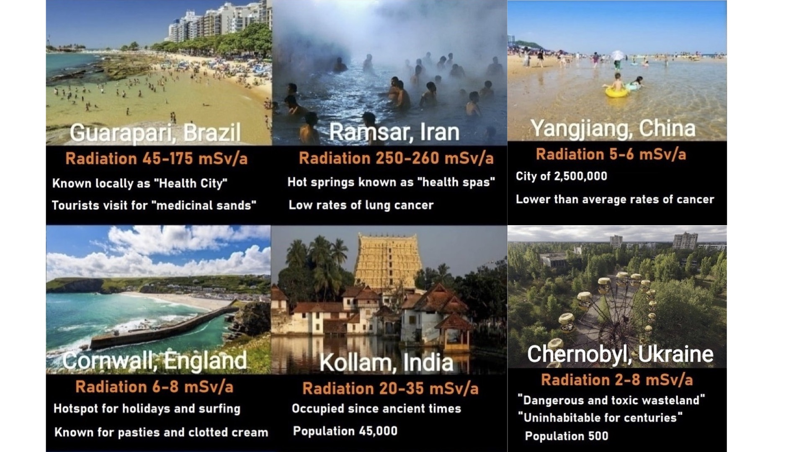
Notes:
http://www.nytimes.com/2014/01/31/opinion/we-are-giving-ourselves-cancer.html
http://atomicinsights.com/ct-scans-save-lives/ response by scientists
http://www.ncbi.nlm.nih.gov/pubmed/26402399 value of CT
http://www.mayoclinicproceedings.org/cms/attachment/2037659391/2052032946/mmc1.pdf
http://www.mayoclinicproceedings.org/article/S0025-6196(15)00591-1/pdf

Slide 8
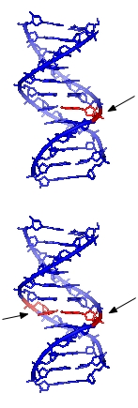
DNA strand breaks occur frequently, by ionized oxygen molecules from metabolism.
Single strand breaks occur 10,000 times per day per cell.
100 mSv/y radiation adds 12 per day.
Double strand breaks occur 10 times per day per cell.
100 mSv/y radiation adds 1 per year.
Notes:
http://en.wikipedia.org/wiki/DNA_repair
Feinendegen et al http://dl.dropboxusercontent.com/u/119239051/Feinendegen-2012_Hormesis-by-LDR_Therapeutic-Nucl-Med.pdf
“at background radiation level, the probability of a radiogenic DSB to occur per day was calculated to be on average only about 1 in 10,000 cells”
Costes “Double strand breaks occur one to 10 times per day per cell. (based on measurements made at Exogen with our finger prick kit) ”
Costes “

Slide 9
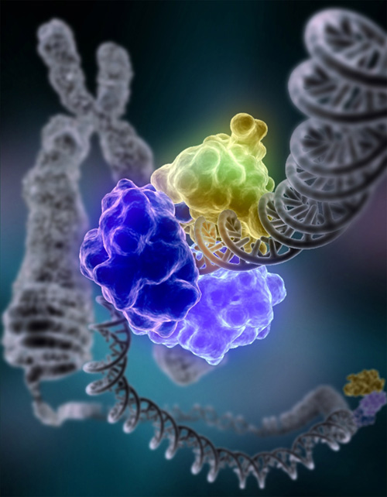
DNA is repaired.
Special enzyme DNA ligase encircles the double helix to repair a broken strand of DNA.
Notes:
https://commons.wikimedia.org/wiki/File:DNA_Repair.jpg
http://www.sciencedaily.com/releases/2015/10/151029185601.htm Nuclear membrane repairs “dark” DNA (different mechanism)

Slide 10
2015 Nobel Prize: How DNA is repaired.
Modrich: how cells correct errors that occur when DNA is replicated during cell division.
Sancar: mapping the mechanism cells use to repair ultraviolet damage to DNA.
Lindahl: excision repair — the cellular mechanism that repairs damaged DNA during the cell cycle.
http://www.nytimes.com/2015/10/08/science/tomas-lindahl-paul-modrich-aziz-sancarn-nobel-chemistry.html
Notes:
http://www.nytimes.com/2015/10/08/science/tomas-lindahl-paul-modrich-aziz-sancarn-nobel-chemistry.html

Slide 11
DNA repair times are ~ 1 hour.
https://www.pnas.org/doi/10.1073/pnas.1117849108
UC Berkeley pictures of DSB repair process
Bright spots are RIF’s, Radiation Induced Foci, clusters of damage sensing/repair proteins.
RIFs are repair centers for Double Strand Breaks (DSBs).
Notes:
http://www.pnas.org/content/early/2011/12/16/1117849108.full.pdf
http://phys.org/news/2015-09-time-lapse-analysis-cells-dna.html time lapse video

Slide 12
Each RIF can accurately repair ~ 1 DSB.
Observe/expect ~ 25-40 DSBs per Gy. Study reveals RIF/Gy, repairability, decreases with radiation exposure: 100 mGy: 73 RIF/Gy 1000 mGy: 28 RIF/Gy
@ 100 mGy, get 7.3/4 RIF/Gy, >1, so repairability OK. @1000 mGy, get 28/40 RIF/Gy, <1, so repair system overwhelmed.
Repairs are nonlinear with dose rate.
Jack Devanney gordianknotbook.com
Notes:
http://www.pnas.org/content/early/2011/12/16/1117849108.full.pdf
http://phys.org/news/2015-09-time-lapse-analysis-cells-dna.html time lapse video

Slide 13
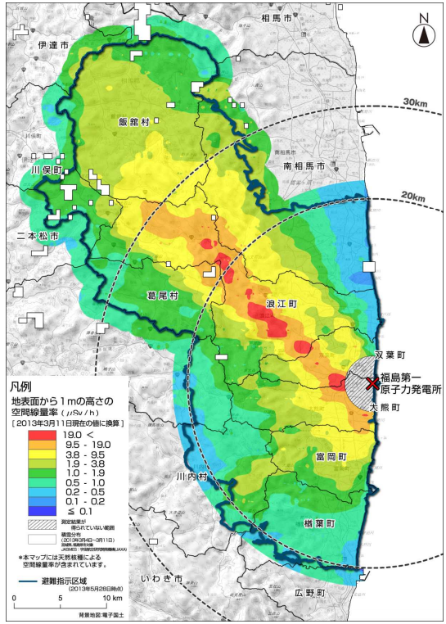
Fukushima evacuation killed 2,000 citizens.
Japan evacuated the black-lined area.
IAEA published recommendation: evacuate the red area.
Evacuation was unnecessary anywhere.
No one died from radiation.
20,000 died from the tsunami.
Notes:
19 microSv/hr = 166 mSv/yr -- even less than IAEA recommendation
Radiation diminishes, to 20 mSv/y, in time.
85,000 mandated evacuees receiving compassion payments of $7,500/month = $3.5 billion
300,000 tsunami homeless receiving little.
http://news.mit.edu/2012/prolonged-radiation-exposure-0515

Slide 14
Tritium in Fukushima water release is harmless.
Tritium is hydrogen with 2 neutrons.
Decays to He-3, releasing electron.
Each electron releases: 6,000 eV, average.
Decay half-life: 12 years.
Biological excretion half-life: 10 days.
Cosmic rays make 15e16 Bq per year.
Fukushima water: 1,000,000 Bq/L x 1e9 L
Lethal dose: 8e15 Bq/kg (in ~35g mouse).
Safe continuous ingestion: 4,000,000 Bq/L.
US drinking water limit: 740 Bq/kg
Tanks storing treated groundwater flowing through destroyed fission power plants at Fukushima
https://www.forbes.com/sites/jamesconca/2017/11/29/japan-should-release-tritium-contaminated-water-to-the-ocean
https://www.jstor.org/stable/3570515
Notes:
19 microSv/hr = 166 mSv/yr -- even less than IAEA recommendation
Radiation diminishes, to 20 mSv/y, in time.
85,000 mandated evacuees receiving compassion payments of $7,500/month = $3.5 billion
300,000 tsunami homeless receiving little.
http://news.mit.edu/2012/prolonged-radiation-exposure-0515

Slide 15
‘No One Died From Radiation At Fukushima’: IAEA Boss Met With Laughter At COP26
“No one died from radiation at Fukushima,” Grossi said, provoking laughter from the audience.
“I don’t know why you’re laughing, it’s a fact. Thousands of people died because of the tsunami but there were no deaths attributable to exposure to radiation. People died also because of the evacuation, it was very traumatic,” he continued.
IPCC scientists’ ignorance is appalling.
https://www.forbes.com/sites/sofialottopersio/2021/11/04/no-one-died-from-radiation-at-fukushima-iaea-boss-statement-met-with-laughter-at-cop26/?sh=697b8ba27a47
Notes:
19 microSv/hr = 166 mSv/yr -- even less than IAEA recommendation
Radiation diminishes, to 20 mSv/y, in time.
85,000 mandated evacuees receiving compassion payments of $7,500/month = $3.5 billion
300,000 tsunami homeless receiving little.
http://news.mit.edu/2012/prolonged-radiation-exposure-0515

Slide 16
…The Dirty Harry atomic bomb test in 1953 dropped two to three times as much radioactive fallout on the residents of St. George, Utah, than people near Fukushima were exposed to. There was no evacuation in Utah. People were asked to stay indoors that day; there was no increase in cancer rates. …
Notes:
19 microSv/hr = 166 mSv/yr -- even less than IAEA recommendation
Radiation diminishes, to 20 mSv/y, in time.
85,000 mandated evacuees receiving compassion payments of $7,500/month = $3.5 billion
300,000 tsunami homeless receiving little.
http://news.mit.edu/2012/prolonged-radiation-exposure-0515

Slide 17
Fission power is the safest energy source.
Brown Coal
32.72
Coal
24.62
Oil
18.43
Biomass
4.63
Gas
2.82
Nuclear
0.07
Deaths per thousand gigawatt hours
https://ourworldindata.org/energy#what-are-the-safest-sources-of-energy

Slide 18
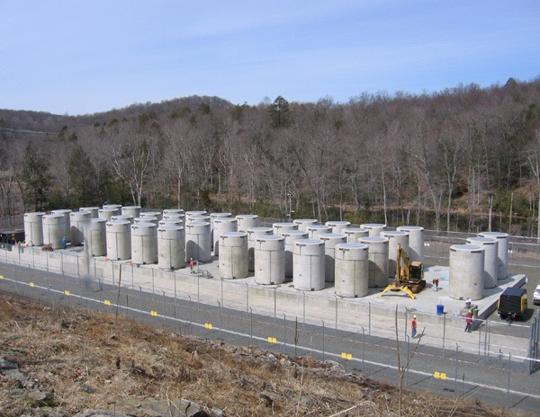
Small amount of waste is easily stored.
Dry cask storage for 28 years of 620 MW Connecticut Yankee.
80 GW-yrs may be stored in casks on pad for ThorCon fission energy.
80 GW-yrs of coal ash on that pad would reach one mile high.
80 GW-yrs of end-of-life solar panels on that pad would reach one mile high.

Slide 19
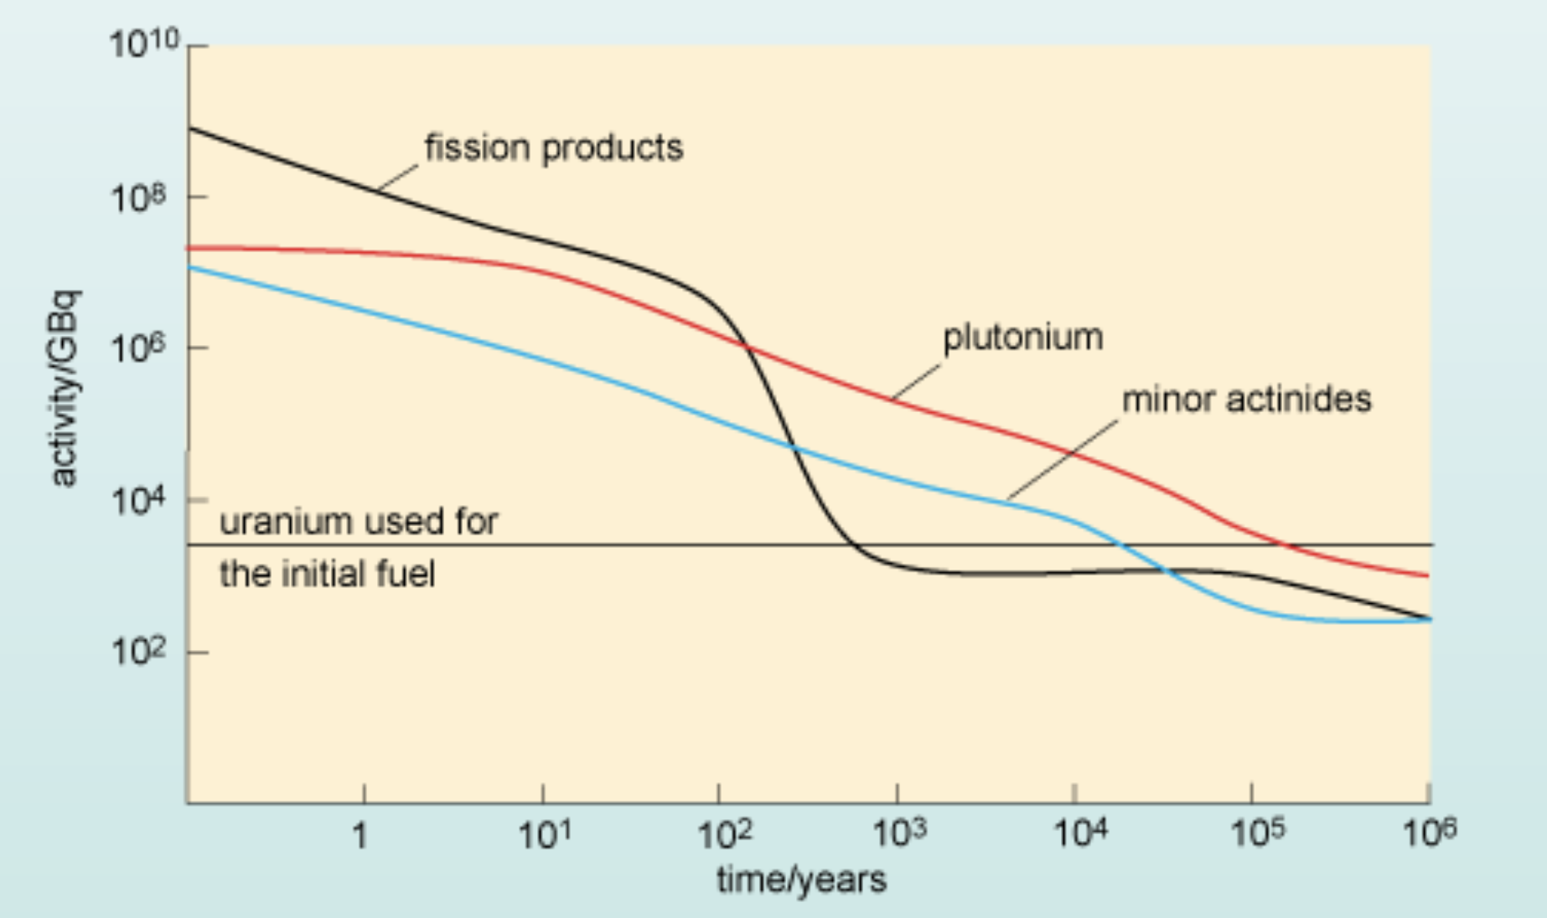
Used fuel radioactivity drops 10,000X in a few hundred years.

Slide 20
Jim Conca: CalTech, NASA, PNNL, WSU, LANL, ANS, Forbes…
https://www.youtube.com/watch?v=0JfJEK3R1k0

Slide 21
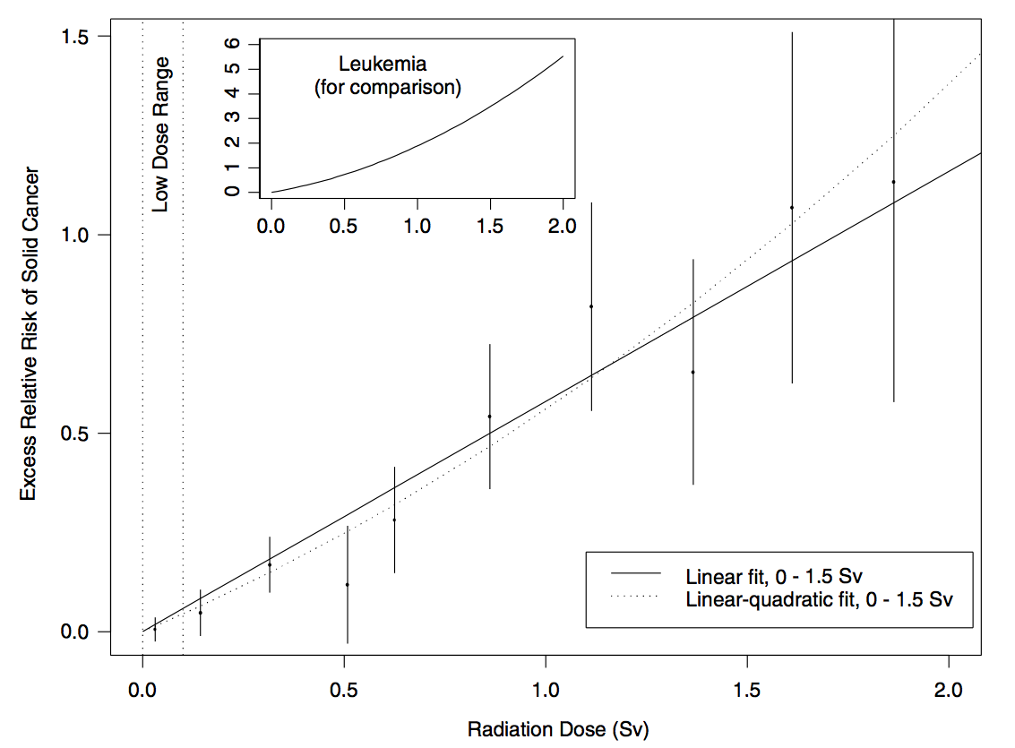
National Academy report said cancer risk is proportional to radiation dose (Linear No Threshold).
LNT
http://www.nap.edu/catalog.php?record_id=11340
Notes:
http://www.nap.edu/catalog.php?record_id=11340

Slide 22
National Council on Radiation Protection hides data.
https://larouchepub.com/eiw/public/2003/eirv30n19-20030516/eirv30n19-20030516_018-problems_of_us_policy_on_radiati.pdf
Notes:
http://www.nap.edu/catalog.php?record_id=11340

Slide 23
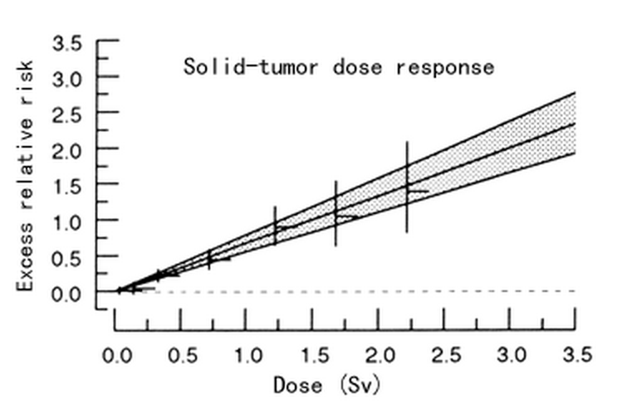
Atomic bomb survivor publications do not show the details of doses < 100 mSv.
100 mSv
http://www.rerf.or.jp/library/update/rerfupda_e/factfig/vaeth.html
Notes:
http://www.rerf.or.jp/library/update/rerfupda_e/factfig/vaeth.html
“hides” data?

Slide 24
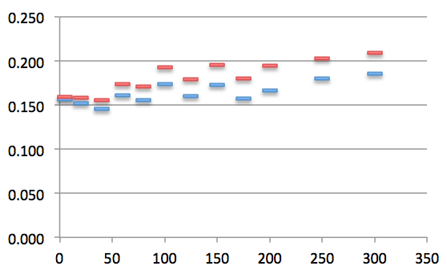
Yet the decrease in cancers below 40 mSv dose is significant.
Cancer rate
6,411 people exposed to >40 mSv
LNT
20-40 mSv n=891
19,369 people exposed 5-40 mSv
5-20 mSv n=2084
Radiation exposure (mSv)
Notes:
http://www.ncbi.nlm.nih.gov/pmc/articles/PMC2592990/ Luckey
http://www.ncbi.nlm.nih.gov/pubmed/24298226 Doss
http://www.ncbi.nlm.nih.gov/pubmed/23304106 Doss
http://www.thenewamerican.com/tech/environment/item/6932-the-effects-of-low-dose-radiation Hiserodt
Over 18,000 observations in tis range
60mSv acute dose may show effect

Slide 25
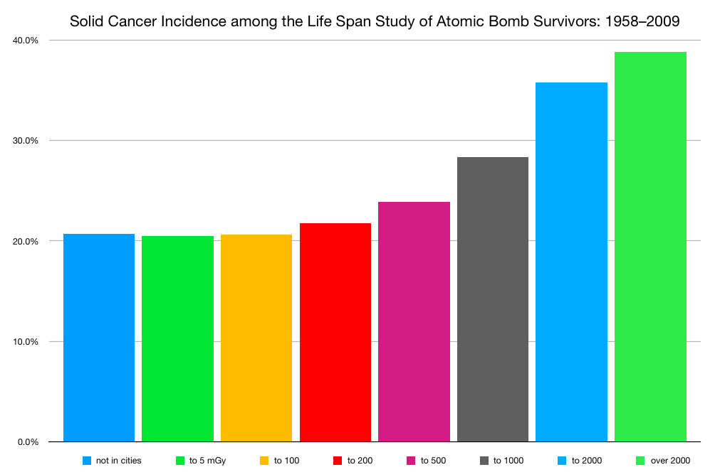
Atom bomb survivors exposures < 100 mSv caused no observed excess cancers.
100 mSv
812 excess cancers for 16,716 people, > 100 mSv
not in cities
25,239 people
< 5
35,978 people
< 100
27,511 people
source data http://www.bioone.org/doi/full/10.1667/RR14492.1
Notes:
source data http://www.bioone.org/doi/full/10.1667/RR14492.1

Slide 26
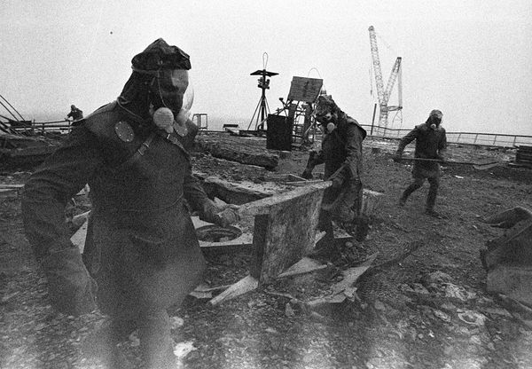
Chernobyl
28 emergency workers died from acute radiation sickness.
15 children died of thyroid cancer.
“possible increase in cancer mortality … might represent up to 4000 fatal cancers.” Chernobyl Forum
https://www.iaea.org/sites/default/files/chernobyl.pdf
Notes:
http://news.nationalgeographic.com/news/energy/2011/04/110426/chernobyl-25-years-liquidators-pictures/#/chernobyl-25th-anniversary-liquidators-firefighters-roof_35076_600x450.jpg
https://www.iaea.org/sites/default/files/chernobyl.pdf

Slide 27
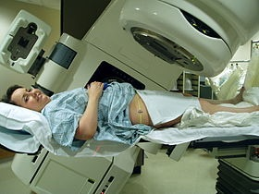
A rotating X-ray beam focused on cancer tissue delivers up to 80,000 mSv.
To minimize the small risk of causing cancer in nearby tissue
radiologists divide the radiation dose into fractions
administered daily rather than all at once
giving healthy tissue time to recover. (3 million therapies/yr)
If LNT were true, fractionated radiation therapy wouldn’t work.
Notes:
https://en.wikipedia.org/wiki/Radiation_therapy

Slide 28
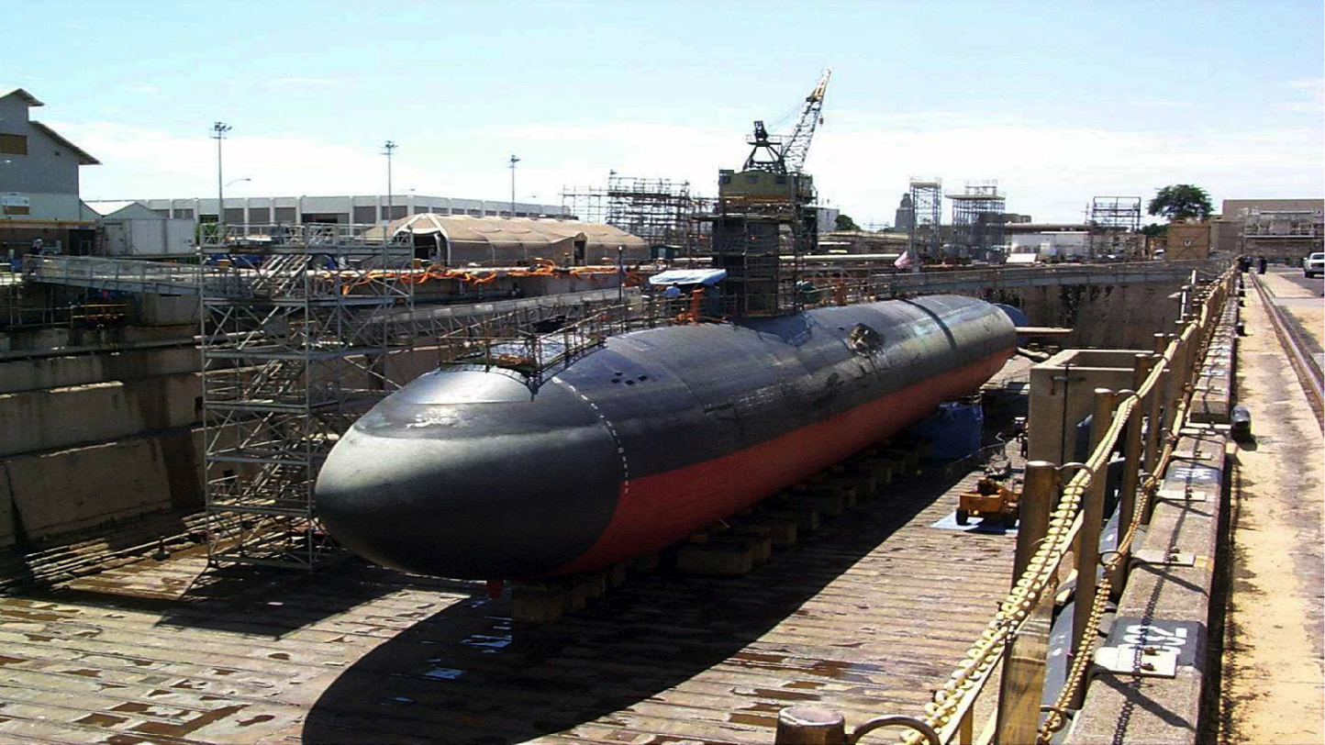
28,000 nuclear shipyard workers exposed to ~8 mSv had a 24% lower death rate.
Controls - age-matched - job-matched
http://www.ecolo.org/documents/documents_in_english/low-dose-NSWS-shipyard.pdf
Notes:
http://upload.wikimedia.org/wikipedia/commons/9/94/USS_Greeneville_(SSN_772)_-_dry_dock_Pearl_Harbor_(1).jpg

Slide 29
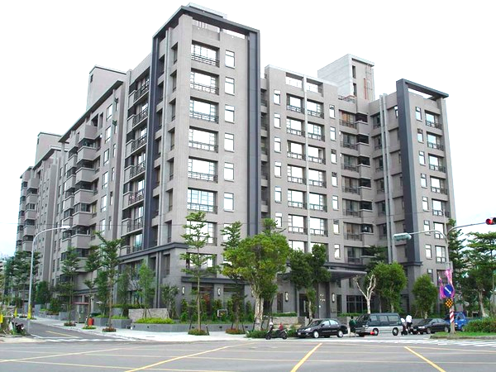
7,271 Taiwan apartment dwellers exposed to ~48 mSv had 55 fewer cancers than 150 predicted by LNT.
http://www.ncbi.nlm.nih.gov/pubmed/17178625
http://taiwan-apt-cancer-data-analysis.blogspot.com/
http://www.ncbi.nlm.nih.gov/pubmed/18666807
Notes:
1983 20,000 tons of Co-60 contaminated steel in 200 buildings
http://m1.behance.net/rendition/modules/38853637/disp/665bd4a87b802078a6df93acf284dc7b.jpg a Taiwan apt building of the right age
http://www.ncbi.nlm.nih.gov/pmc/articles/PMC2477708/
http://www.ncbi.nlm.nih.gov/pubmed/17178625
http://www.ncbi.nlm.nih.gov/pubmed/18666807
http://taiwan-apt-cancer-data-analysis.blogspot.com/http://taiwan-apt-cancer-data-analysis.blogspot.com/

Slide 30
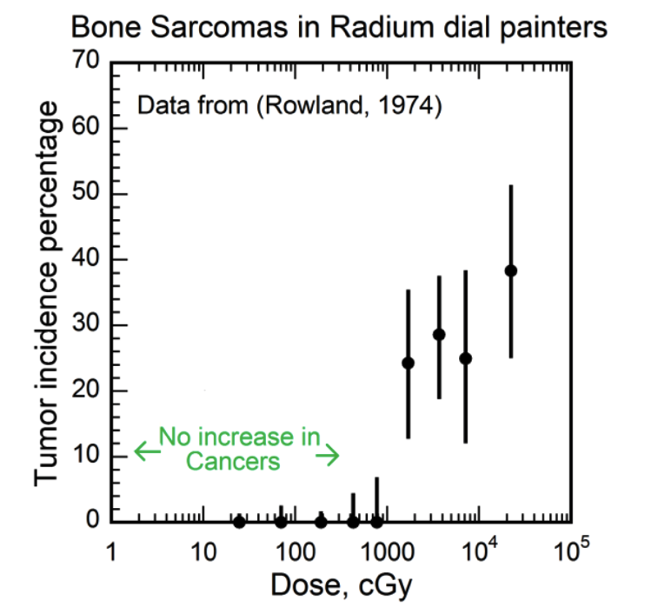
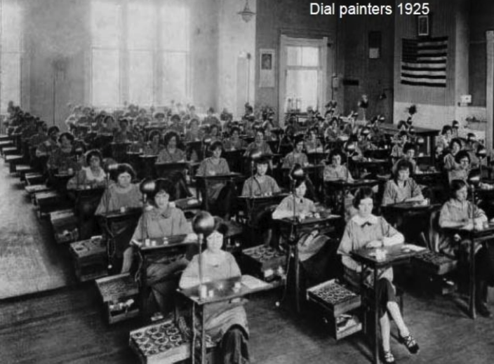
56 radium dial painters’ bone sarcomas occurred at a threshold over ~ 10,000 mGy. (1412 unharmed)
http://journals.lww.com/health-physics/Abstract/1974/11000/Radium_in_Man_.10.aspx
http://www.ncbi.nlm.nih.gov/pubmed/6862895
Notes:
http://journals.lww.com/health-physics/Abstract/1974/11000/Radium_in_Man_.10.aspx
Dose-response relationships for radium-induced bone sarcomas., Rowland RE, Stehney AF, Lucas HF. 1983. http://www.ncbi.nlm.nih.gov/pubmed/6862895
Radiation Hormesis and the Linear-No-Threshold Assumption, Charles L. Sanders - 2009, page 44, http://books.google.com/books?isbn=3642037208

Slide 31
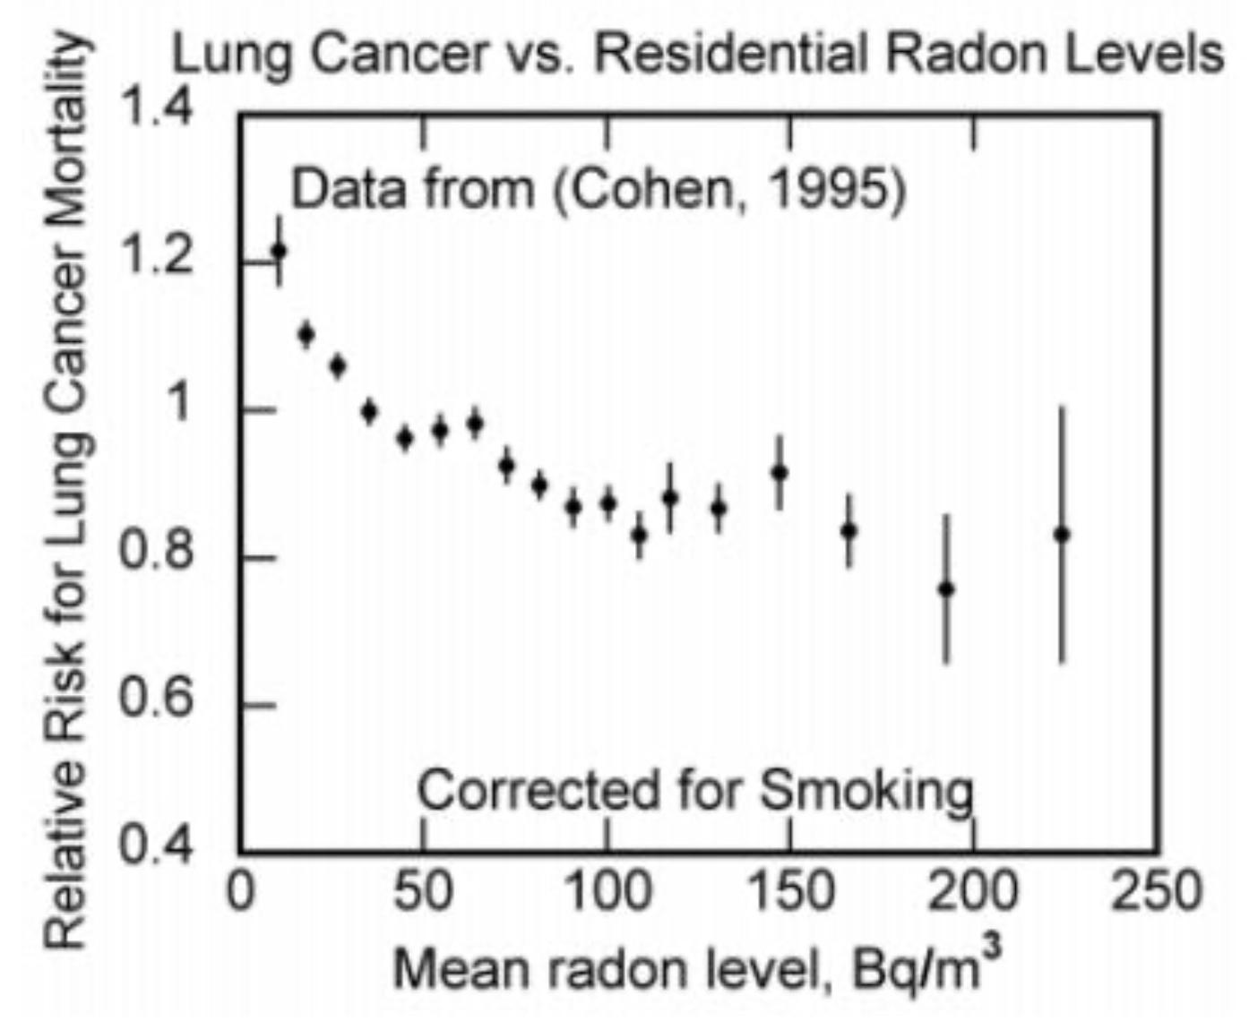
Lung cancer rates decrease with increasing residential radon levels.
https://www.x-lnt.org/debate-announcement
https://www.ncbi.nlm.nih.gov/labs/pmc/articles/PMC2477686/

Slide 32
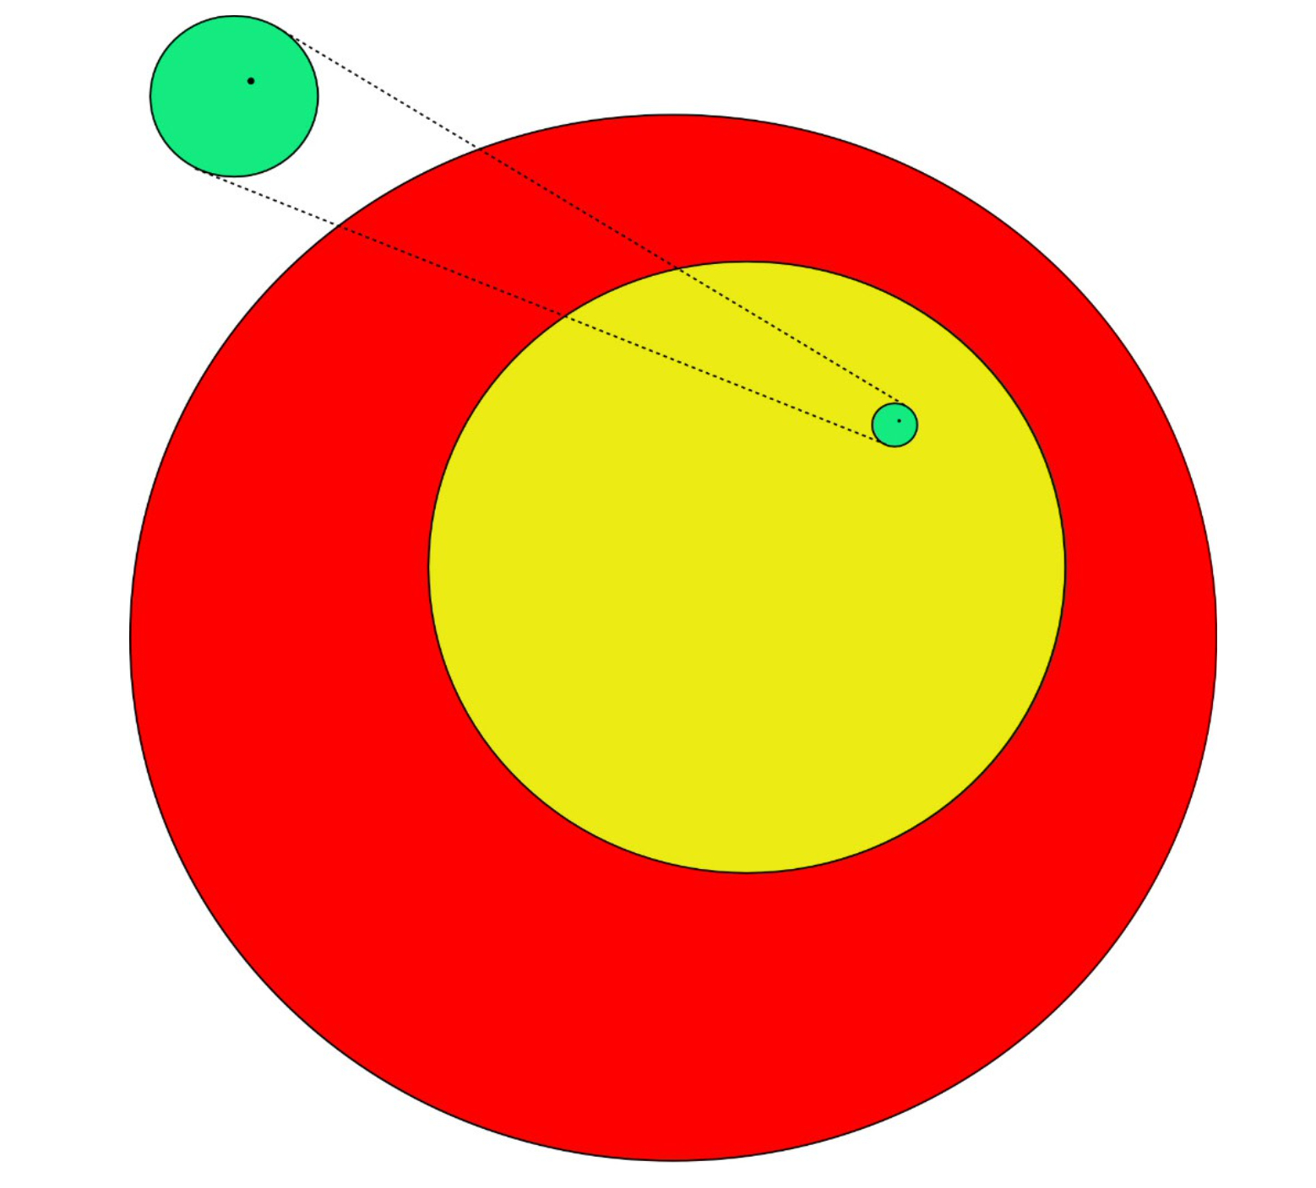
What radiation exposure is safe? 100 mGy per month
Red: 80,000 mGy/mo
- deadly to cancer tumors
Yellow: 30,000 mGy/mo
- healthy tissue recovers, rarely causing second cancer
Green: 100 mGy/mo
- harmless
Black dot: < 0.08 mGy/mo
- ICRP, EPA, NRC public limit
https://www.researchgate.net/publication/311175620_Nuclear_energy_and_society_radiation_and_life_-_the_evidence_1 Wade Allison

Slide 33
French Academy of Sciences accepts safe threshold.
At US NRC, policy trumps science. No threshold! ALARA!
https://www.nrc.gov/docs/ML0701/ML070160572.pdf
https://www.epa.gov/sites/production/files/2015-05/documents/hmbuygud.pdf
https://hps.org/publicinformation/ate/q11963.html

Slide 34
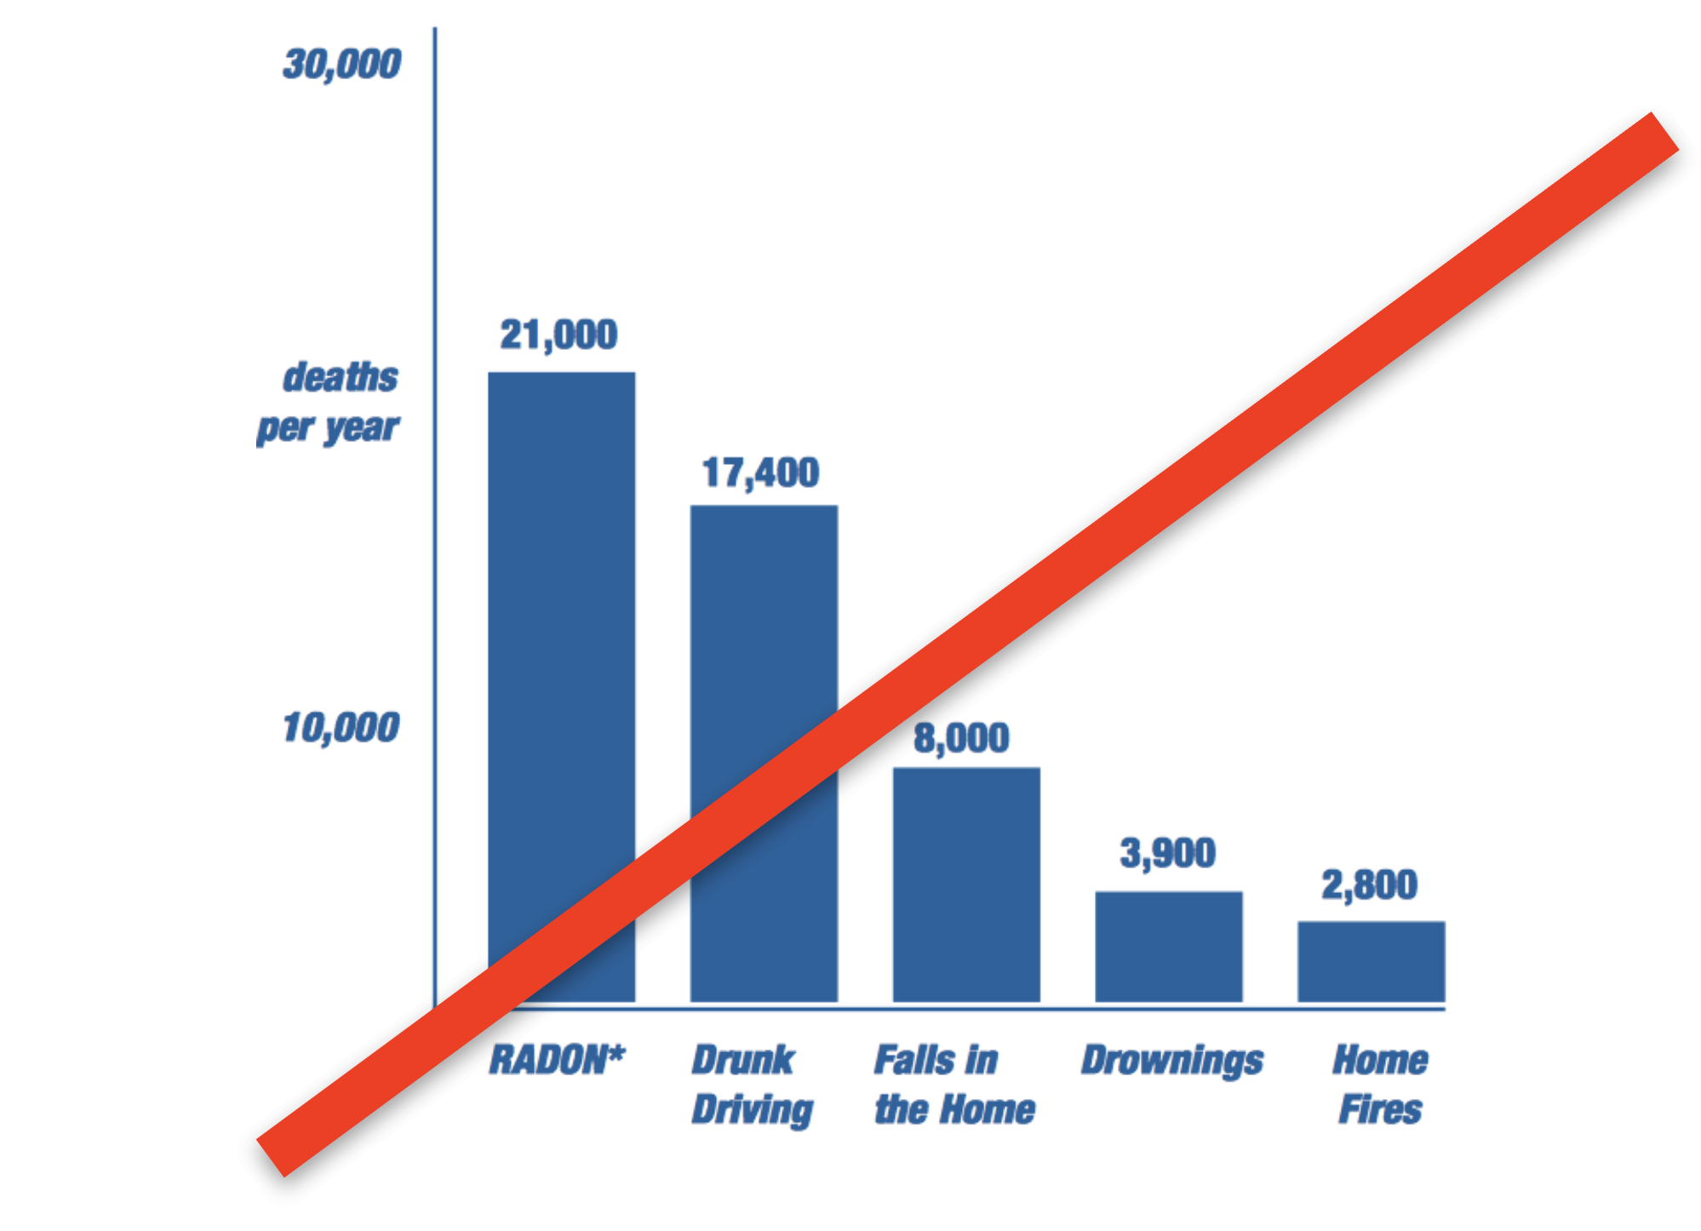
Ignoring science, with no observed evidence, EPA claims radon deaths exceed those from drunk driving.
EPA recommends radon testing and remediation if radioactivity exceeds 4 pico-curies per liter of air.
= 0.15 Bq/liter, 20 mSv/yr
1 Bq = 1 decay/sec
Note: humans are naturally slightly radioactive at about 2,700 pico-curies per liter.
= 100 Bq/liter
https://www.epa.gov/sites/production/files/2015-05/documents/hmbuygud.pdf
https://hps.org/publicinformation/ate/q11963.html

Slide 35
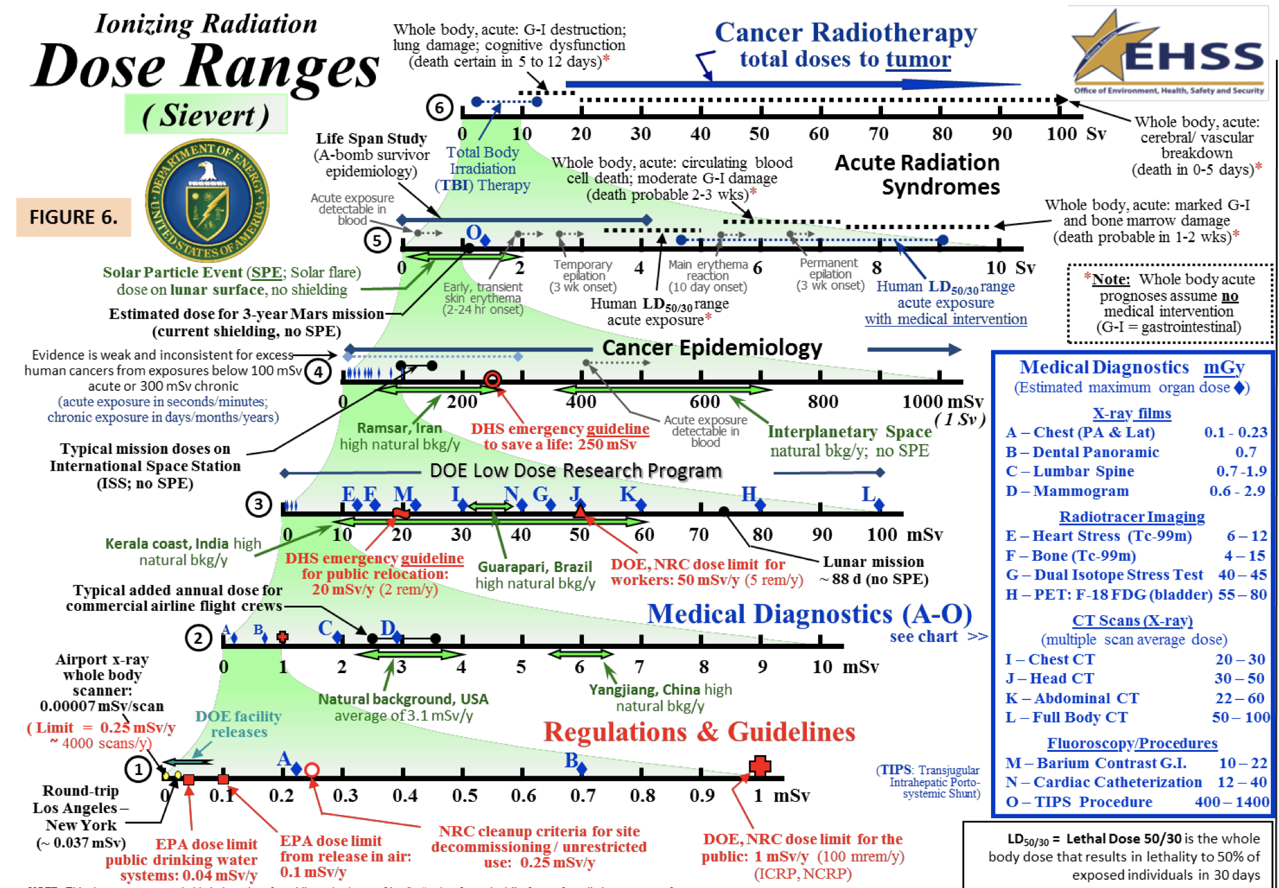
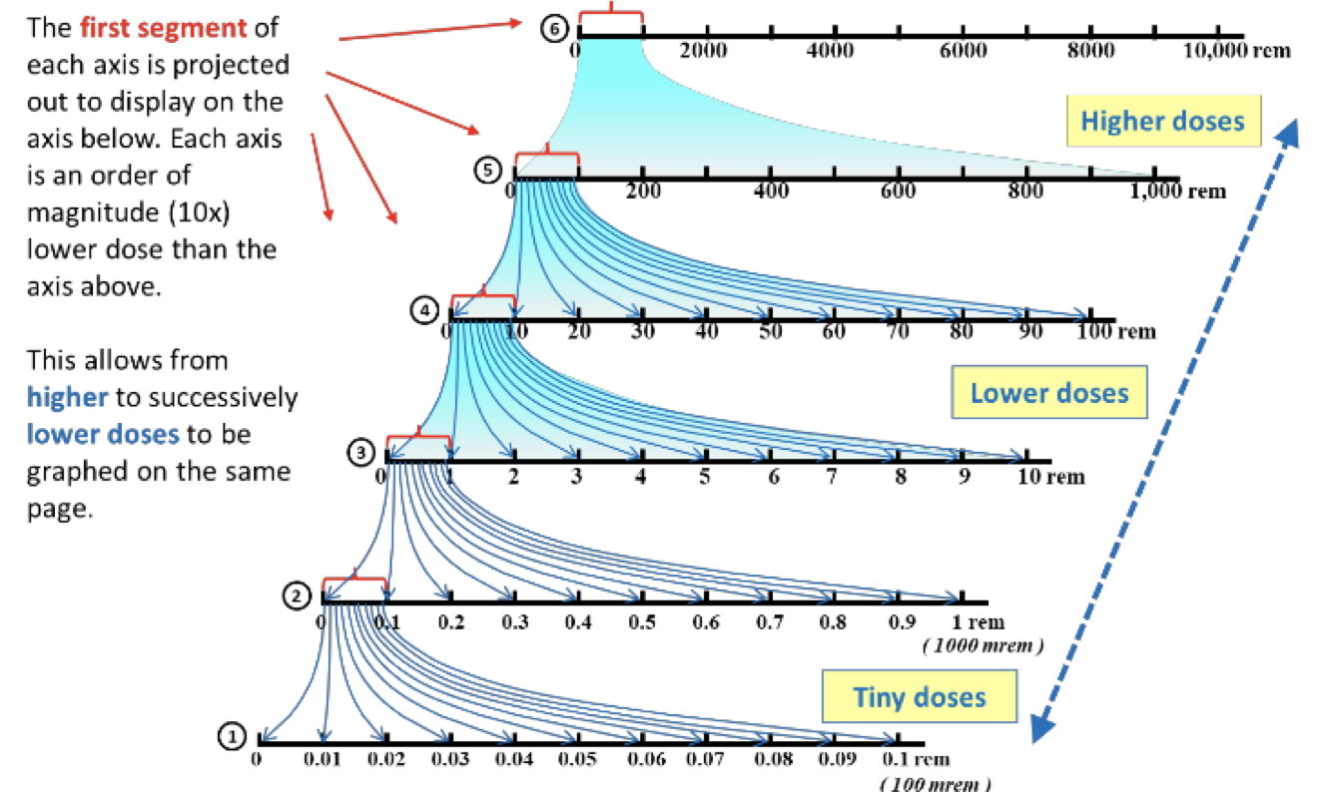
6 orders of magnitude of ionizing radiation effects
https://www.energy.gov/sites/prod/files/2018/01/f46/doe-ionizing-radiation-dose-ranges-jan-2018.pdf

Slide 36
Excerpts from 2015 petition to end LNT 2022: denied!
There has never been scientifically valid support for this LNT hypothesis since its use was recommended by the U.S. National Academy of Sciences Committee on Biological Effects of Atomic Radiation (BEAR I)/Genetics Panel in 1956. The costs of complying with these LNT- based regulations are enormous. Prof. Dr. Gunnar Walinder has summed it up: “The LNT is the greatest scientific scandal of the 20th century.”
----------
Regulators use the LNT assumption because nationally and internationally respected bodies recommend and advocate it. NCRP, ICRP, IAEA, and NAS-NRC’s BEIR Committee come to mind. However, they appear to have lost their sheen of expertise and appear mostly committed to maintaining the status quo. An army of regulators at NRC, EPA, FDA, as well as DOE, would be unbudgeted if the LNT disappeared. In addition, there are politicians whose anti-nuclear stand gets them votes.
----------------
I am not talking about a few scientific papers that show that the LNT model is in error. We are talking about thousands. There are a couple of textbooks in this field, and journals that publish scientific findings that refute the LNT model. This is a whole field of science that regulators pretend does not exist. The attitude of today’s regulators is reminiscent of the Catholic Church at the time of Galileo.
https://issuu.com/johna.shanahan/docs/150209_nrc_petition_to_end_lnt_and_

Slide 37
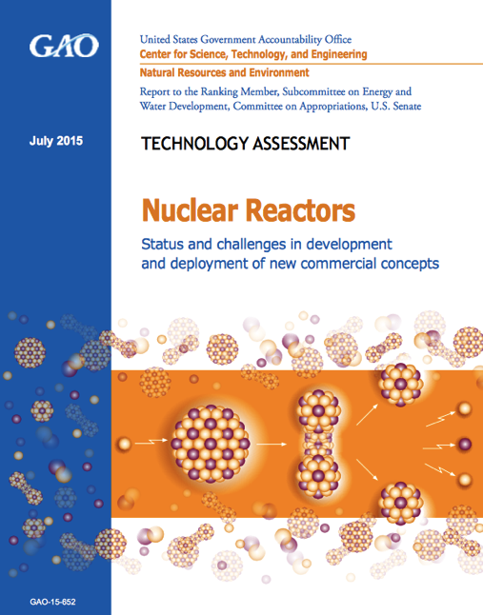
Consequence: US NRC certification of an advanced reactor design costs $1 billion.
“It is a multi-decade process, with costs up to $1 billion to $2 billion, to design and certify or license the reactor design, … ”
GAO, July 2015
…and then you may be allowed to build and test it.
Notes:
http://www.gao.gov/assets/680/671686.pdf
http://www.technologyreview.com/news/542411/advanced-nuclear-industry-to-regulators-give-us-a-chance/ “way it should be” Macfarlane

Slide 38
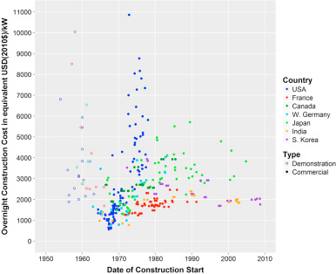
Consequence:
Fission power plants became too expensive in the US.
$2/W --> $11/W
regulation
inexperience
delays
https://www.sciencedirect.com/science/article/pii/S0301421516300106

Slide 39
Bad science is decried by editors.
“The case against science is straightforward: much of the scientific literature, perhaps half, may simply be untrue. Afflicted by studies with small sample sizes, tiny effects, invalid exploratory analyses, and flagrant conflicts of interest, together with an obsession for pursuing fashionable trends of dubious importance, science has taken a turn towards darkness.” Richard Horton, Lancet editor
“It is simply no longer possible to believe much of the clinical research that is published, or to rely on the judgment of trusted physicians or authoritative medical guidelines. I take no pleasure in this conclusion, which I reached slowly and reluctantly over my two decades as an editor of the New England Journal of Medicine” Marcia Angell, New England Journal of Medicine editor
Notes:
http://www.collective-evolution.com/2015/05/16/editor-in-chief-of-worlds-best-known-medical-journal-half-of-all-the-literature-is-false/
http://www.thelancet.com/pdfs/journals/lancet/PIIS0140-6736%2815%2960696-1.pdf
http://www.ncbi.nlm.nih.gov/pmc/articles/PMC2964337/

Slide 40
For the great enemy of the truth is very often not the lie—deliberate, contrived, and dishonest—but the myth—persistent, persuasive, and unrealistic. Too often we hold fast to the clichés of our forebears. We subject all facts to a prefabricated set of interpretations. We enjoy the comfort of opinion without the discomfort of thought. (1966)

Slide 41
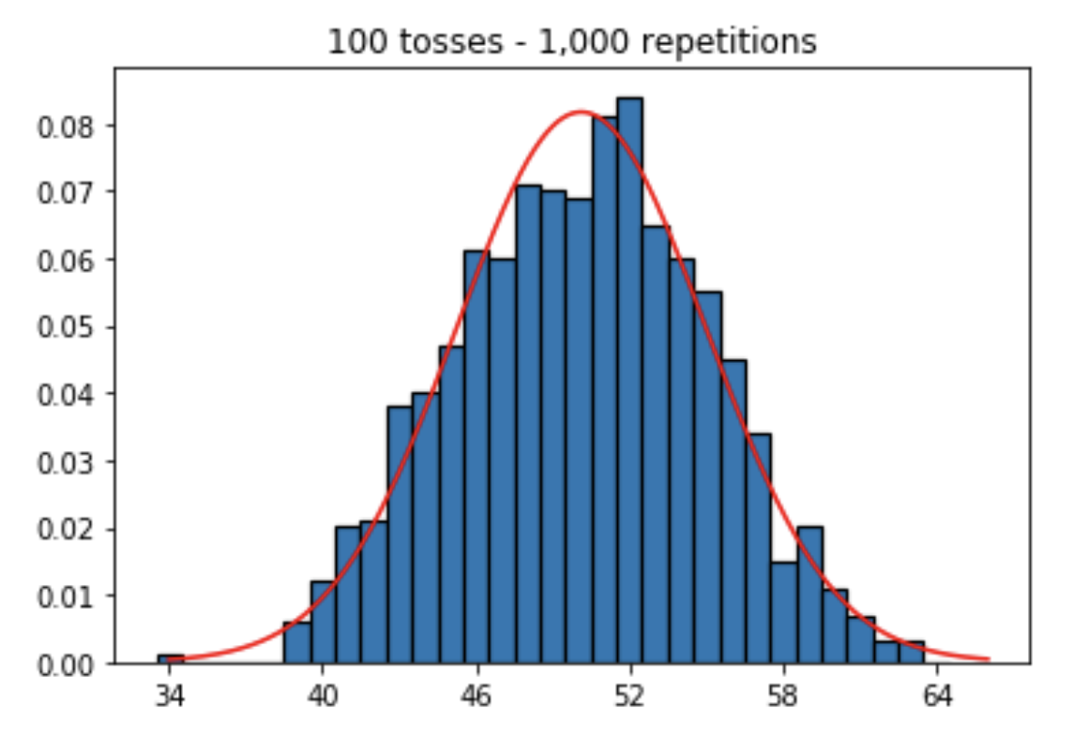
What's a p-value?
Toss a coin 100 times. Repeat.
Null hypothesis: Every day is equally lucky.
My Hypothesis: Friday-the-13ths are lucky days.
I observed 66 heads on Friday the 13th! I'm right!
p-value = 0.05 is the probability such an extreme result would be observed under the null hypothesis.

Slide 42
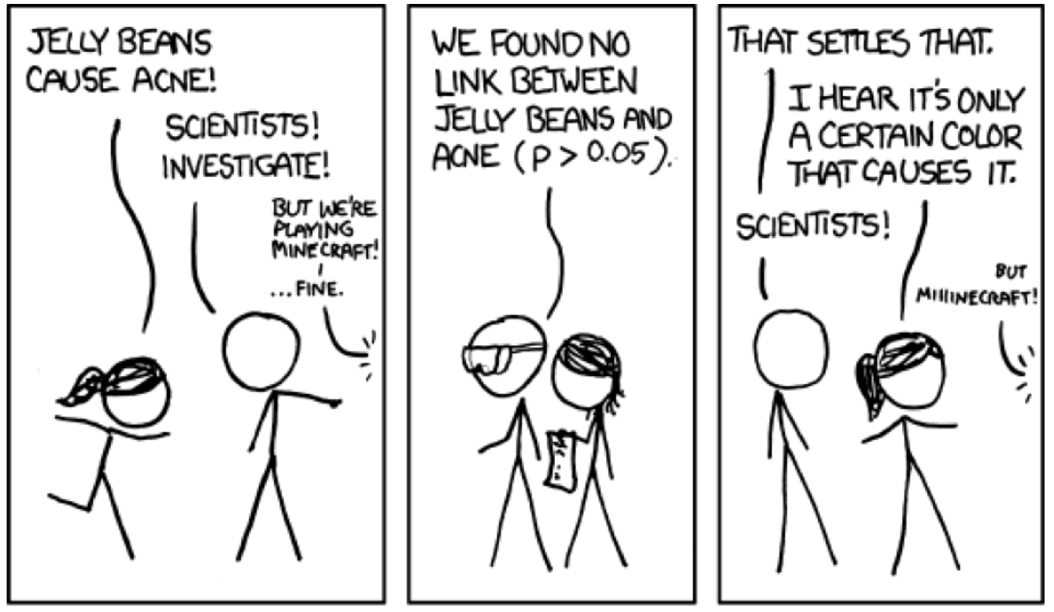

Slide 43
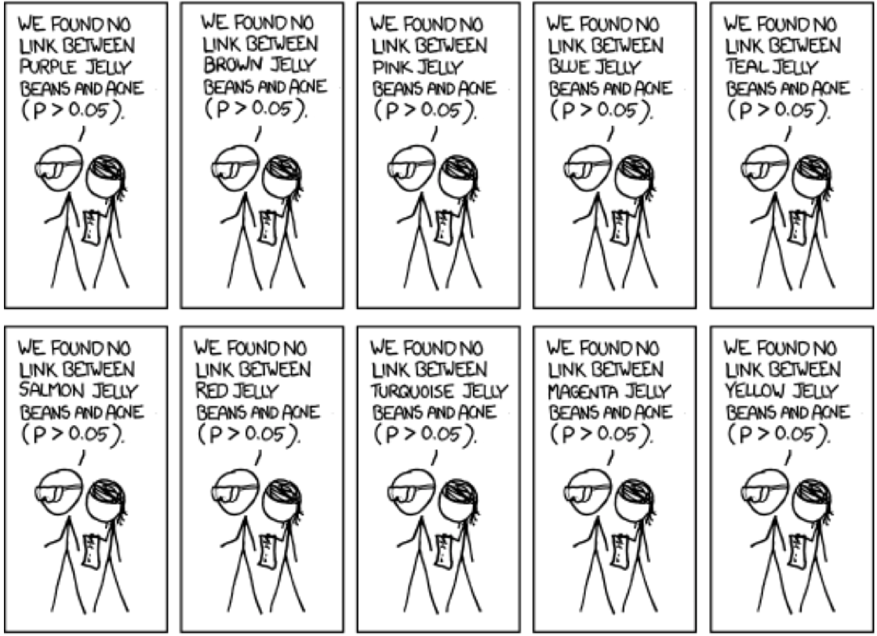
xkcd.com/882/

Slide 44
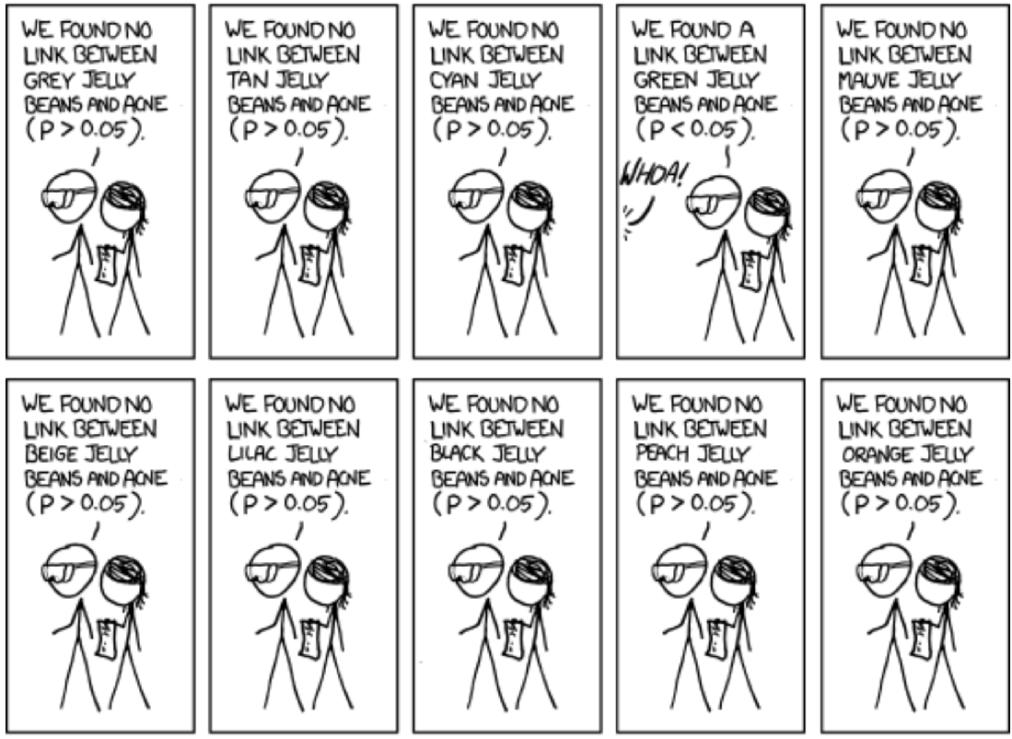
xkcd.com/882/

Slide 45
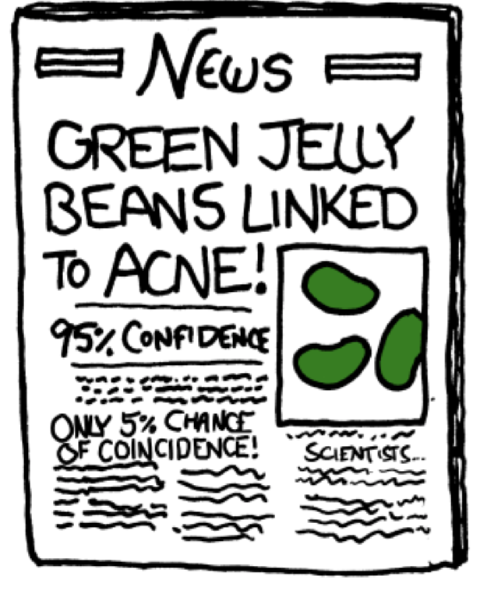

Slide 46
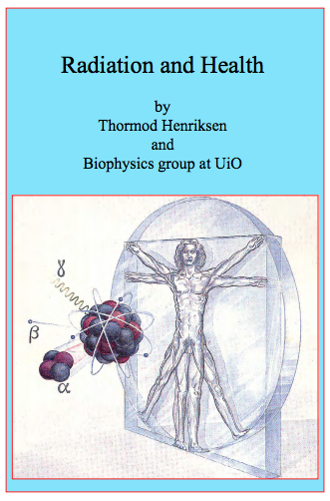
Dose of sanity and science:
Radiation and Health, Thormod Henriksen
Free to download at http://www.mn.uio.no/fysikk/tjenester/kunnskap/straling/radiation-and-health-2015.pdf
With his OK, I published paperback version on Amazon at cost.
https://www.amazon.com/dp/1499104073
http://www.mn.uio.no/fysikk/tjenester/kunnskap/straling/radiation-and-health-2015.pdf
Notes:
http://www.mn.uio.no/fysikk/tjenester/kunnskap/straling/radiation-and-health-2015.pdf

Slide 47
American Nuclear Society
reprinted two dozen scientific studies showing low level radiation is benign.
Free to download at:
https://www.ans.org/file/1336/special_session-low_level_radiation-fukushima-v1.4.pdf
https://www.ans.org/file/1336/special_session-low_level_radiation-fukushima-v1.4.pdf
Notes:
http://www.mn.uio.no/fysikk/tjenester/kunnskap/straling/radiation-and-health-2015.pdf

Slide 48
Ed Calabrese uncovers LNT’s scientic fraud. 22 episodes, 12 hours
https://hps.org/hpspublications/historylnt/episodeguide.html
Notes:
http://www.mn.uio.no/fysikk/tjenester/kunnskap/straling/radiation-and-health-2015.pdf

Slide 49
https://www.youtube.com/watch?v=JpcUCo0ebNA&feature=youtu.be Theo Richel
Theo Richel

Slide 50
8 Radiophobia
Fear sells
Fission power safest
Metabolism
DNA, cellular repair
Evidence ignored by authorities
Deadly evacuations unnecessary
Radiophobia policy, NRC, EPA
Educational video, book
Confounders, controls, p-hunting
Fission is in Fashion

