Slide 1
7 Fission power
Fission energy
PWR nuclear power plants
ThorCon
Molten salt reactor
Cheaper than coal
Market size, growth
Shipyard mass production
Fission is in Fashion

Slide 2
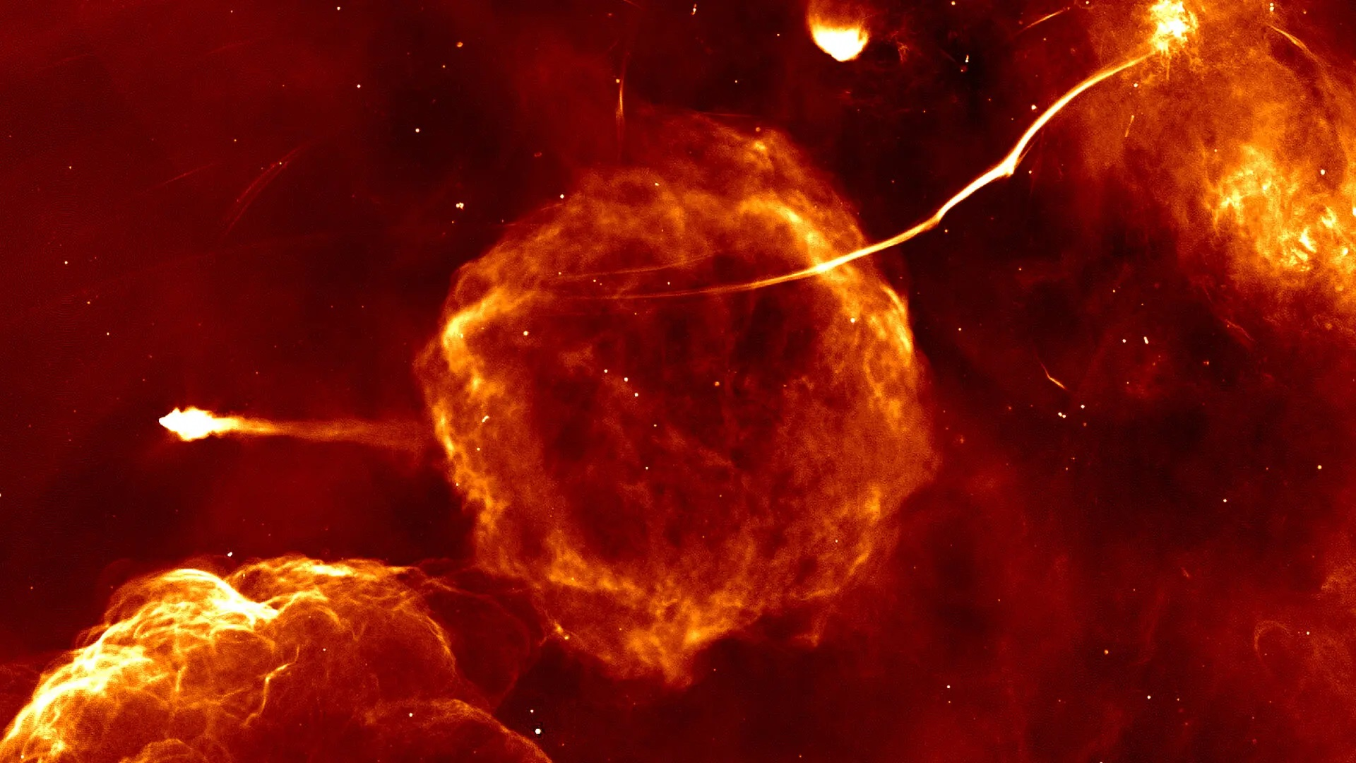

Slide 3
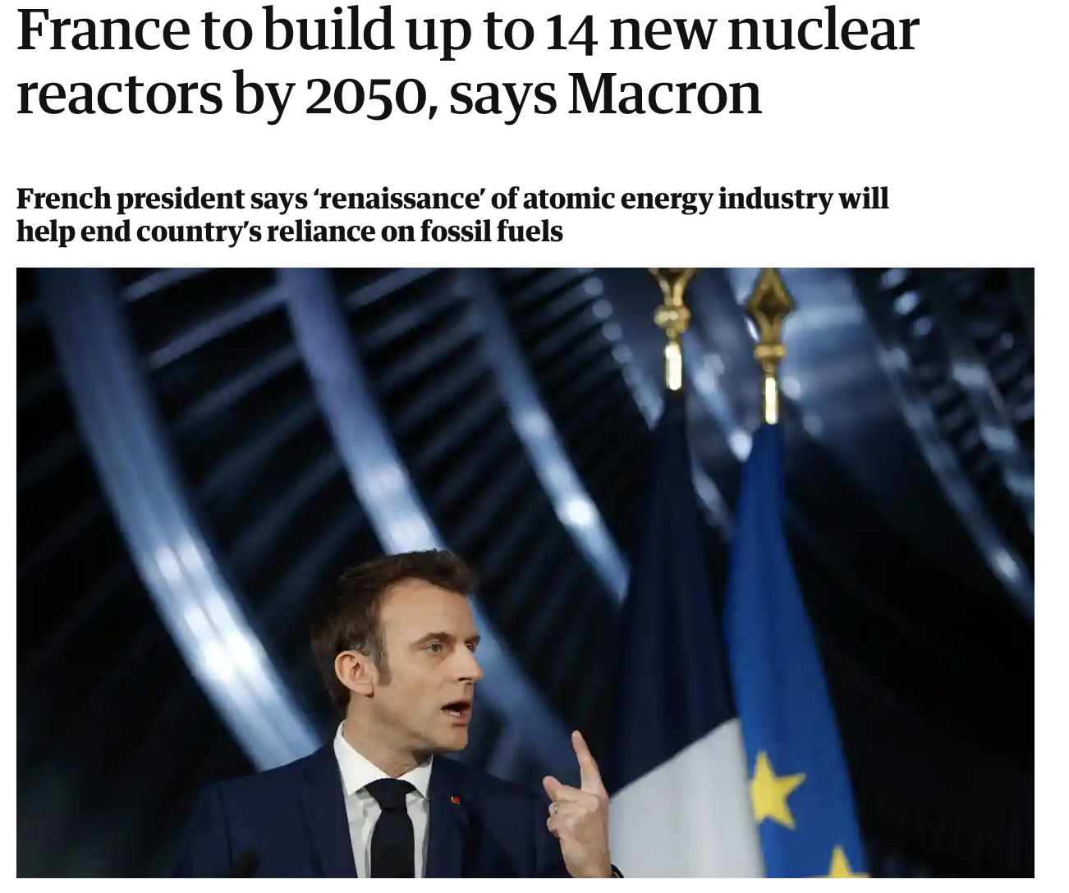
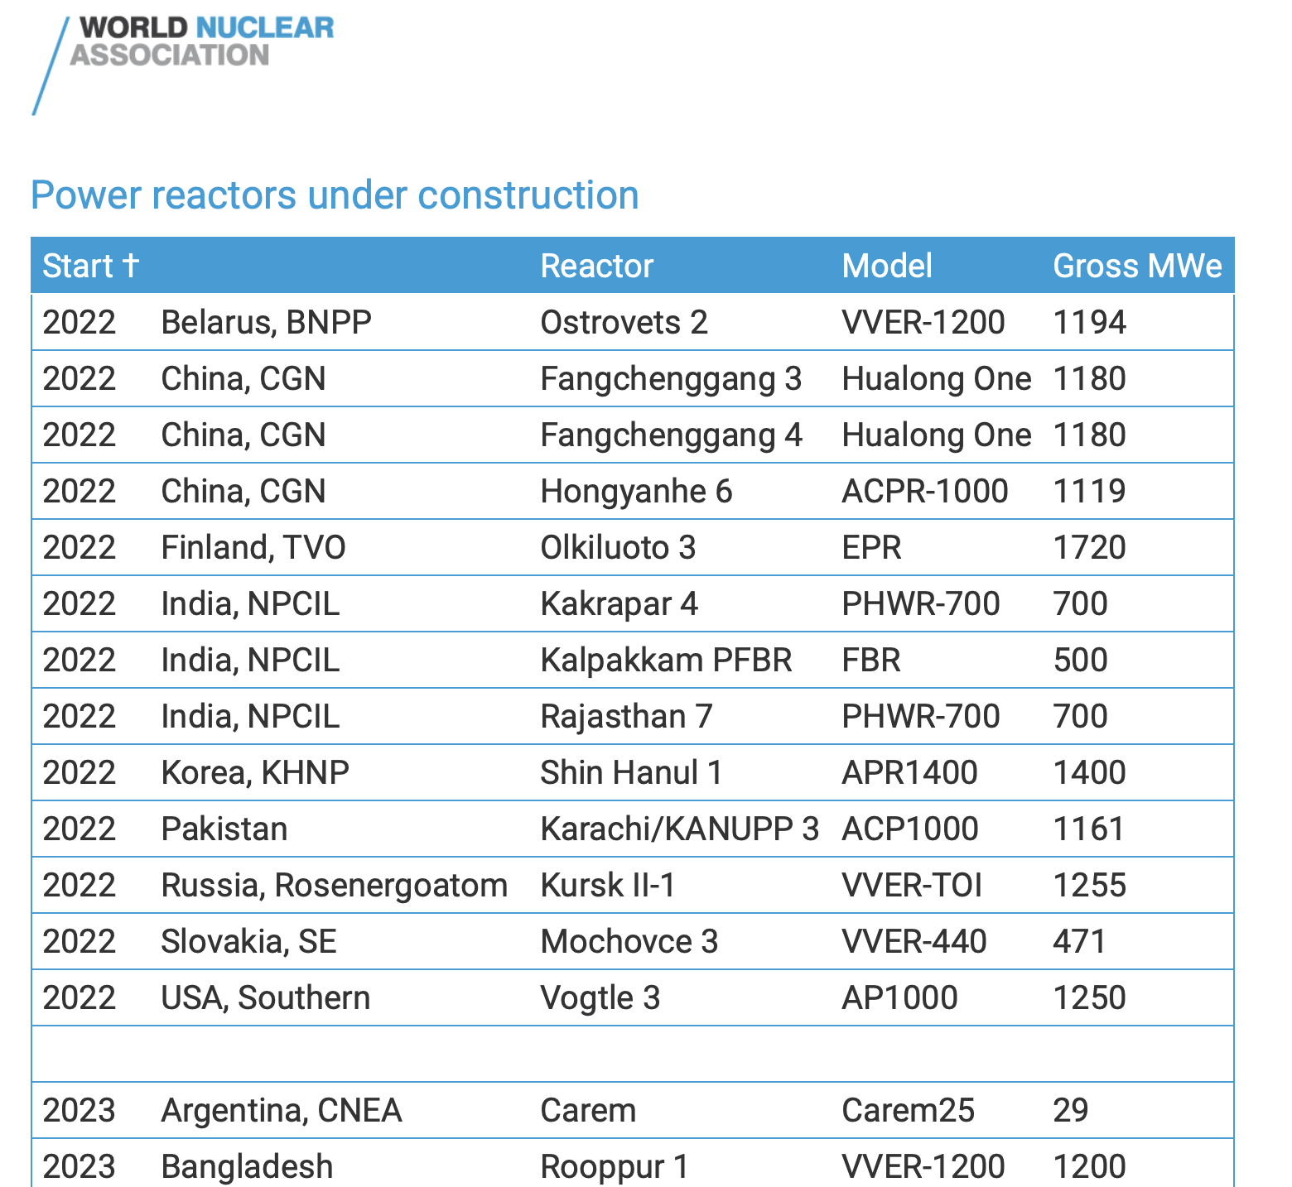
Fission is in Fashion
References

Slide 4
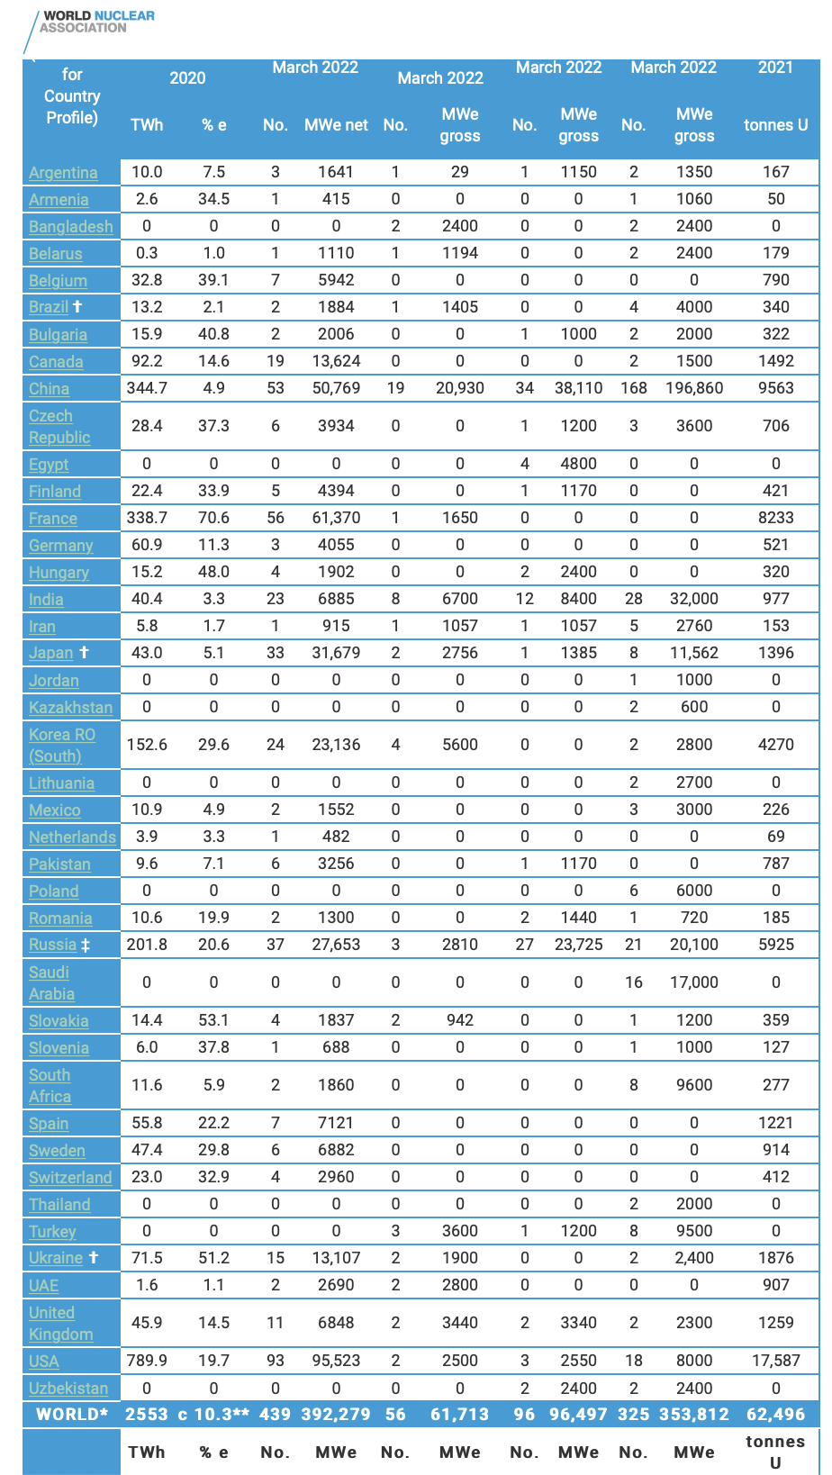
World Nuclear Association
tracks fission power plants in 42 countries.
Power Status
392 GW in operation
62 GW under construction
96 GW planned
354 GW proposed
https://www.world-nuclear.org/information-library/facts-and-figures/world-nuclear-power-reactors-and-uranium-requireme.aspx

Slide 5
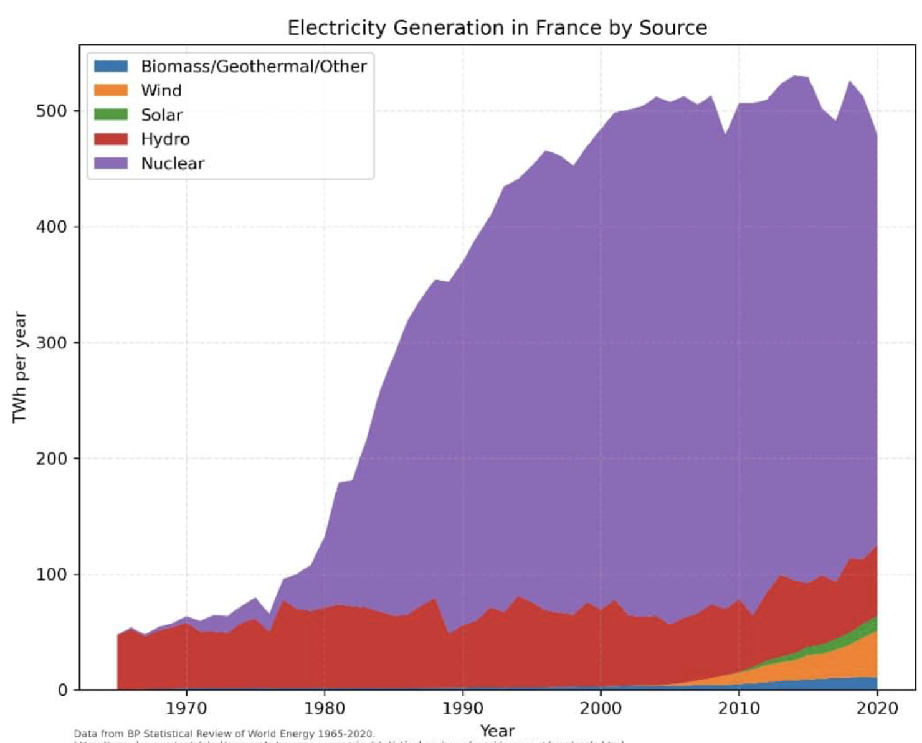
France electric power:
80% atomic fission:
39 GW
https://www.world-nuclear.org/information-library/facts-and-figures/world-nuclear-power-reactors-and-uranium-requireme.aspx

Slide 6
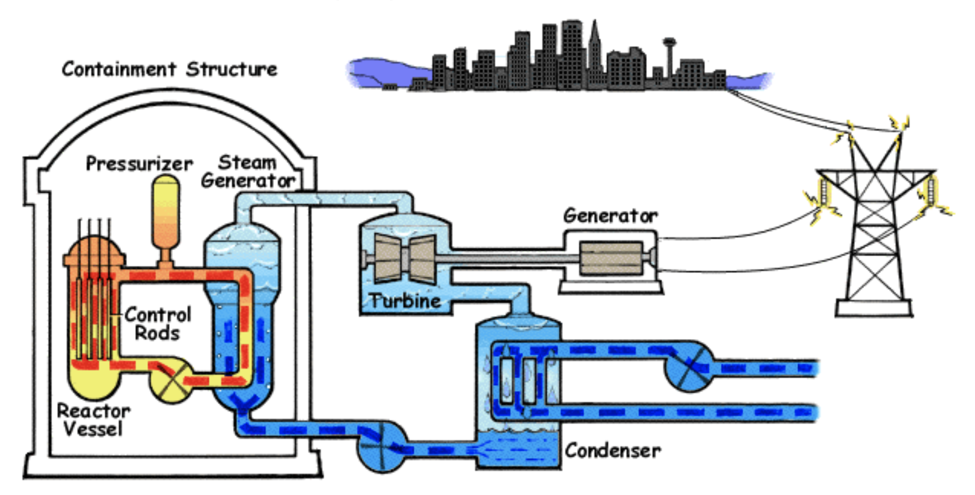
Pressurized water reactor (PWR) uses 155 bar 275C water to move heat to steam generator to turn turbine-generator.
https://www.nrc.gov/reading-rm/basic-ref/students/animated-pwr.html

Slide 7
Pressurized water slows neutrons so they split uranium atoms. Cooling water carries away rejected heat.
cooling water
https://www.nrc.gov/reading-rm/basic-ref/students/animated-pwr.html

Slide 8
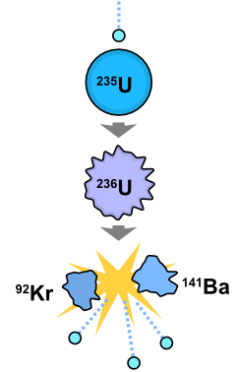
Uranium-235 fissions to krypton and barium releasing energy.
The total mass of the resulting
barium-141
krypton-92
neutrons (3)
is a bit less than the mass of the U-235 + neutron,
and by e = mc2
immediately releases 166 MeV of energy, totaling
200 MeV after Kr and Ba decay.
1 tonne-U235 fissioned -> 79,000 TJ = 2.6 GW-years(t)
http://en.wikipedia.org/wiki/Nuclear_fission
Notes:
How LWRs work. E = mc2. Many other pairs of fission products, too. Fission product decay brings total to ~200 MeV. Multiply by Avogadro's number 6 x 10**23 for 235 grams of U, or 4.4GWH of heat! Plus decay of fission products (+7%?)! ..or about .7 t/GWeY.

Slide 9
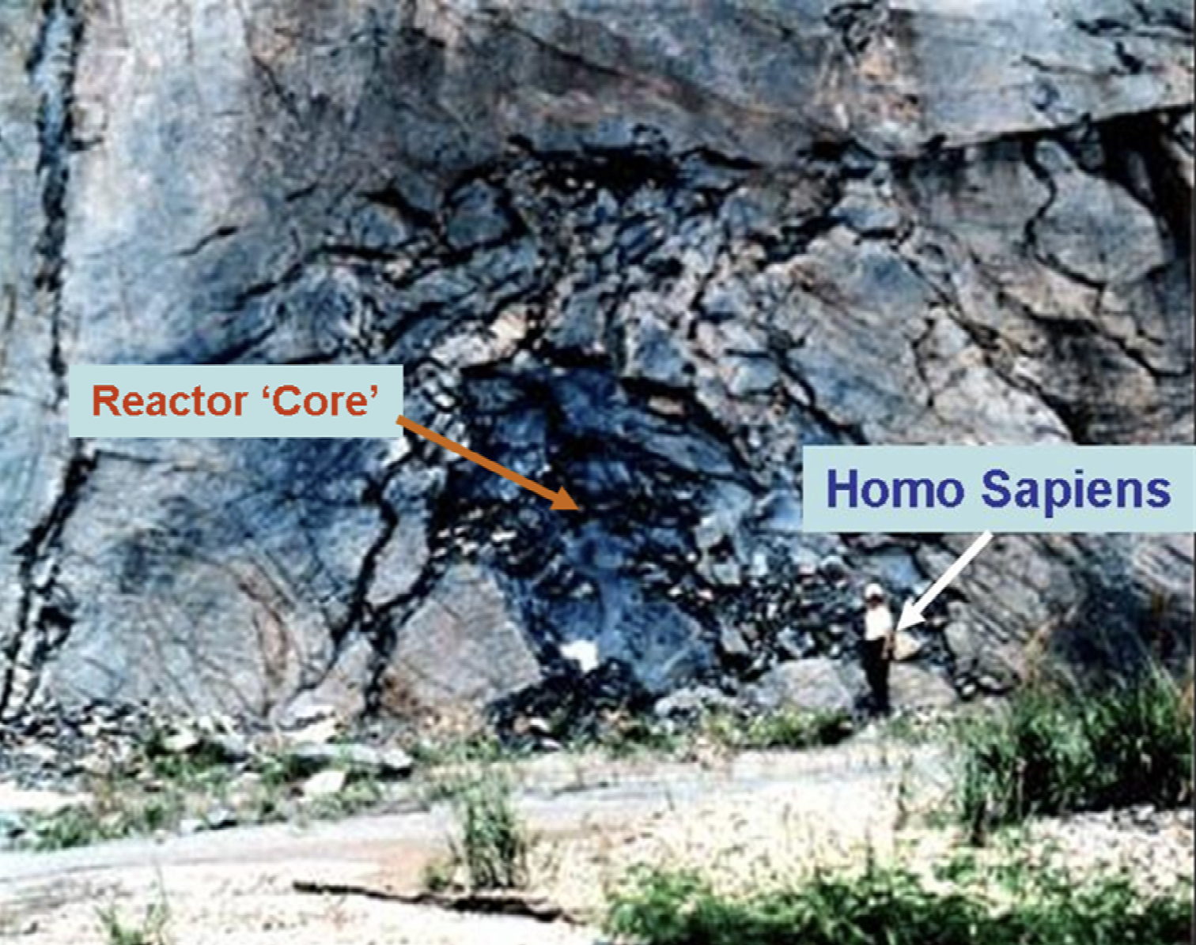
Oklo, Gabon
2 billion years ago
Fissile U-235 was ~ 3% of uranium.
Groundwater H2O slowed neutrons to
fissioning speeds.
Fission heat evaporated water.
Reactor cycled on/off.

Slide 10
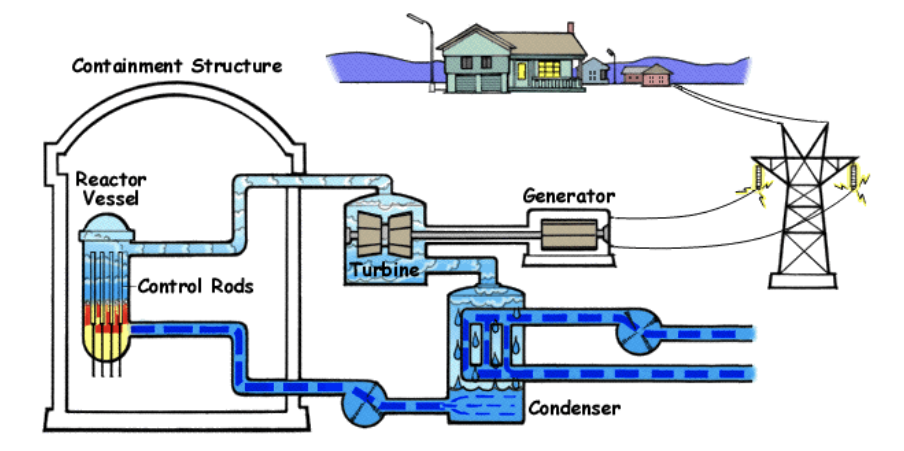
Boiling water reactor (BWR) 75 bar steam turns turbine-generator directly.
https://www.nrc.gov/reading-rm/basic-ref/students/animated-bwr.html

Slide 11
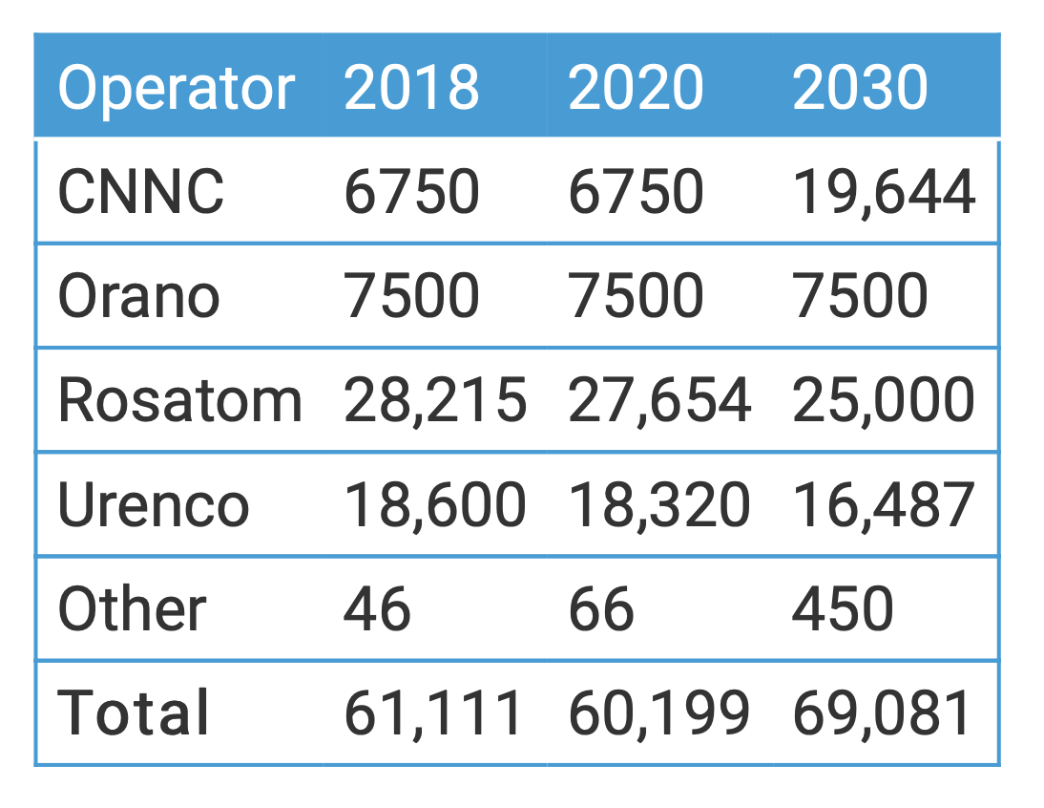
Uranium fuel is typically enriched from 0.7% U-235 to 3-5%.
Centrifuge enrichment capacity.
Cascade of centrifuges incrementally concentrating UF6 gas
https://www.world-nuclear.org/information-library/nuclear-fuel-cycle/conversion-enrichment-and-fabrication/uranium-enrichment.aspx

Slide 12
CANDU reactor moderator is D2O, w/o large pressure vessel.
D2O is heavy water, H2O where each H has 1 proton and 1 neutron, so does not absorb fission neutrons.
CANDU can use natural, unenriched uranium.
Hot and cold sides of the primary heavy-water loop
hot and cold sides of secondary light-water loop
cool heavy water moderator in the calandria
https://en.wikipedia.org/wiki/CANDU_reactor

Slide 13
Russian RBMK is graphite moderated, water cooled
Chernobyl, 1986
Positive void coefficient
Safety systems improved
8 RBMK plants still operating in Russia
https://world-nuclear.org/information-library/nuclear-fuel-cycle/nuclear-power-reactors/appendices/rbmk-reactors.aspx

Slide 14
Sodium cooled fast reactor has no neutron moderator.
Fueled by U-238, which is 99% of natural uranium
https://en.wikipedia.org/wiki/Sodium-cooled_fast_reactor

Slide 15
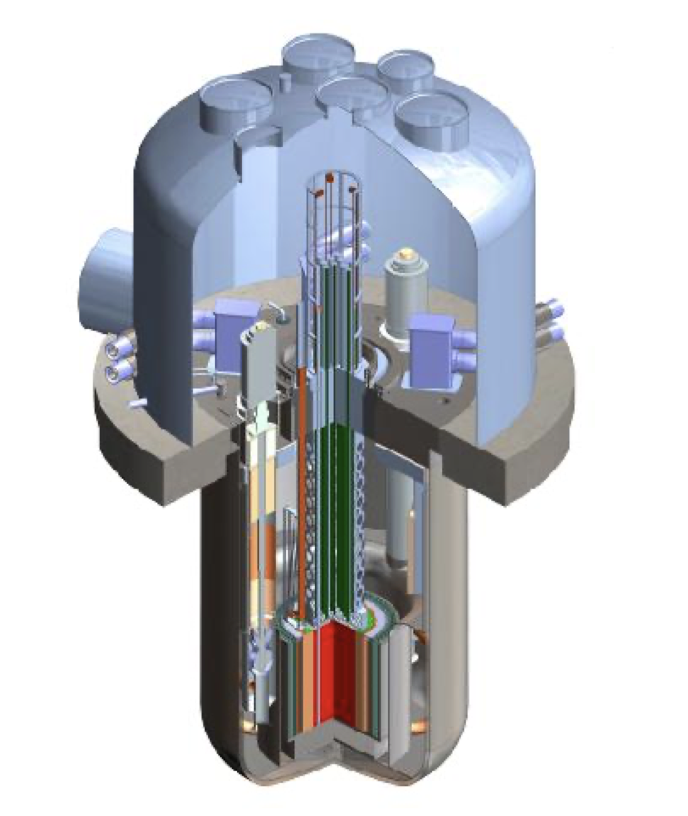
TWR-P (TerraPower)
Sodium cooled fast reactor
Funded by Bill Gates
US, then China, then US
1475MWt, 600 MWe
U-238 fuel rods breed Pu-239 then moved internally
Ample U-238 fuel, tailings
https://aris.iaea.org/PDF/TWR-P.pdf

Slide 16
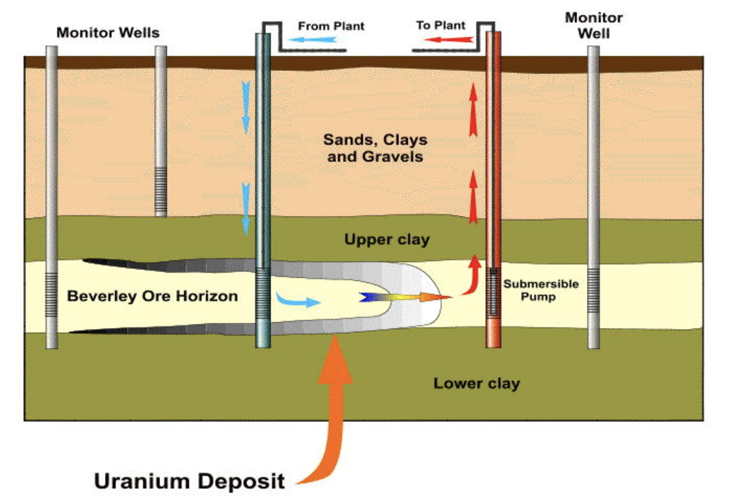
In situ leach mining of uranium
https://world-nuclear.org/information-library/nuclear-fuel-cycle/mining-of-uranium/in-situ-leach-mining-of-uranium.aspx

Slide 17
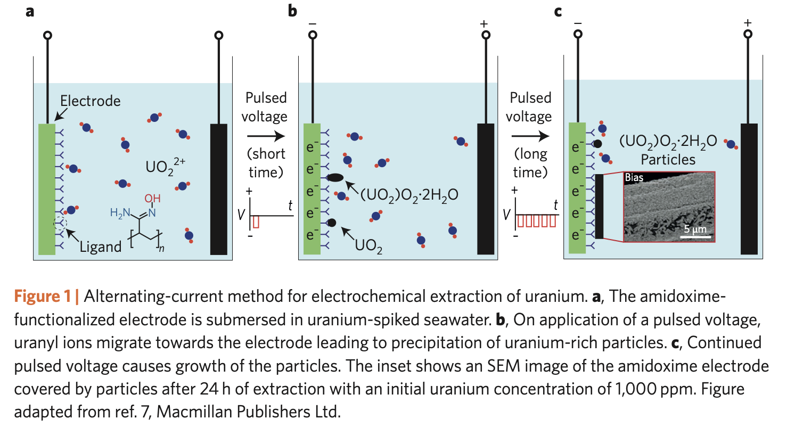
Many laboratories are developing seawater uranium extraction.
https://www.nature.com/articles/nenergy201722.pdf.

Slide 18
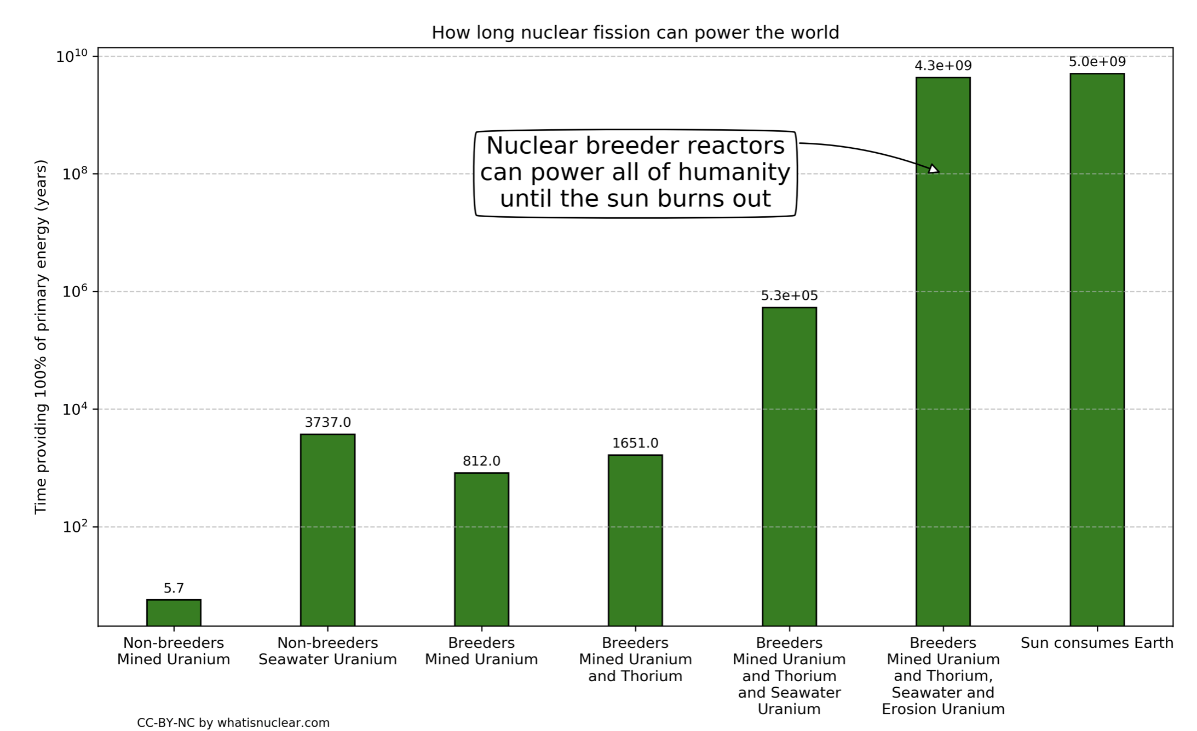
Nuclear fuel will last us for 4 billion years, writes Nick Touran.
https://whatisnuclear.com/blog/2020-10-28-nuclear-energy-is-longterm-sustainable.html. CC-by-NC

Slide 19
The US supplies very little of its uranium fuel needs.
https://thebreakthrough.org/issues/energy/report-energy-security-and-decarbonization-in-response-to-russian-aggression?utm_source=Breakthrough+Newsletter&utm_campaign=78ed62e0df-BTI_Weekly_3_16_2022&utm_medium=email&utm_term=0_49b872540e-78ed62e0df-44367585

Slide 20
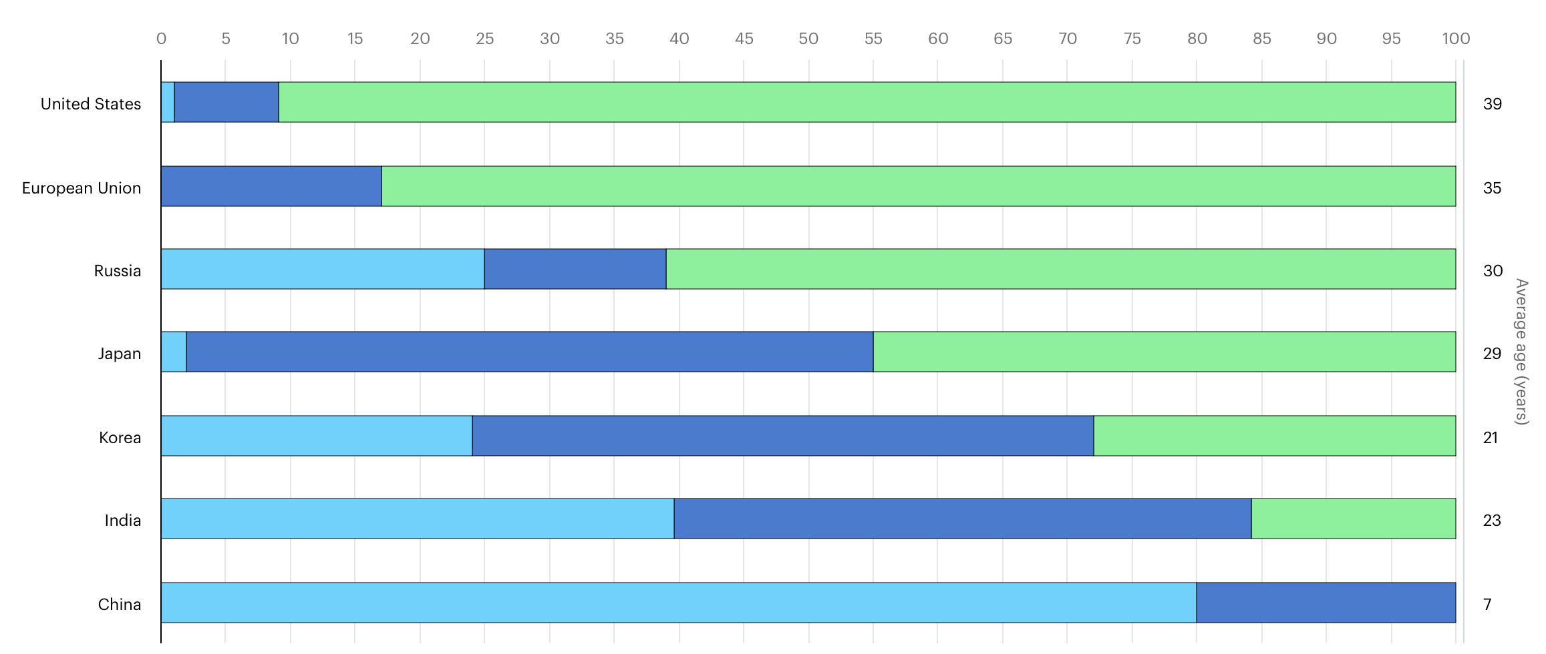
Age profile of nuclear power capacity in selected nations, 2019
Green = over 30 years old
Light blue = under 10 years old
https://www.iea.org/data-and-statistics/charts/age-profile-of-nuclear-power-capacity-in-selected-regions-2019

Slide 21
ThorCon
to mass-produce fission power plants
to generate CO2-free, 24x7 electricity
cheaper than from coal or LNG
at shipyard scale — 10 GW per year
helping people achieve prosperity.
Robert Hargraves is a cofounder of ThorCon.

Slide 22
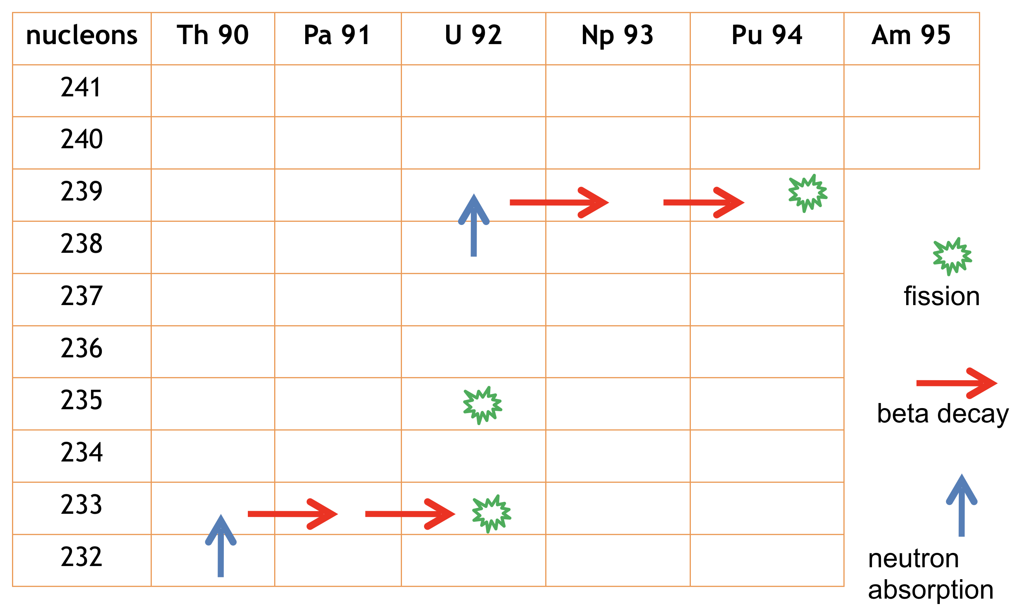
ThorCon is a Thorium Converter
Fission power
Uranium - 19.75% U-235
- 50%
Thorium
Th-232 —> U-233 - 25%
Plutonium
U-238 —> Pu-239 - 25%
Notes:
Indonesia state-owned company INUKI already purchases LEU20 from the US, for medical isotope reactor.
Both the Russians and Chinese have expressed interest in supplying such uranium to Indonesia.

Slide 23
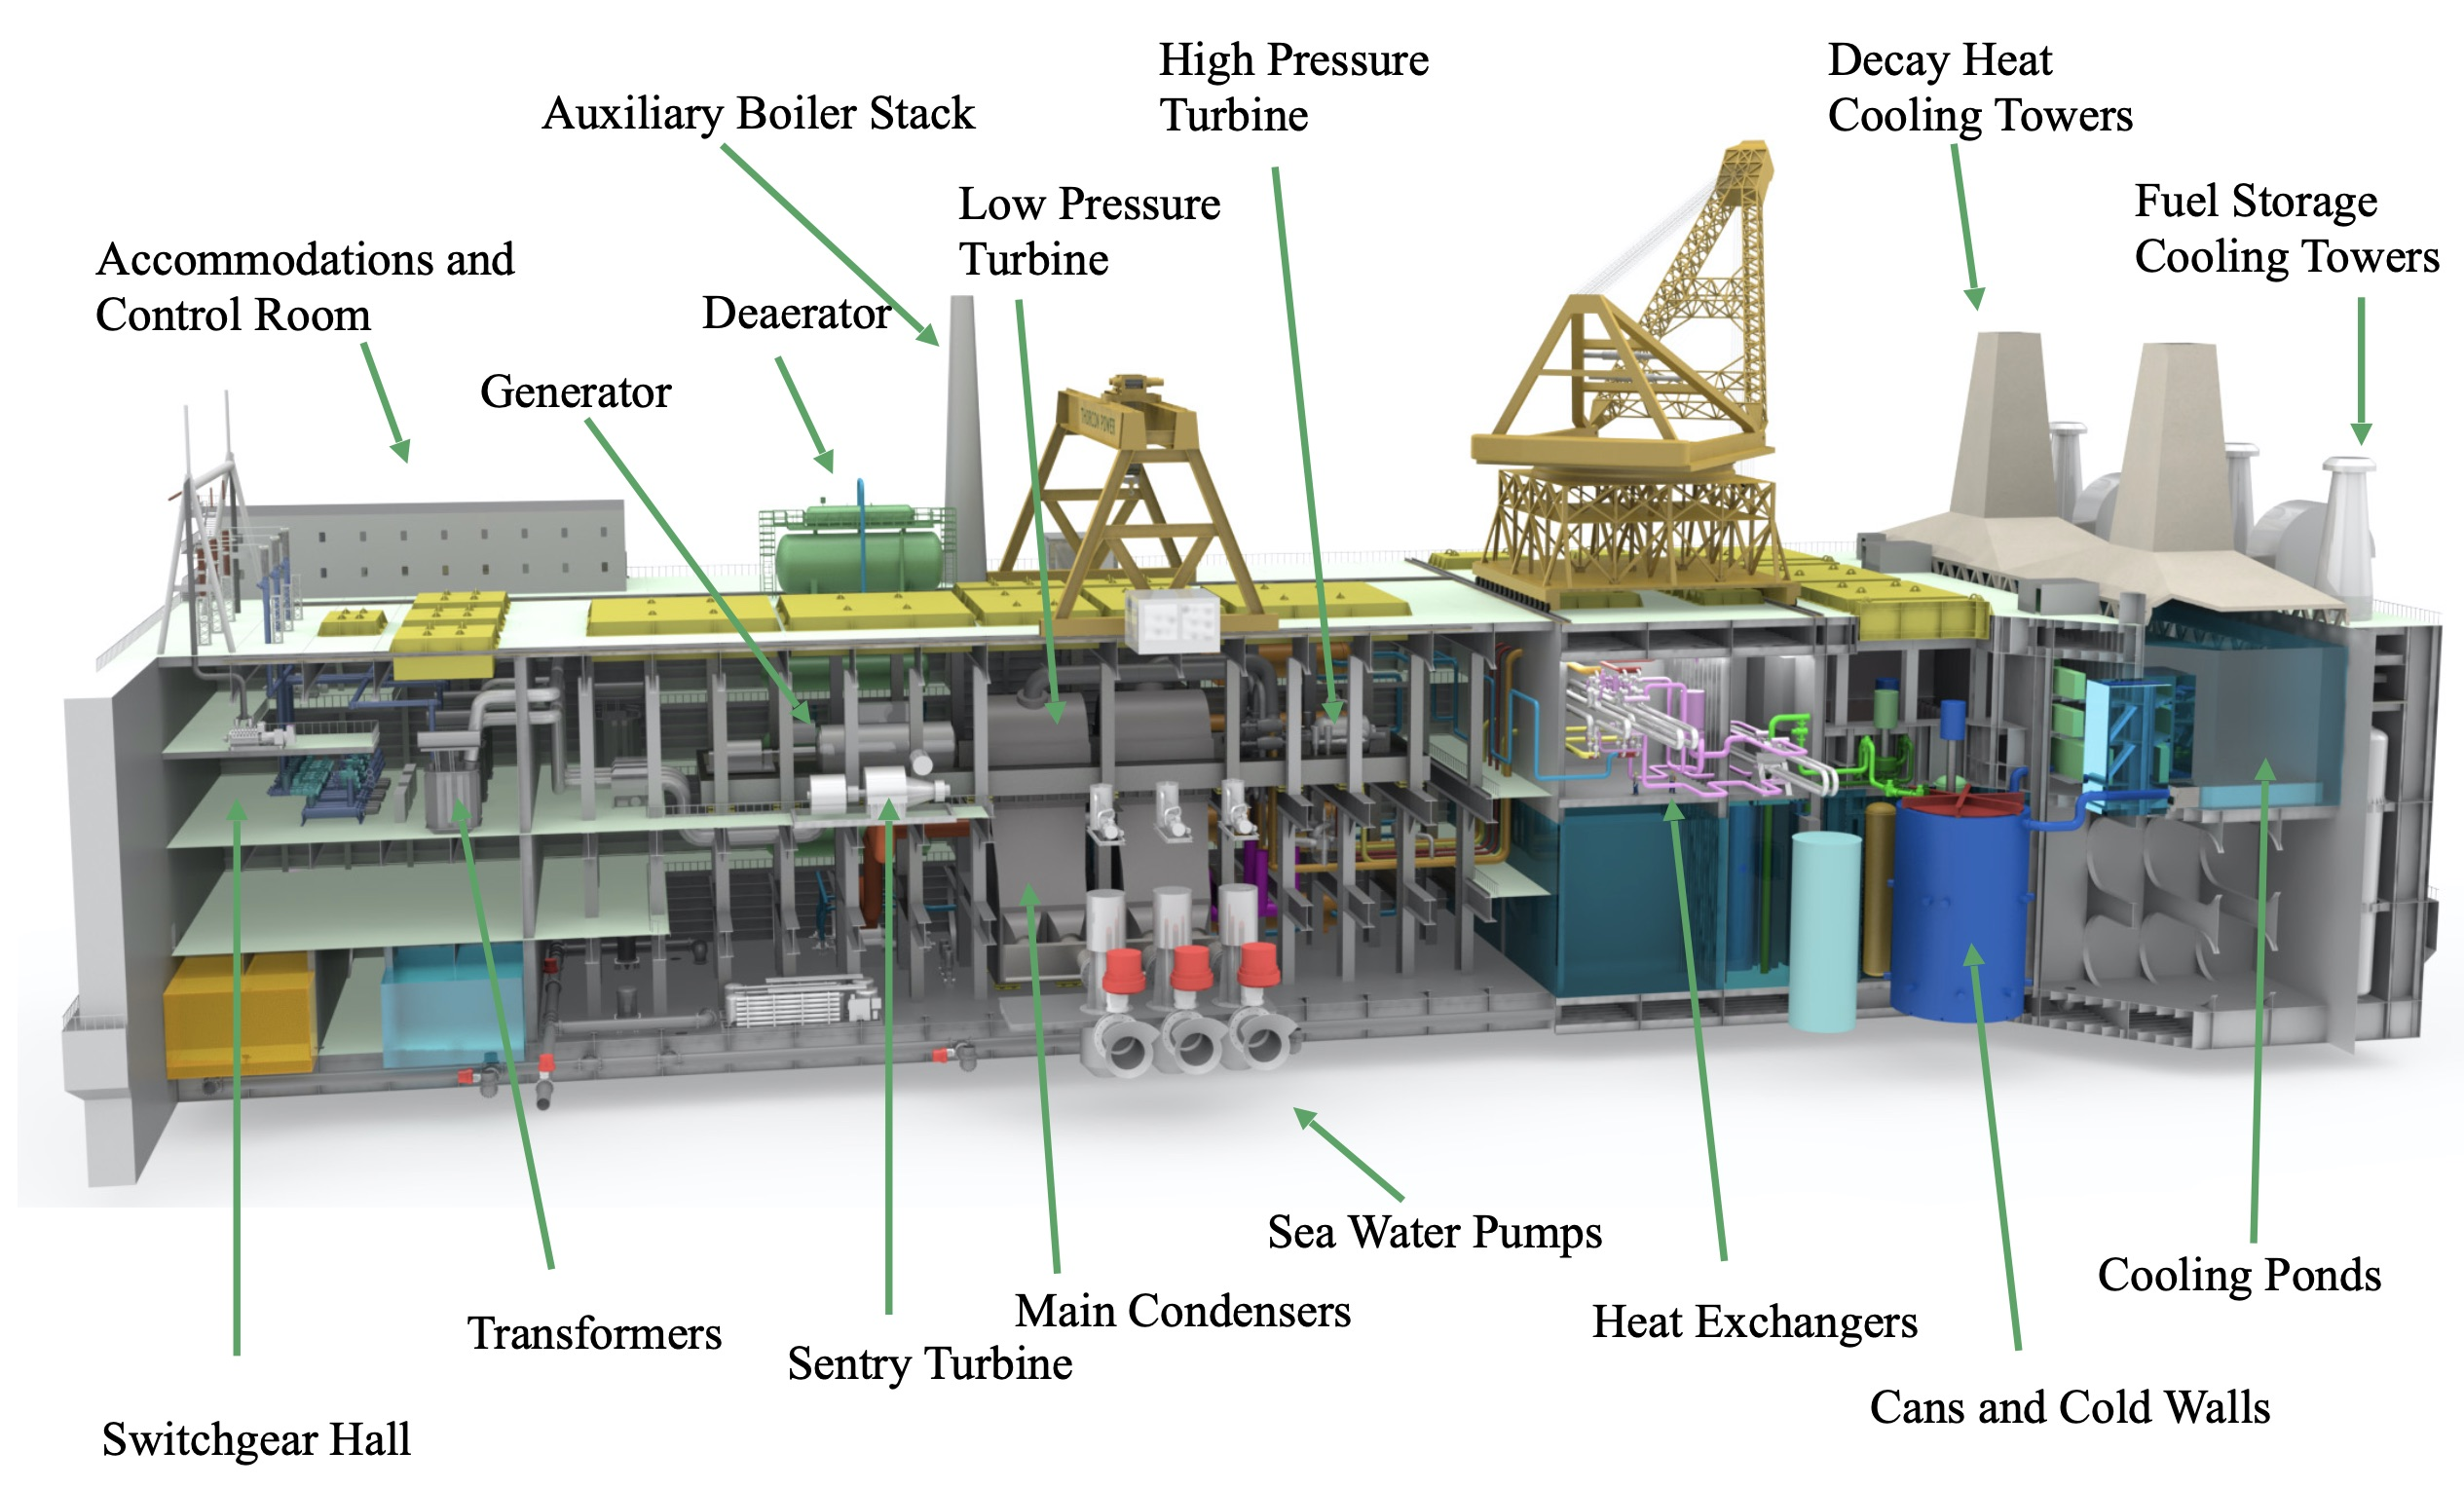
ThorCon 500 MW liquid fuel fission power plant

Slide 24
Molten salt with dissolved fuel flows up in channels in graphite moderator core.
Notes:
ORNL designed in 1940s.
ORNL ran without U-238.

Slide 25
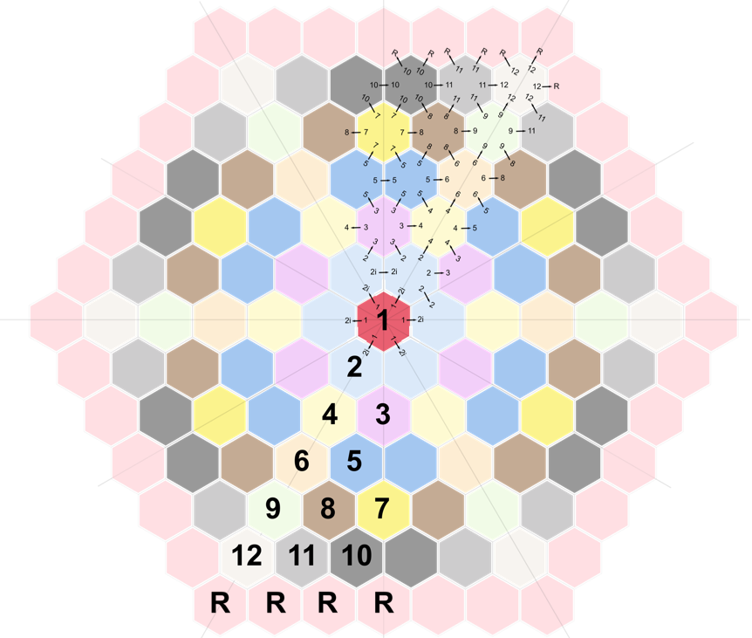
In the reactor Pot the molten fuelsalt flows up in channels of graphite moderator logs.
Fission energy heats molten salt as it is pumped up.
Stable power: fission slows as temperature rises.
Heat exchangers isolate radioactivity and transfer heat to make steam.
High 700°C temperature gives high 46% efficiency.

Slide 26
Replaceable Can, in Silo Cold Wall
The reactor Pot contains the graphite moderator with channels for molten salt flow.
Freeze valve melt drains salt to drain tank.
Cold wall absorbs heat radiated from drain tank.
Cold wall is cooled by natural water circulation.
Fig 5: Pot in Can with drain tank in cold-wall silo

Slide 27
Daewoo Shipbuilding and Marine Engineering will be ThorCon’s EPC.

Slide 28
Prototype will be towed to Indonesia.

Slide 30
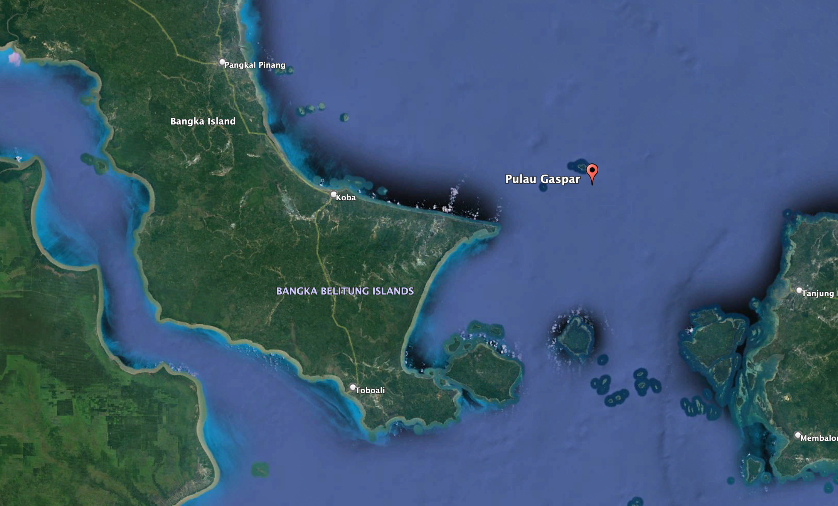
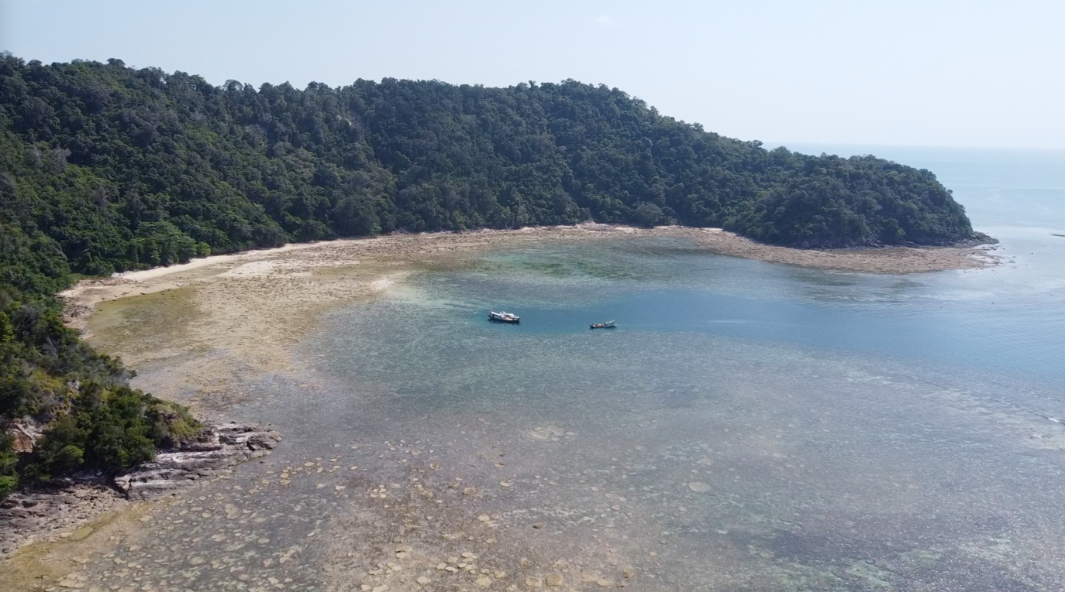
Bangka-Belitung governor approved island site.

Slide 31
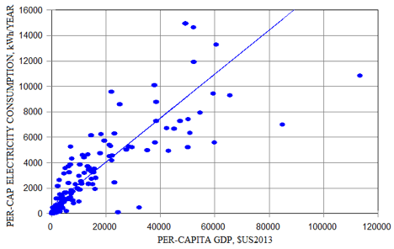
+$32 billion GDP per 1 GW plant
$→

Slide 32
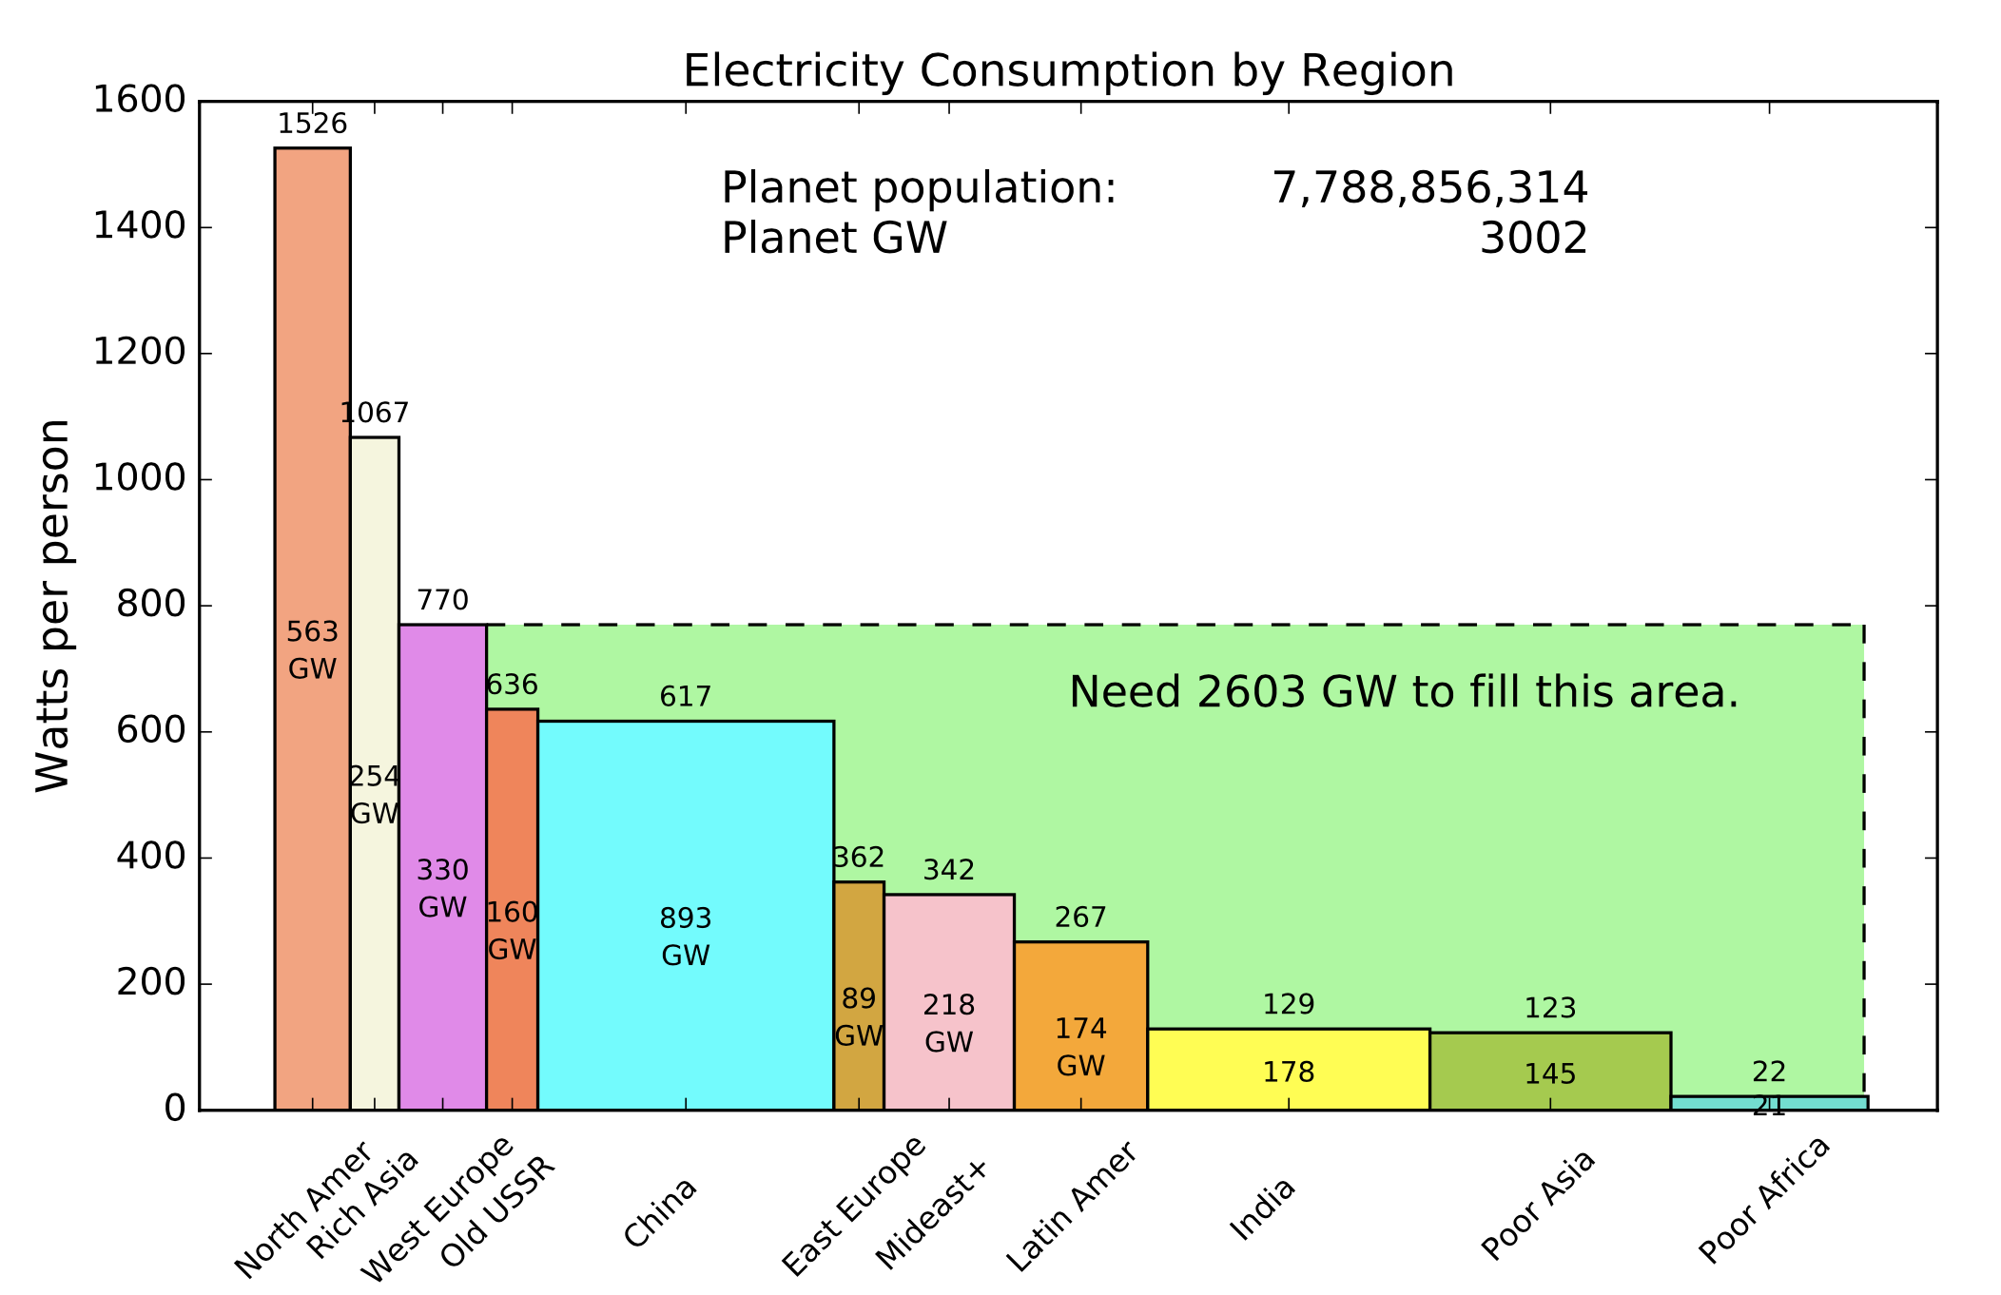
3,000 GW global electricity use may grow by 2,600 GW.

Slide 33
Developing nations now build coal-fired power plants.
Reliable, 24x7, affordable

Slide 34
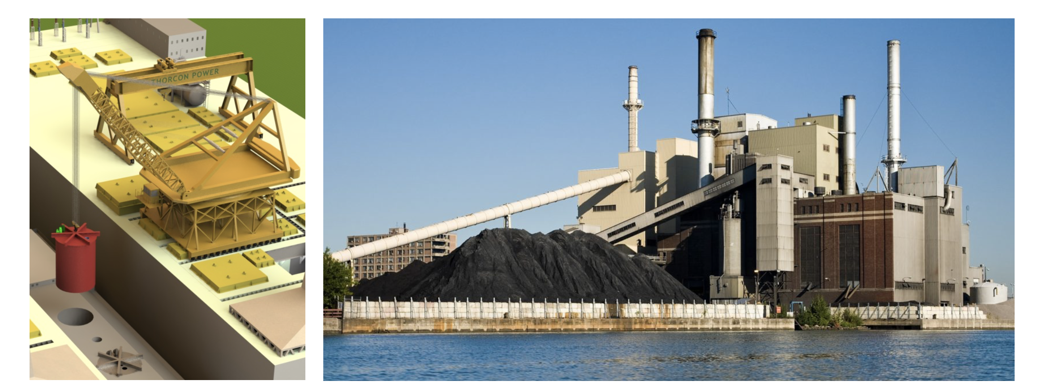
ThorCon capital, fuel, and electricity: cheaper than coal.
10,000 tons per day
ThorCon
280 tons every 8 years
Coal plant

Slide 35
Nations will choose 24x7 fission, if it’s cheaper.
Economics | Fission | Coal
Capital cost, $/Watt | 1.2 | 2.0
Fuel cost, cents/kWh | 0.53 | 2.27
Electricity, cents/kWh | 3 | 5
Notes:
http://www.world-nuclear.org/information-library/facts-and-figures/world-nuclear-power-reactors-and-uranium-requireme.aspx

Slide 36
One large shipyard can build 10 GW of liquid fission power plants a year.
Cheaper than coal, 24x7, zero CO2, 3¢/kWh

Slide 37
Cheaper than coal, 24x7, zero CO2, 3¢/kWh

Slide 38
The shipbuilding industry has capacity to build 12,000 GW of liquid fission plants in 30 years.
Powering Up Our World with 12,000 GW
@ $1.2/watt = $14.4 trillion, $30 per person per year

Slide 39
7 Fission power
Fission energy
PWR nuclear power plants
ThorCon
Molten salt reactor
Cheaper than coal
Market size, growth
Shipyard mass production
Fission is in Fashion

