Slide 1
6 Global power
Thermal power: 19,000 GW
Electric power: 3,000 GW
Developing demand
CO2 emissions
Electrify everything: 12,000 GWe
IEA: biofuels, carbon capture
Hydrogen, synfuels
Sector power use vision
Fission is in Fashion

Slide 2
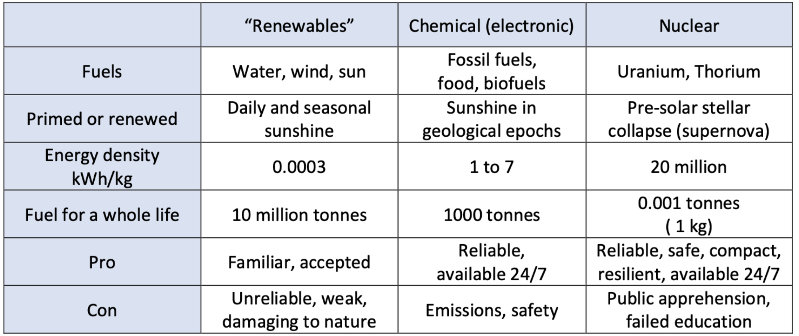
Wade Allison: Energy options facing society today
Adam Smith: “Science is the great antidote to the poison of enthusiasm and superstition.”
https://www.researchgate.net/publication/339629356_Nature_Energy_and_Society_A_scientific_study_of_the_options_facing_civilisation_today

Slide 3
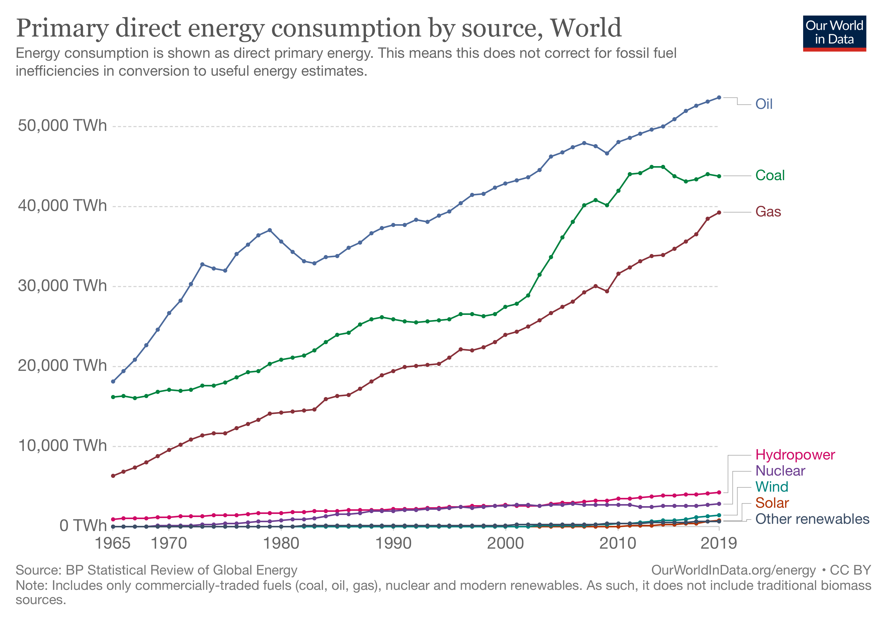
Global power sources
Oil 53,620 TWh/year
6,200 GW(t)
5,000 GW(t)
4,500 GW(t)
480
320
160
80
70
GW(e)
https://ourworldindata.org/grapher/primary-energy-consumption-by-source?year=latest&time=1965..2019
Notes:
https://ourworldindata.org/grapher/primary-energy-consumption-by-source?year=latest&time=1965..2019

Slide 4
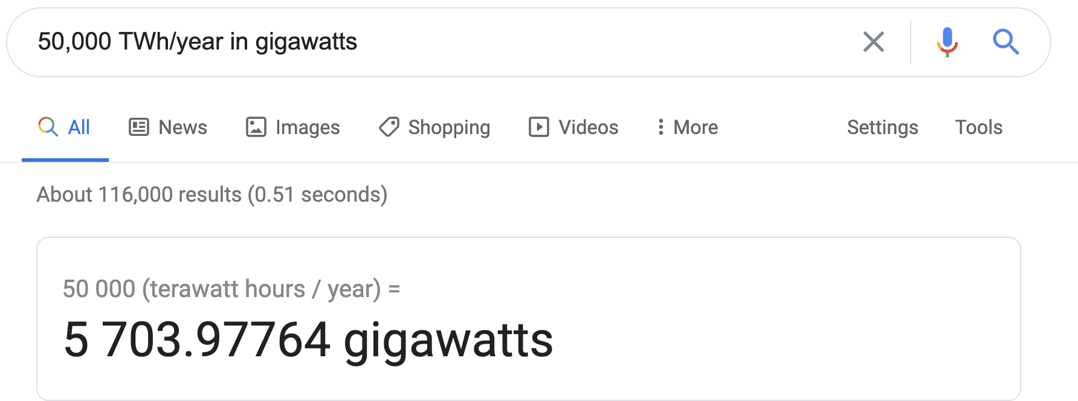
Handy math trick from Google:

Slide 5
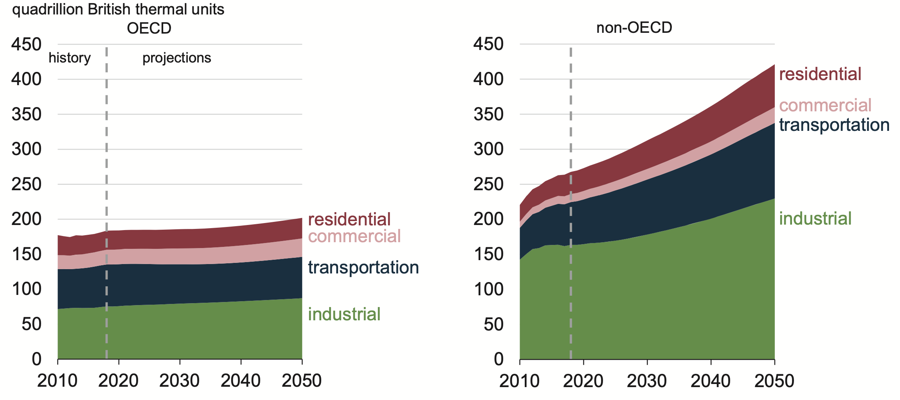
OECD energy non-OECD energy
180 quadrillion BTU/year ~
6,000 GW(t)
270 quadrillion BTU/year ~
9,000 GW (t)
https://www.eia.gov/outlooks/ieo/pdf/ieo2019.pdf

Slide 6
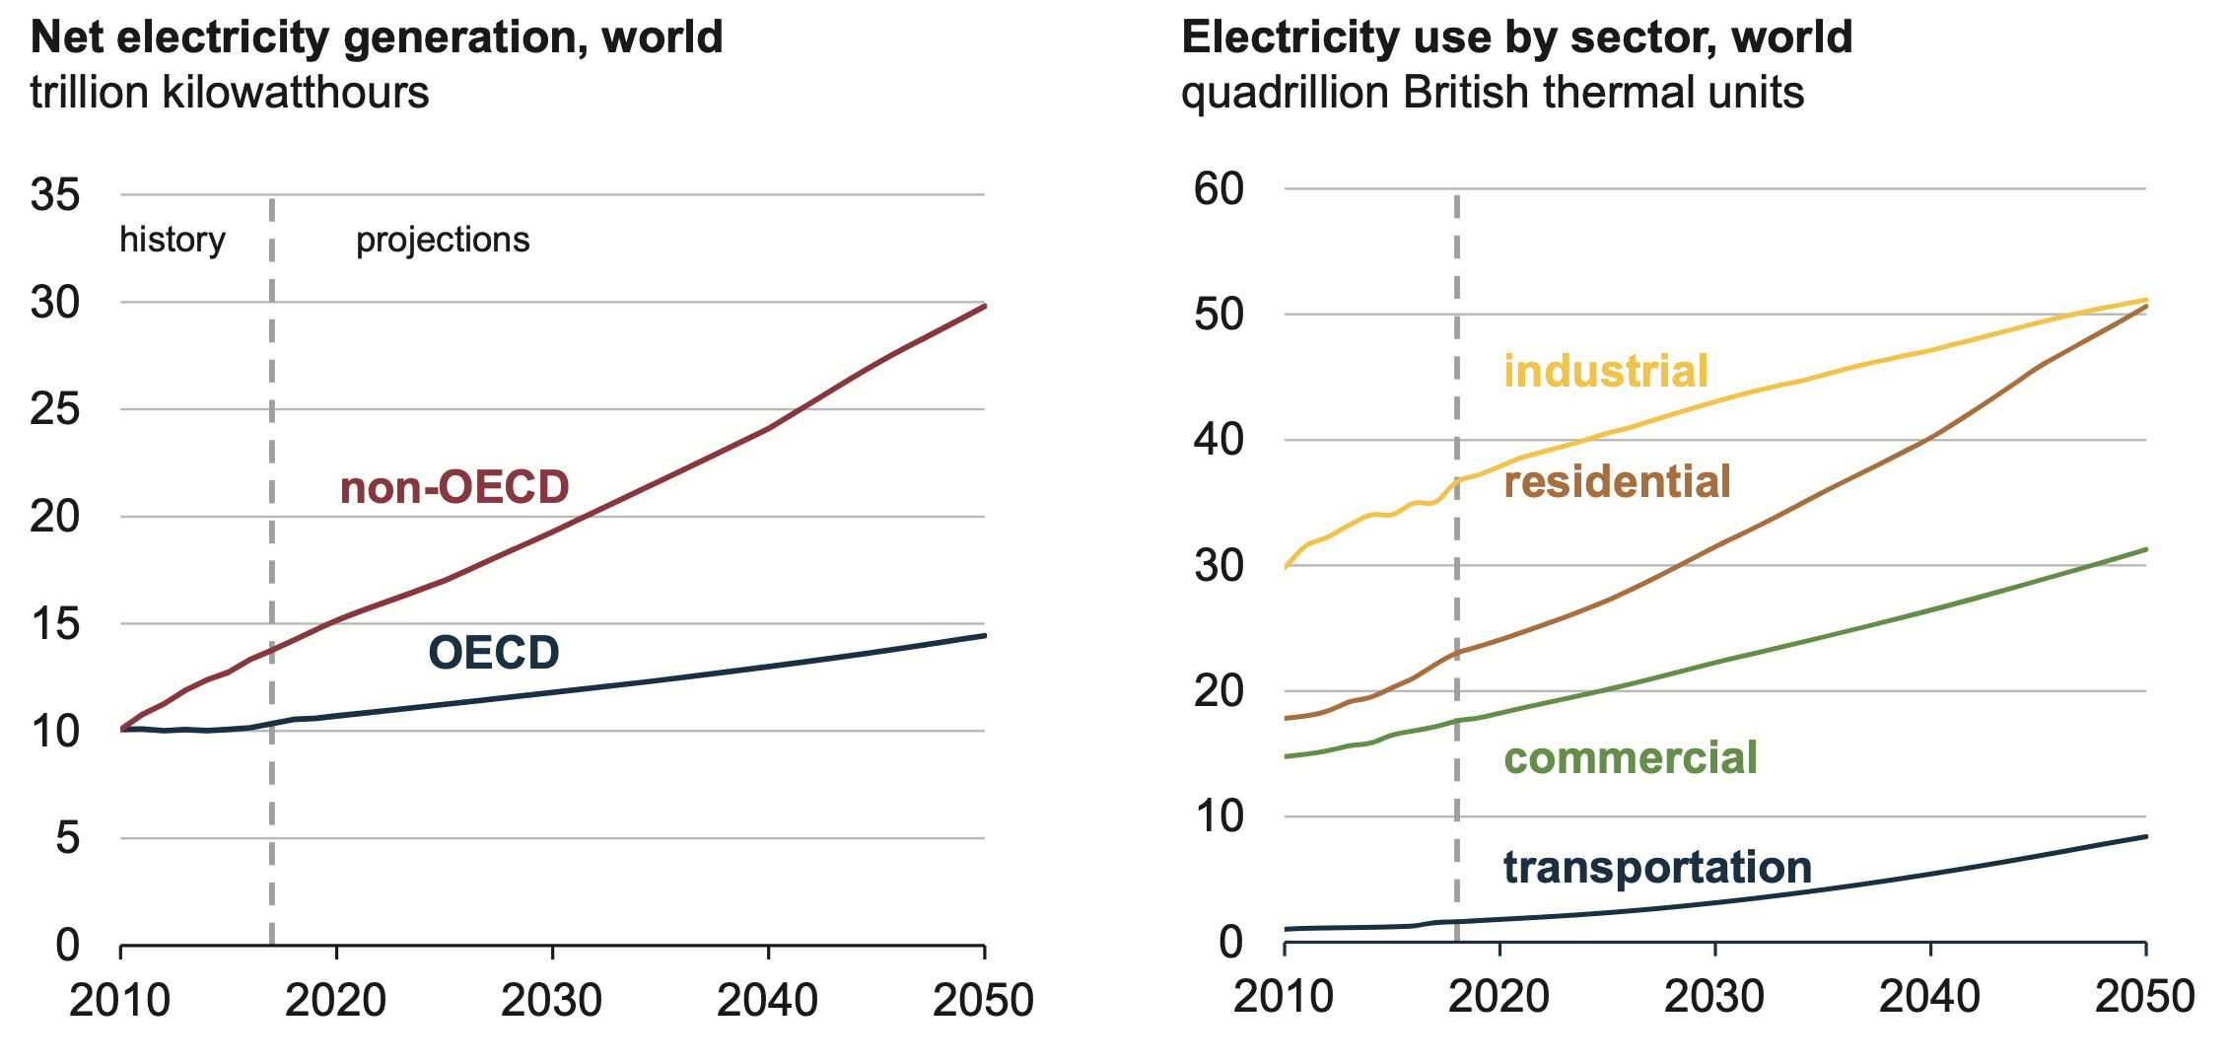
Global electricity use ~3,000 GW(e).
by economic class
by use
https://www.eia.gov/outlooks/ieo/pdf/ieo2019.pdf

Slide 7
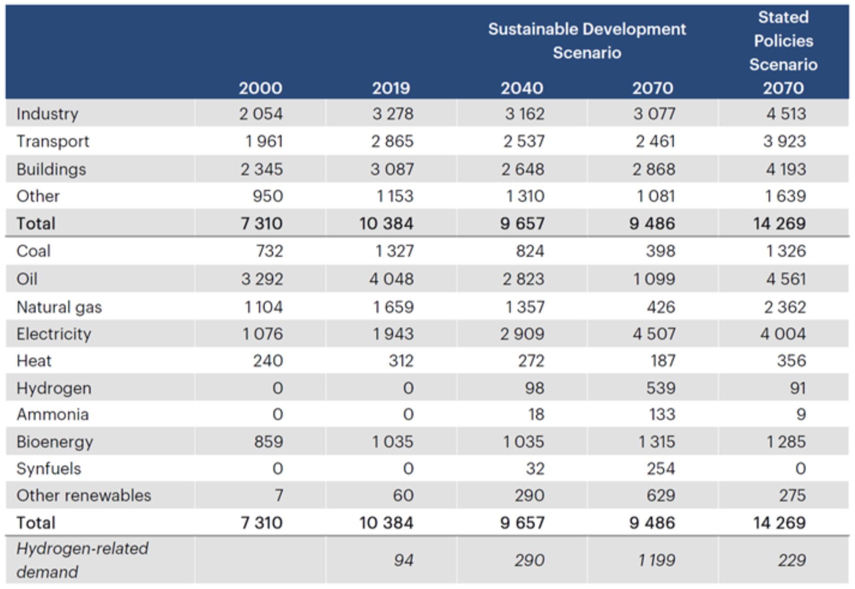
IEA World thermal power (Mtoe/year) Gigawatts
4,400
uses
3,800
4,100
13,800
12,600
19,000
sources
2,600
6,000
1,400
1,700
https://webstore.iea.org/download/direct/4165

Slide 8
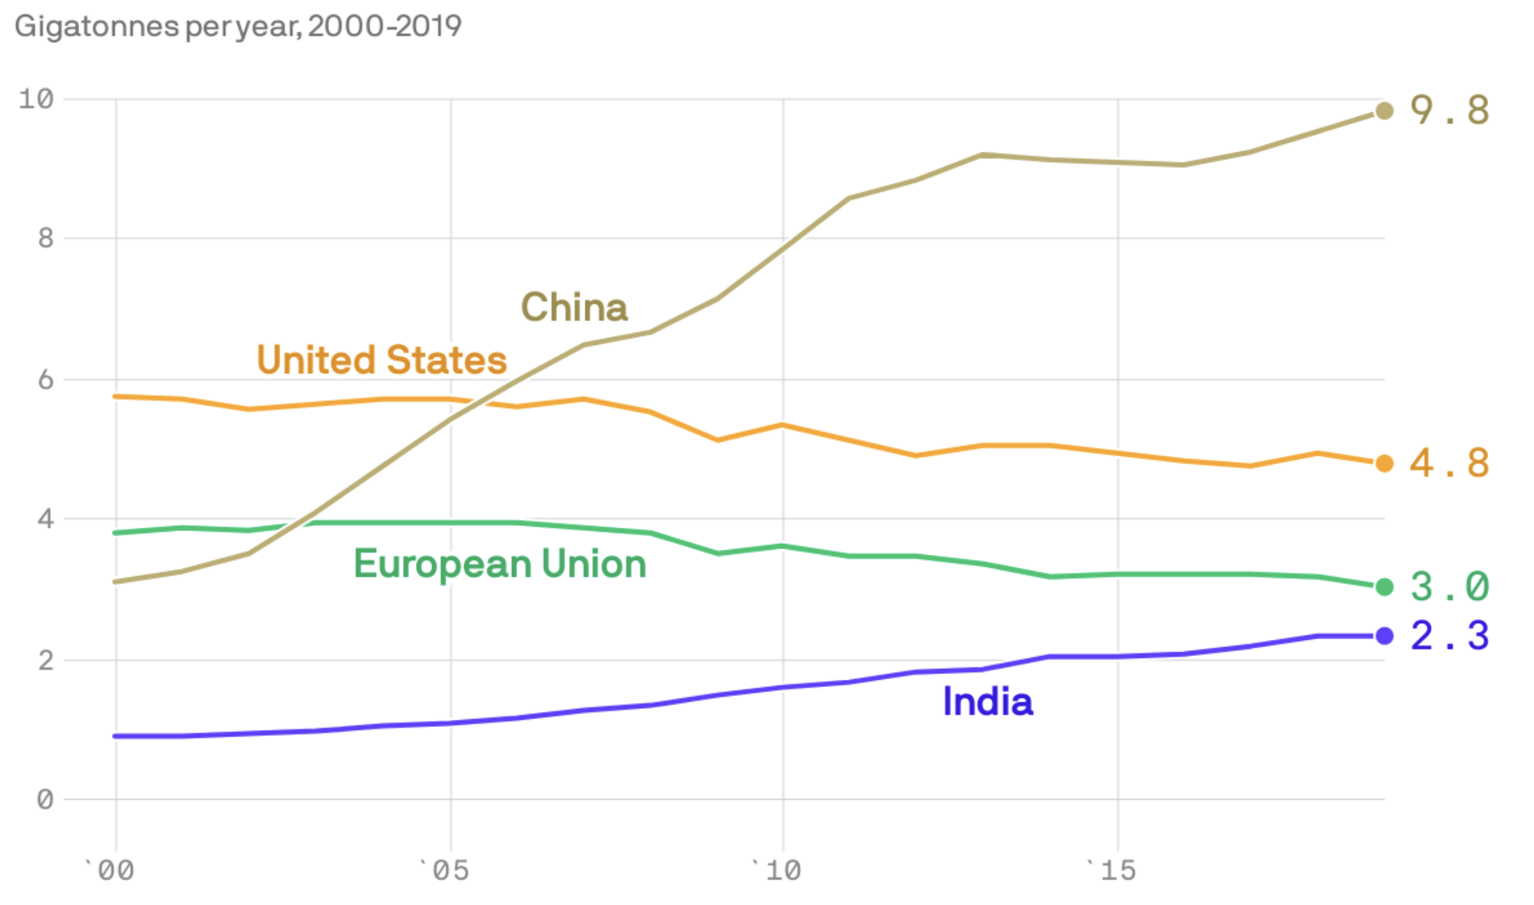
IEA: China, US, EU, and India emit most of the 32 Gt-CO2/year from fuel consumption.
https://www.iea.org/reports/co2-emissions-from-fuel-combustion-overview

Slide 9
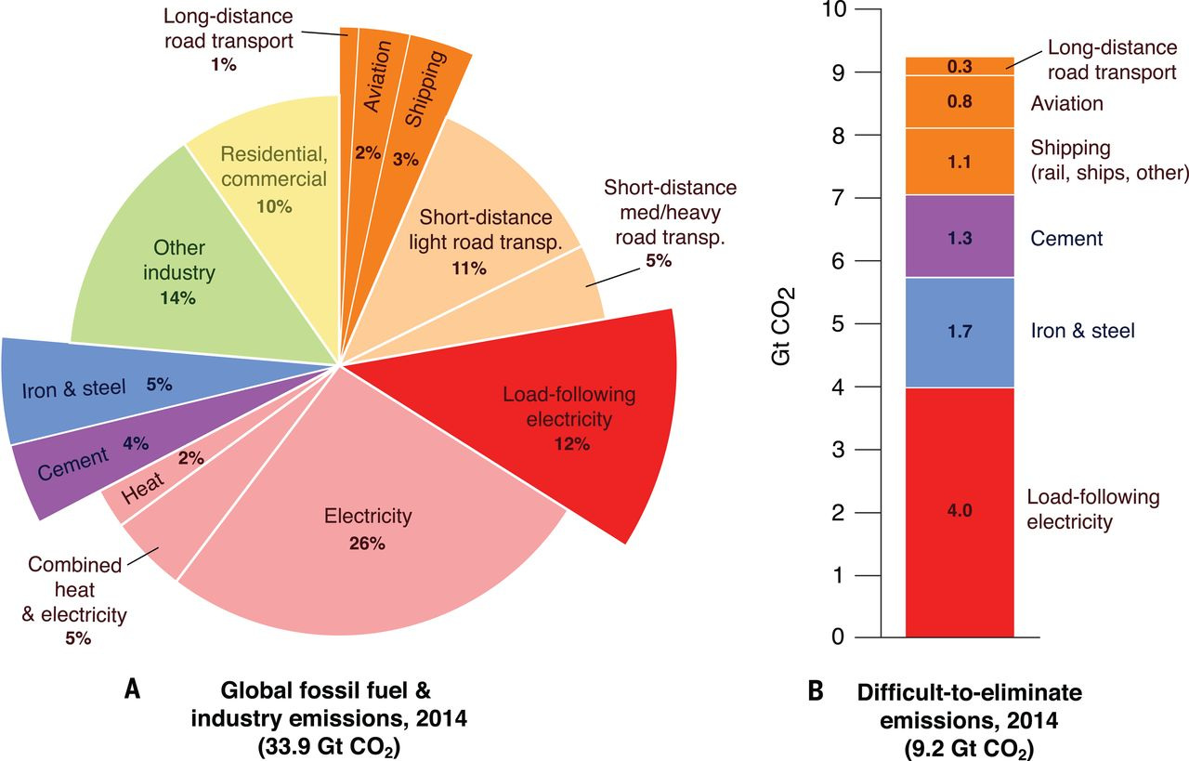
Emissions
23 Gt CO2 (2014)
excluding agriculture,
land use changes, waste
https://science.sciencemag.org/content/360/6396/eaas9793

Slide 10
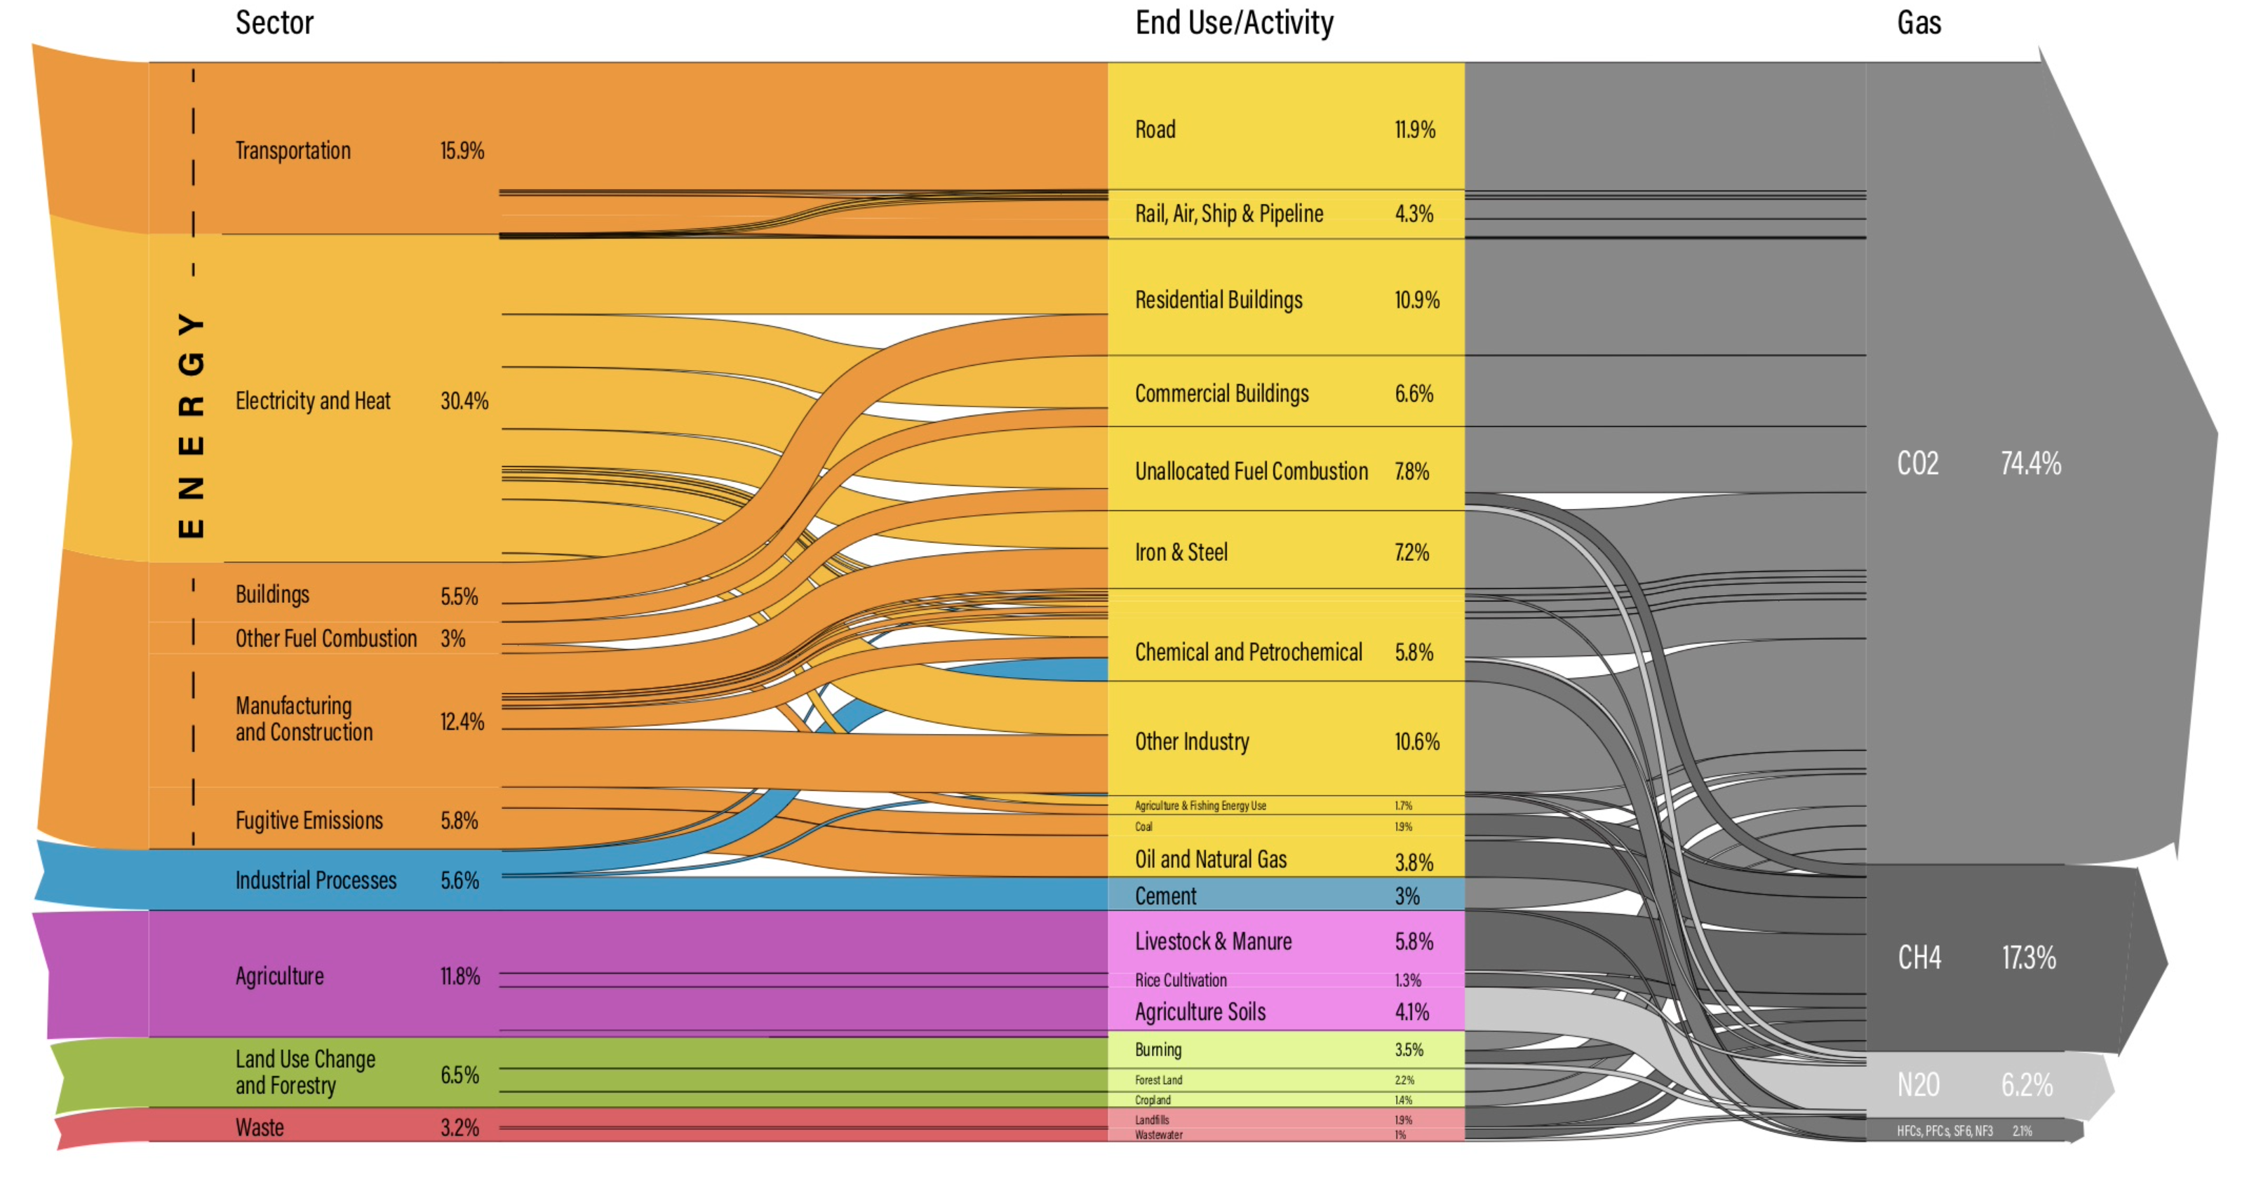
Emissions 49 Gt CO2-eq (2016)
https://www.wri.org/blog/2020/02/greenhouse-gas-emissions-by-country-sector

Slide 11
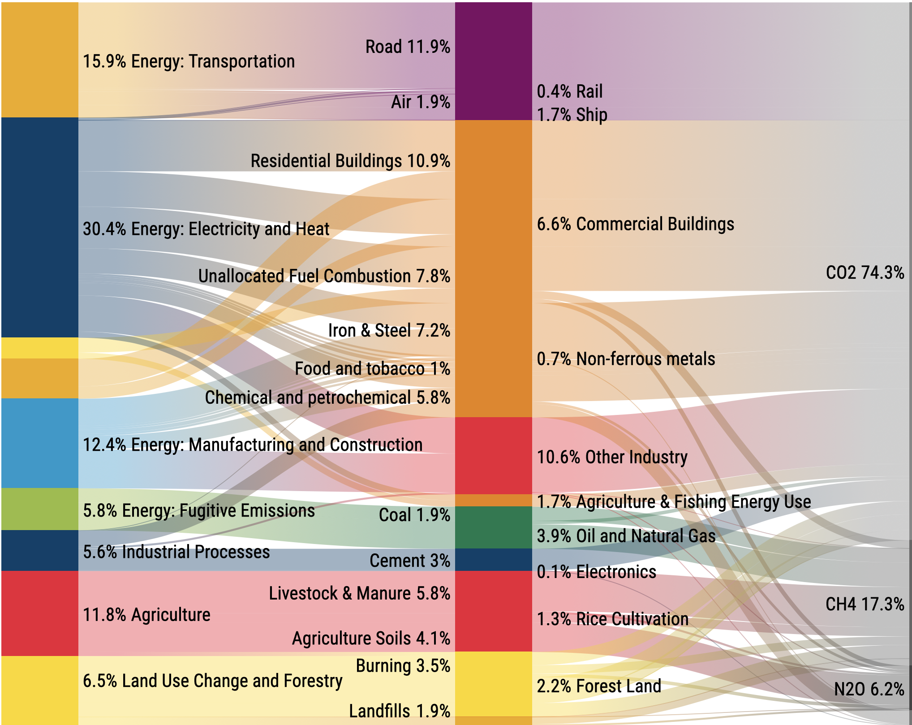
Emissions:
49 Gt CO2-eq (2016)
by source and use
World Resources Institute
https://www.wri.org/blog/2020/02/greenhouse-gas-emissions-by-country-sector

Slide 12
Mark Z. Jacobson WWS (water/wind/solar) article
16,519 GW(t) combustion power replaced by WWS sources.
Everything is electrified, including transportation, industry.
2050 electricity demand grows to 11,800 GW(e).
https://web.stanford.edu/group/efmh/jacobson/Articles/I/CountriesWWS.pdf

Slide 13
Jacobson WWS issues
59-85% of power demand must adjust to availability.
49,900 GW(e) nameplate capacity to generate 11,800 GW(e)
Capital investment: $125 trillion.
Electricity cost: 11 cents/kWh.
The energy storage cost of 0.8 cents/kWh is far too low.
New, global, public policies needed to force adoption.
https://web.stanford.edu/group/efmh/jacobson/Articles/I/CountriesWWS.pdf

Slide 14
Let’s power up our world with 12,000 GW(e).
Using fossil fuel combustion
19,000 GW(t) 2019, BP
9,705 GW(t) 2012, Jacobson
16,519 GW(t) 2050, Jacobson, business as usual
CO2-free electrification of everything
11,800 GW(e) 2050, Jacobson WWS, writing in 2012
9,000 GW(e) 2020, Hargraves/Uhlik, in 2017
Goal: generate 12,000 GW(e) CO2-free, cheap, 24x7 power
https://atomicinsights.com/clean-doable-liquid-fission-lf-energy-roadmap-%E2%80%A8powering-world/

Slide 15
Difficult to eliminate
emissions
9 Gt CO2 (2014)
https://science.sciencemag.org/content/360/6396/eaas9793

Slide 16
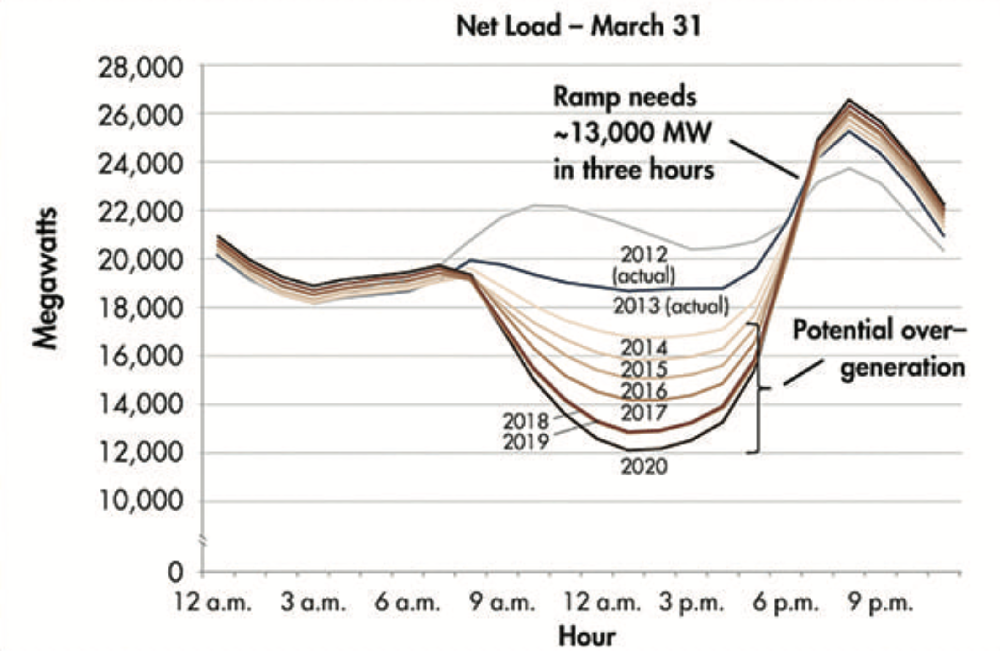
Subsidized solar helped create the “difficult” load-following demand.
https://www.energy.gov/eere/articles/confronting-duck-curve-how-address-over-generation-solar-energy

Slide 17
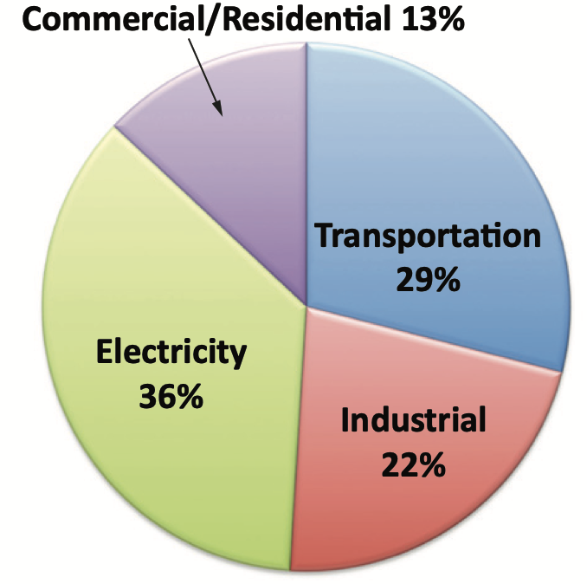
US DOE EIA energy by use sector

Slide 18
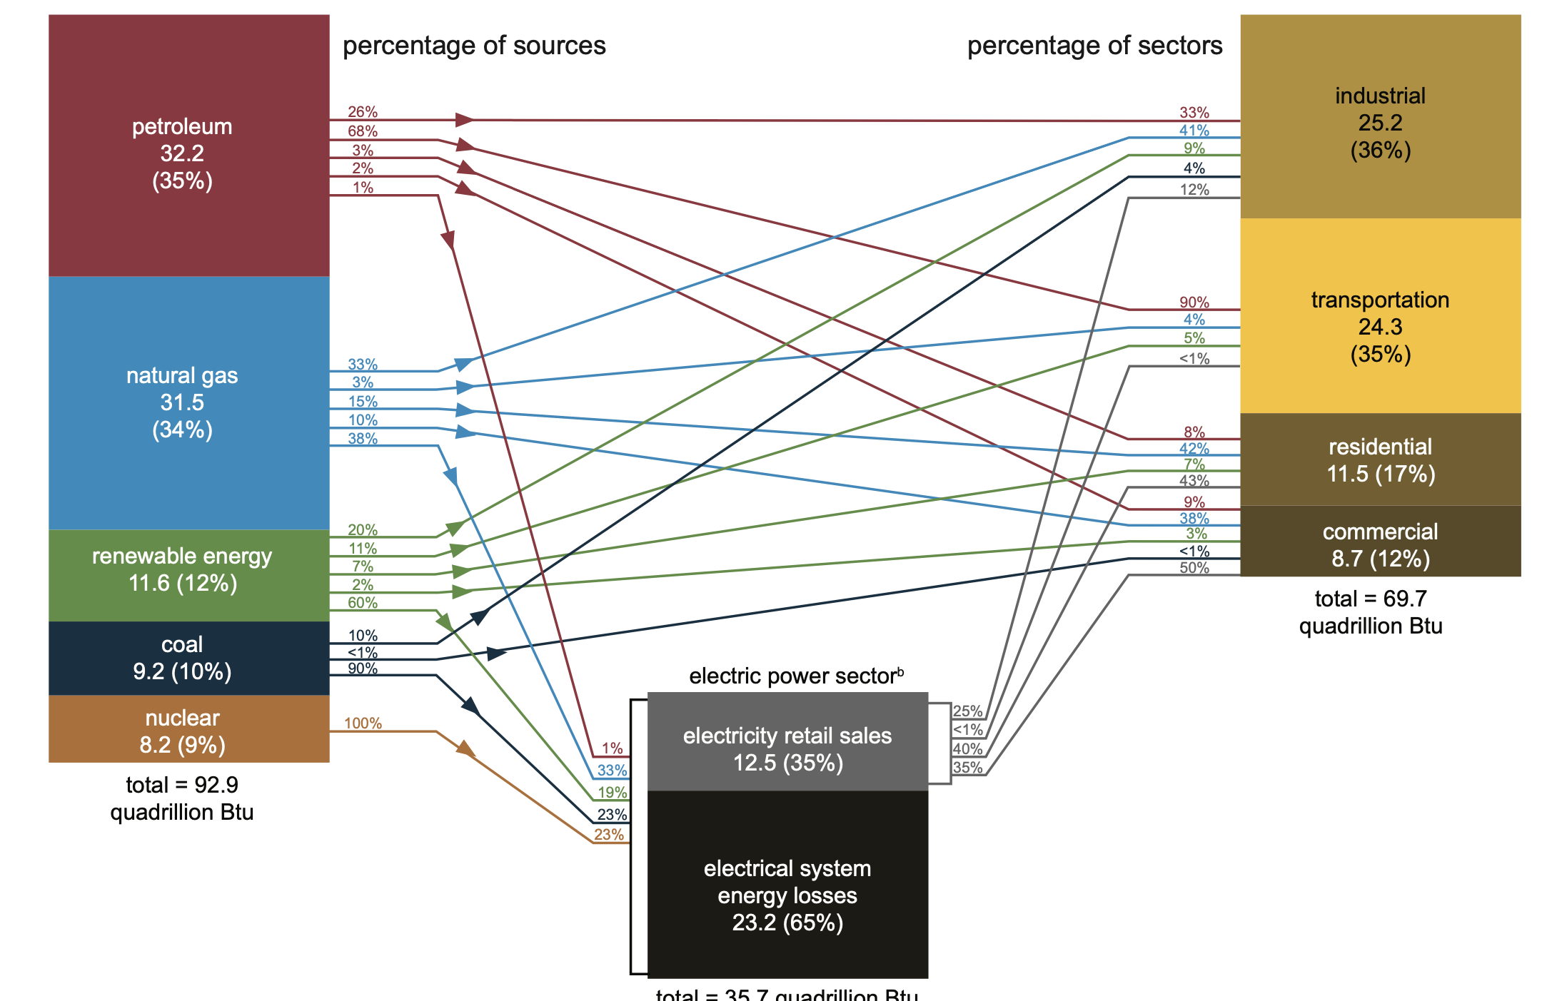
US energy consumption, from source, to sector, 2020
EIA error in adding kW(e) to kW(t)
93 quad/yr ~ 5000 GW (heat energy)
36 quad/yr ~ 1200 GW (heat energy) (multiply by EIA’s 35% to get ~ 420 GW(e)
https://www.eia.gov/energyexplained/us-energy-facts/images/consumption-by-source-and-sector.pdf

Slide 19
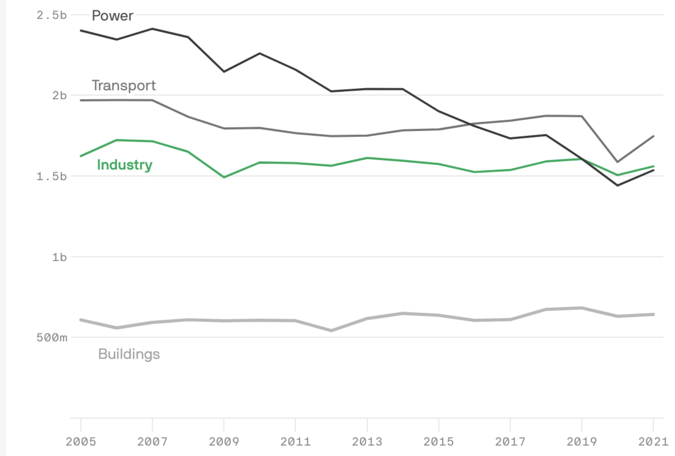
US annual CO2-eq emissions, tons. Axios/Rhodium
https://www.axios.com/newsletters/axios-generate-d6e39fe0-39f4-4082-a19c-3e59f68b459c.html

Slide 20
Mark Z Jacobson strategy is a 100% water/wind/solar zero-CO2 solution.
Inspired Green New Deal.
Refuted, discredited.
Jacobson sued refuting authors.
https://web.stanford.edu/group/efmh/jacobson/Articles/I/CountriesWWS.pdf

Slide 21
IEA strategy (Sept 2020)
Transforming the power sector alone would only get the world one-third of the way to net-zero emissions.
Spreading the use of electricity into more parts of the economy is the single largest contributor to reaching net-zero emissions.
Hydrogen extends electricity’s reach.
Carbon capture and bioenergy play multifaceted roles.
Long-distance transport and heavy industry are the hardest emissions to reduce.
https://www.iea.org/reports/energy-technology-perspectives-2020

Slide 22
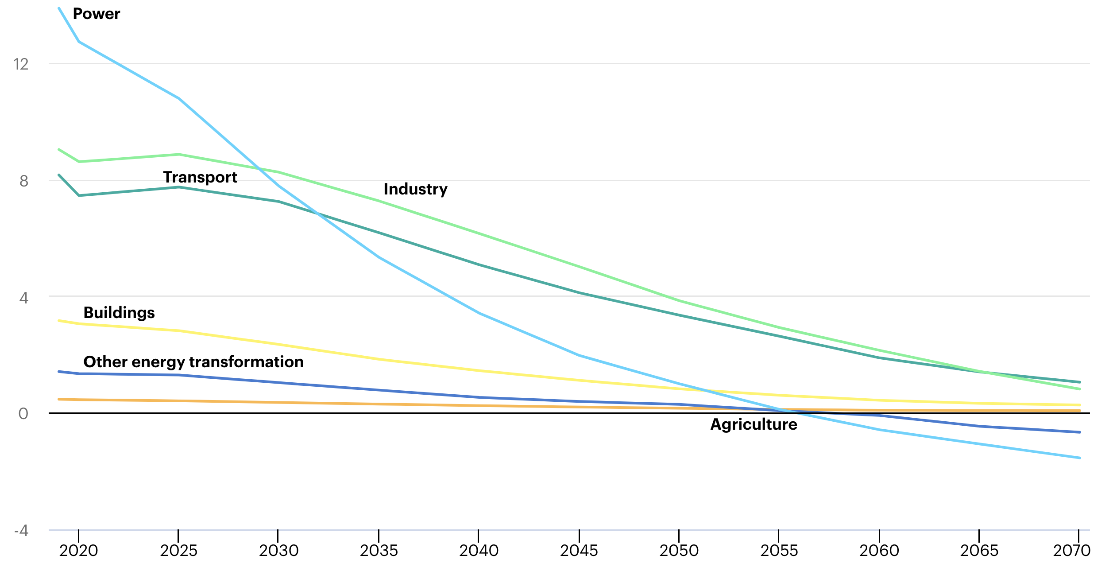
IEA strategy: annual CO2 emissions over 50 years.
Electricity nearly triples.
~20% of electricity for hydrogen and synfuels
Negative emissions?!
https://www.iea.org/reports/energy-technology-perspectives-2020

Slide 23
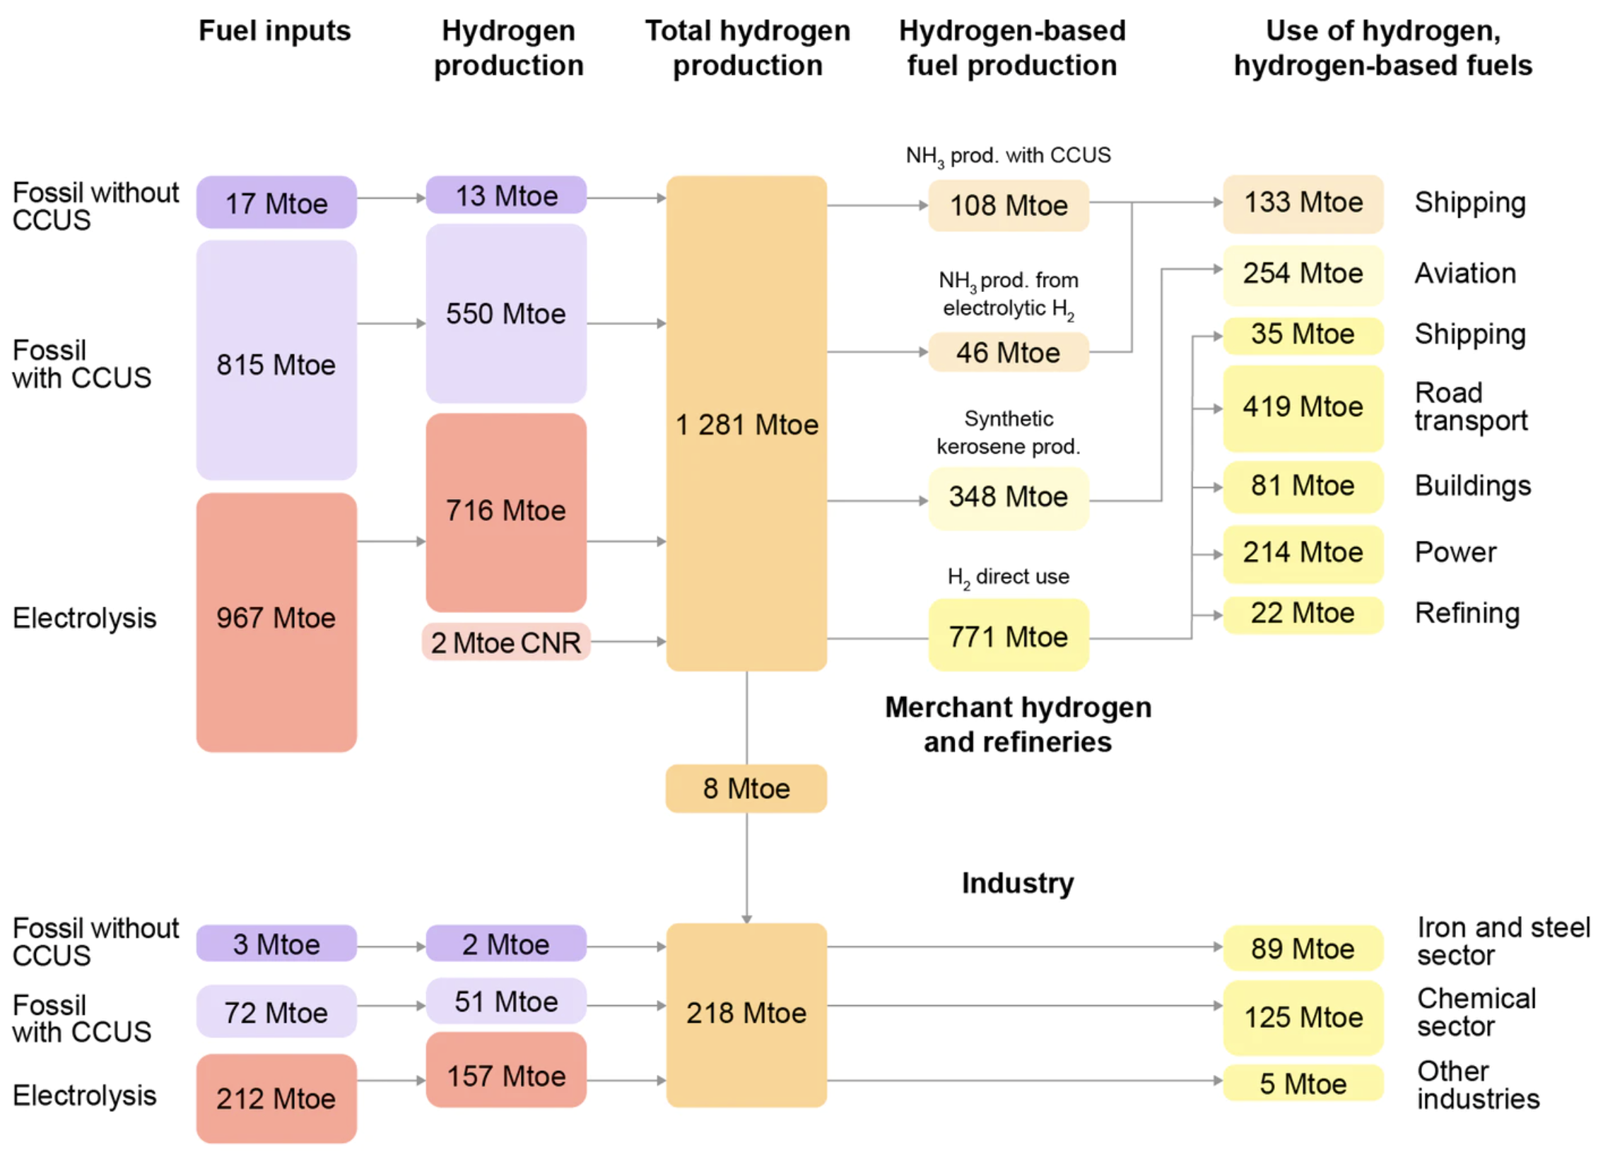
IEA Hydrogen strategy
Electrolyze 300 Mt-hydrogen per year (half H2 demand)
Total H2 prod =
1,281+218 =
1500 Mtoe/year =
2,000 GW(t) of H2
CCUS =
carbon capture underground storage
https://www.iea.org/reports/energy-technology-perspectives-2020

Slide 24
IEA synfuel strategy
154 Mtoe/year of ammonia =
204 GW NH3 for shipping
348 Mtoe/year kerosene =
462 GW aviation fuel
771 Mtoe/year hydrogen =
1000 GW H2 fuel
Note expectation of CCUS, carbon capture underground storage
176 GW
336 GW
46 GW
554 GW
107 GW
https://www.iea.org/reports/energy-technology-perspectives-2020

Slide 25
Lucid Catalyst hydrogen synfuel strategy.

Slide 26
Lucid Catalyst fossil fuel replacement strategy.
Clean hydrogen, as fuel or feedstock.
High temperature electrolysis, to make hydrogen at 95% efficiency.
Cheap electricity, source of hydrogen energy.
Full-time operation, to minimize capital costs.
Clean heat, for industrial processes.
Synfuels, such as ammonia, for shipping.
Shipyard mass production, of power plants, electrolyzers, and factories.

Slide 27
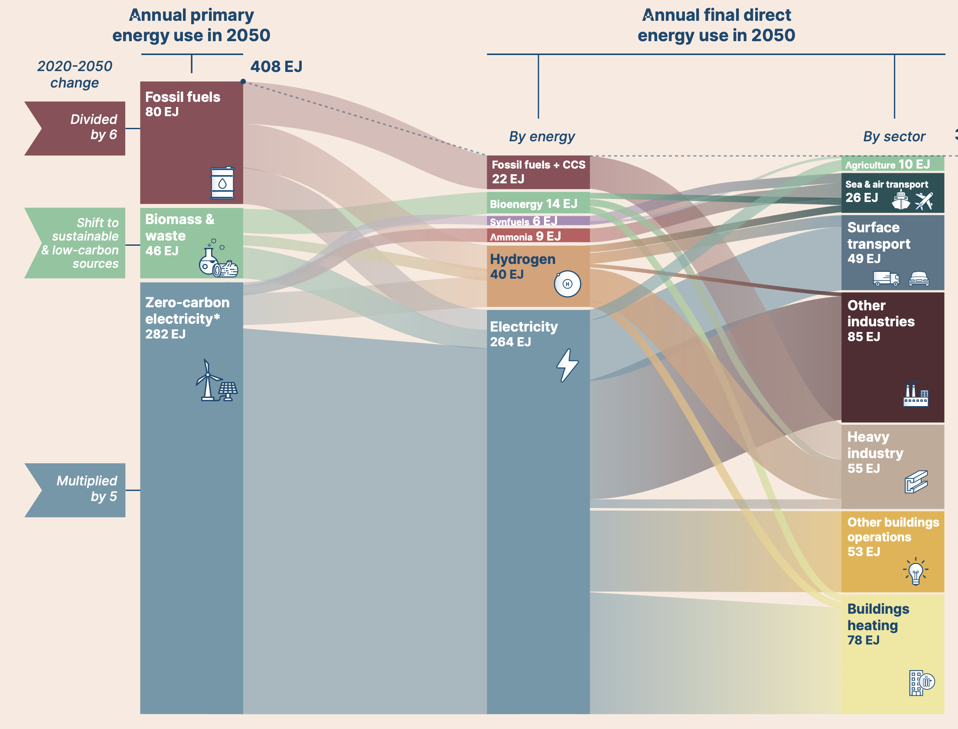
Energy Transitions Commission 2050 strategy (RMI, BNEF, ...)
total
11,000 GWe
fossil fuels
2,500 GWt
356 EJ
transport
2,400 GWe
biomass
1,500 GWt
hydrogen
1,300 GWt
lite industry
2,700 GWe
electricity
9,000 GWe
hvy industry
1,800 GWe
bldg ops
1,700 GWe
heating
2,500 GWe
https://www.energy-transitions.org/wp-content/uploads/2020/09/Making-Mission-Possible-Full-Report.pdf

Slide 28
Fission energy grand strategy
Key technologies
Electricity
Ample, cheap, 24x7 electric power
Transportation
electrify rail, light vehicles
synfuels for air, sea, heavy land transport
Buildings
building codes, heat pumps
district heating
Industry
high heat: electric arcs, plasma torches
new processes, H2 reduction
Liquid fission
high temp, low press
liquid fuel
Hydrogen
water electrolysis
Ammonia
fuel, fertilizer
Shipyard manufacturing
fast, efficient
power plants
factories

Slide 29
Electrified world power flow
2500 GW
Heating
Cheap, 24x7
liquid fission electricity 12,000 GW
intermediate
Hydrogen 3,000 GW
2700 GW
Light industry
1700 GW
Building ops
1800 GW
Heavy industry
300 GW
Electric vehicles
C-synfuel 400 GW
300 GW
1600 GW
Heavy transport
200 GW
400 GW
Airplanes
Ammonia 700 GW
800 GW
400 GW
Shipping
Biomass
400 GW
300 GW
1700 GW
Food

Slide 30
6 Global power
Thermal power: 19,000 GW
Electric power: 3,000 GW
Developing demand
CO2 emissions
Electrify everything: 12,000 GWe
IEA: biofuels, carbon capture
Hydrogen, synfuels
Sector power use vision
Fission is in Fashion

