Slide 1
5 Wind and solar power
CO2 quantities
Cubic mile of oil
Wind and solar costs
Capacity factor
Natural gas dependency
Intermittency
Materials mining
$ trillions per year?
Fission is in Fashion

Slide 2
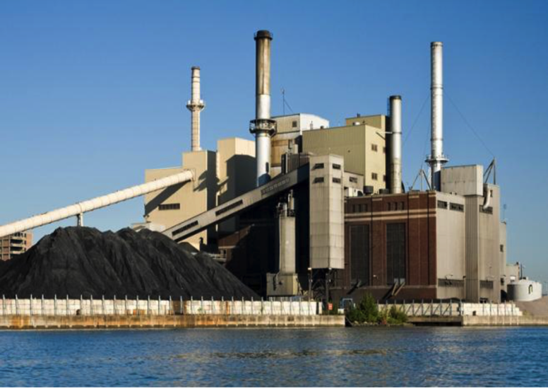
Each new 1-GW coal plant emits 8 Mt CO2/year. 574 GW of new coal plants' emissions = 5 Gt/year.
Notes:
https://www.scientificamerican.com/article/climate-pledges-will-fall-short-of-needed-2-degree-c-limit/
https://www.eenews.net/special_reports/global_climate_debate/stories/1060045212/print
http://wedocs.unep.org/bitstream/handle/20.500.11822/10572/EGR_Executive%20_summary_EN.pdf?sequence=1&isAllowed=y

Slide 3
Economic suicide?
Don’t end reliable, cheap power before getting a substitute!
Vaclav Smil:
Energy from burning carbon is the basis of civilization.
We need to put in place a different source of reliable, economic energy before removing the old.
https://www.wyodaily.com/photos/big/11242/12

Slide 4
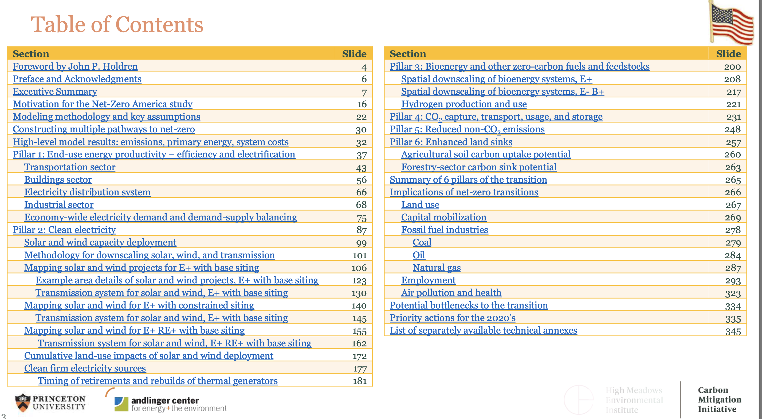
Princeton University Net-Zero America
345 page PowerPoint presentation; $2.5 trillion by 2050.
USA only
wind, solar
batteries
transmission
bioenergy
CCS
H2 for synfuel
https://netzeroamerica.princeton.edu/img/Princeton_NZA_Interim_Report_15_Dec_2020_FINAL.pdf

Slide 5
Princeton University Net-Zero America
Practical? Technology? Cost? Mining? Land area? Just US?
https://netzeroamerica.princeton.edu/img/Princeton_NZA_Interim_Report_15_Dec_2020_FINAL.pdf

Slide 6
Global energy equivalent: 3 cubic miles of oil
Ripu Malhotra et al, SRI

Slide 7
We might supply all the world’s energy with ALL of these.

Slide 8
Energy equivalent of 1 cubic mile of oil

Slide 9
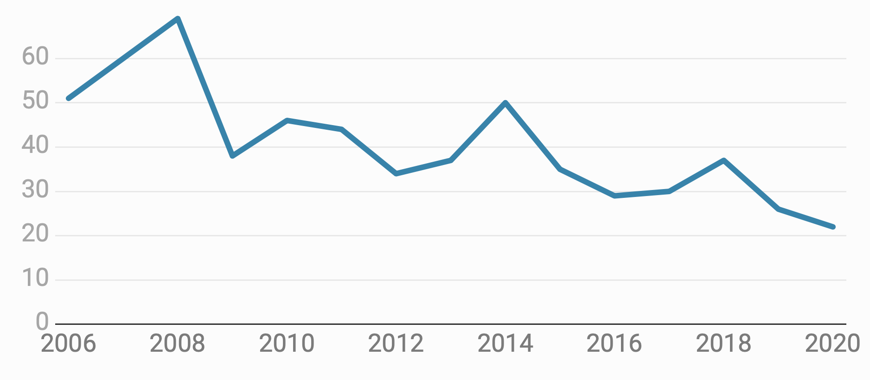
Low natural gas costs dropped electricity prices to ~ 2.5 cents/kWh in US mid-West and mid-Atlantic regions.
https://www.forbes.com/sites/scottcarpenter/2020/09/30/when-nuclear-plants-ask-for-money-states-find-they-cant-afford-to-say-no/#4d15dc4c4b9b

Slide 10
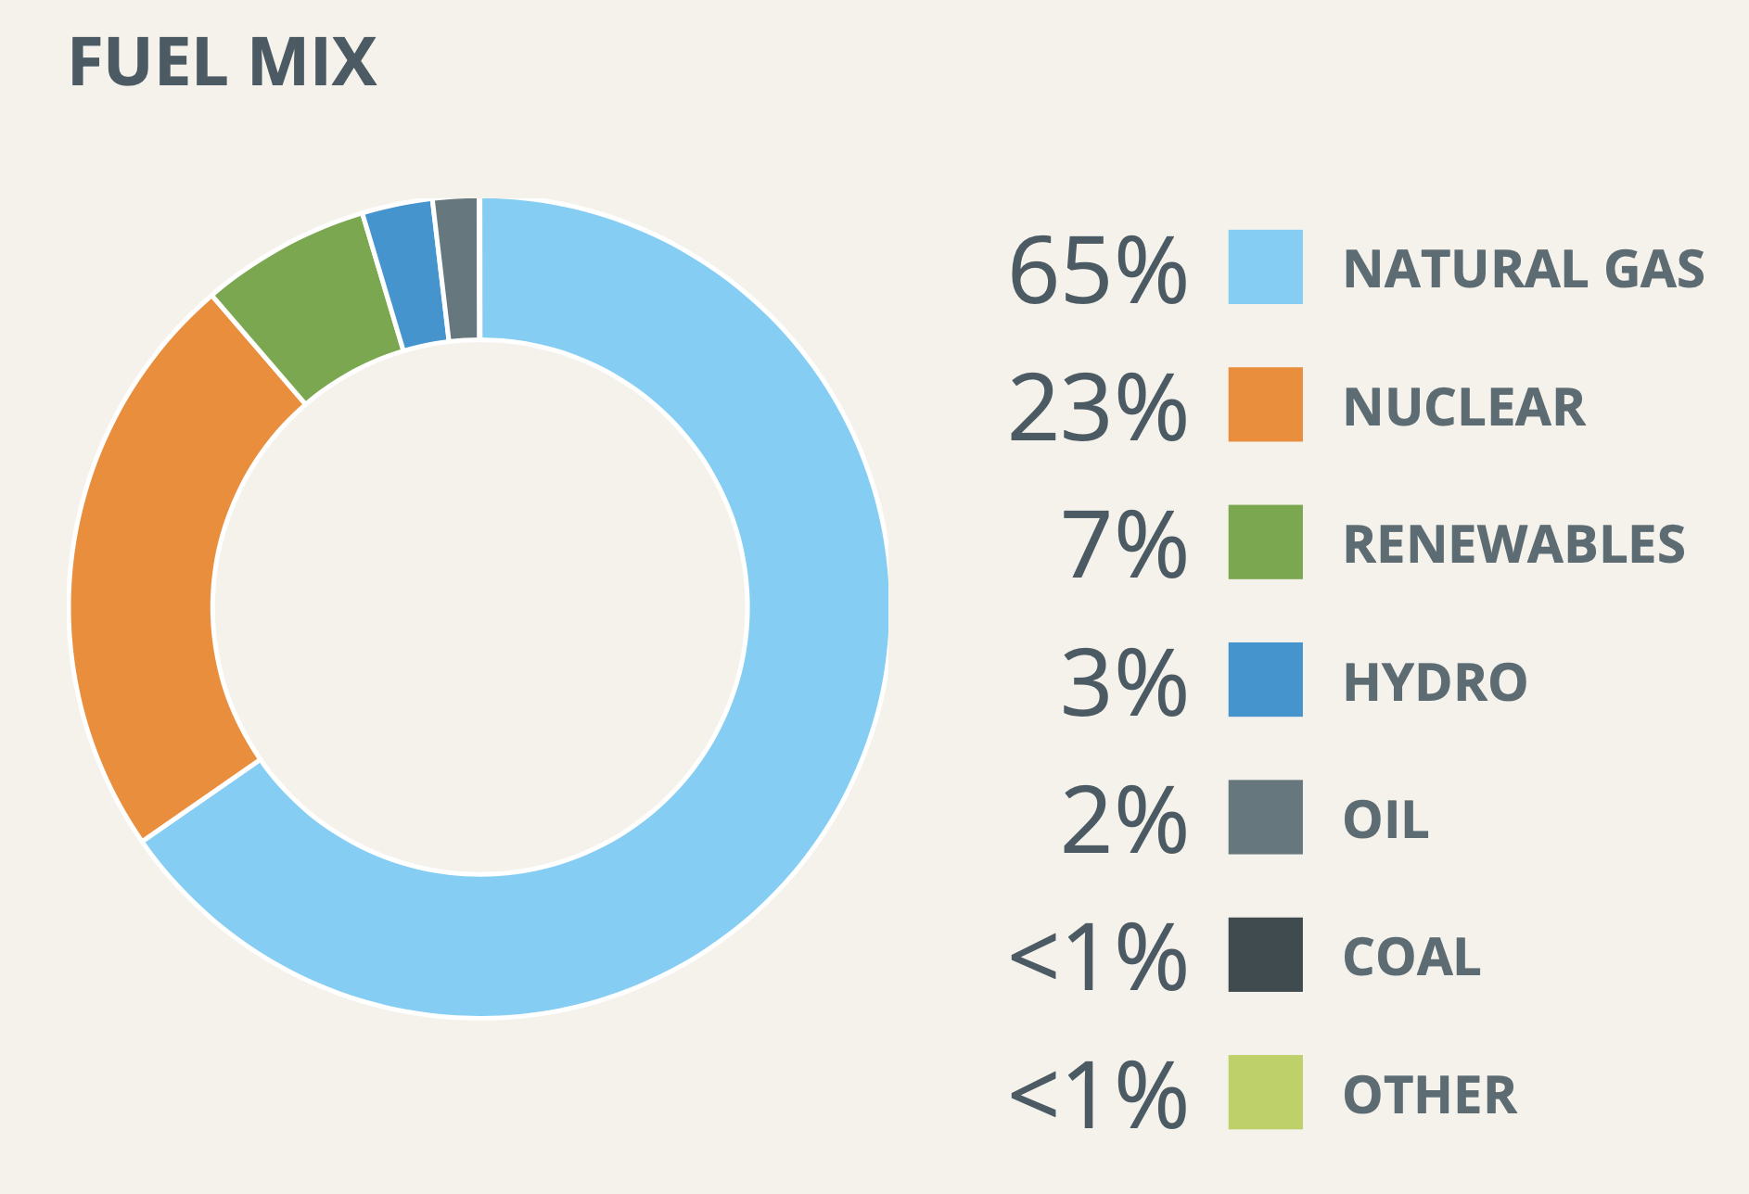
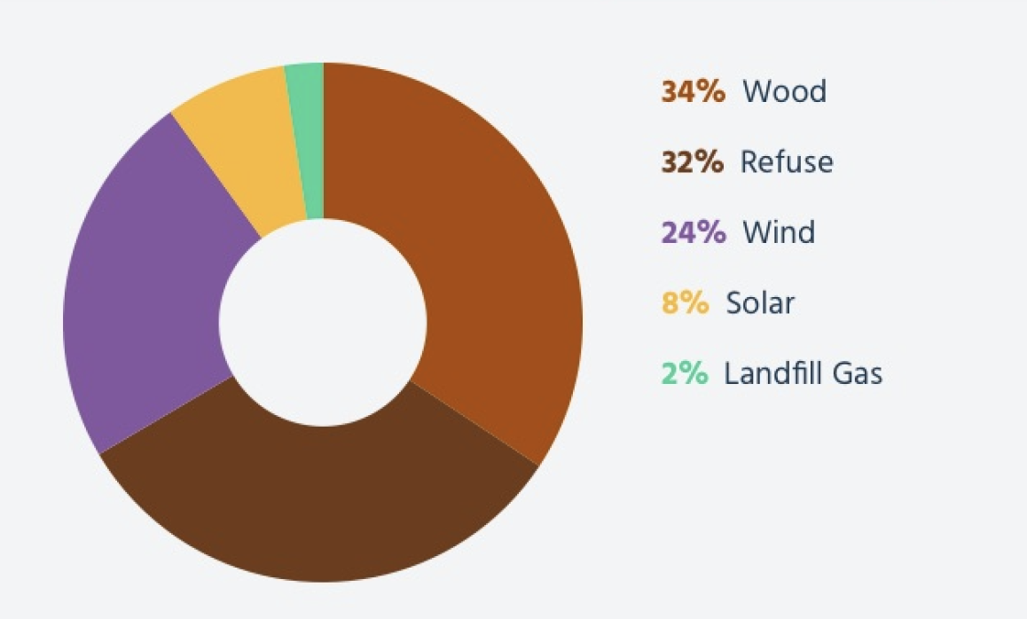
New England electricity generation 7/8/20
All sources
Renewables, % of 7%
Source: ISO-NE.com

Slide 11
Copper Mountain solar facility, Nevada, 802 MW largest in US
https://www.ysgsolar.com/blog/15-largest-solar-farms-world-2021-ysg-solar

Slide 12
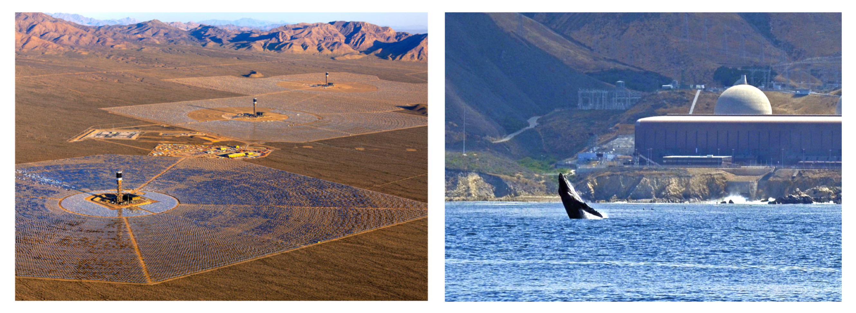
Solar power needs 450X the land of fission plants.
https://environmentalprogress.org/the-complete-case-for-nuclear

Slide 13
Net metering: Utilities must buy electricity from rooftop solar panels at retail (~20 ¢/kWh) not grid market (~5 ¢/kWh).
Power can’t be controlled by utility.
Exacerbates duck curve.
Increases total power costs; paid by other customers.
The most expensive “renewable” energy.
Community solar brings benefits to homes in shade.
https://www.solarreviews.com/blog/california-net-metering-nem-2

Slide 14
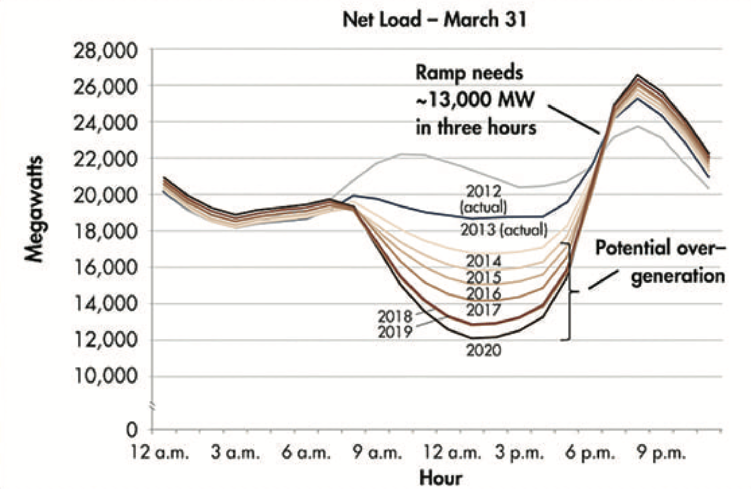
California's “duck curve”, created by by unmanaged, subsidized solar, causes mid-day shutdown of power plants.
https://www.energy.gov/eere/articles/confronting-duck-curve-how-address-over-generation-solar-energy

Slide 15
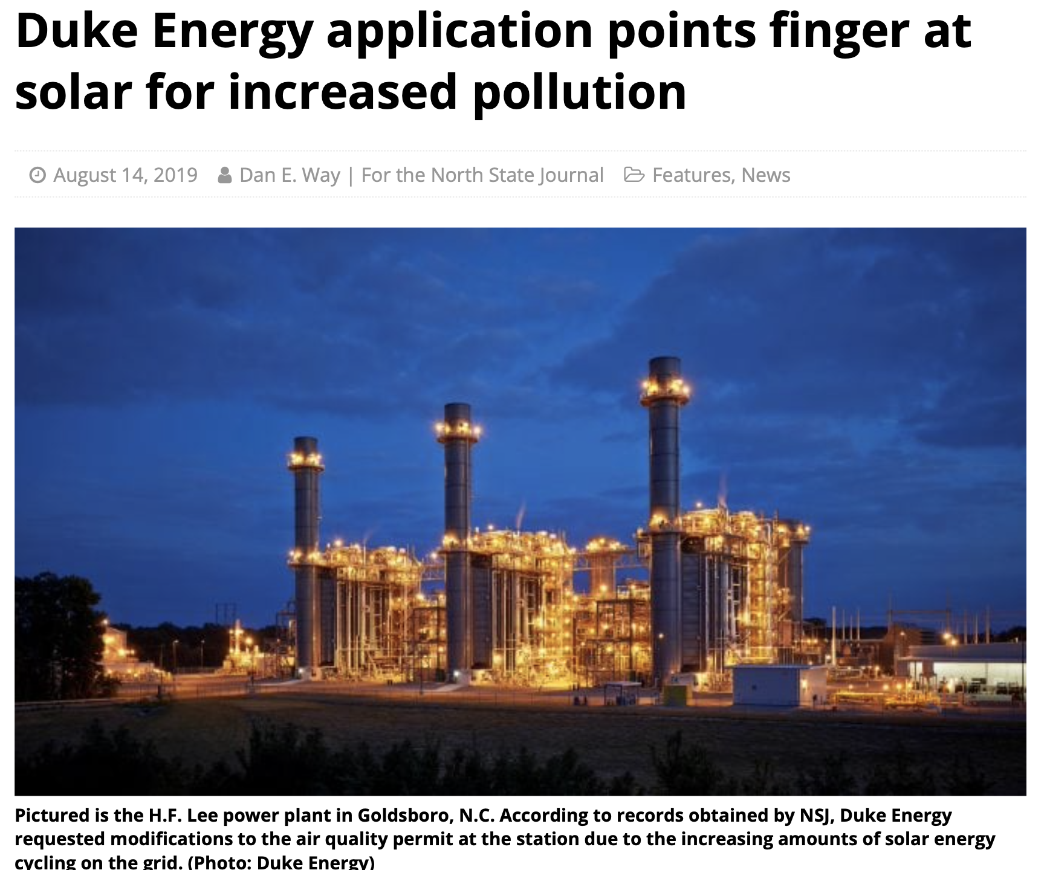
NOx emissions increase as gas turbines start/stop as solar panels stop/start.
Full time 264#/day
Off if sunny 624#/day
Idle if sunny 381#/day
https://nsjonline.com/article/2019/08/duke-energy-application-points-finger-at-solar-for-increased-pollution/

Slide 16
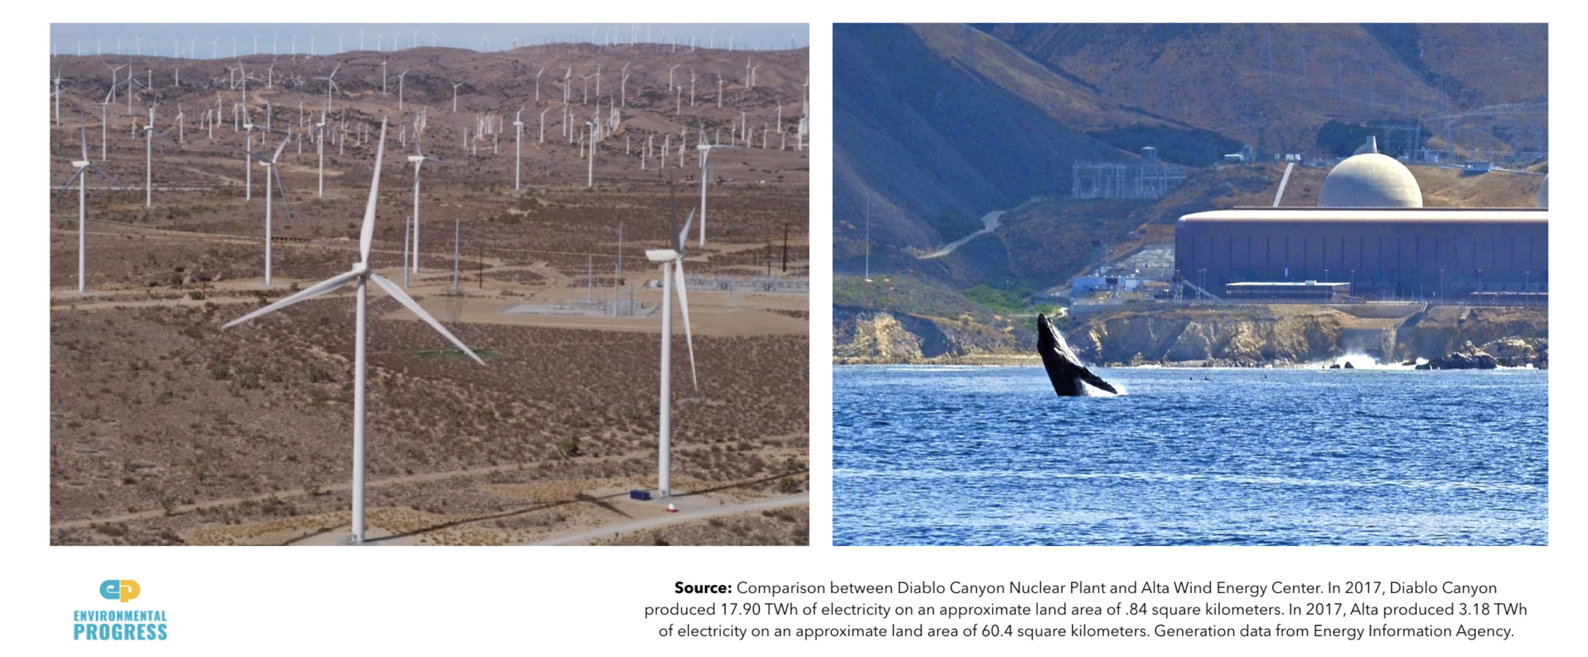
Wind power needs 400X the land of fission plants.
Ergo the emphasis on expensive off-shore wind.
https://environmentalprogress.org/the-complete-case-for-nuclear

Slide 17
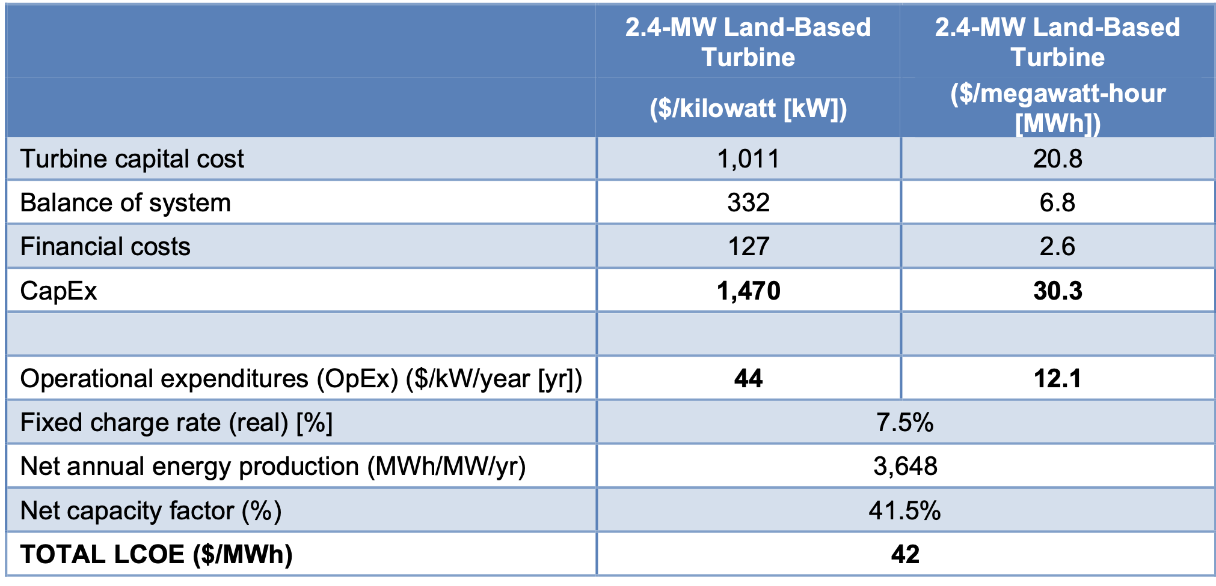
Wind energy costs ~ $42/MWh. US National Renewable Energy Labs, on land @ 42% capacity factor)
https://www.nrel.gov/docs/fy20osti/74598.pdf

Slide 18
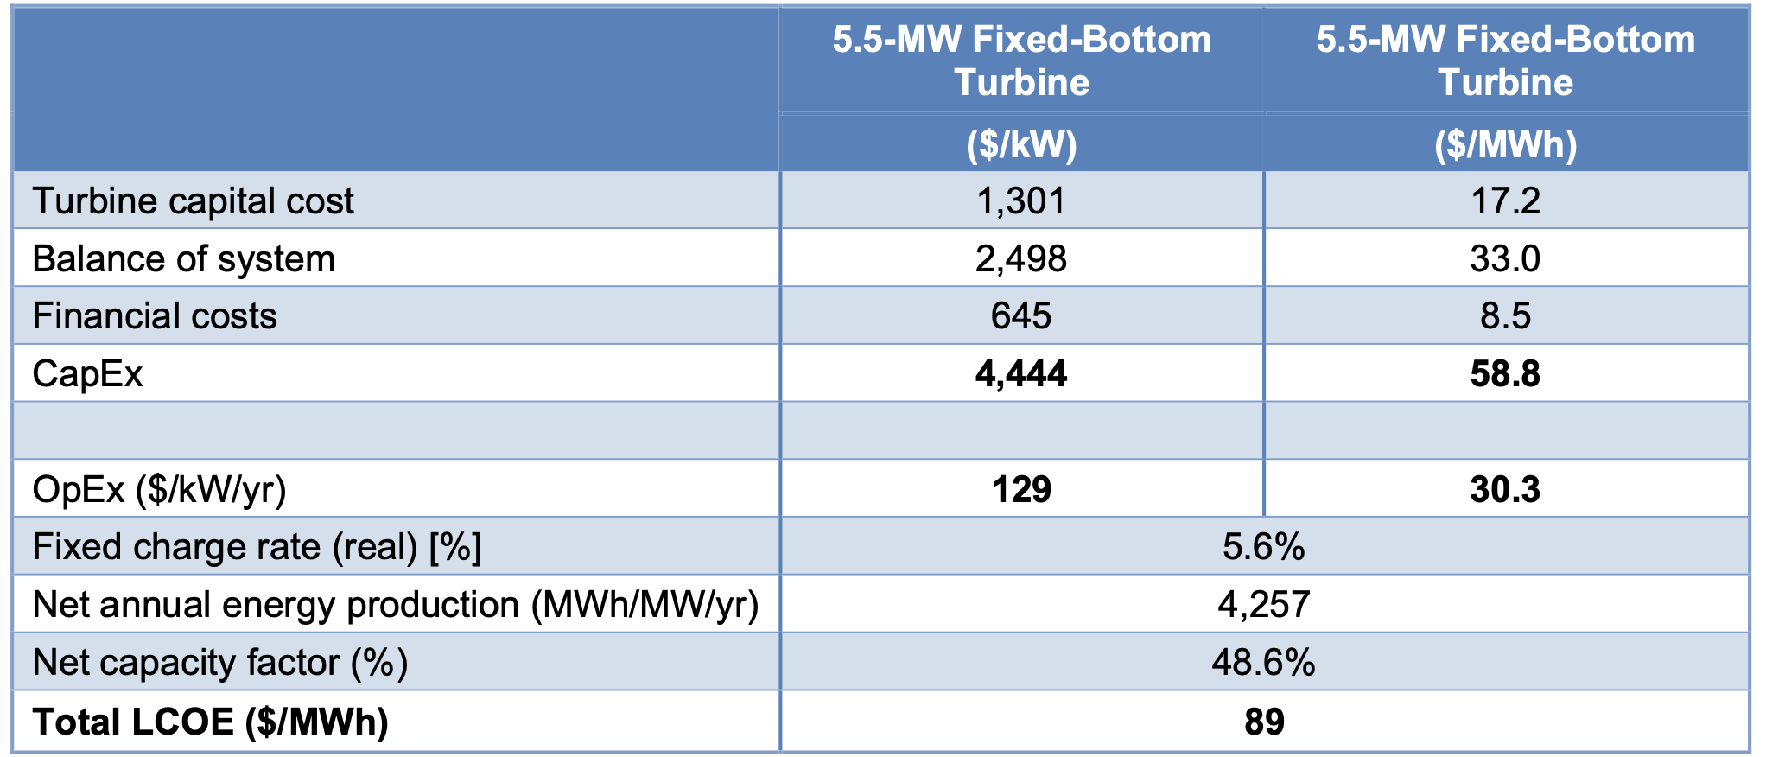
Offshore wind costs ~$89/MWh (off shore @ 49% capacity factor)
https://www.nrel.gov/docs/fy20osti/74598.pdf

Slide 19
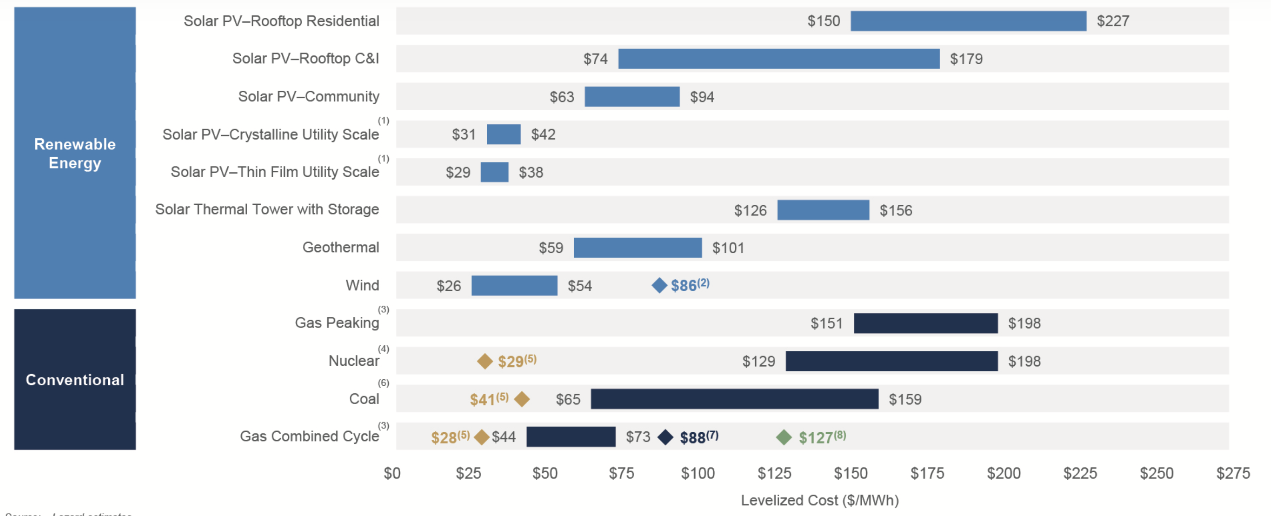
Lazard: levelized cost of electric energy
( $100/MWh = 10 cents/kWh )
~3.7 cents/kWh
~4.1 cents/kWh
https://www.lazard.com/perspective/lcoe2020

Slide 20
Often wind/solar $/kWh is < 50% of revenue.
electricity generated $/kWh
Wind/Solar preferences
Feed-in tariffs
Renewable portfolio standards
Bird kill examptions
Local zoning overrides
15-50% credit in auctions for firm power capacity
electricity $ curtailed
capacity payments $
$ renewable energy credits
federal investment tax credits $
Wind/Solar Developer
$ production tax credits
accelerated $ depreciation
$ tax exempt green bond interest discount
state income $ tax credits
$ grants
property tax $ exemption
Angwin: Shorting the Grid

Slide 21
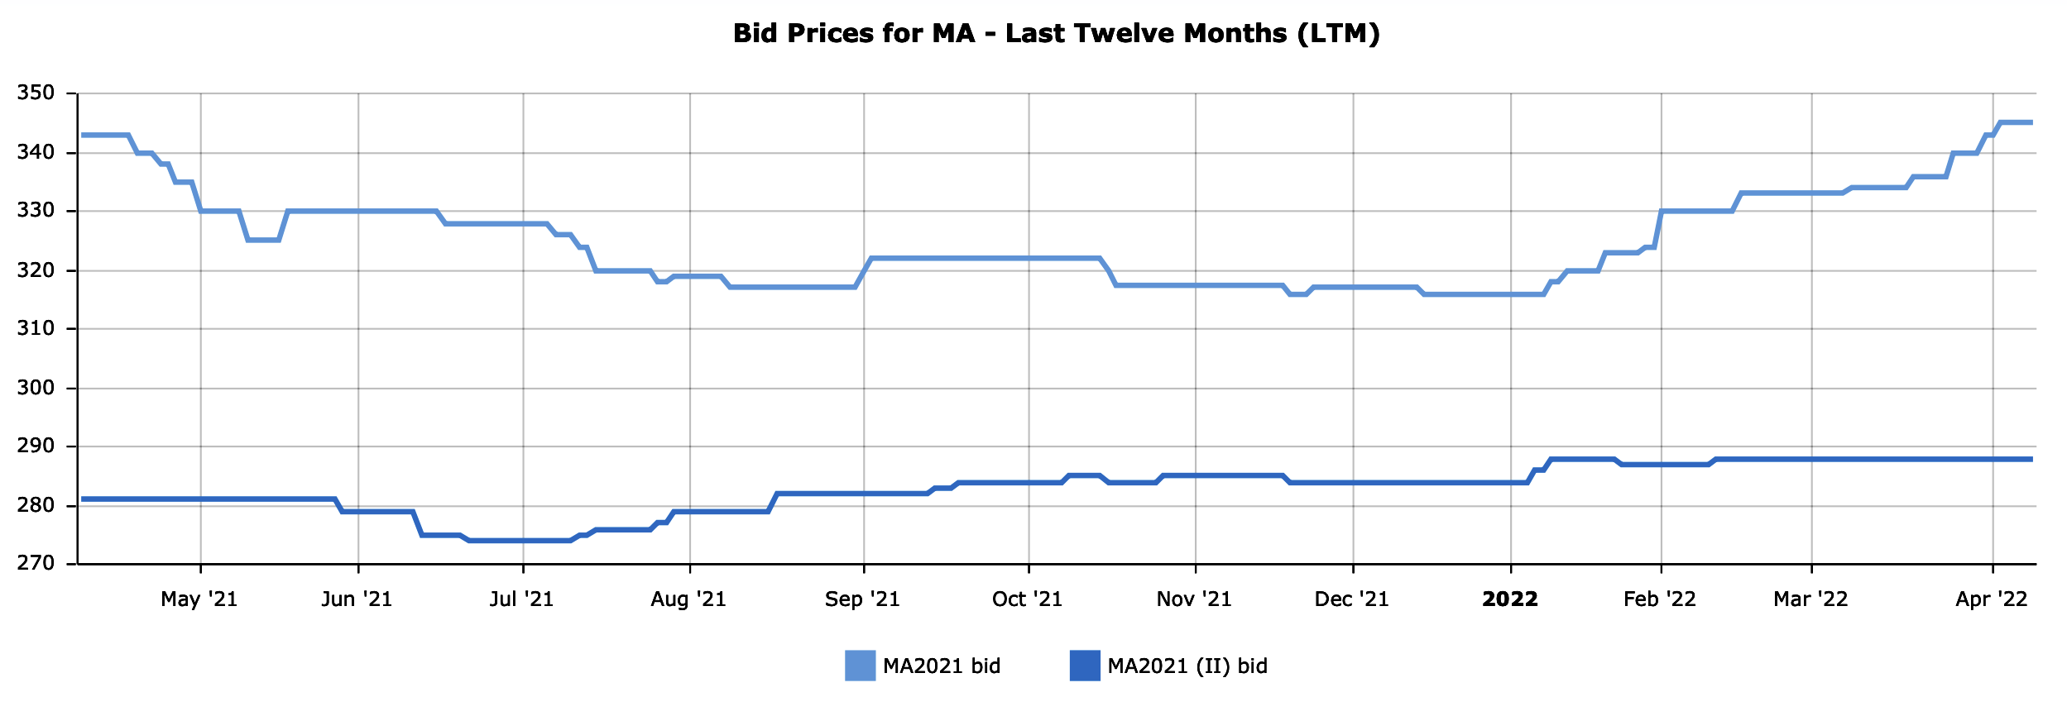
Massachusetts utilities pay solar panel generators $345/MWh (34.5¢/kWh) for solar energy RECs (renewable energy credits).
https://www.srectrade.com/markets/rps/srec/massachusetts

Slide 22
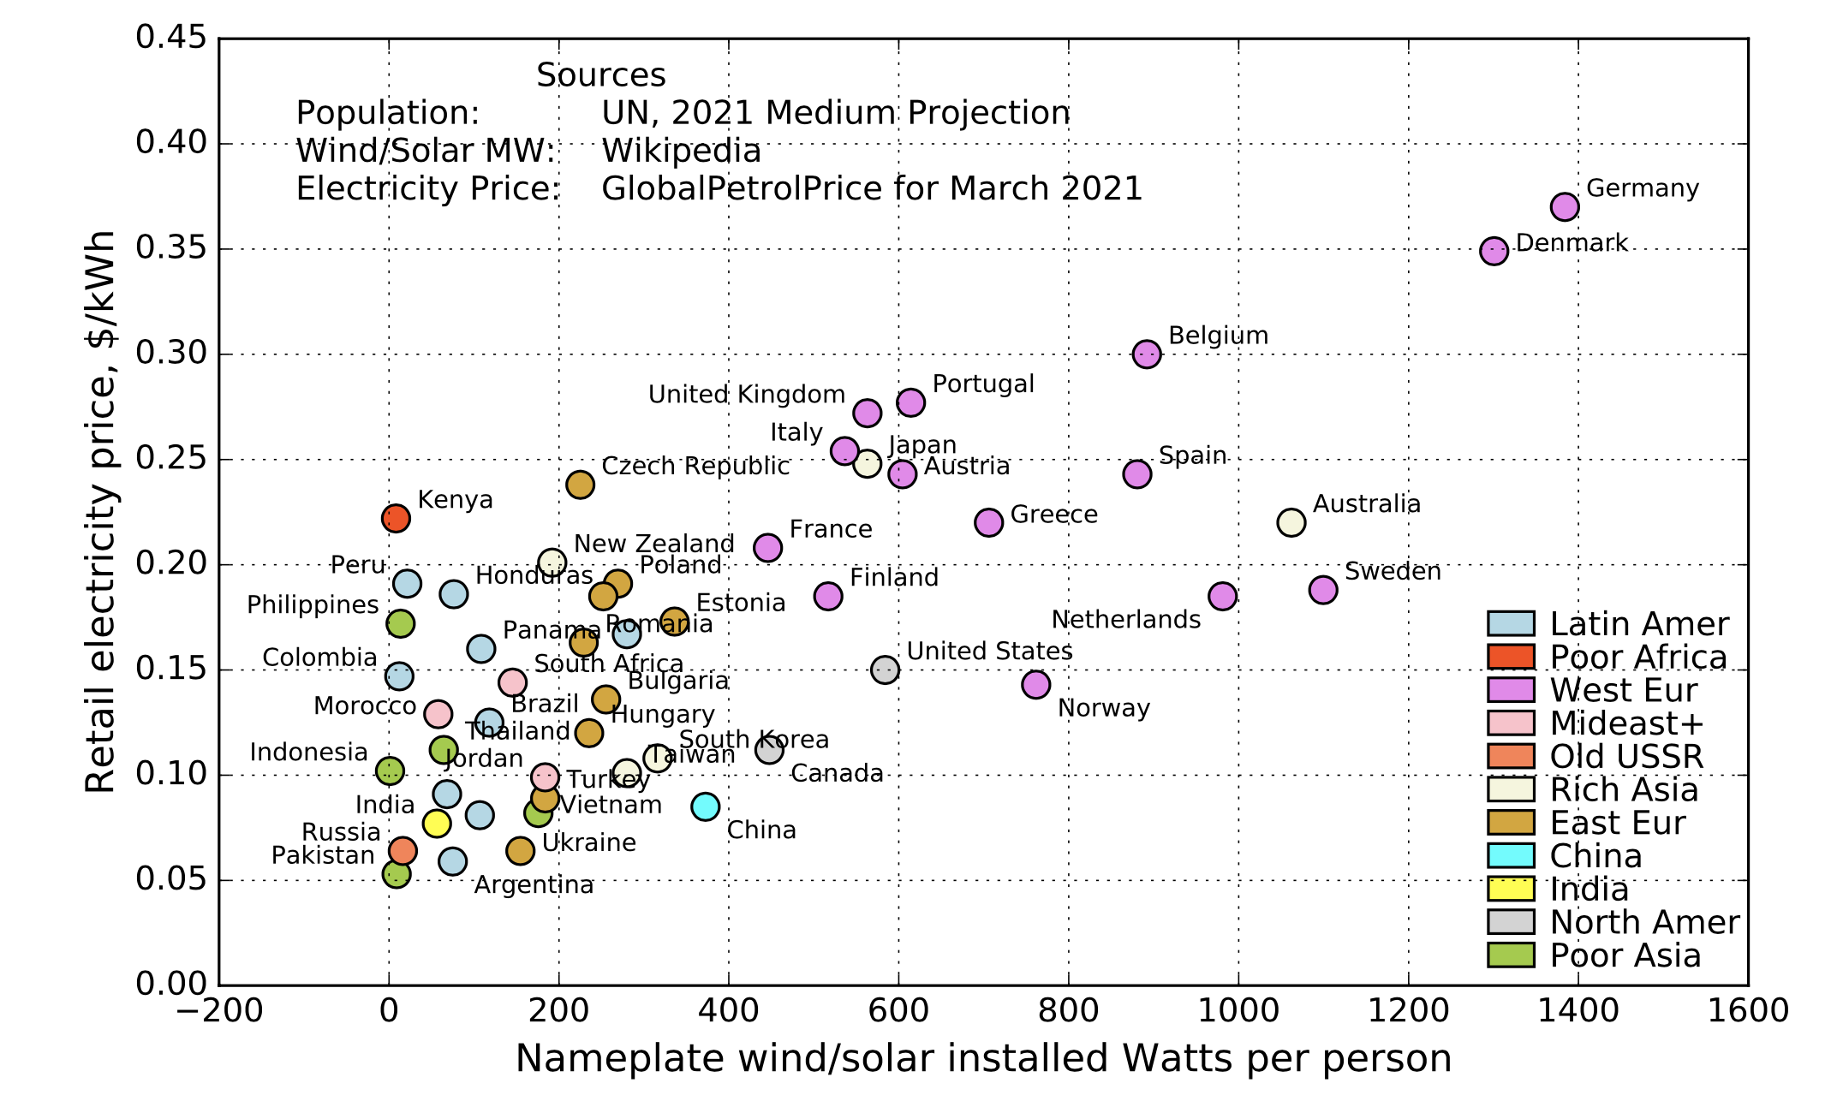
Nations supporting wind/solar doubled electricity prices.
Jack Devanney

Slide 23
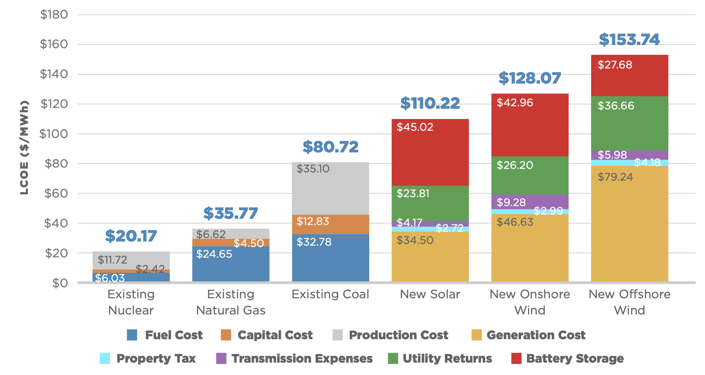
American Experiment analysis of Virginia electricity costs
https://files.americanexperiment.org/wp-content/uploads/2022/02/The-Hgh-Cost-of-the-Virginia-Clean-Economy-Act.pdf

Slide 24
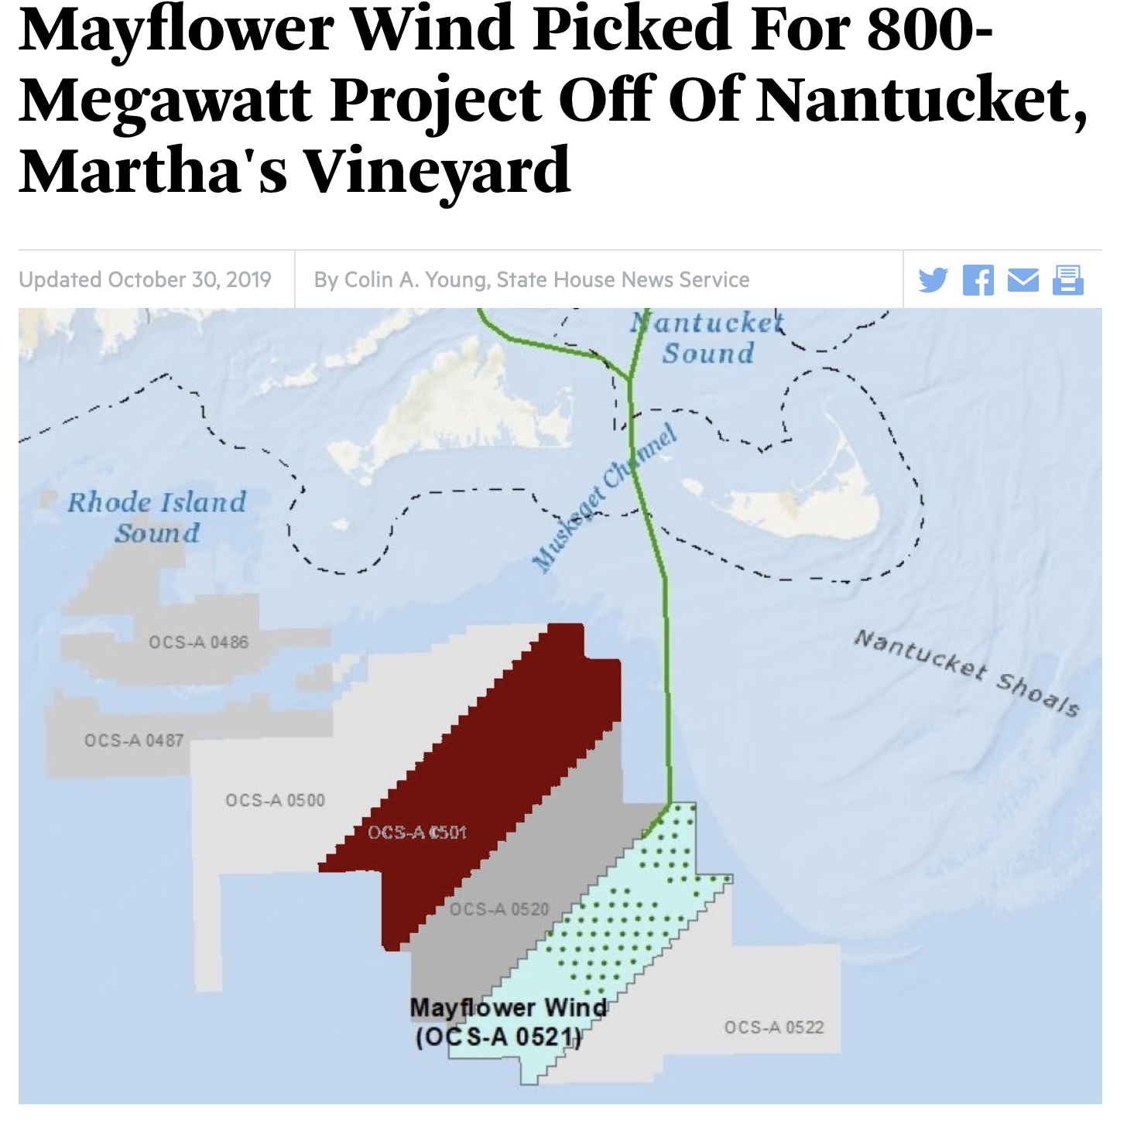
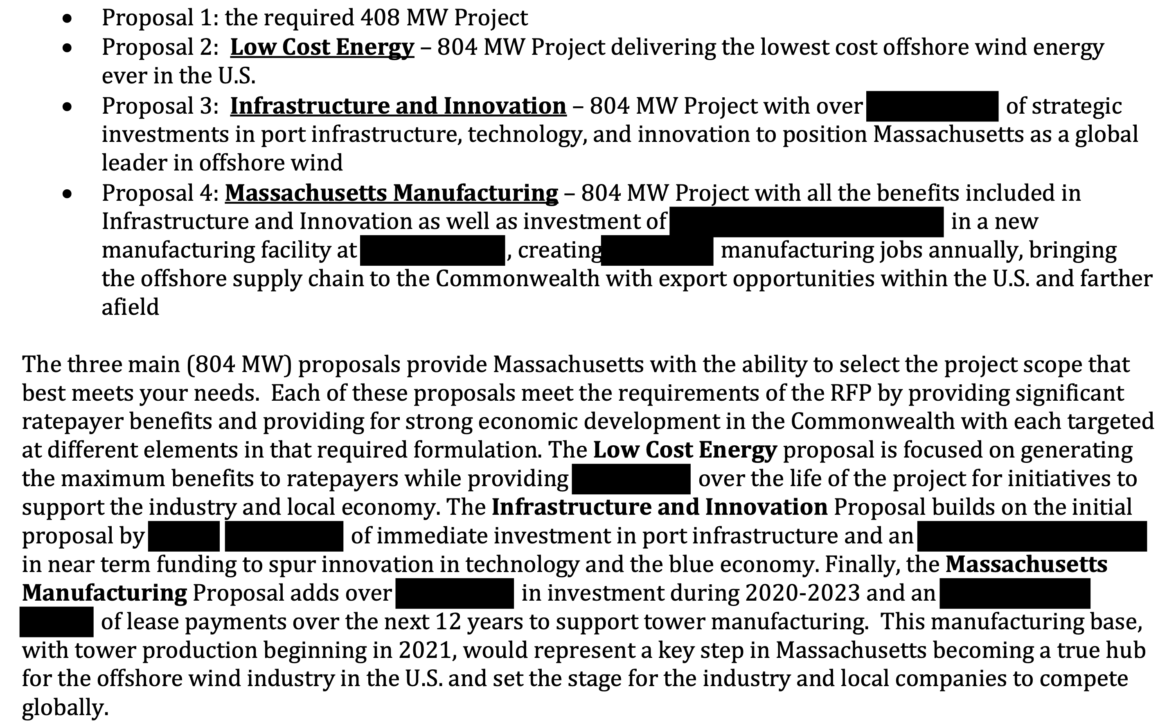
Wind/solar power costs kept secret from public.
https://static1.squarespace.com/static/5cffcb6d97cc59000115fa39/t/5d683e54c6a21e0001f18cc2/1567112815707/Mayflower+Wind+Project+2+%28804MW+Low+Cost+Energy%29_Public+Version.pdf

Slide 25
High capital costs cause high electricity costs.
Rhode Island and Massachusetts state officials picked Deepwater Wind to build a $1.5-billion, 385-megawatt wind farm in federal waters off Block Island.
$1500/385W = $3.90 per watt (of capital cost)
Deepwater signed an agreement with National Grid to sell the power from a $200-million, 30-MW wind farm off Block Island, at an initial price of 24.4 ¢/kWh
$200/30 = $6.67 per watt. Completion update: $13/watt
https://en.wikipedia.org/wiki/Wind_power_in_the_United_States

Slide 26
US wind turbine average capacity factor ~ 1/3.
https://www.nature.com/articles/s41598-020-59936-x

Slide 27
INTERMITTENT wind and solar power generate power ~ 1/3 of the time.
Ad
Each 1 GW of wind or solar is matched by 1 GW of natural gas generation ~ 2/3 of the time.
https://www.ingaa.org/File.aspx?id=30374&v=b0798882
Notes:
https://www.ingaa.org/File.aspx?id=30374&v=b0798882

Slide 28
Wind turbines increase CO2 emissions 44%. (2014)
Scenario: Build full-time CCGT? or on/off NGCT for off/on wind?
Turbine type | Efficiency | Start time | Cost
NGCT natural gas combustion turbine | 29% | 10 min | $700/kW
CCGT combined cycle gas turbine | 60% | 30 min | $1100/kW
1,000 MW(e) power plant alternatives
Power source | Use | Efficiency | Gas burned
Wind turbine with NGCT | 30% | - | -
 | 70% | 29% | 2410 MW(t)
CCGT only | 100% | 60% | 1670 MW(t)
Hargraves THORIUM: energy cheaper than coal
Notes:
Wind does decrease CO2 with hydro backup that can be controlled – not run of the river.
Thee are TWO kinds of NG turbines.

Slide 29
Offshore wind turbines increase CO2 emissions 10%.
Same scenario, 50% wind capacity factor, new 64% CCGT efficiency.
Turbine type | Efficiency | Start time | Cost
NGCT natural gas combustion turbine | 29% | 10 min | $700/kW
CCGT combined cycle gas turbine | 64% | 30 min | $1100/kW
1,000 MW(e) power plant alternatives
Power source | Use | Efficiency | Gas burned
Wind turbine with NGCT | 50% | - | -
 | 50% | 29% | 1720 MW(t)
CCGT only | 100% | 64% | 1565 MW(t)
Notes:
Wind does decrease CO2 with hydro backup that can be controlled – not run of the river.
Thee are TWO kinds of NG turbines.

Slide 30
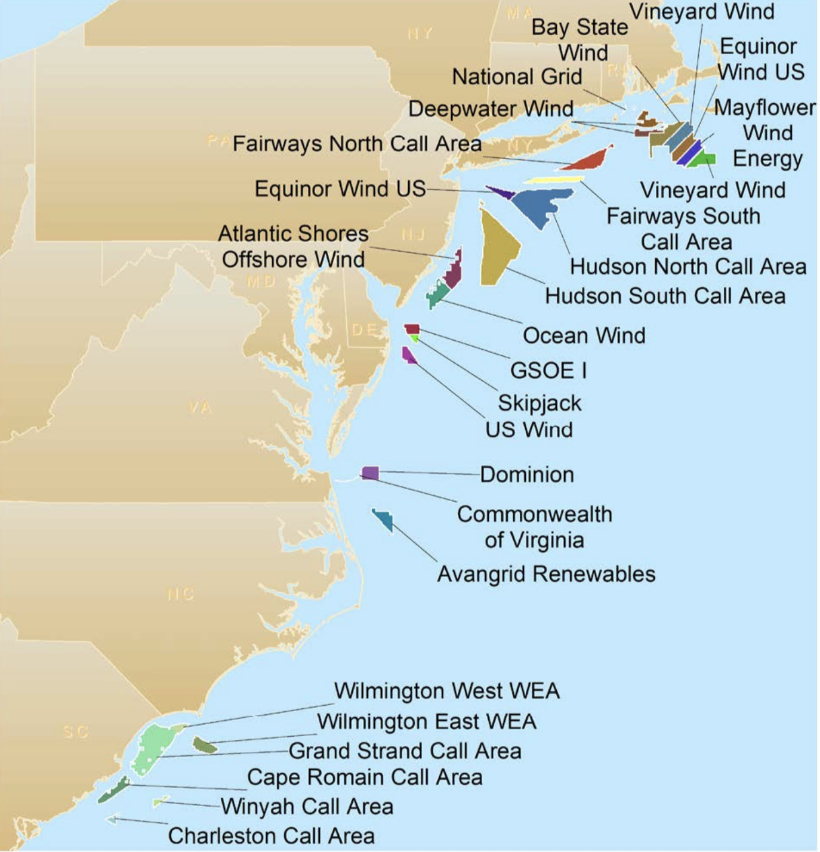
US plans 30 GW offshore wind turbines by 2030.
Only one, 30 MW, project operating in 2022.
Block Island 5 x 6 MW costing $400 million.
$13 million per MW of wind-dependent capacity.
https://www.manhattan-institute.org/lesser-biden-administrations-offshore-wind-fantasy

Slide 31
Robert Bryce: 2018 tax incentives per unit energy produced.
PTC = production tax credit, 2.5¢/kWh; ITC = investment tax credit 1 EJ = 1 exajoule ~ 32 GW-years
https://www.forbes.com/sites/robertbryce/2021/12/27/why-is-solar-energy-getting-250-times-more-in-federal-tax-credits-than-nuclear/?sh=42d0bc6721cf
https://www.energy.senate.gov/services/files/444FFC94-54BC-49BC-85B2-C694194F9232

Slide 32
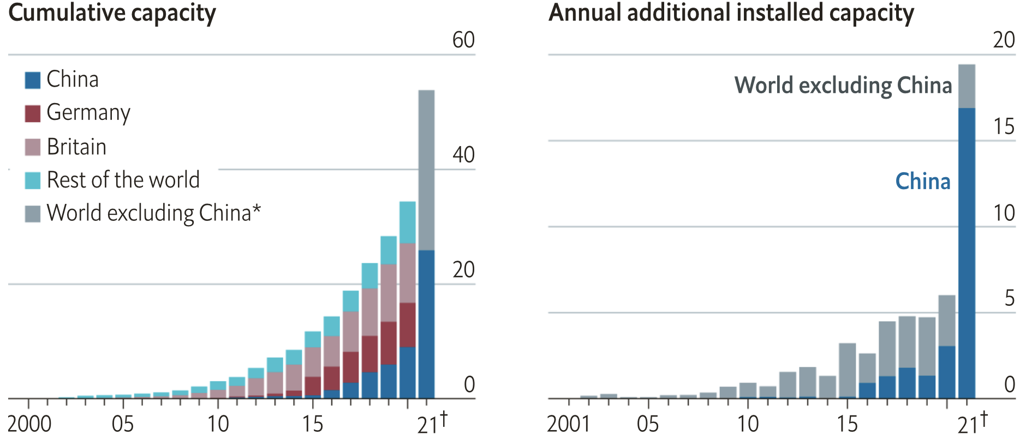
China added 17 GWe of offshore wind capacity in 2021.
References

Slide 33
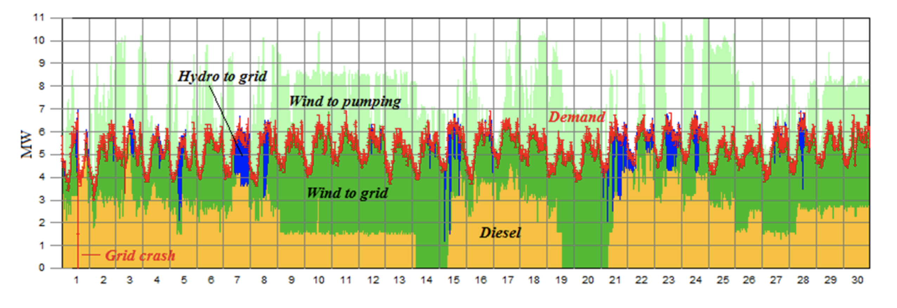
Spain’s El Hierro island attempted 100% renewable power.
Three wind turbines with pumped hydro energy storage.
During 2018 it supplied 57% of El Hierro’s electricity, though only 28% during 4Q 2018.
https://euanmearns.com/tag/el-hierro/

Slide 35
Use batteries to store on/off wind/solar power?
1 DAY of global energy use requires
1 cubic mile of batteries
36 billion Tesla Powerwalls @ 13.5 kWh
Build 1000 per second for 10 years
$250 trillion @ $7,000
$518/kWh of storage

Slide 36
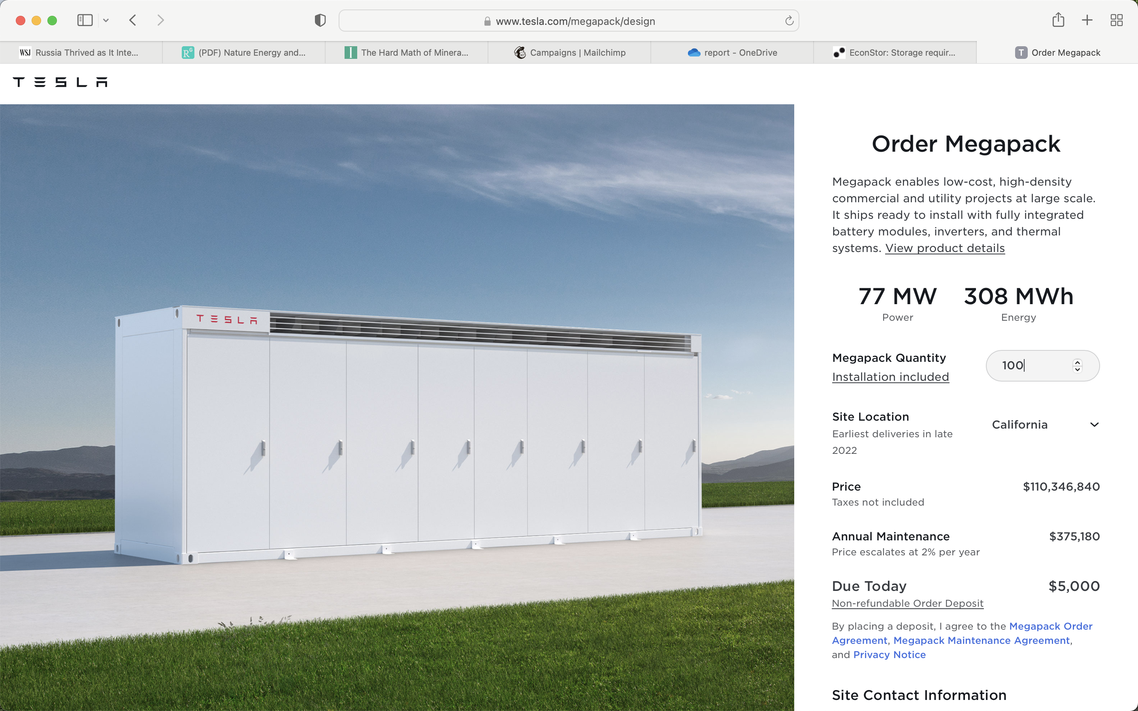
100 Tesla 3100 kWh Megapack batteries cost $358/kWh.
https://electrek.co/2021/07/26/tesla-reveals-megapack-prices/ https://www.tesla.com/megapack/design

Slide 37
“World’s biggest lithium battery storage facility now completely offline after weekend incident.”
100MW/400MWh expansion phase
now joins
300MW/1,200MWh Phase I
in being out of action
https://www.energy-storage.news/worlds-biggest-lithium-battery-storage-facility-now-completely-offline-after-weekend-incident/
https://www.tesla.com/megapack/design

Slide 38
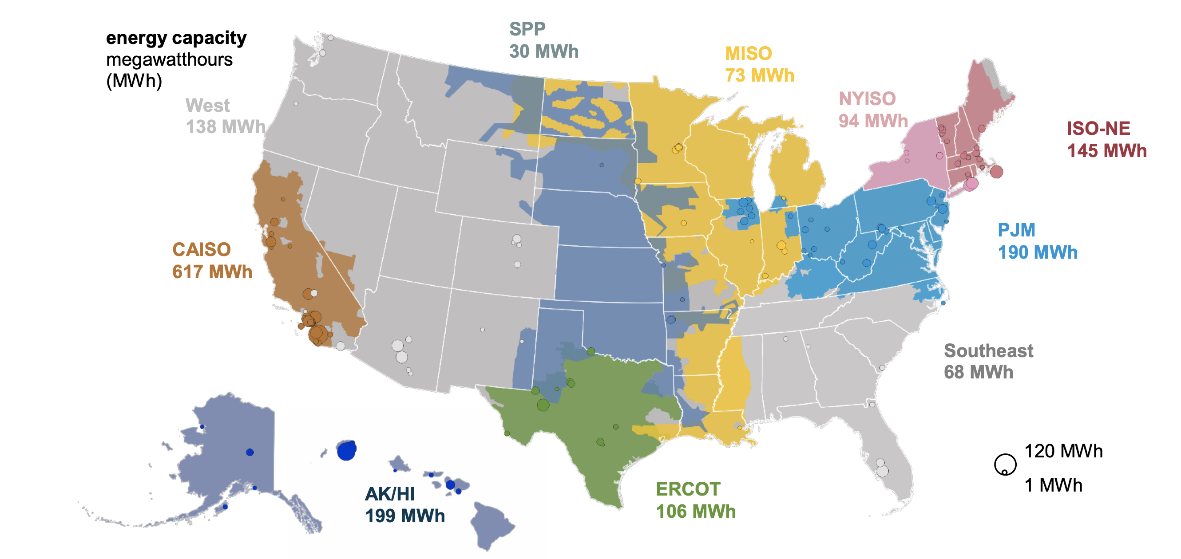
US total battery storage < 2 GWh; @ $589/kWh
https://www.eia.gov/analysis/studies/electricity/batterystorage/pdf/battery_storage_2021.pdf

Slide 39
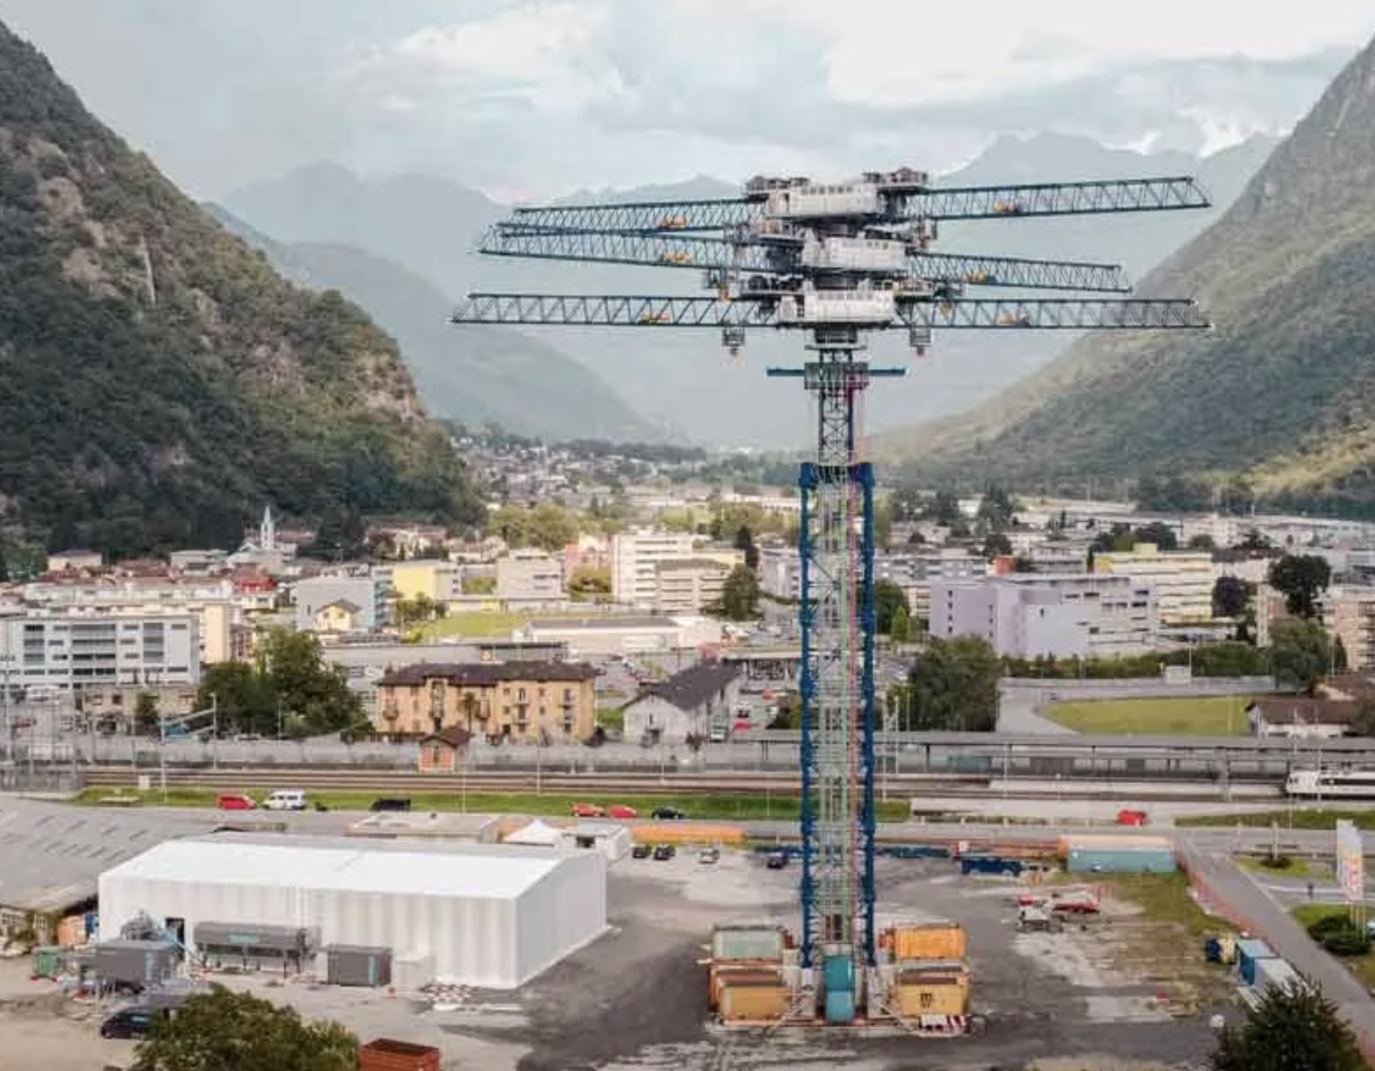
Leonardo DiCaprio? Energy Vault investment smart?
Do the math: F = m x g, E = F x D
Energy Valult raised $230 million.
Lifts 35 tonne blocks to store energy, lowers them to generate elecricity.
Force (neutons) = 9.8 x mass (kg) Joules = Force x 100 meters (lift) kWh = 1000 x 60 x 60 x joules
One lift stores 9.5kWh(e). [50¢ worth]
< $3400 for Tesla@$358/kWh?
4 GWh storage worth $1.4 billion?
https://spectrum.ieee.org/gravity-energy-storage-will-show-its-potential-in-2021
https://www.tesla.com/megapack/design

Slide 40
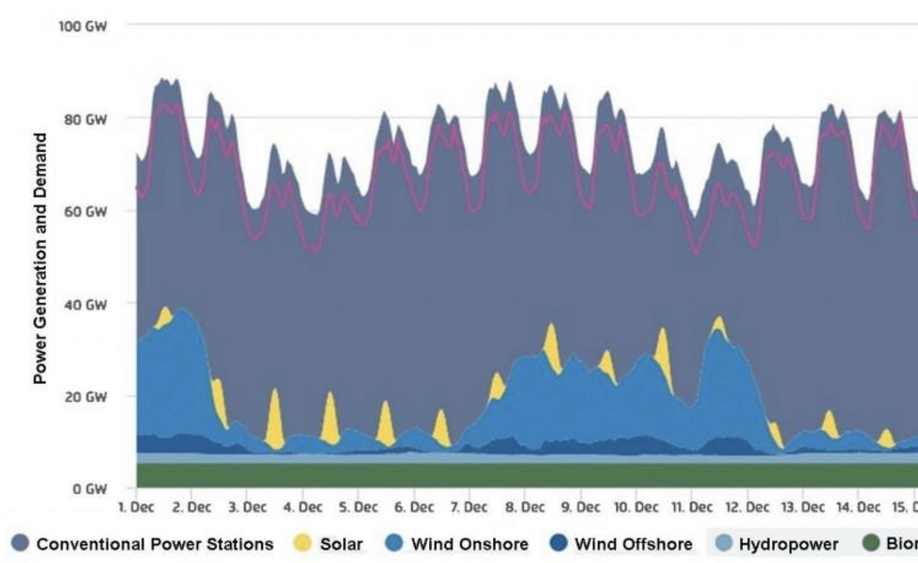
Tripling 33%-capacity-factor wind, solar does not fix lulls. Germany experienced a 100 hour lull, 3-6 Dec 2016.
Wind and solar supplied just 2% of nameplate capacity.
Power sources | GW nameplate | GW delivered
Solar | 41.0 | 0.7
Wind | 47.8 | 1.4
Reliables |  | 68.0
Total |  | 70.0
https://energycentral.com/c/ec/wind-and-solar-energy-lulls-energy-storage-germany

Slide 41
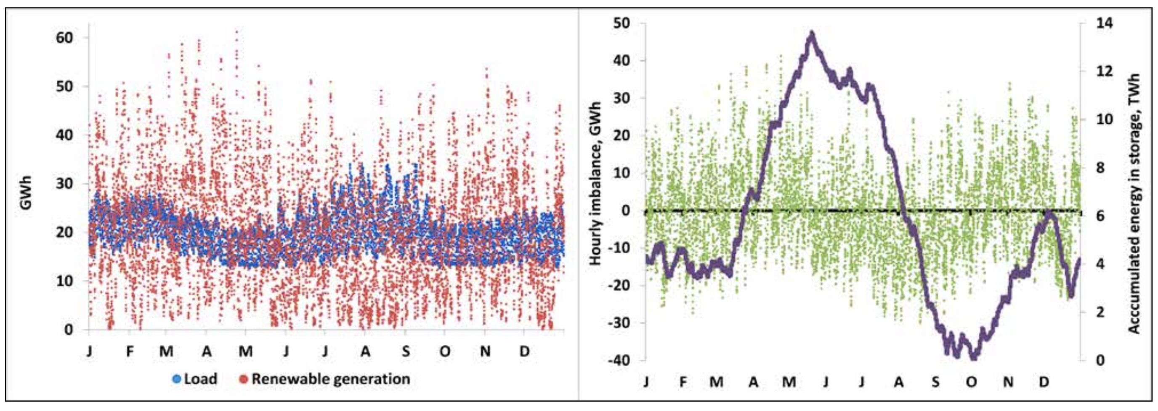
Powering New England with just wind and solar requires 13,000 GW-hours of battery storage, costing $4.7 trillion.
Actual 2018 hourly electricity demand, sun, and wind possible energy
Tesla Megapack batteries @ $358/kWh
13,000 GWh x $358/kWh ~ $4.7 trillion
https://www.nae.edu/File.aspx?id=239123

Slide 42
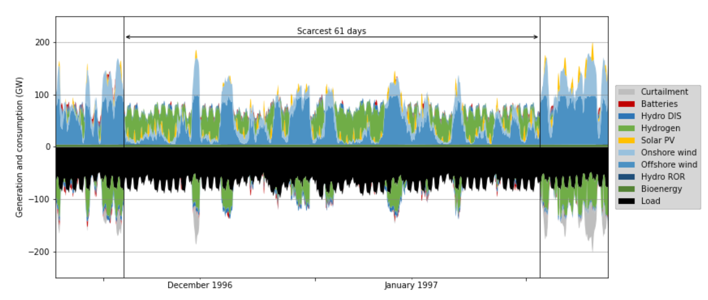
Observed Dunkleflaute needs 24 days of power storage.
Cost-optimized storage, solar, wind. Studied 35 years of hourly German power. Need time between Dunkleflauten to recharge.
https://www.econstor.eu/handle/10419/236723 Ruhnau, Qvist

Slide 43
China monopolized magnet component rare earths, which US dominated in 1990s.
https://doomberg.substack.com/p/not-a-rare-to-spare

Slide 44
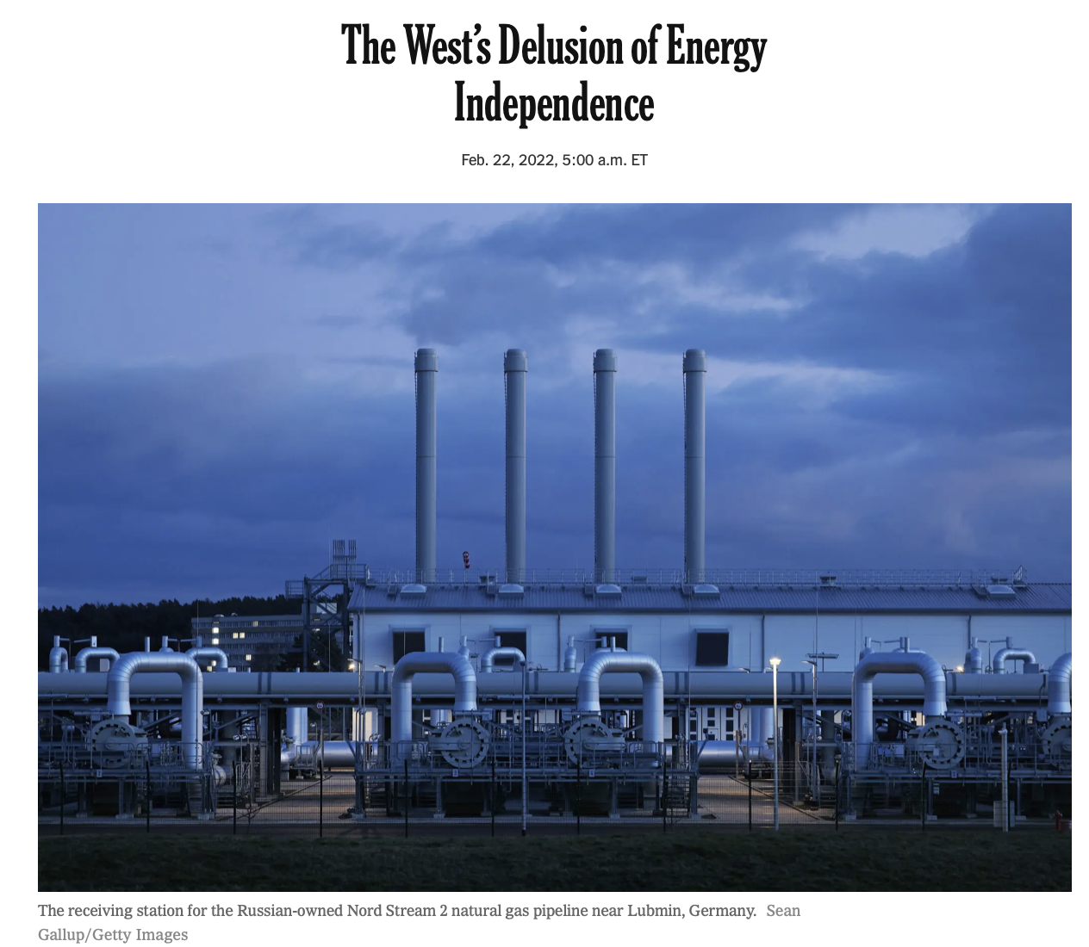
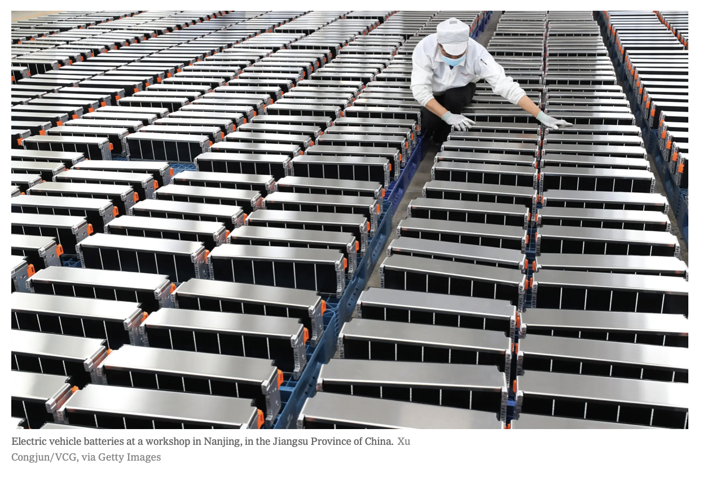
China produces 41% of cathodes and 71% percent of anodes used in EV batteries; the US essentially none of such key components.
https://doomberg.substack.com/p/not-a-rare-to-spare
https://www.nytimes.com/2022/02/22/opinion/russia-ukraine-energy-conflict.html

Slide 45
Materials used per TWh generated, by energy source

Slide 46
IEEE, Vaclav Smil: To Get Wind Power You Need Oil Each wind turbine embodies a whole lot of petrochemicals and fossil-fuel energy
Large trucks bring steel and other raw materials to the site, earth-moving equipment beats a path to otherwise inaccessible high ground, large cranes erect the structures, and all these machines burn diesel fuel. So do the freight trains and cargo ships that convey the materials needed for the production of cement, steel, and plastics.
For a 5-megawatt turbine, the steel alone averages 150 metric tons for the reinforced concrete foundations, 250 metric tons for the rotor hubs and nacelles (which house the gearbox and generator), and 500 metric tons for the towers.
https://spectrum.ieee.org/to-get-wind-power-you-need-oil

Slide 47
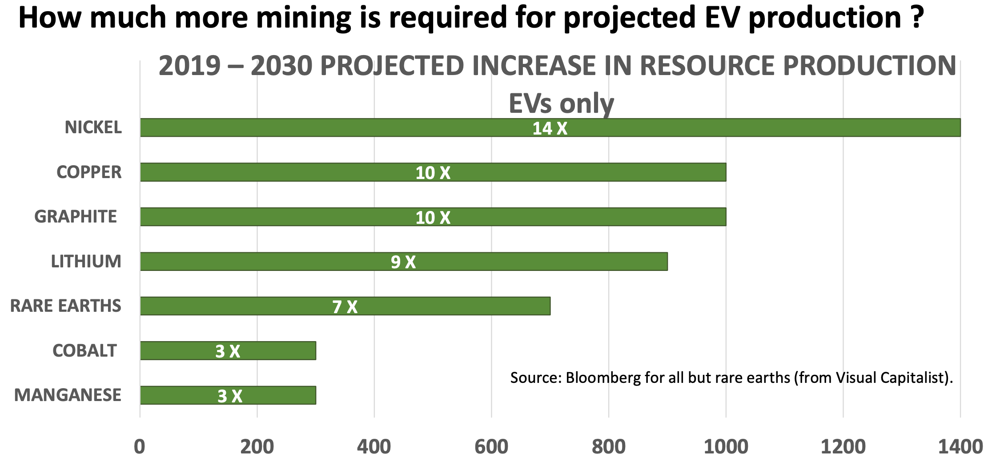
Jim Kennedy projects massive mining increases for EVs.
Presentation by James Kennedy, President of ThREE Consulting 2.25.22

Slide 48
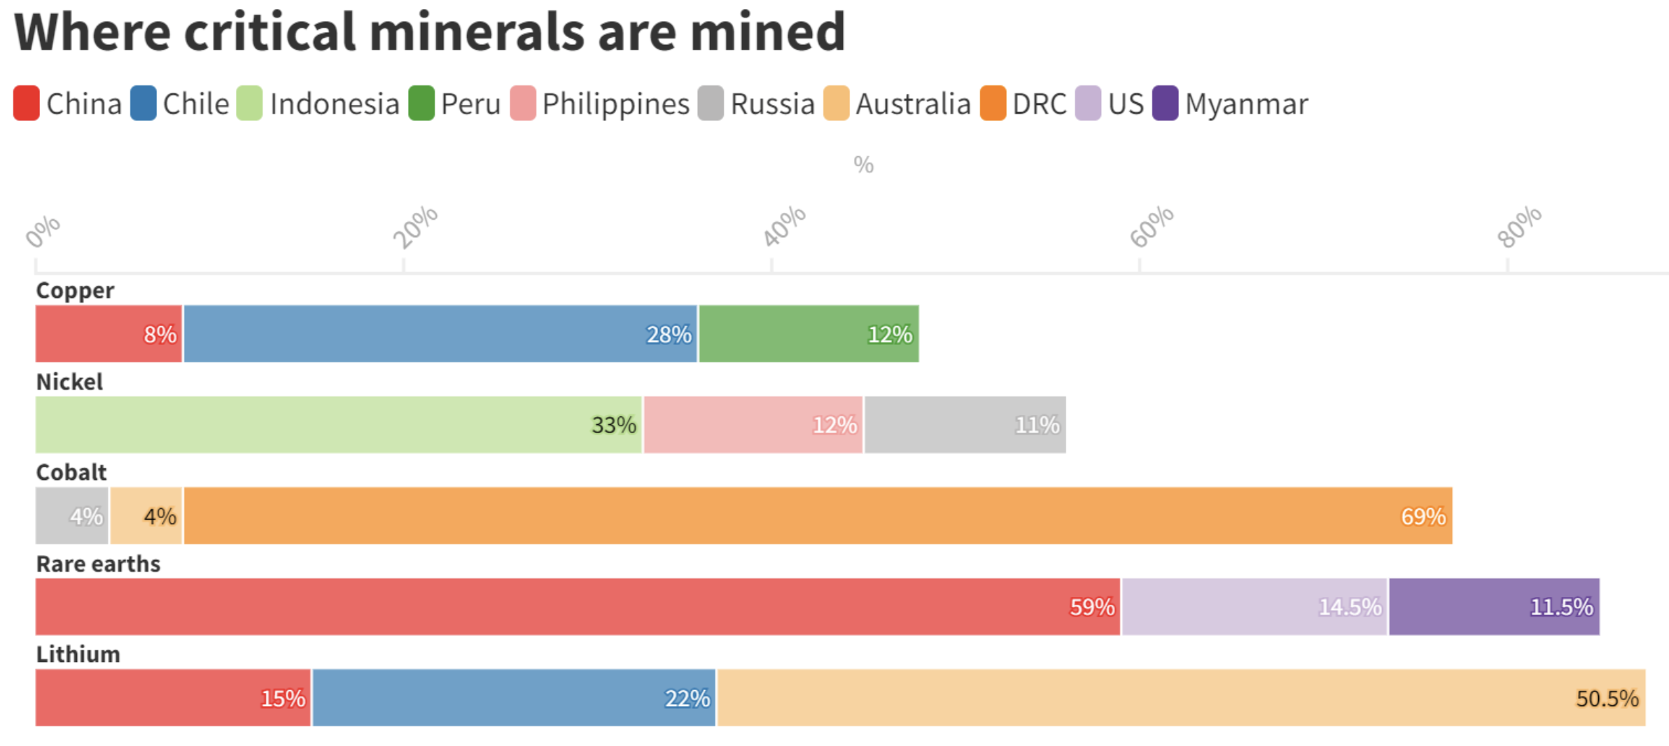
https://energypost.eu/critical-minerals-and-materials-supply-bottlenecks-and-risks-need-international-cooperation/

Slide 49
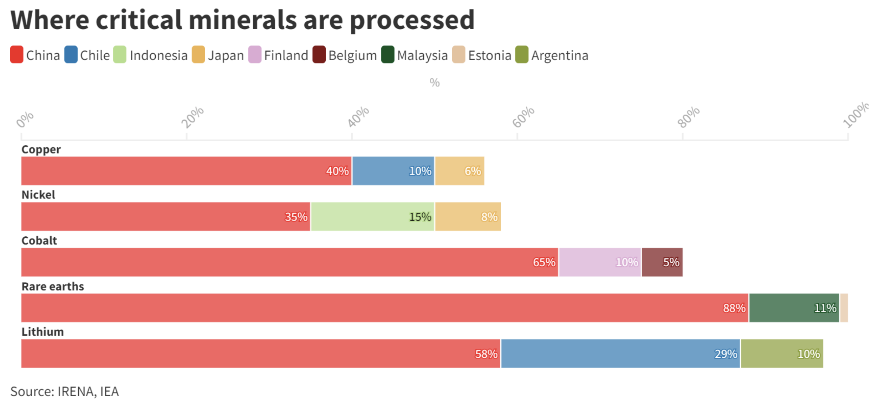
https://energypost.eu/critical-minerals-and-materials-supply-bottlenecks-and-risks-need-international-cooperation/

Slide 50
German documentary on mining impact
https://www.youtube.com/watch?v=CqSqNIsC04g

Slide 51
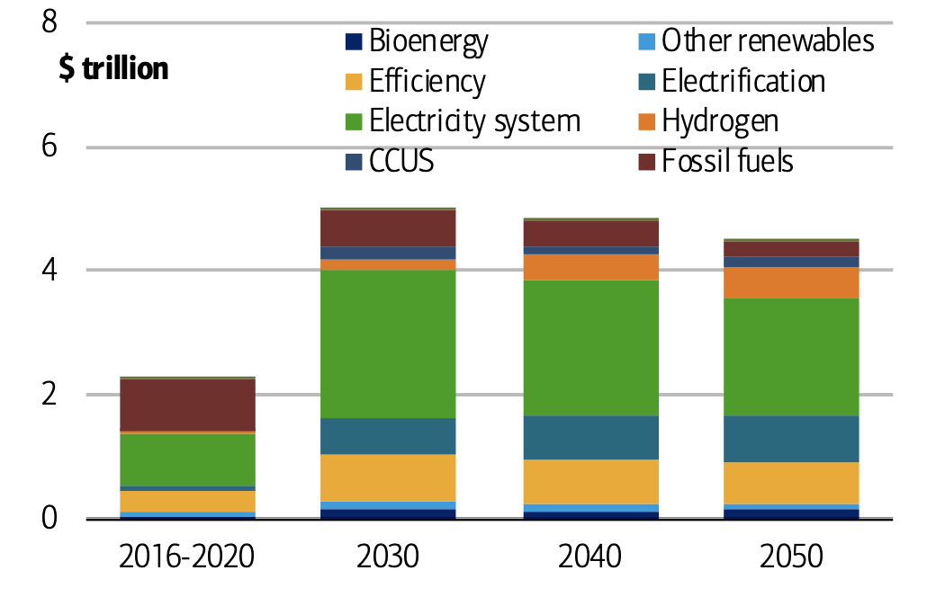
BofA: Green energy transition costs $5 trillion/yr x 30 yrs.
“Even in global terms and over a 30-year span, $150 trillion is a gargantuan amount.
The latter number is almost twice the total global GDP in 2019…”
https://news.yahoo.com/fighting-climate-change-a-150-trillion-battle-bank-of-america-report-163422676.html
Note: no fission power.
Source: International Energy Agency (2021), Net Zero by 2050, IEA, Paris
https://business.bofa.com/content/dam/boamlimages/documents/articles/ID21_1543/Net_Zero_Redacted_Note_Updated_Final.pdf

Slide 52
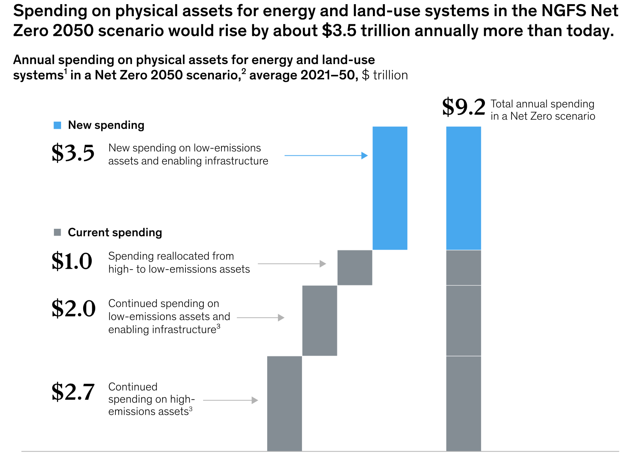
McKinsey: $9.2 trillion/yr including ongoing capital spending.
https://www.mckinsey.com/business-functions/sustainability/our-insights/the-economic-transformation-what-would-change-in-the-net-zero-transition

Slide 53
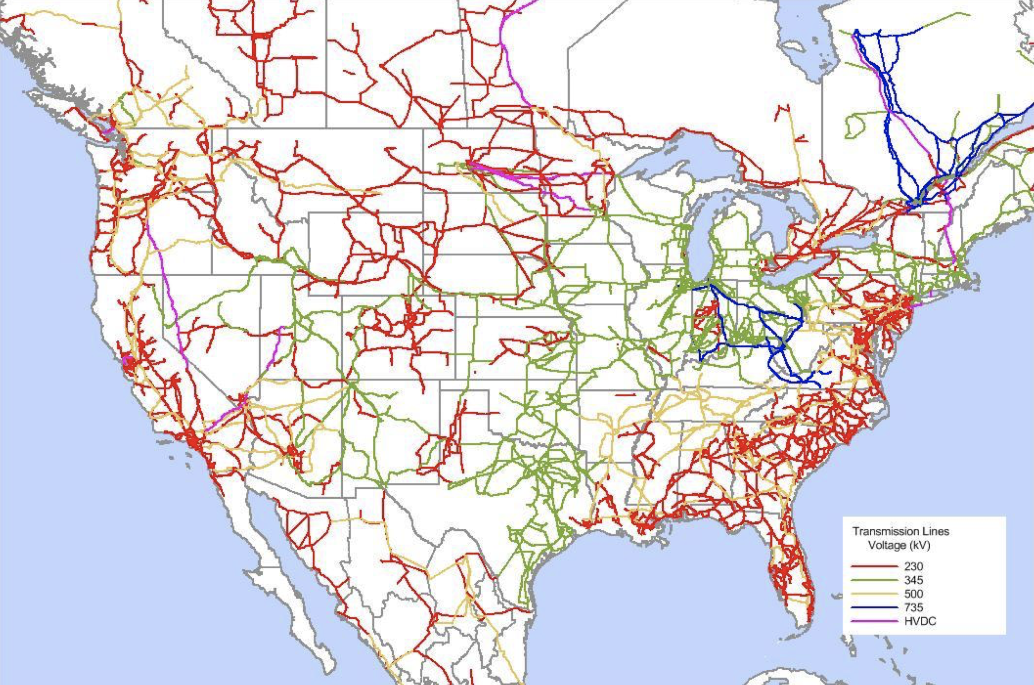
US transmission, 230 kV and above
https://www.ncsl.org/documents/energy/ASilverstein4-20-11.pdf

Slide 54
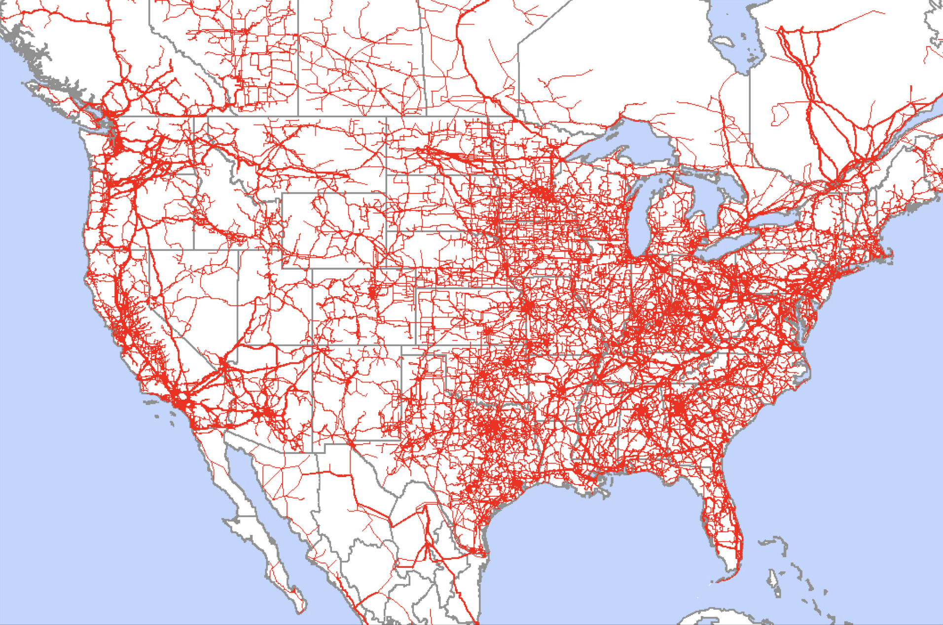
US transmission, 69 kV and above
https://www.ncsl.org/documents/energy/ASilverstein4-20-11.pdf

Slide 55
Elon Musk's Boring Company might overcome right-of-way barriers to transportation and power.
$10 million per mile
build 1 mile/week
goal: 7 miles/day
https://www.boringcompany.com

Slide 56
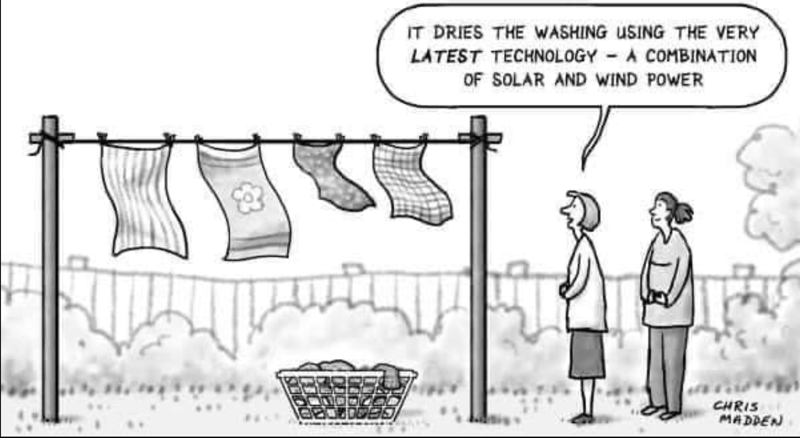
https://www.facebook.com/HeinleinSociety/photos/a.881625528546480/6997567896952182/?type=3

Slide 57
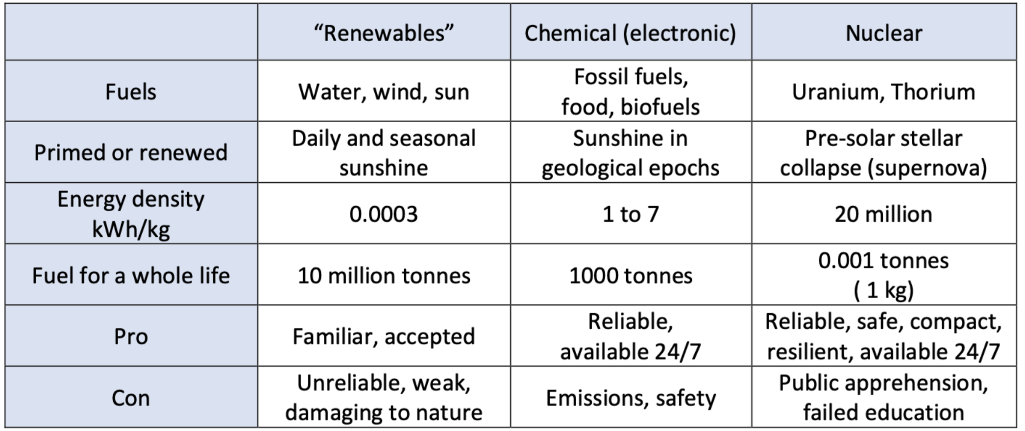
Wade Allison: Energy options facing society today
Adam Smith: “Science is the great antidote to the poison of enthusiasm and superstition.”
https://www.researchgate.net/publication/339629356_Nature_Energy_and_Society_A_scientific_study_of_the_options_facing_civilisation_today

Slide 58
5 Wind and solar
CO2 quantities
Cubic mile of oil
Wind and solar costs
Capacity factor
Natural gas dependency
Intermittency
Materials mining
Fission is in Fashion

