Slide 1
4 Energy economics
Value of energy to civilization
Thermodynamics and economy
Systems, entropy, exergy
Energy return on investment
GDP = f { capital, labor, energy}
GDP, energy, happiness
Cheap energy: the only answer
Fission is in Fashion

Slide 2
Energy Realism
Energy IS the economy. $1 GDP demands ~1.5 kWh heat, ~0.2 kWh electricity.
Earth’s carbon battery supplies the energy that enabled our civilization.
Harvesting fossil fuels is becoming more energy intensive, so more economic productivity (GDP) is being diverted to obtaining the needed energy.
The energy return on invested energy (EROI) from wind, solar, and storage is too low to sustain our civilization.
Burning fossil fuels releases CO2 that exacerbates global warming.
Fission-sourced energy can power the world for centuries.

Slide 3
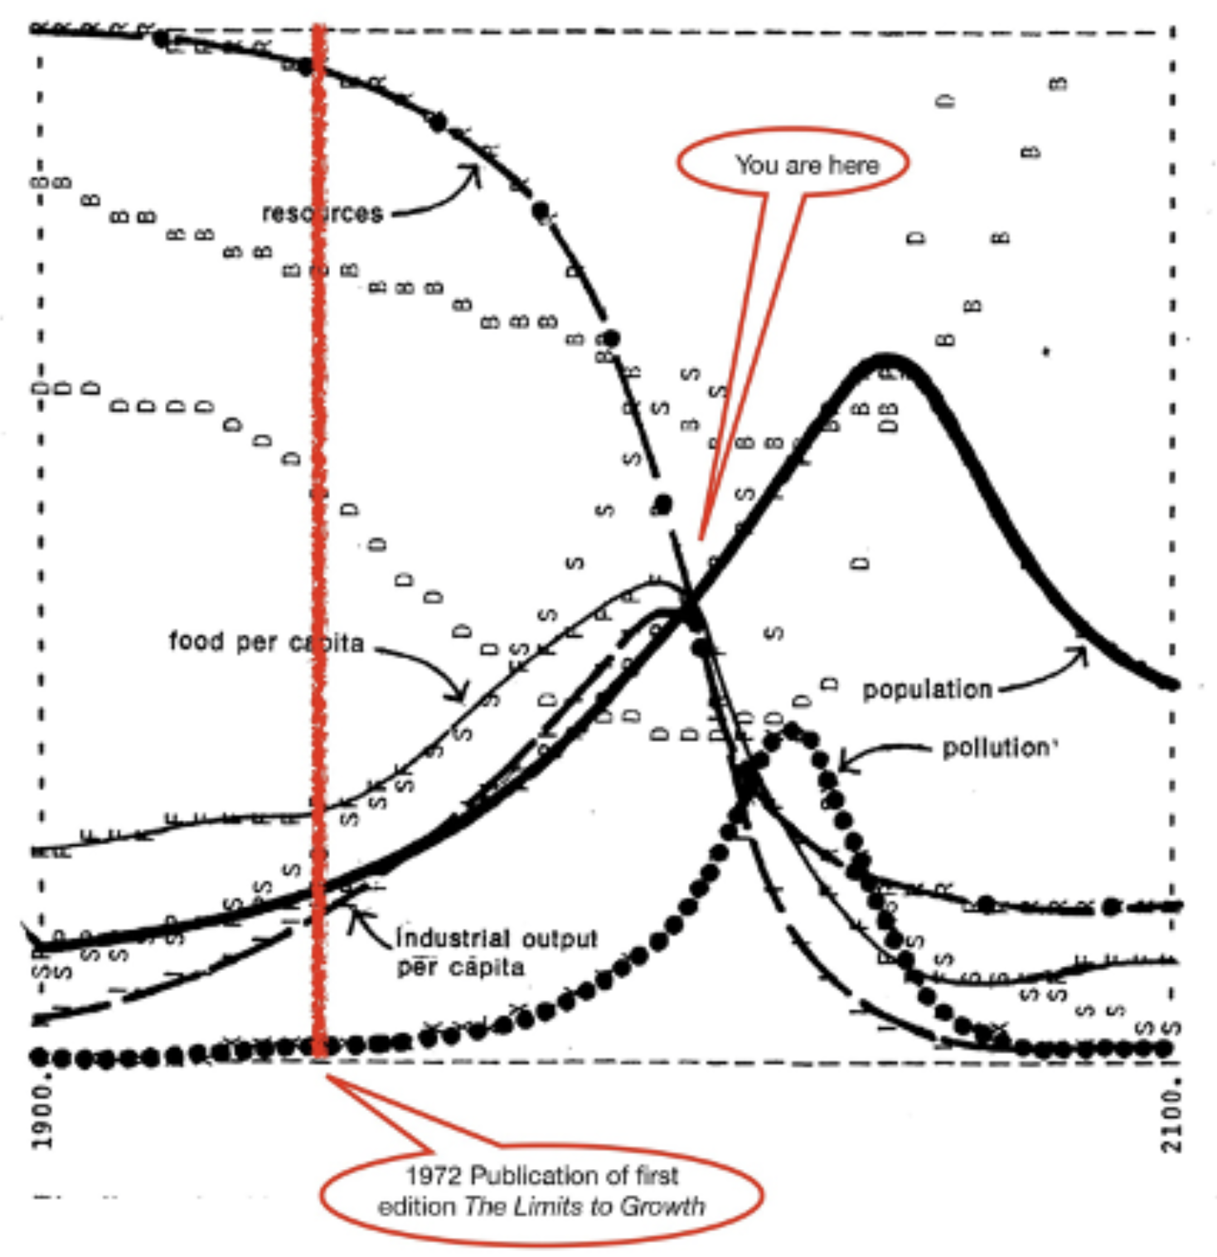
March 2022 50th anniversary of Club of Rome Limits to Growth
Dennis Meadows of MIT and Dartmouth used system dynamics to model the earth’s resources, industry, food, population, etc
https://www.thegreatsimplification.com/episode/12-dennis-meadows

Slide 4
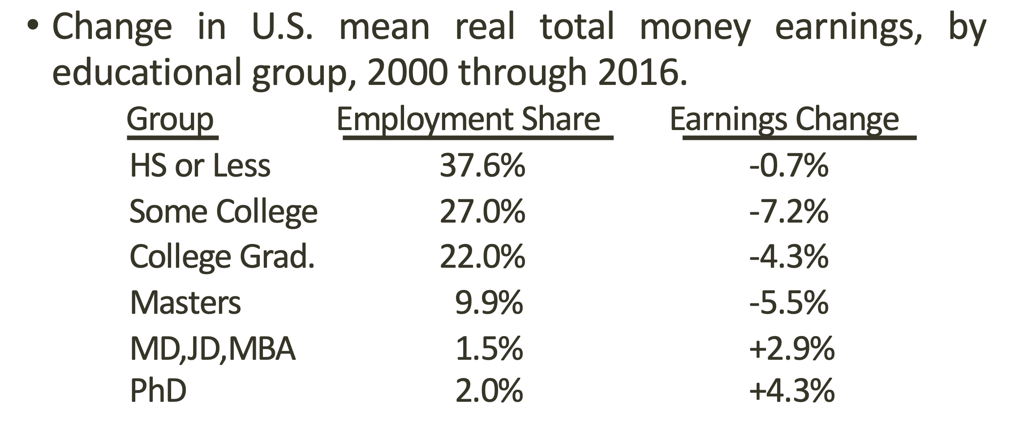
Real income is dropping for 96.5% of US earners. Why?
Matthew J. Slaughter, Osher at Dartmouth, July 15, 2021

Slide 5
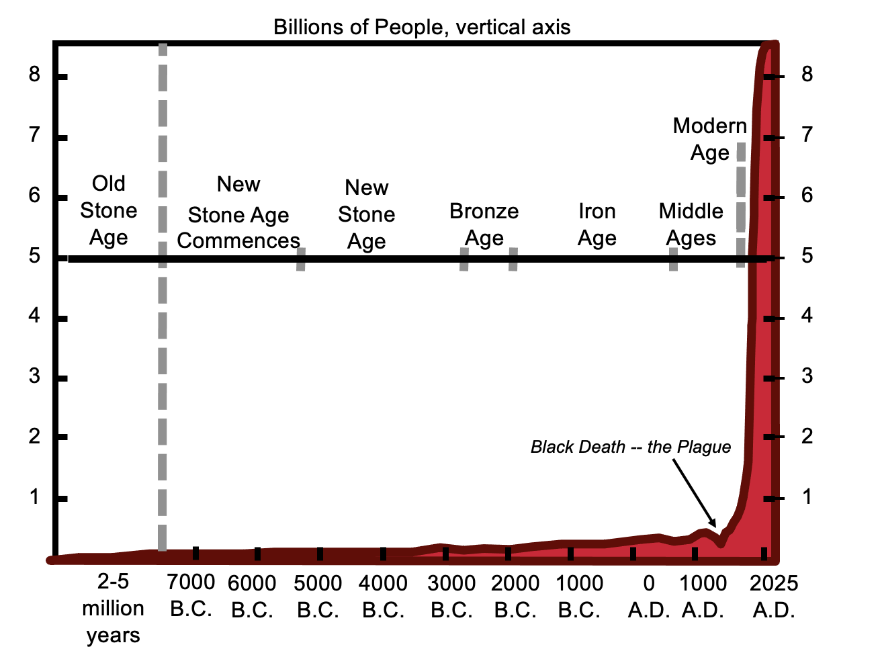
What's the value of energy to civilization?
Ayres INSEAD lecture #3

Slide 6
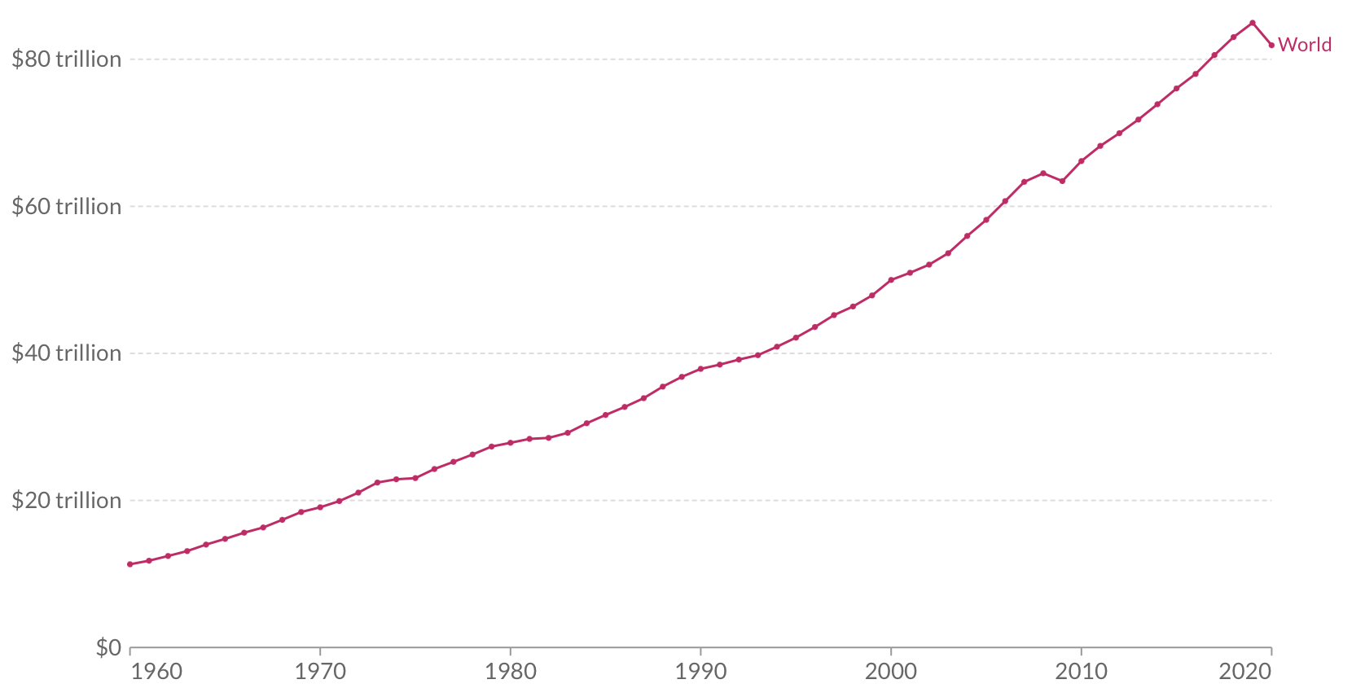
Gross world product (World GDP) (US dollars)
https://ourworldindata.org/grapher/gross-domestic-product?tab=chart&country=~OWID_WRL

Slide 7
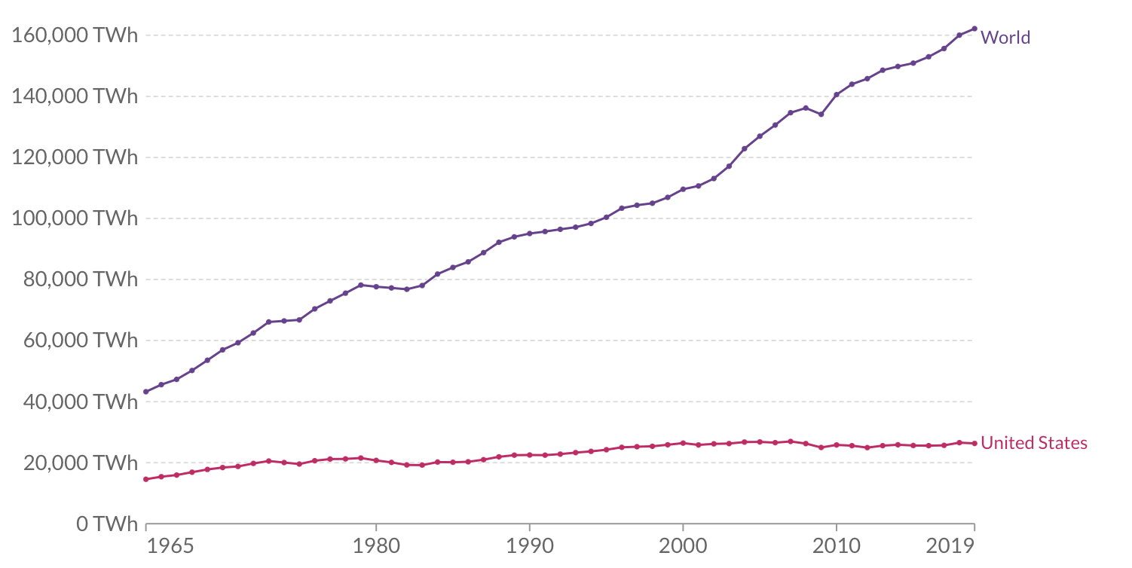
World energy consumption, per year (thermal, primary, heat energy)
(160,000 TWh/year ~ 18,000 GW)
https://ourworldindata.org/energy-production-consumption

Slide 8
World energy consumption, per year (thermal, primary, heat energy)
(160,000 TWh/year ~ 18,000 GW)
Q: Why is US energy consumption flat?
A: Outsourcing energy-intensive industries
https://ourworldindata.org/energy-production-consumption

Slide 9
Overlay world GDP on world energy…
(160,000 TWh/year ~ 18,000 GW)
https://ourworldindata.org/energy-production-consumption

Slide 10
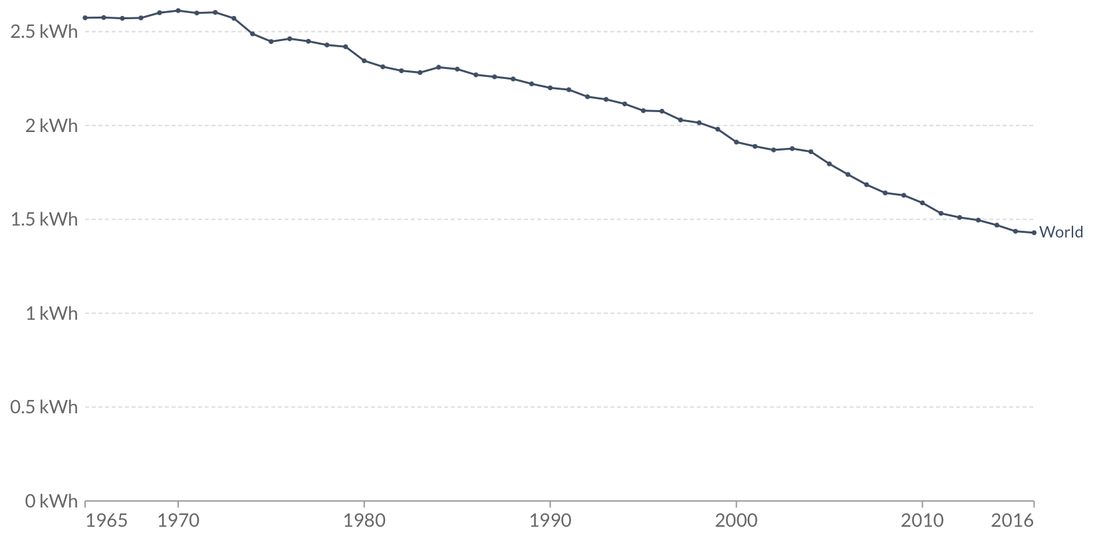
World energy intensity, kWh/$ ($-2011, PPP)
Estimate each $1 of GDP demands 1.5 kWh(t) energy.
https://ourworldindata.org/grapher/energy-intensity?tab=chart&country=~OWID_WRL

Slide 11
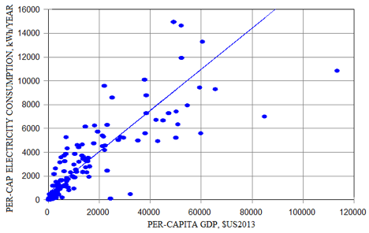
Each $1 of GDP demands ~ 0.2 kWh electric energy.
$GDP vs kWh/yr
per capita
each dot a nation
Sources
http://euanmearns.com/electricity-and-the-wealth-of-nations/
Robert Ayres and Benjamin Warr, The Economic Growth Engine: How Energy and Work Drive Material Prosperity (The International Institute for Applied Systems Analysis)
$4-6 GDP
per
1 kWh
Notes:
Assume 90% capacity factor
http://euanmearns.com/electricity-and-the-wealth-of-nations/ , also see
The Economic Growth Engine: How Energy and Work Drive Material Prosperity (The International Institute for Applied Systems Analysis)

Slide 12
Summary: Each $1 of GDP demands ~1.5 kWh(t) heat energy, and ~0.2 kWh(e) electric energy.
https://ourworldindata.org/grapher/energy-intensity?tab=chart&country=~OWID_WRL

Slide 13
Laws of Thermodynamics and the Economy Dan O’Neill
https://www.youtube.com/watch?v=h6Clz8DQvIk&t=1sReferences

Slide 14
Laws of Thermodynamics and the Economy
Dan O’Neill
https://www.youtube.com/watch?v=h6Clz8DQvIk

Slide 15
1st law of thermodynamics: conservation of energy
https://www.youtube.com/watch?v=h6Clz8DQvIk&t=1sReferences

Slide 16
2nd Law of Thermodynamics
https://www.youtube.com/watch?v=h6Clz8DQvIk&t=1sReferences

Slide 17
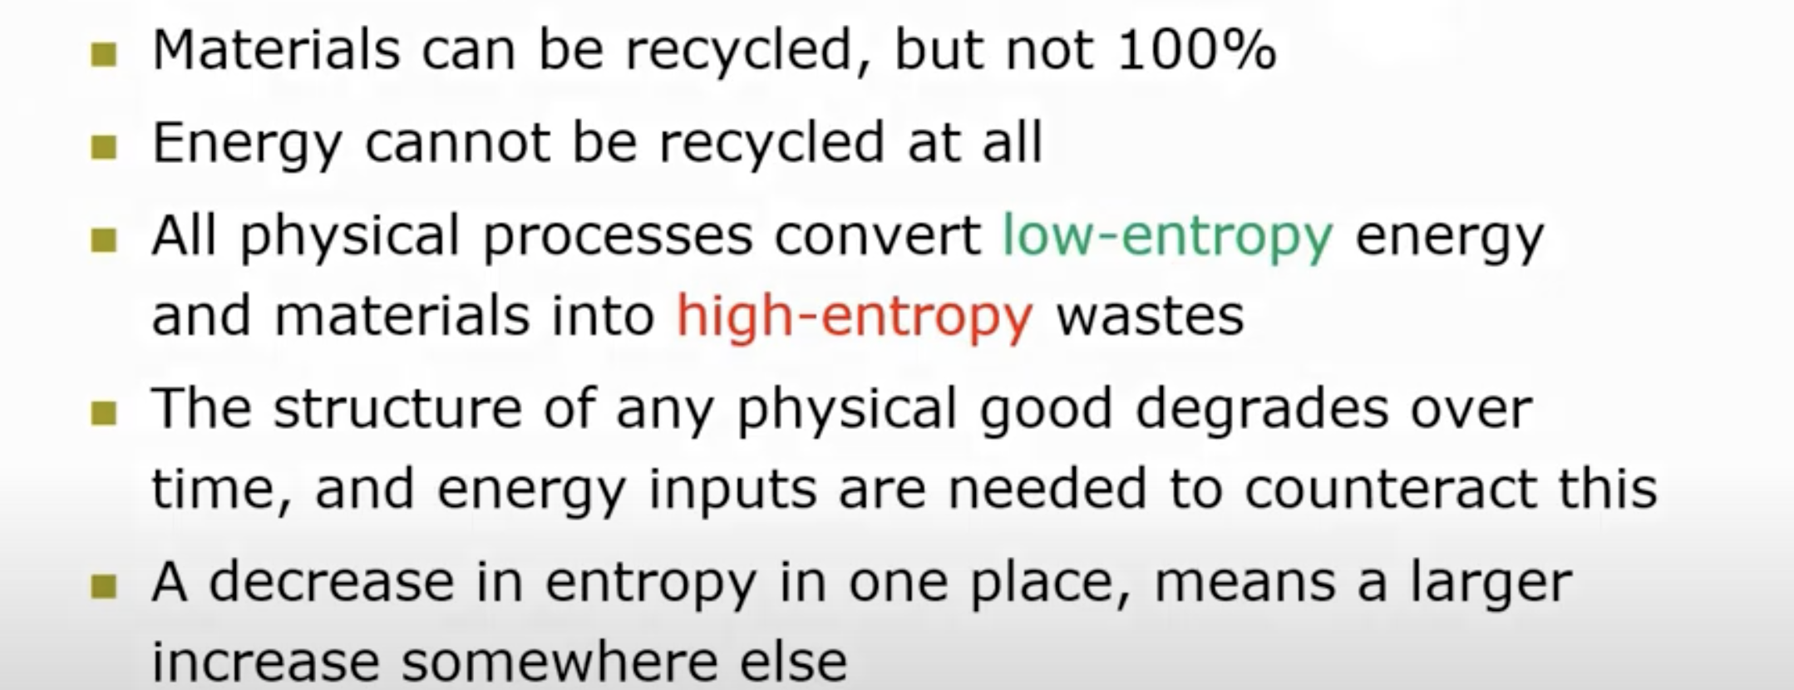
Implications of 2nd Law of Thermodynamics
https://www.youtube.com/watch?v=h6Clz8DQvIk

Slide 18
Natural systems
Isolated, physical systems drive to the lowest equilibrium energy state. Example: rock falling, hot and cold water mixing.
Natural systems are in disequilibrium. Matter and energy may flow in and out. Example: organism.
Natural systems may be in steady state disequilibrium.
Natural systems are sustained by external energy sources.
How to build a habital planet

Slide 19
Thermodynamic of the economic system
https://www.youtube.com/watch?v=h6Clz8DQvIk&t=1sReferences

Slide 20
Energy and Economic Growth (starring Exergy and EROI)
https://www.youtube.com/watch?v=Opkc3UUfdz4&t=315s

Slide 21
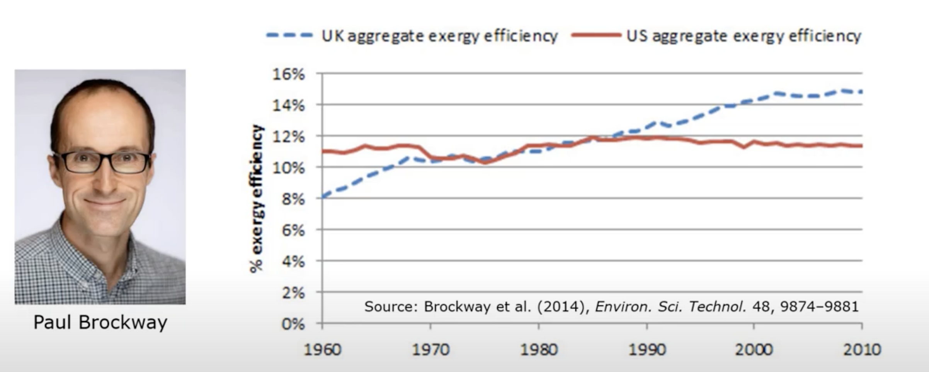
The exergy growth cycle may be weakening.
eg: CC gas turbine 62% efficiency approaches Carnot’s limit.
References

Slide 22
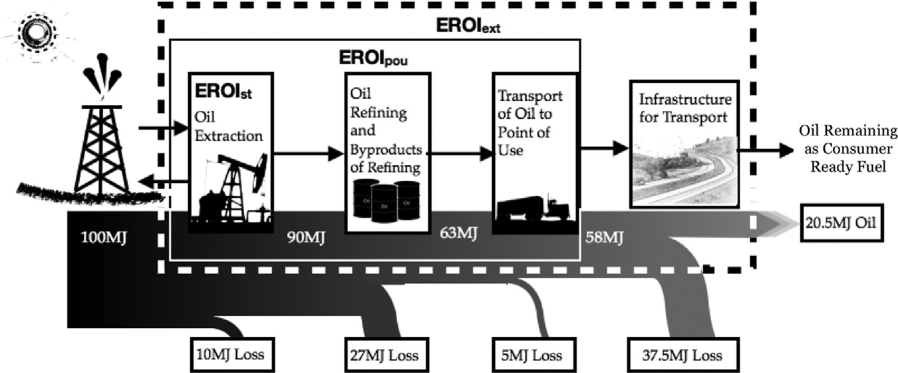
EROI example: Invest 79.5 MJ to get 20.5 MJ to consumer use.
Oil’s 100 MJ is “free”, created from sunlight 100 million years ago.
References

Slide 23
Society’s discretionary investment and consumption high.
References

Slide 24
Society’s discretionary investment and consumption low.
References

Slide 25
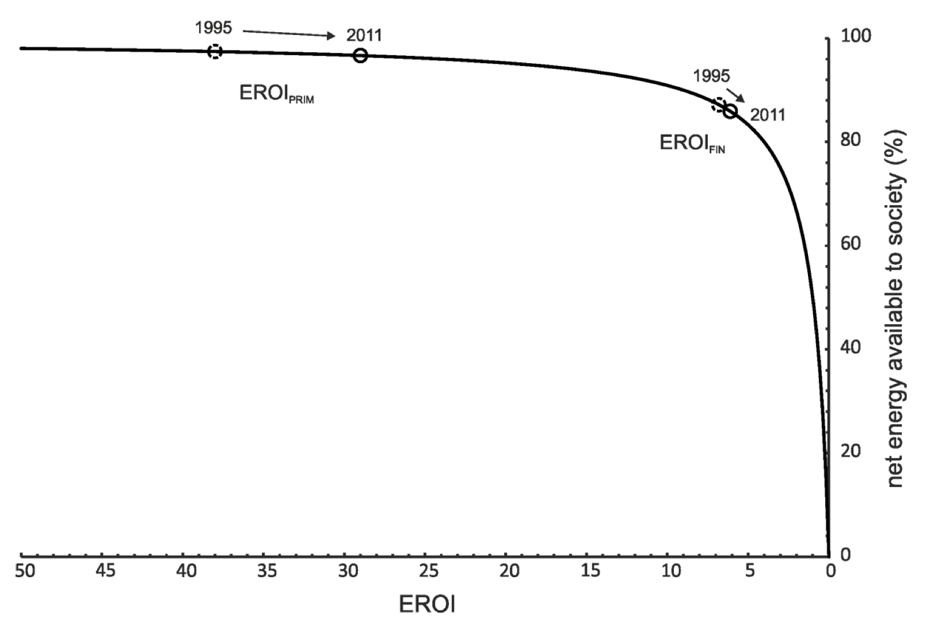
As EROI declines, less useful energy is available to society.
https://eprints.whiterose.ac.uk/148748/1/2019_05_22_EROI-2_Author_accepted_manuscript.pdf

Slide 26
Hall: EROI from oil sources is declining.
Discovering oil | 1000:1 1919 | 5:1 2010
Producing oil | 25:1 1970s | 10:1 2007
Shale oil |  | 7:1 2012
Tar sands |  | 4:1 2012
https://www.sciencedirect.com/science/article/pii/S0301421513003856

Slide 27
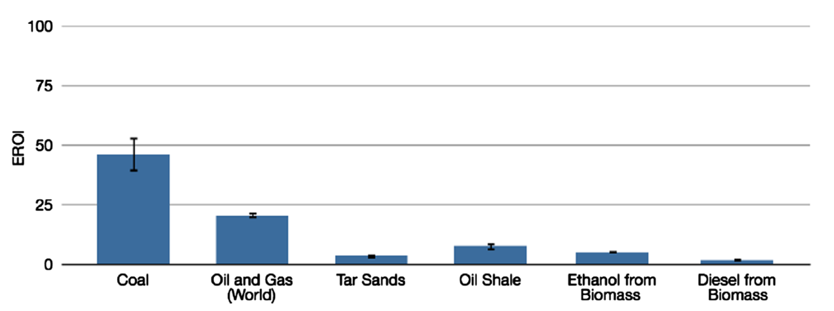
Hall: (Thermal) Energy Return on Invested Energy
https://www.sciencedirect.com/science/article/pii/S0301421513003856

Slide 28
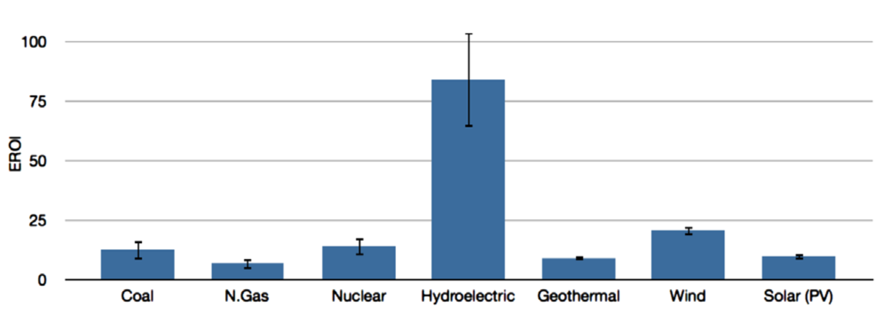
Hall: Electrical Energy Return on Invested Energy
https://www.sciencedirect.com/science/article/pii/S0301421513003856

Slide 29
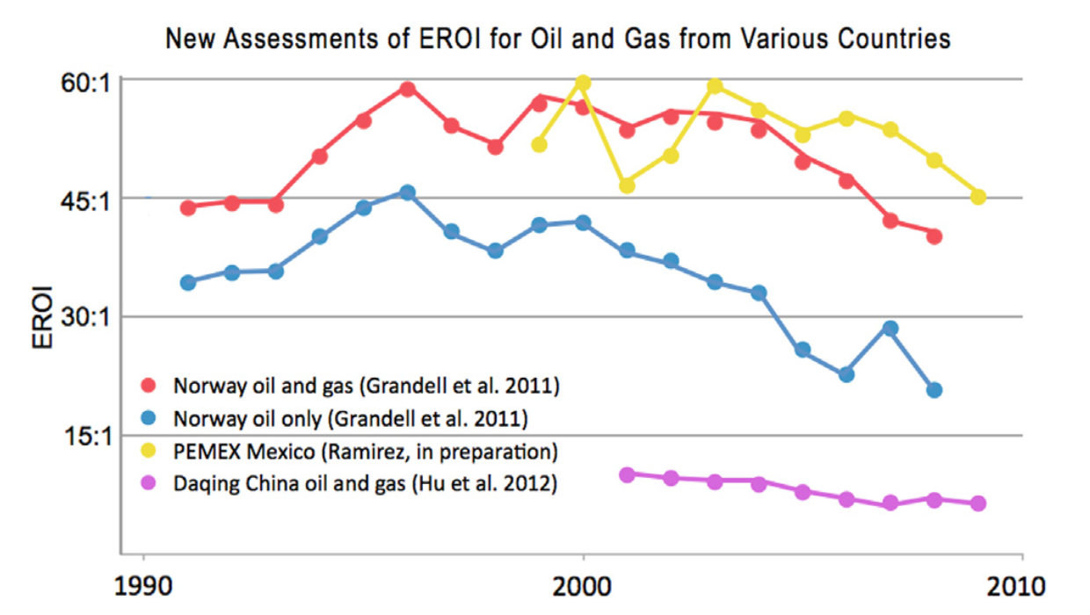
EROI declines in Norway, Mexico, and China
https://www.sciencedirect.com/science/article/pii/S0301421513003856#bib35

Slide 30
Goehring & Rozencwajg: EROI explains world prosperity.
 |  |  |  | Energy uses
Year | Energy sources | GJ/yr/capita | EROI | Energy | Food | Shelter, work | Surplus
ancient | Food, feed, wood | 5 | 5:1
1 | Food, feed, wood | 17 | 5:1 | 3 | 4 | 10 | << 1
1650 | No forest wood Coal discovery | 20 | 10:1 | 2 | 4 | 10 | 4
1900 | Oil, gas, coal | 25 | 30:1 | 1 | 4 | 10 | 10
2019 | OIl, gas, coal | 75 | 30:1 | 1 | 4 | 10 | 56
2030 ? | Wind, solar | 75? | 3.5:1 | 25? | 4 | 10 | -39?
5 GJ/yr = ~160 watts
https://f.hubspotusercontent40.net/hubfs/4043042/Content%20Offers/2021.Q4%20Commentary/2021.Q4%20GR%20Market%20Commentary.pdf

Slide 31
Goehring & Rozencwajg: EROI explains world prosperity.
 |  |  |  | Energy uses
Year | Energy sources | GJ/yr/capita | EROI | Energy | Food | Shelter, work | Surplus
ancient | Food, feed, wood | 5 | 5:1
1 | Food, feed, wood | 17 | 5:1 | 3 | 4 | 10 | << 1
1650 | No forest wood Coal discovery | 20 | 10:1 | 2 | 4 | 10 | 4
1900 | Oil, gas, coal | 25 | 30:1 | 1 | 4 | 10 | 10
2019 | OIl, gas, coal | 75 | 30:1 | 1 | 4 | 10 | 56
2030 ? | Wind, solar | 75? | 3.5:1 | 25? | 4 | 10 | -39?
https://f.hubspotusercontent40.net/hubfs/4043042/Content%20Offers/2021.Q4%20Commentary/2021.Q4%20GR%20Market%20Commentary.pdf

Slide 32
Goehring & Rozencwajg: EROI explains world prosperity.
 |  |  |  | Energy uses
Year | Energy sources | GJ/yr/capita | EROI | Energy | Food | Shelter, work | Surplus
ancient | Food, feed, wood | 5 | 5:1
1 | Food, feed, wood | 17 | 5:1 | 3 | 4 | 10 | << 1
1650 | No forest wood Coal discovery | 20 | 10:1 | 2 | 4 | 10 | 4
1900 | Oil, gas, coal | 25 | 30:1 | 1 | 4 | 10 | 10
2019 | OIl, gas, coal | 75 | 30:1 | 1 | 4 | 10 | 56
2030 ? | Wind, solar | 75? | 3.5:1 | 25? | 4 | 10 | -39?
https://f.hubspotusercontent40.net/hubfs/4043042/Content%20Offers/2021.Q4%20Commentary/2021.Q4%20GR%20Market%20Commentary.pdf

Slide 33
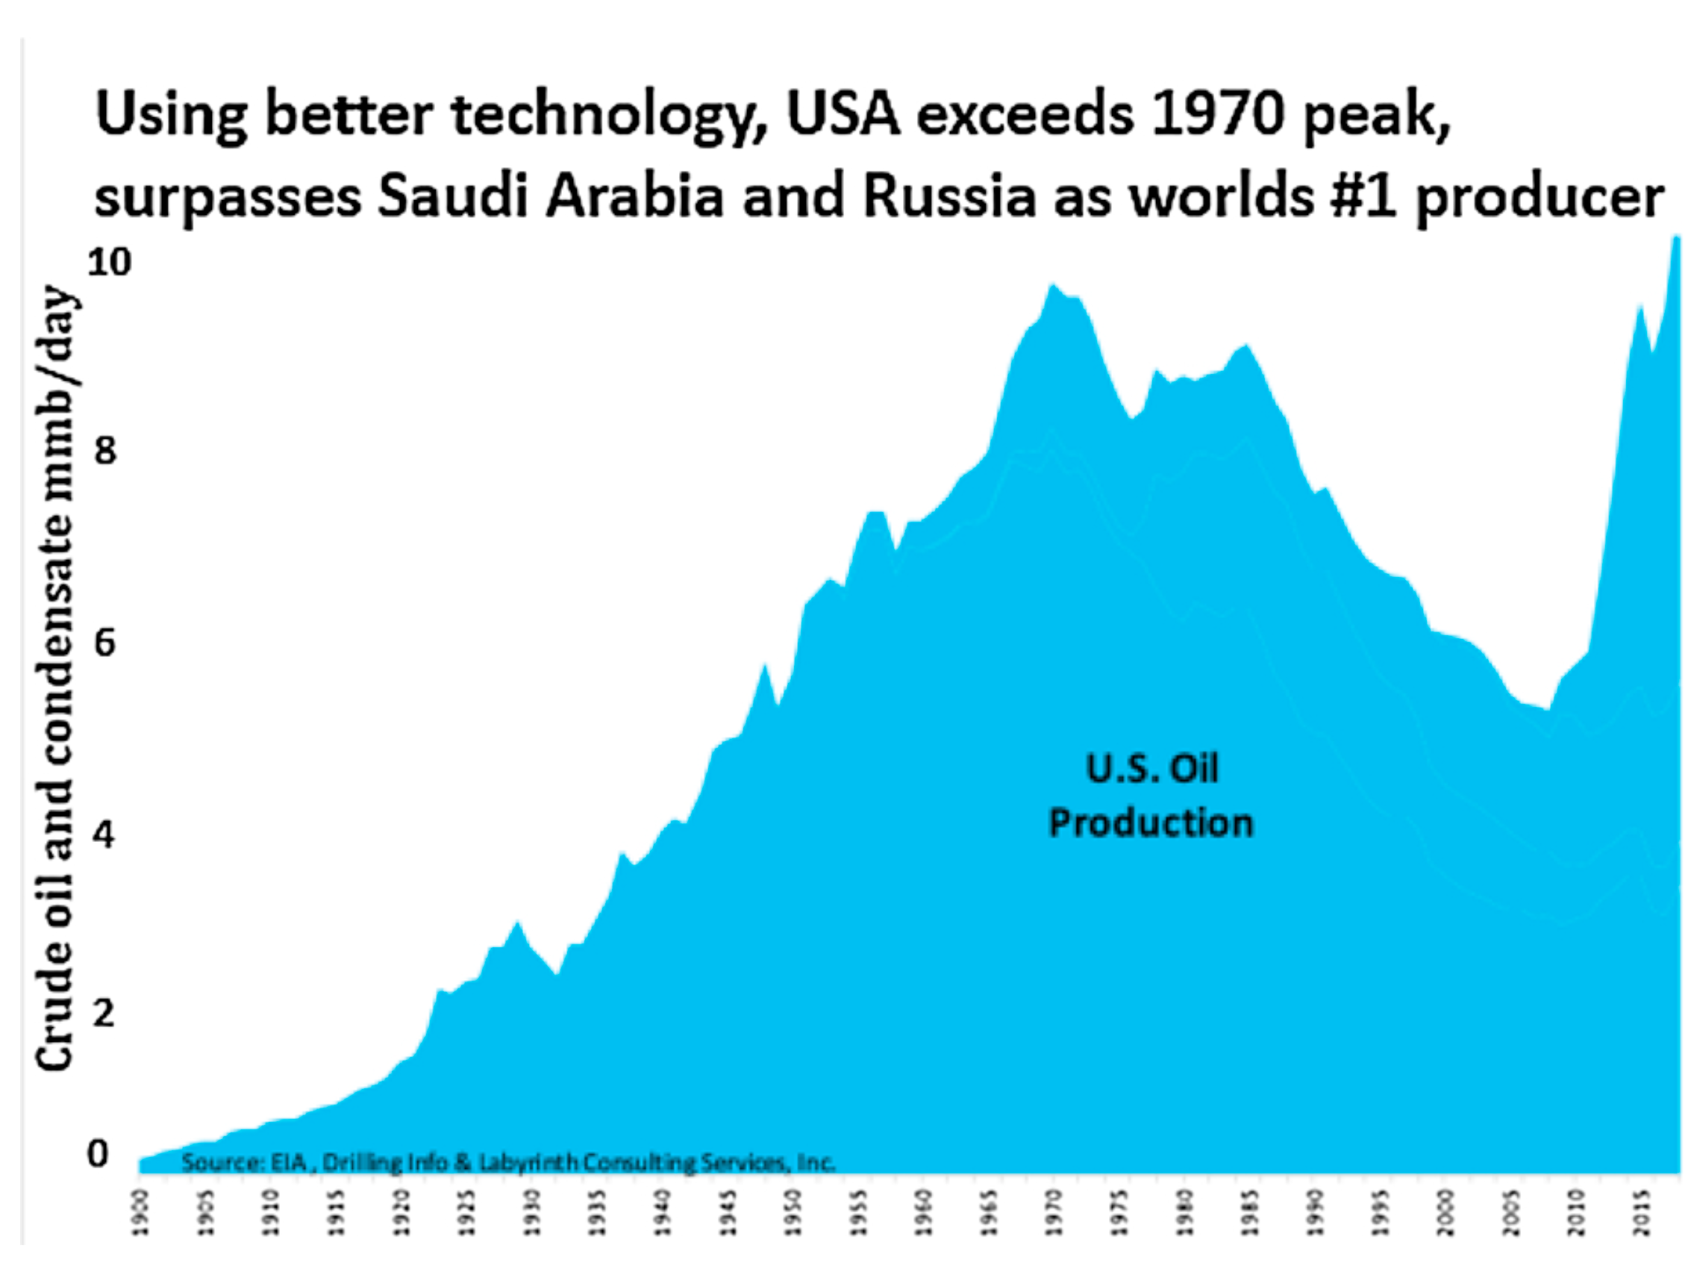
Misleading view: new technology made US #1 oil producer.
References

Slide 34
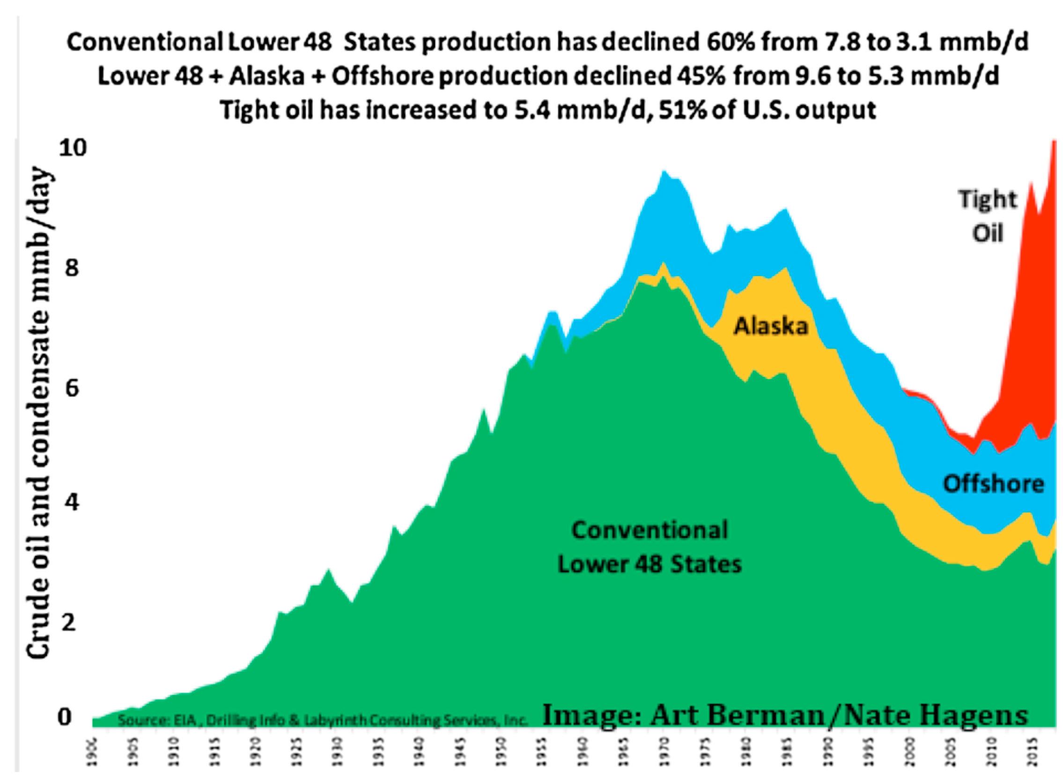
Realism: fracking technology increased drilling costs 350%.
References

Slide 35
Minimum EROI useful to society: ~ 3:1
Ethanol from cellulose from wood. 0.64:1
Diesel from biomass: 2:1
Diesel from coal: < 1:1 Reason= ?
https://www.sciencedirect.com/science/article/pii/S0301421513003856

Slide 36
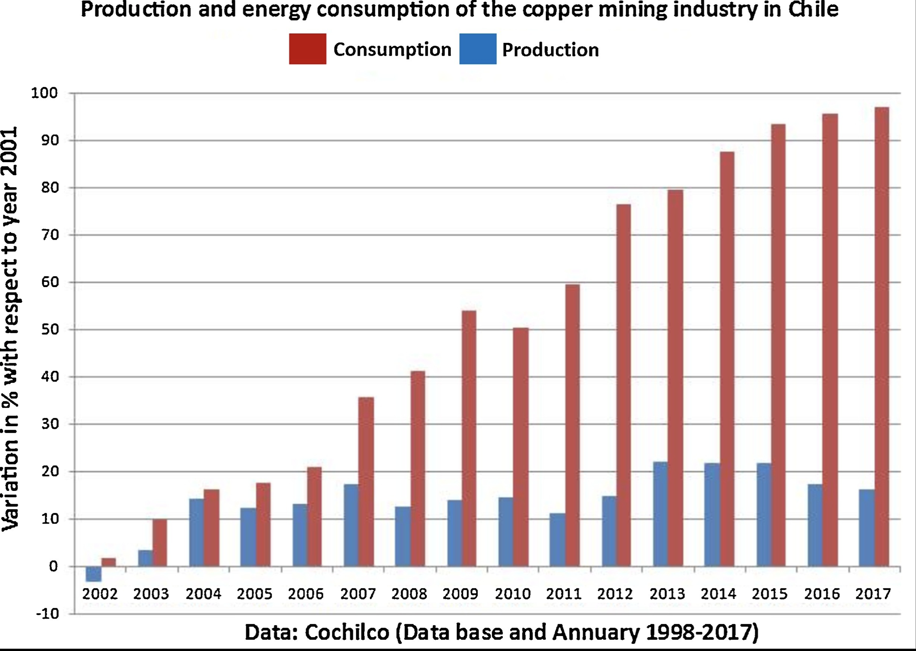
Energy to mine copper increases as best ores are depleted.
https://www.sciencedirect.com/science/article/pii/S0921800919310067

Slide 37
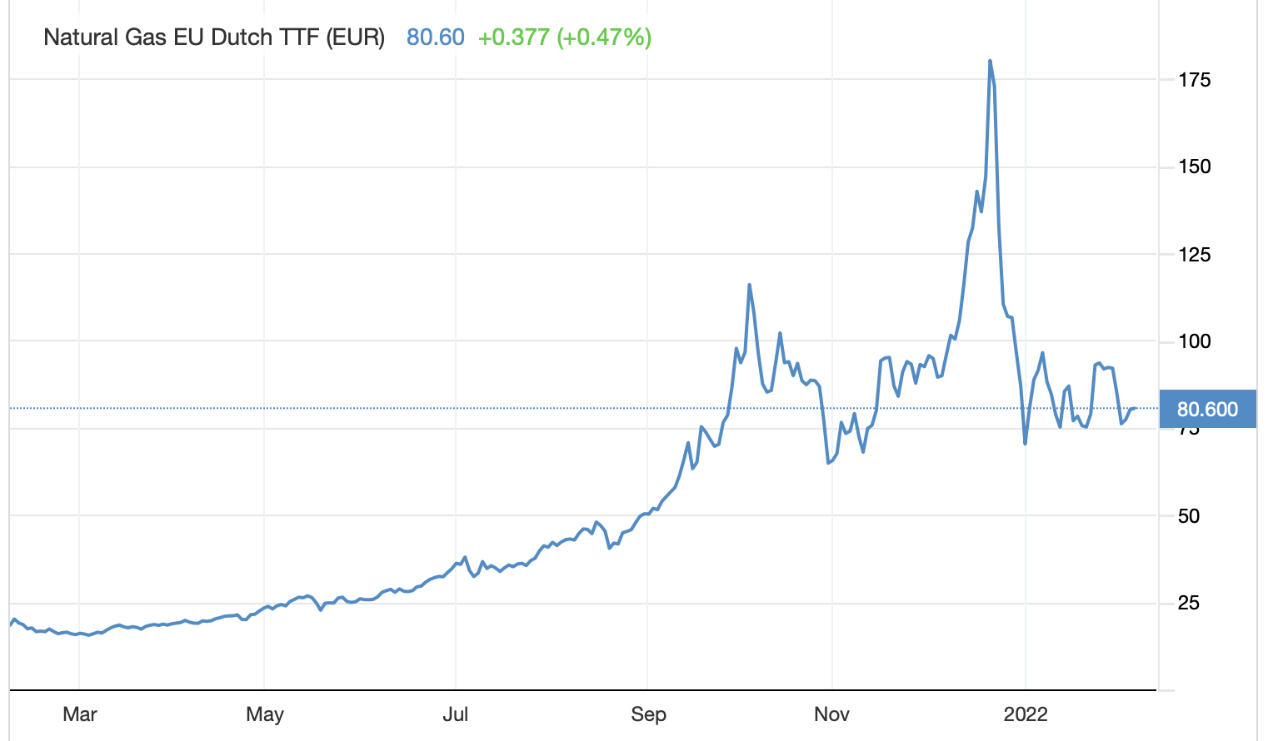
EU natural gas costs rose from 20 to 80 € per MWh(t).
https://tradingeconomics.com/commodity/eu-natural-gas

Slide 38
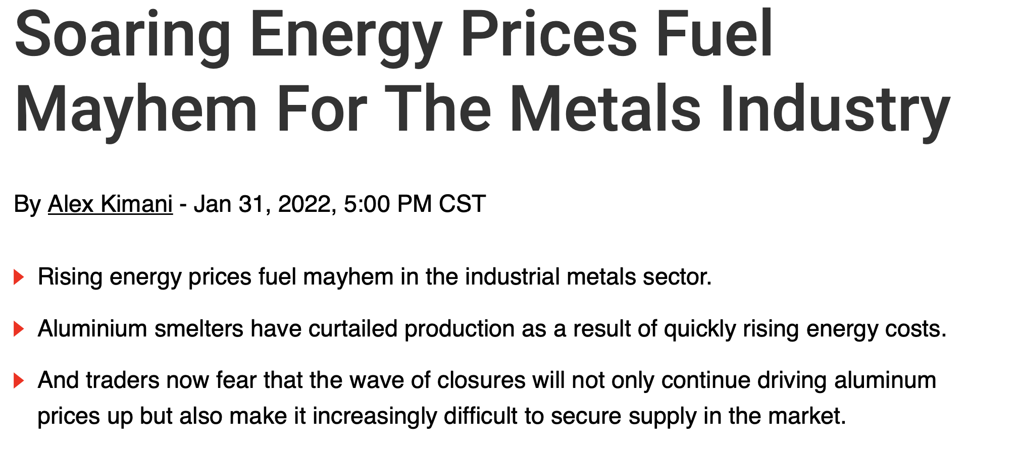
Aluminum Prices Can’t Keep Up With Energy Costs, Driving Wave of Closures. WSJ 2/3/22
https://oilprice.com/Metals/Commodities/Soaring-Energy-Prices-Fuel-Mayhem-For-The-Metals-Industry.html

Slide 39
US energy prices rose in 2021.
https://www.axios.com/newsletters/axios-generate-441d89bd-0543-45d5-9745-d703a5de0d59.html

Slide 40
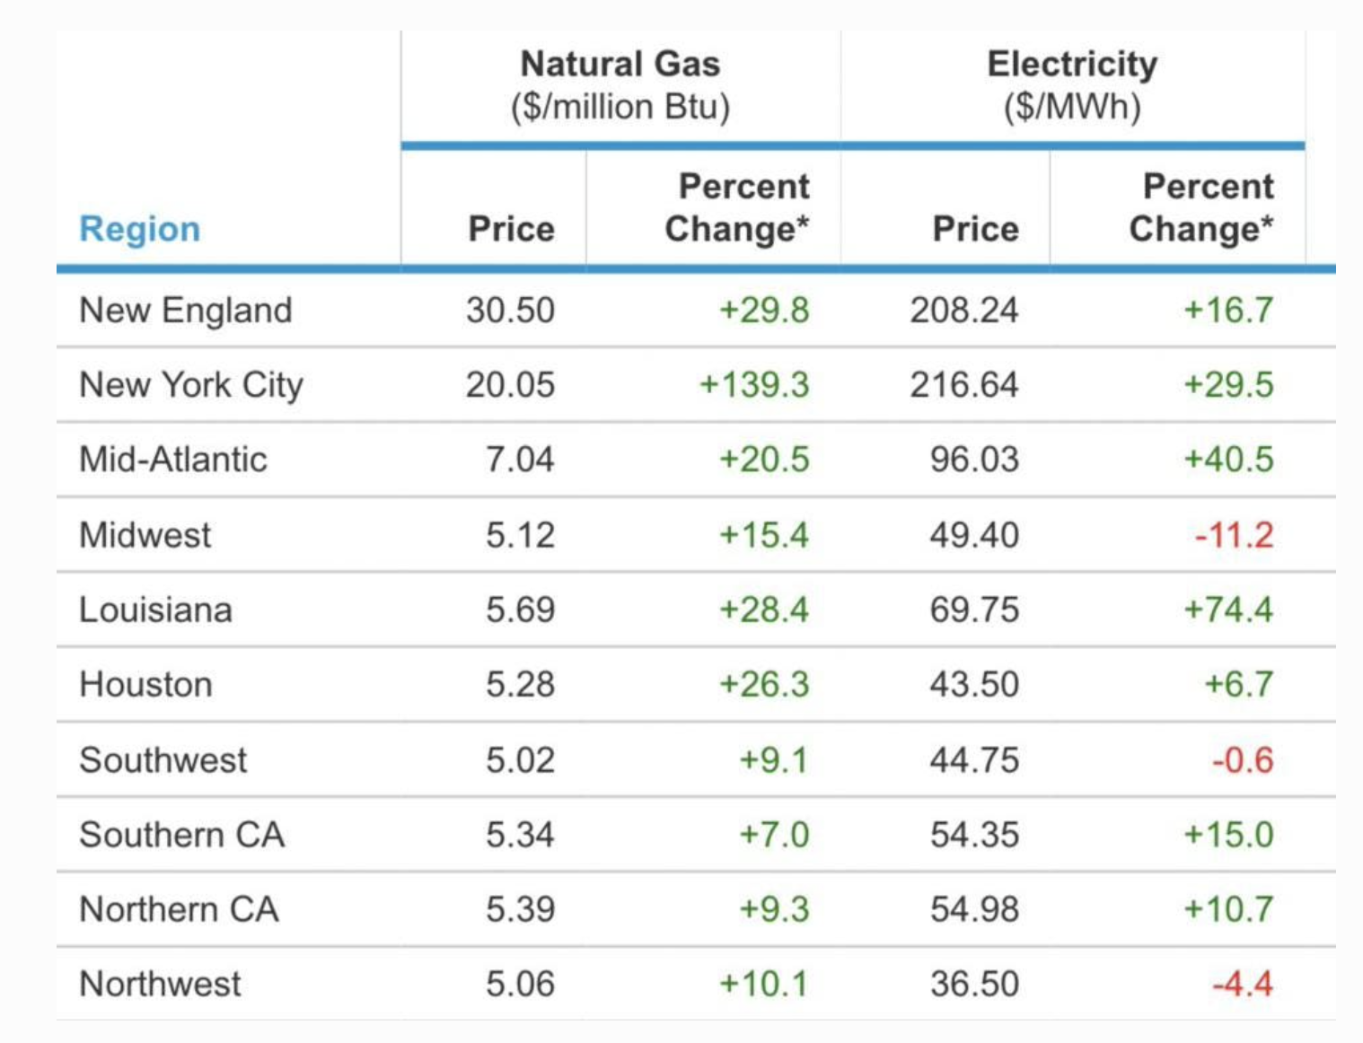
Limited pipeline gas boosted by expensive LNG imports.
January, 2022
https://www.forbes.com/sites/christopherhelman/2022/02/01/why-is-new-england-paying-the-equivalent-of-180-oil-for-natural-gas/?sh=247d1bf530a7

Slide 41
Special interest groups stop major infrastructure projects.
pipeline
transmission lines
Jones Act

Slide 42
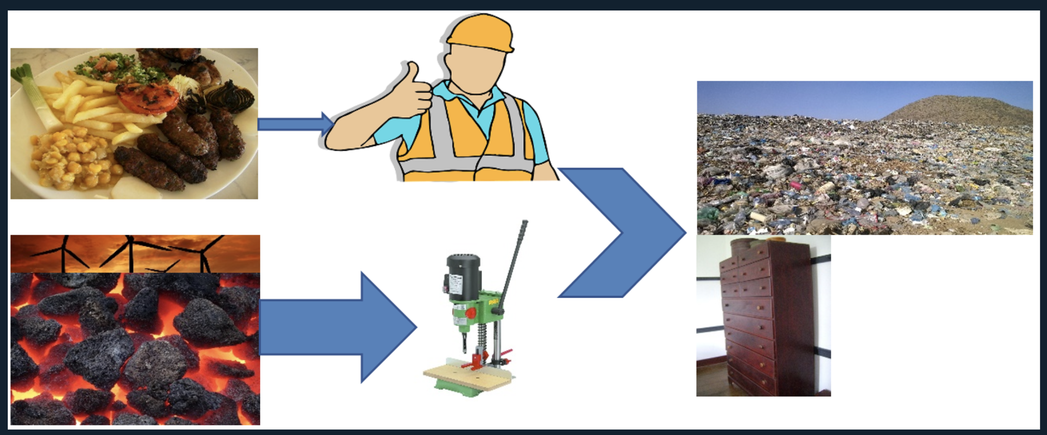
How does GDP depend on energy? Steve Keen
Classical economics
Modern economics
https://www.rebuildingmacroeconomics.ac.uk/post/labour-without-energy-is-a-corpse-capital-without-energy-is-a-sculpture

Slide 43
GDP depends on capital and labor, which depend on energy.
Feudal times: GDP = function { land }
Classical economics: GDP = function { capital, labor }
Three factor fix: GDP = function { capital, labor, energy}
Modern economics: GDP = function { capital(energy), labor(energy) }
Tim Garrett:
Steve Keen: alpha = 0.8
https://www.sciencedirect.com/science/article/pii/S0921800917311746

Slide 44
Energy’s contribution to production is much higher than its share of GDP.
Looks nearly linear!
https://www.rebuildingmacroeconomics.ac.uk/post/labour-without-energy-is-a-corpse-capital-without-energy-is-a-sculpture

Slide 45
Energy’s value to GDP is much more than its cost share.
Steve Keen https://www.youtube.com/watch?v=BAjN6bG7XzM

Slide 46
Steve Keen
https://www.youtube.com/watch?v=BAjN6bG7XzM https://www.sciencedirect.com/science/article/pii/S0921800917311746?via%3Dihub

Slide 47
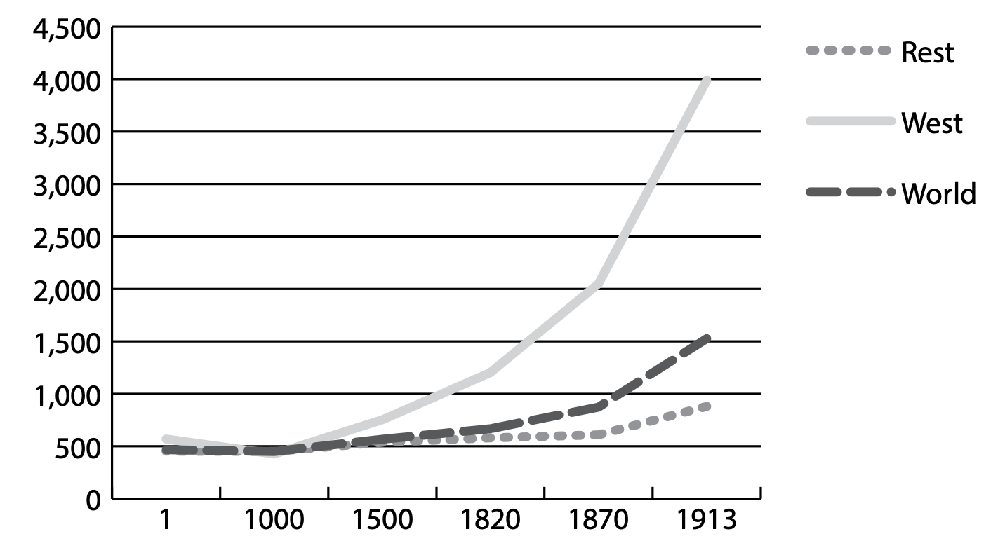
John Constable: Energy, Entropy and the Theory of Wealth
Why were we poor for so long?
GDP per capita, 1990$
Nature of energy
Sun sourced, sparce
Variable, seasonally, yearly
UK coal near surface
Steam also enhanced old technolgies, wood, ships.
Decouple economy from energy? “The suggestion that we can stay rich without consuming resources, particularly energy, is incompatible with what we know thermodynamically about the world.”
http://www.libellus.co.uk/uploads/jc_energy_entropy_wealth_2016.pdf

Slide 48
Constable: cheap energy is the only answer
https://www.ref.org.uk/attachments/article/321/ref_greenough_society_30_10_14.pdf

Slide 49
https://environmentalprogress.org/the-complete-case-for-nuclear

Slide 50
German renewables surcharges increase electricity costs.
https://www.cleanenergywire.org/factsheets/what-german-households-pay-power

Slide 51
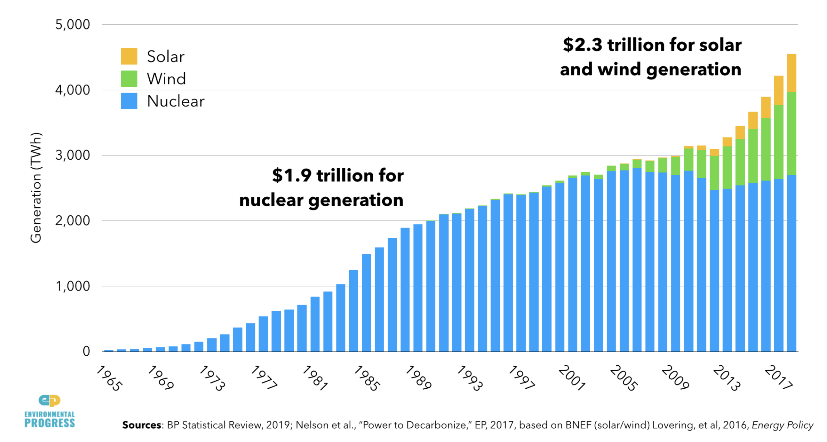
Fission power 10X more cost-effective than wind and solar.
https://environmentalprogress.org/the-complete-case-for-nuclear

Slide 52
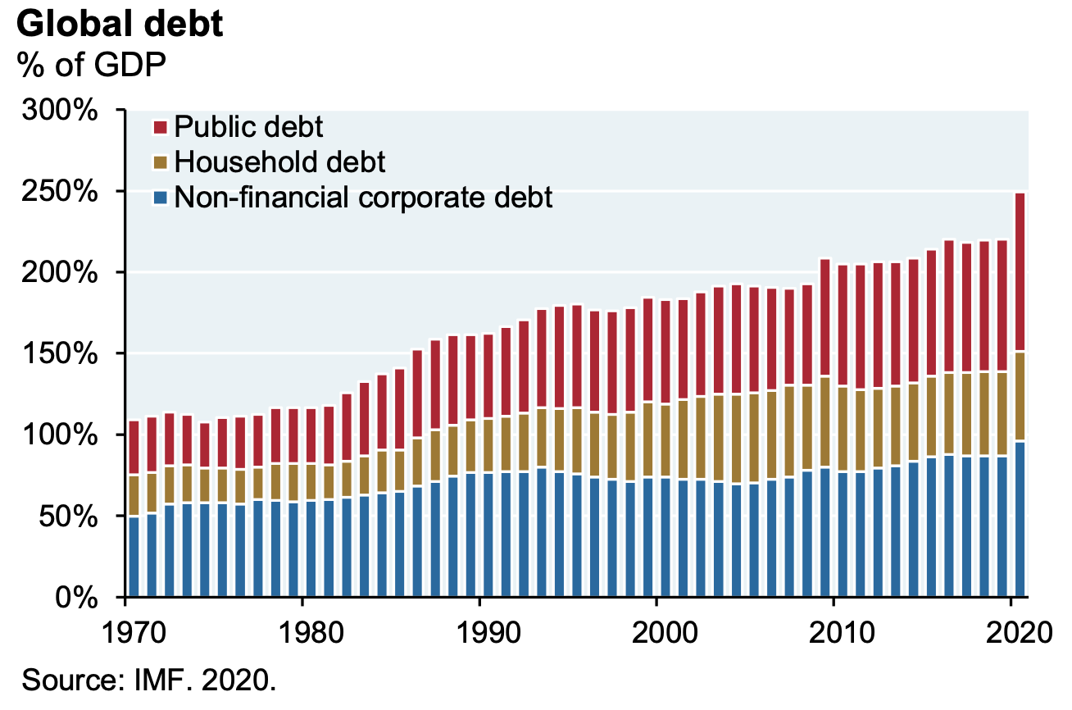
Global debt, as %GDP
https://am.jpmorgan.com/content/dam/jpm-am-aem/global/en/insights/eye-on-the-market/the-maltese-falcoin-amv.pdf

Slide 53
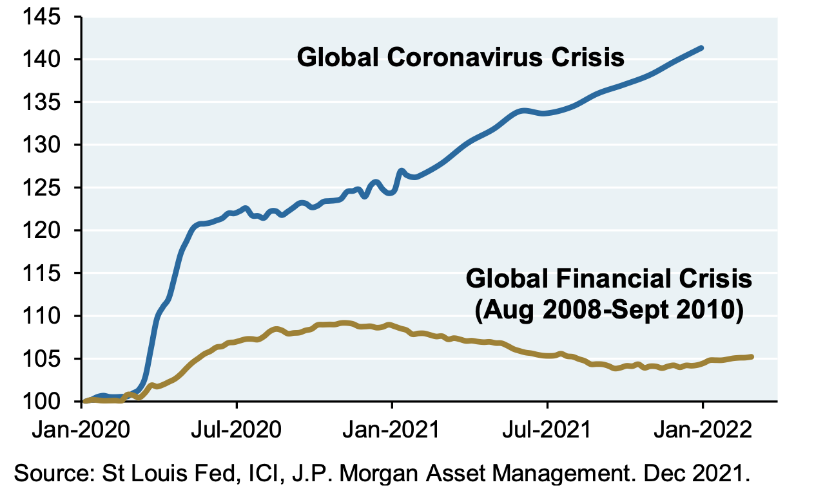
M2 money supply + institutional money market fund balances, index
https://am.jpmorgan.com/content/dam/jpm-am-aem/global/en/insights/eye-on-the-market/the-maltese-falcoin-amv.pdf

Slide 54
Some argue against excessive fiat money supply.
Money basis: gold? fiat? US$? petroleum? uranium? joule?
Energy IS the economy. Each $1 GDP demands ~1.5 kWh heat, ~ 0.2 kWh electricity.
Ford, Edison proposed energy dollar.
(1 MJ = 0.28 kWh)
Fission-sourced energy of uranium and thorium can power the world for centuries.
https://www.bu.edu/synapse/tag/uranium/. https://energybackedmoney.com

Slide 55
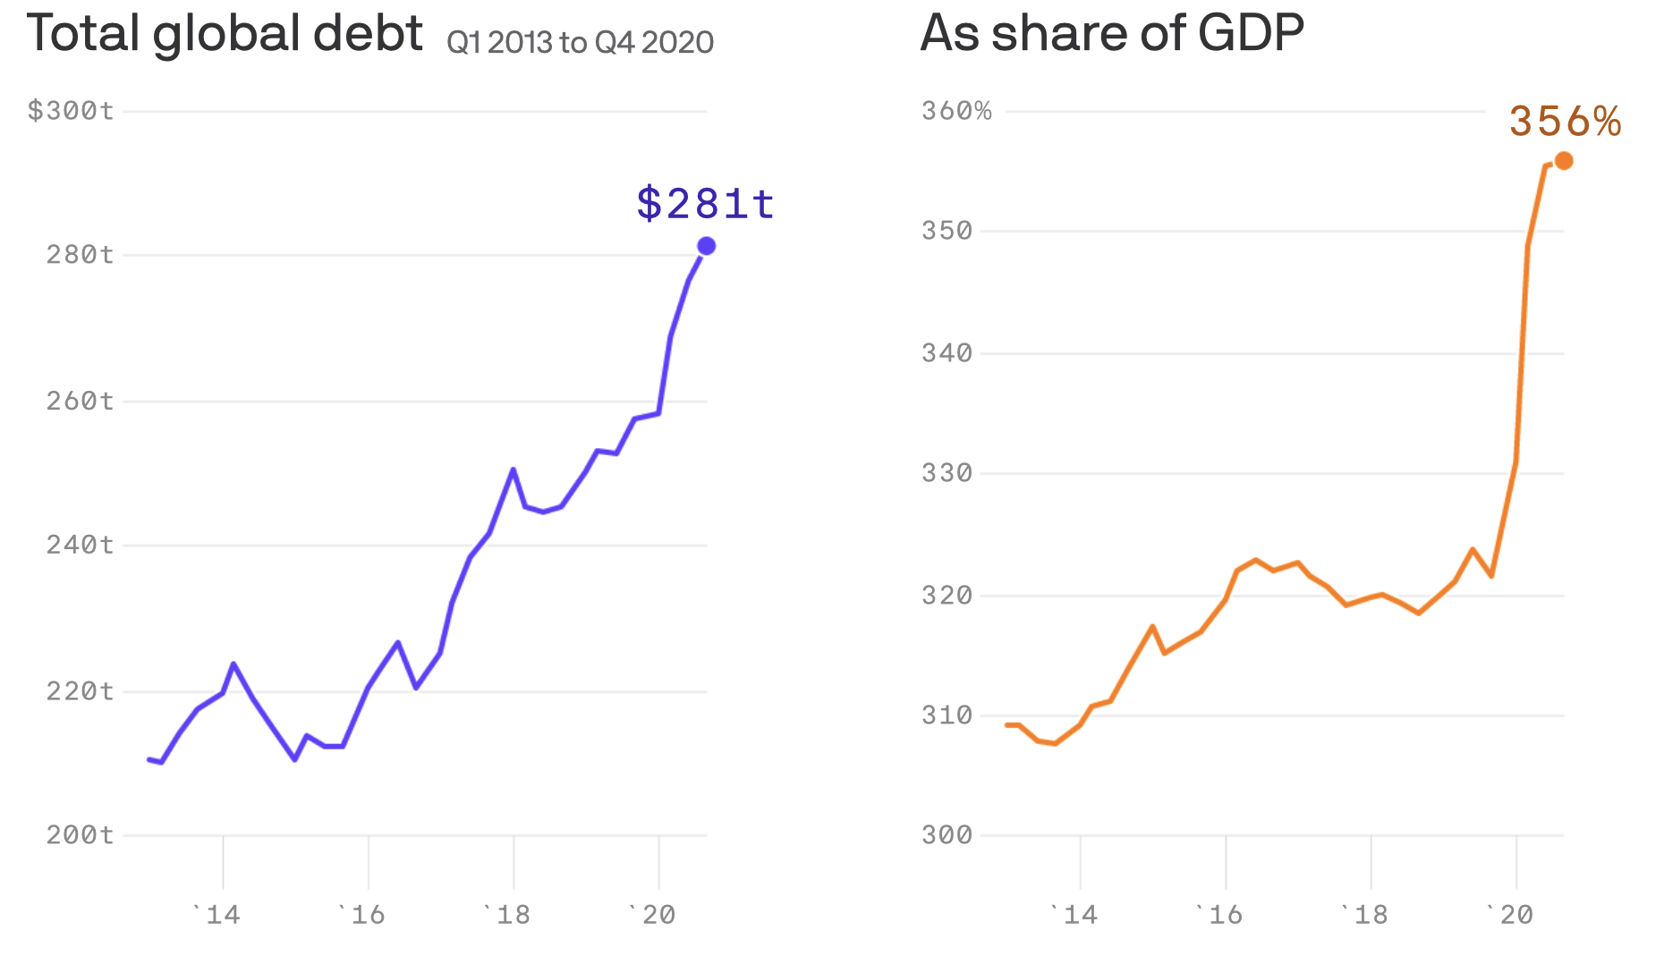
Debt is a call on future earnings.
https://www.axios.com/global-debt-gdp-898959ed-f96a-4c4d-85a3-5d3cc419631f.html

Slide 56
Debt is a lien on future energy! 1.5 kWh/$ x $281 trillion = 48,000 GW-years = 2.6 years of world energy production! But EROI is going down.
https://www.axios.com/global-debt-gdp-898959ed-f96a-4c4d-85a3-5d3cc419631f.html

Slide 57
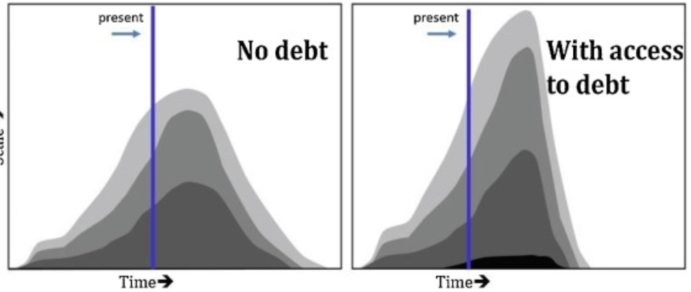
Hagens’ concept: cheap debt funding allowed oil companies to extract new higher-cost oil (dark black on right panel)
https://www.sciencedirect.com/science/article/pii/S0921800919310067

Slide 58
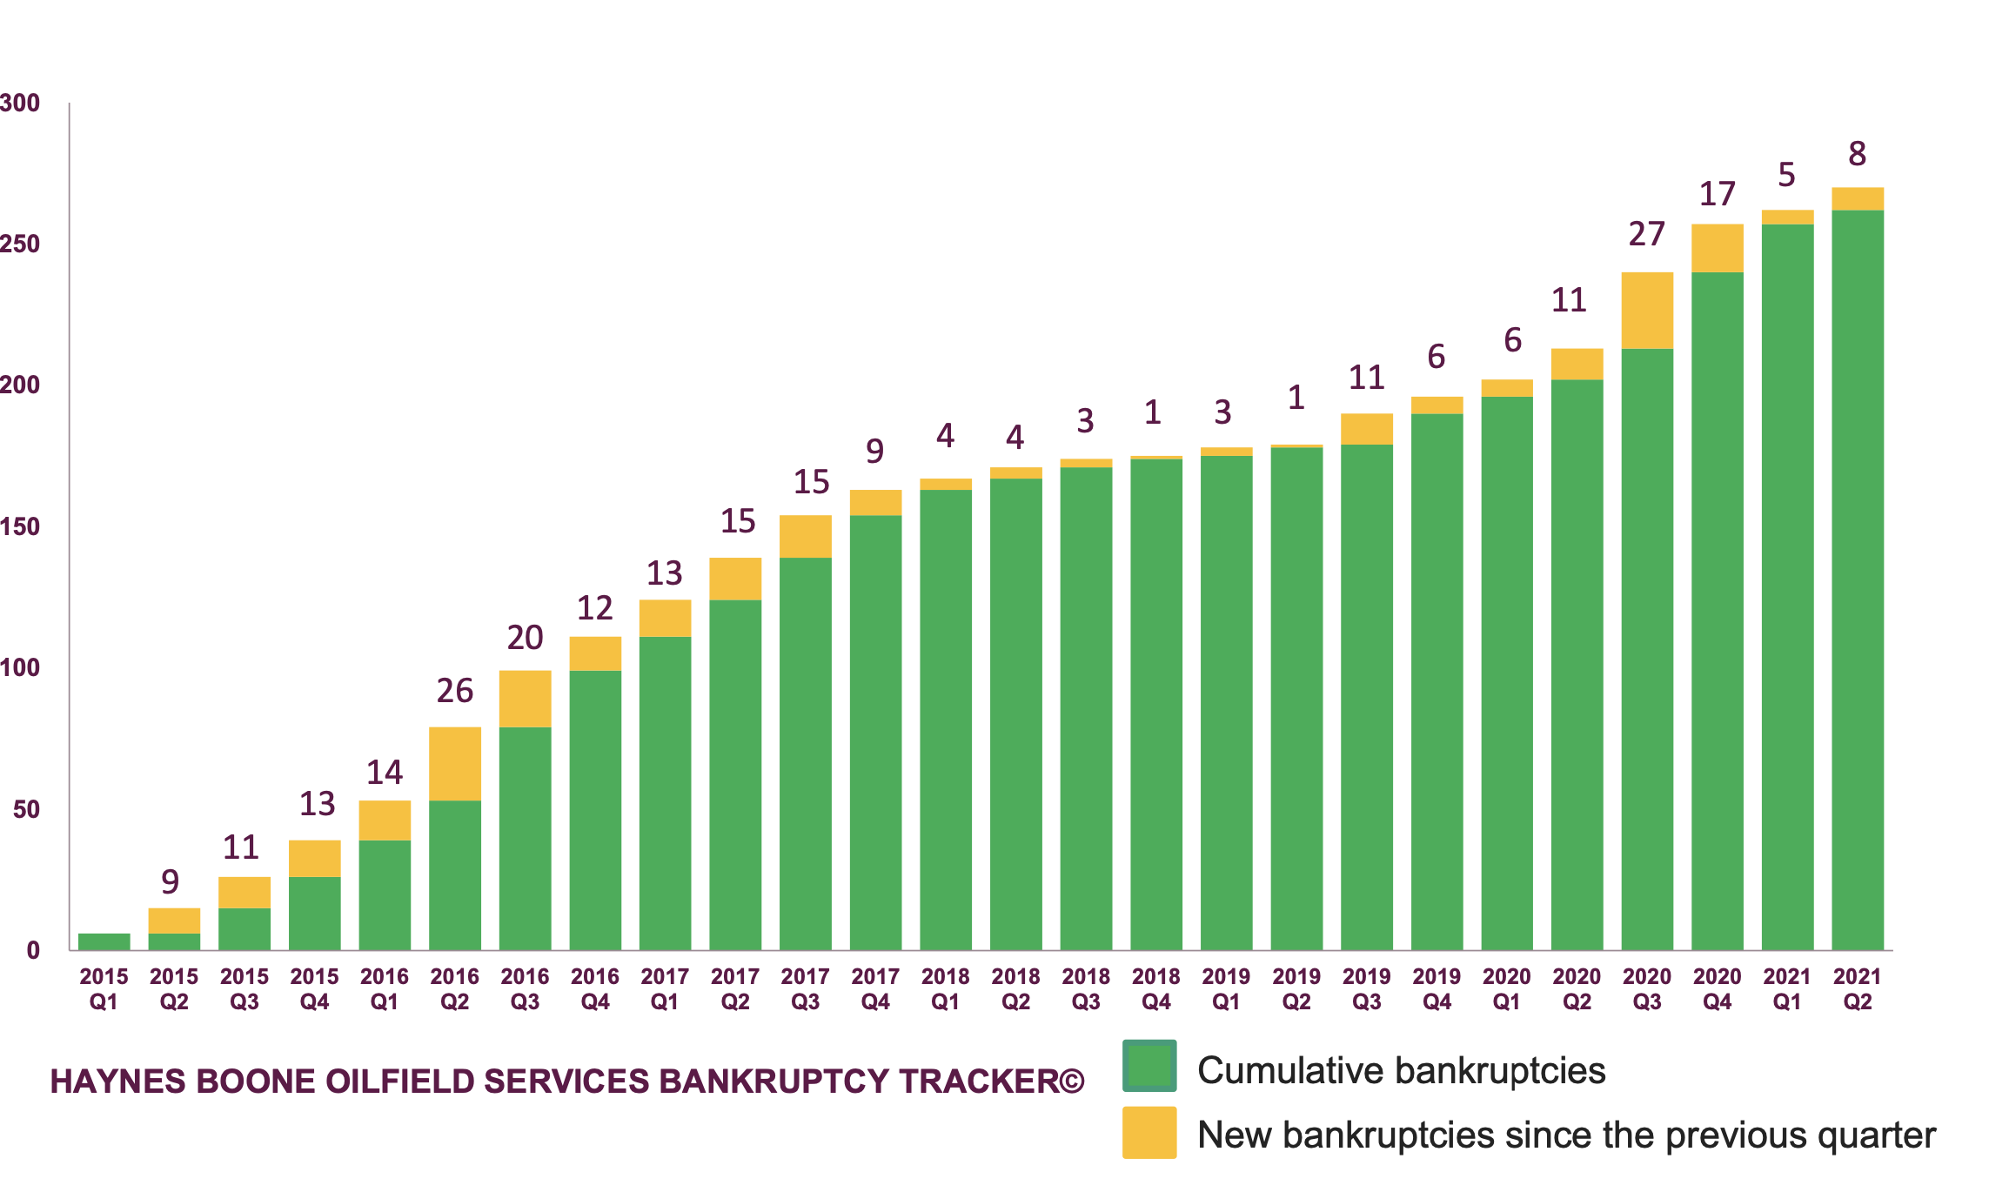
Ollfield services bankruptcies: $117 billion, 2015-2021
https://www.haynesboone.com/-/media/project/haynesboone/haynesboone/pdfs/energy_bankruptcy_reports/oilfield_services_bankruptcy_tracker.pdf?rev=9854fe54a05f4611ad63dda65c2a1f26&hash=52EF867504D7FA8EC9F4CF9F1453090D

Slide 59
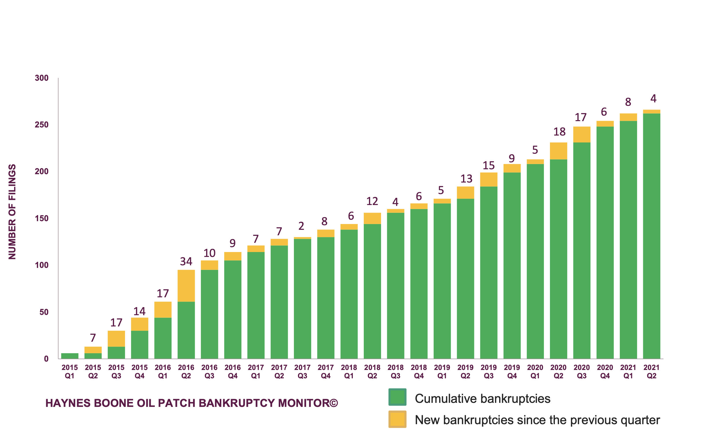
Explorer and producer bankruptcies: $177 billion, 2015-2021
https://www.haynesboone.com/-/media/project/haynesboone/haynesboone/pdfs/energy_bankruptcy_reports/oil_patch_bankruptcy_monitor.pdf?rev=61c2606a5be547598c8d716d1a795c39&hash=97ECA4B149560404B19497FA37CB2B50

Slide 60
Realism: fracking technology increased drilling costs 350%.
https://www.sciencedirect.com/science/article/pii/S0921800919310067

Slide 61
Real income is dropping for 96.5% of US earners.
Matthew J. Slaughter, Osher at Dartmouth, July 15, 2021

Slide 62
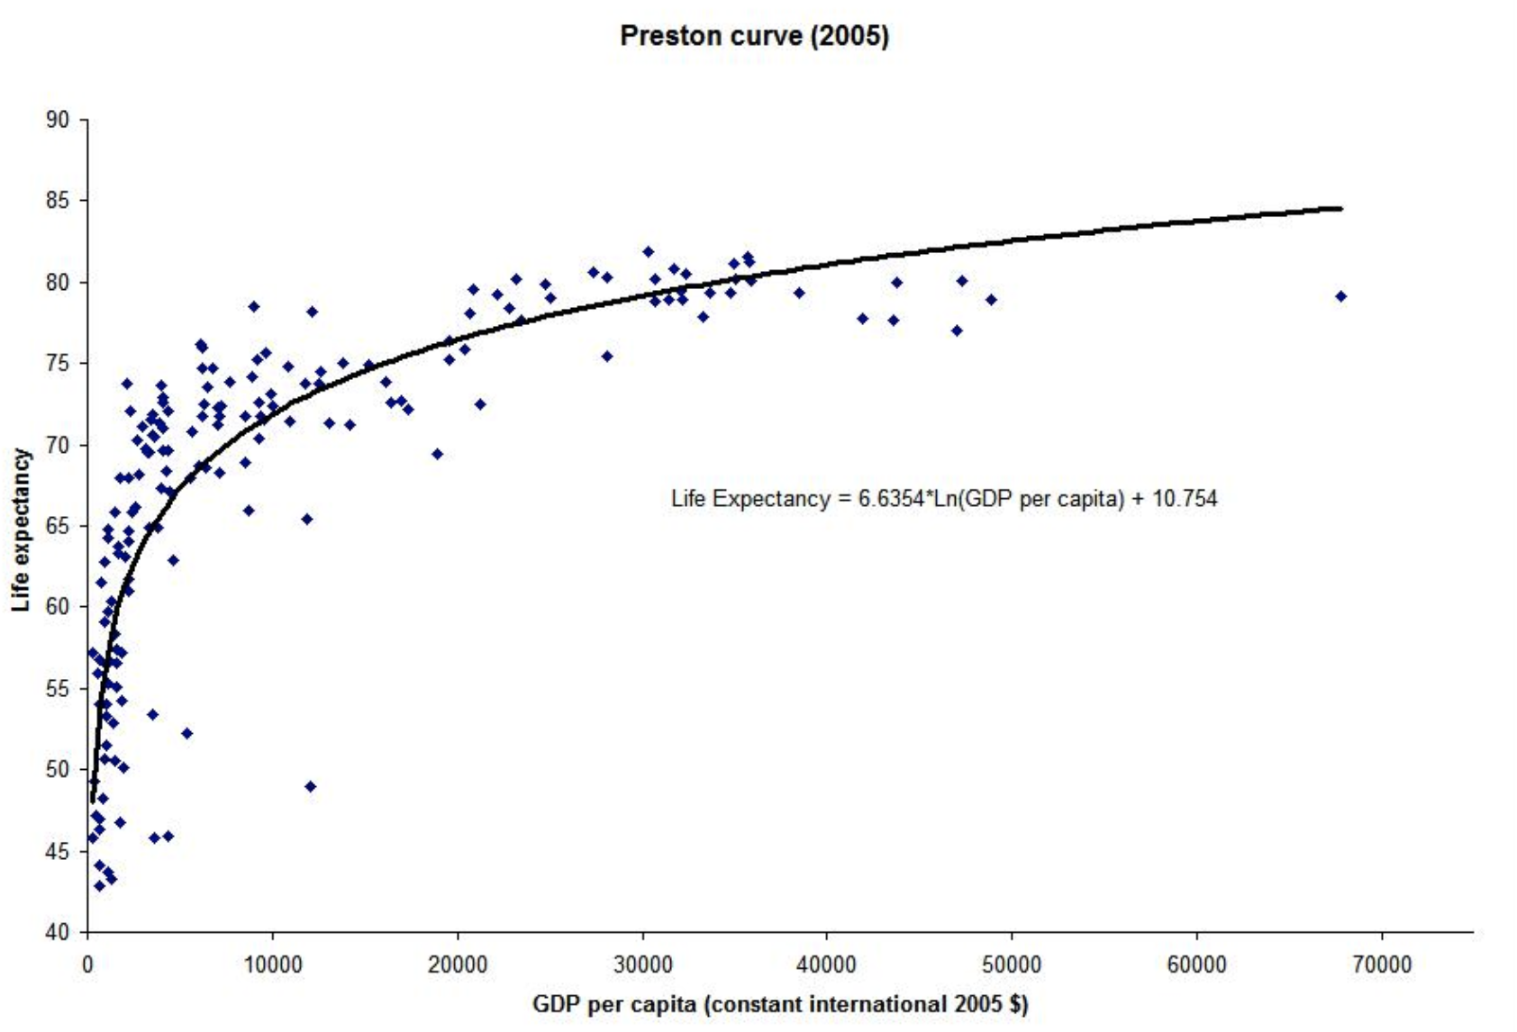
Life expectancy as function of GDP/capita
https://medium.com/generation-atomic/for-the-first-time-world-learns-truth-about-risk-of-nuclear-6b7e97d435df

Slide 63
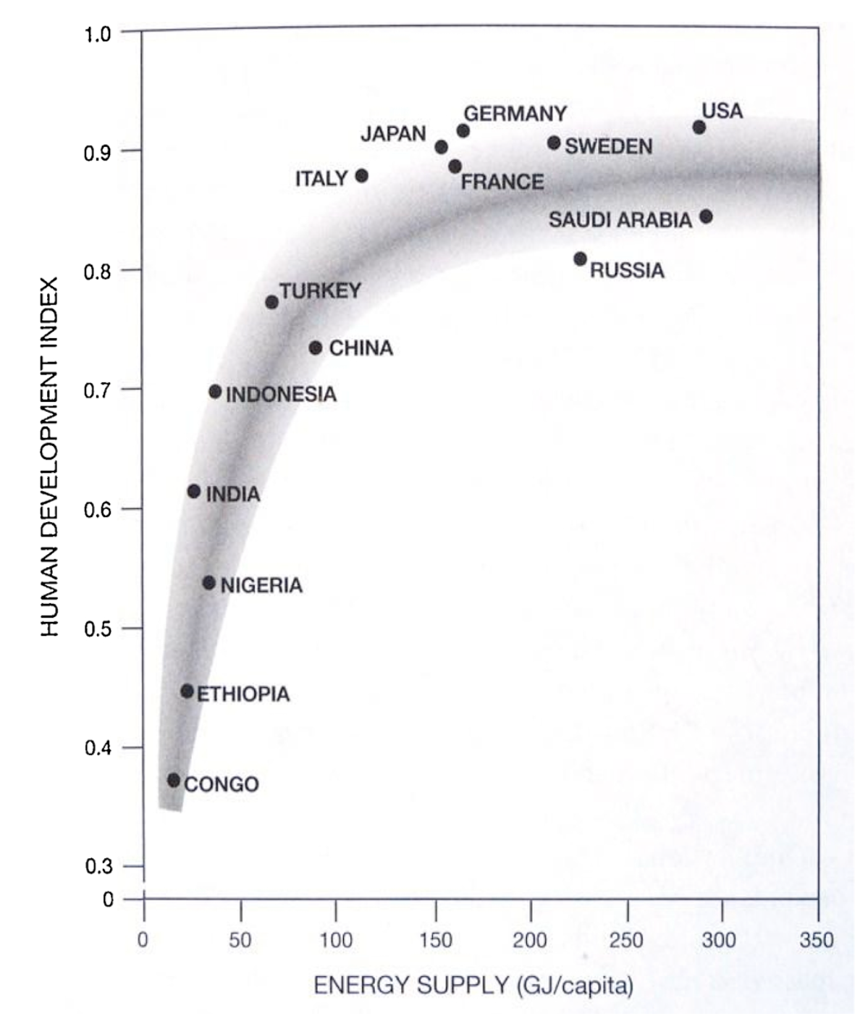
Human development index vs global energy supply
Hagens Ecological Economics 169 (2020) 106520

Slide 64
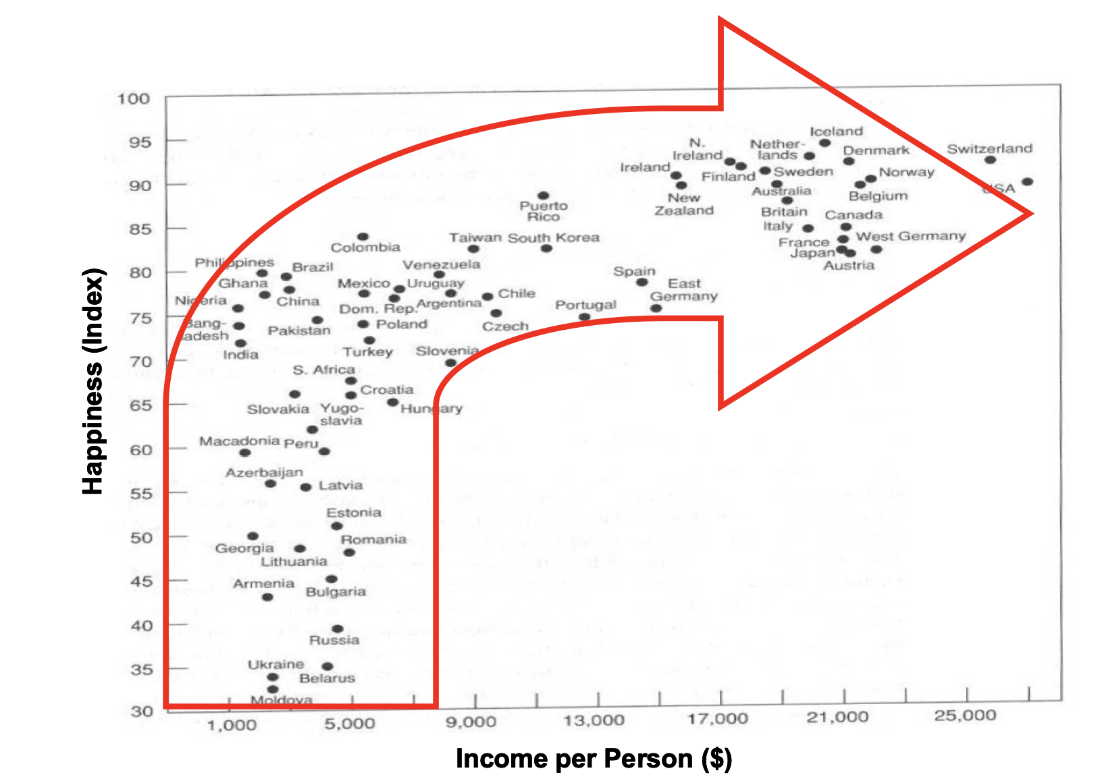
Income and happiness by country
https://neweconomics.org/uploads/files/0369000fddb0bb6226_36m6voh4u.pdf

Slide 65
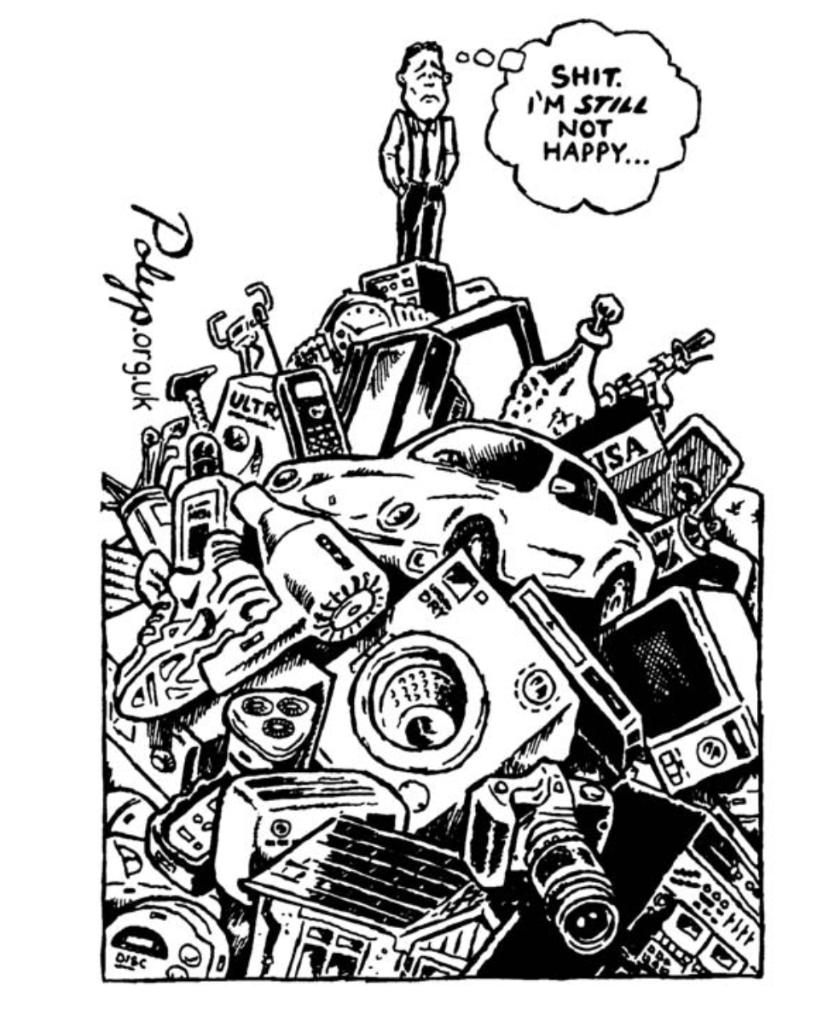
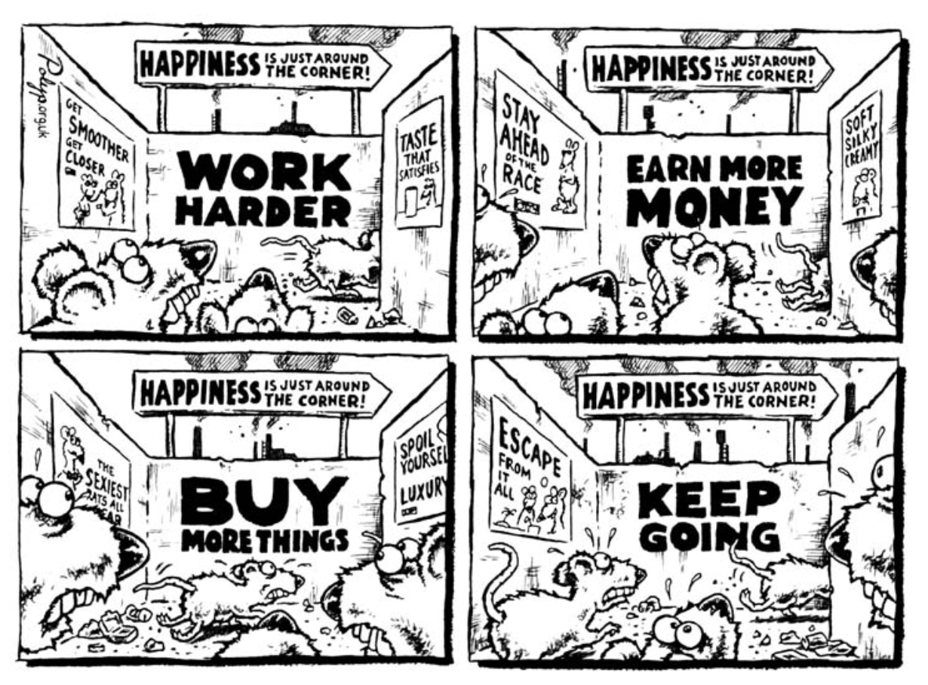
What's the value of energy to happiness?
enough is enough Building a SuStainaBle economy in a World of finite reSourceS Rob Dietz and Dan O’Neill

Slide 66
Davos
World Economic Forum
Jan 2021
The Great Reset
50th annual meeting of the World Economic Forum
https://survivingtomorrow.org/you-will-own-nothing-and-be-happy-is-just-feudalism-2-0-ee15cefa9f1b

Slide 67
Some economists argue against excessive fiat money supply.
https://www.amazon.com/New-Economics-Manifesto-Steve-Keen-ebook-dp-B09LRN67BD/dp/B09LRN67BD/ref=mt_other

Slide 68
Some argue against excessive fiat money supply.
Tim Garrett
http://nephologue.blogspot.com

Slide 69
Some argue against excessive fiat money supply.
Nate Hagens: The Great Simplification
https://citizenactionmonitor.wordpress.com/2019/06/10/the-great-simplification-coming-next-decade-with-30-drop-in-capitalist-economies-says-dr-nate-hagens/

Slide 70
Energy Realism
Energy IS the economy. $1 GDP demands ~1.5 kWh heat, ~0.2 kWh electricity.
Earth’s carbon battery supplies the energy that enabled our civilization.
Harvesting fossil fuels is becoming more energy intensive, so more economic productivity (GDP) is being diverted to obtaining the needed energy.
The energy return on invested energy (EROI) from wind, solar, and storage is too low to sustain our civilization.
Burning fossil fuels releases CO2 that exacerbates global warming.
Fission-sourced energy can power the world for centuries.

Slide 71
4 Energy economics
Value of energy to civilization
Thermodynamics and economy
Systems, entropy, exergy
Energy return on investment
GDP = f { capital, labor, energy}
GDP, energy, happiness
Cheap energy: the only answer
Fission is in Fashion

