Slide 1
2 Basics of energy and power
Useful energy
Heat
Work from heat
Power
Fission is in Fashion

Slide 2
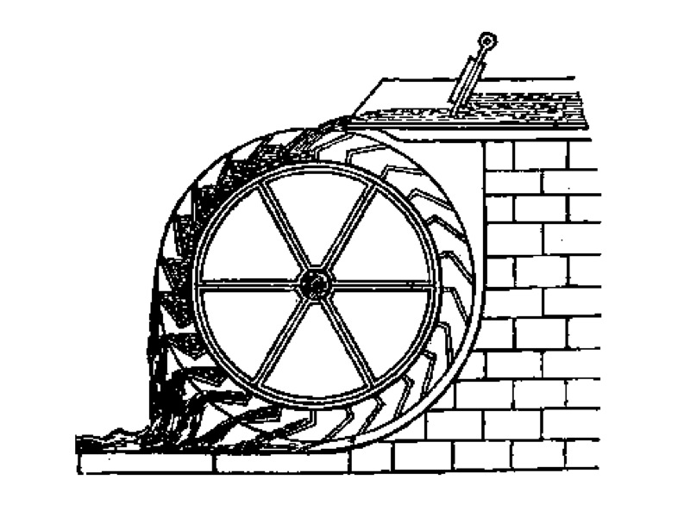
Kinetic energy is a form of useful energy.
Kinetic energy: mass x velocity squared / 2
Gravitational energy: height x mass x g
Work: force (newtons) x distance (meters)
Electric energy: amps x volts x time
Joule = 1 amp x 1 volt x 1 sec
1000 x 60 x 60 joules = 1 kilo-watt hour, kWh

Slide 3
Heat energy is the kinetic energy of many molecules.

Slide 4
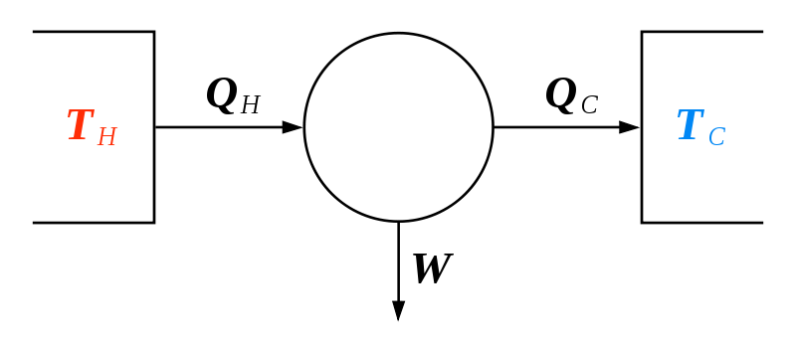
Heat flows from hot to cold.
Q is heat energy
Hot heat source
Cold heat sink

Slide 5
Work, energy, can be extracted from the flow of heat from hot to cold.
Heat Engine
W
Work is useful energy
“Exergy” is a term for the useful energy extracted.

Slide 6
1763-1775 James Watt developed the steam engine.
Pumped water from coal mines.
Powered industrial revolution.
Patented, but not paid for.
https://en.wikipedia.org/wiki/James_Watt

Slide 7
Work, energy, can be extracted from the flow of heat from hot to cold.
Heat Engine
W
Work is useful energy
eg: 100°C to 0°C
(373K - 273K) / 373K
= 100/373 = 27%
Efficiency max = (TH - TC ) / TH (Carnot theorem)

Slide 8
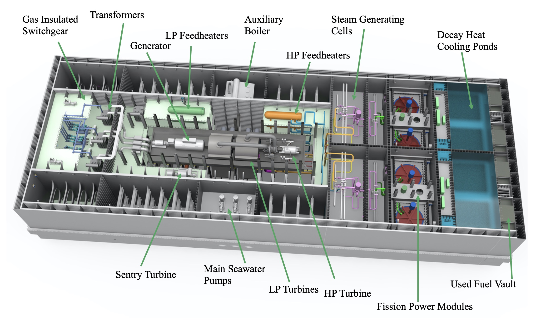
The heat engine is the biggest part of a power plant.

Slide 9
In a power plant, Qc is termed rejected heat, sometimes called waste heat.
Heat Engine
W
Cogeneration Rejected heat can be transferred in hot water to heat buildings.

Slide 10
Using work energy, heat can flow from cold to hot.
Heat Pump
W

Slide 11
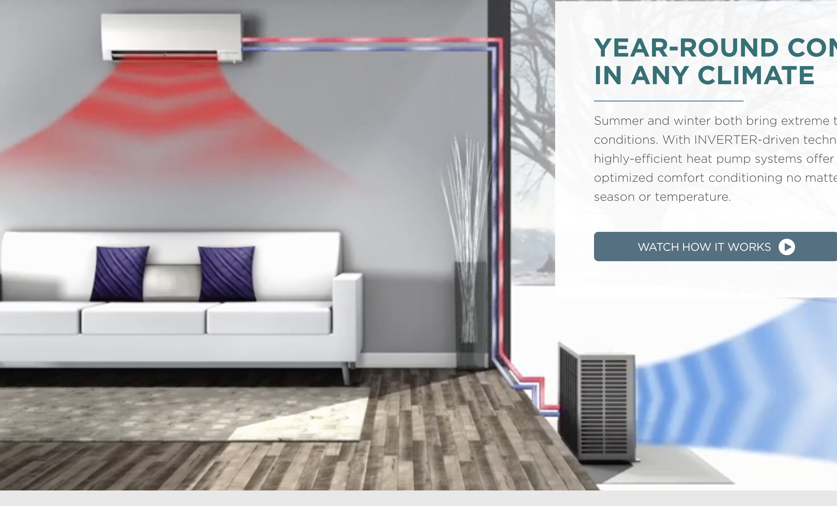
Heat pump examples:
Mitsubishi air source heat pump
LG air conditioner
For cooling
For heating and cooling

Slide 12
Heat pump
Mitsubishi air source heat pump
Coefficient of Performance
= kW(t) / kW(e)
= heat output / electicity input
COP
~ 3.8 to 2.9
As air temperature drops
from 55°F to 5°F
heat output may drop
from 7 kW(t) to 3 kW(t).
Coefficient of Performance = kW(t) / kW(e)
COP ~ 3.8 to 2.9 in air dropping from 55°F to 5°F
as heat output drops from ~ 7 kW to 3 kW.

Slide 13
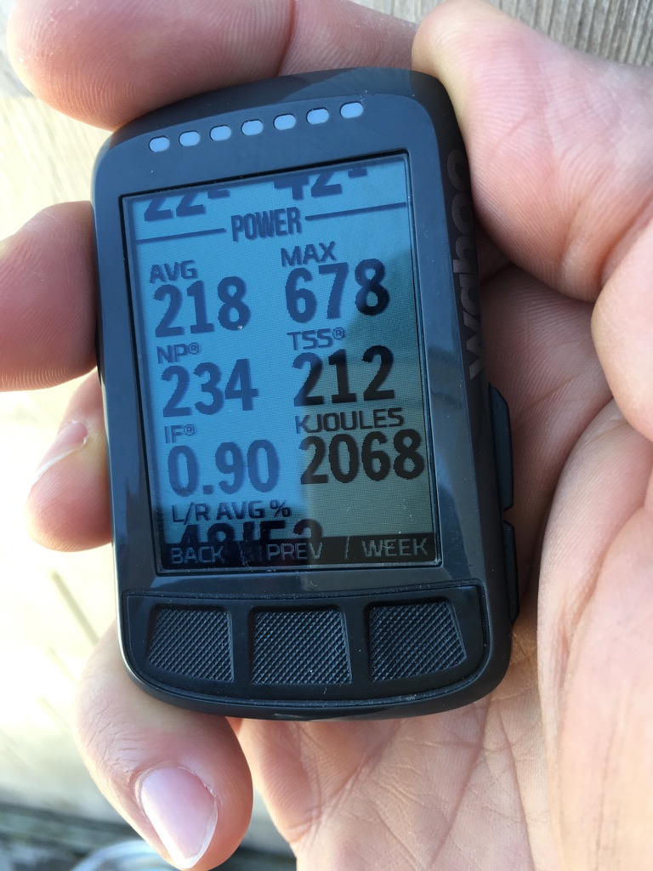
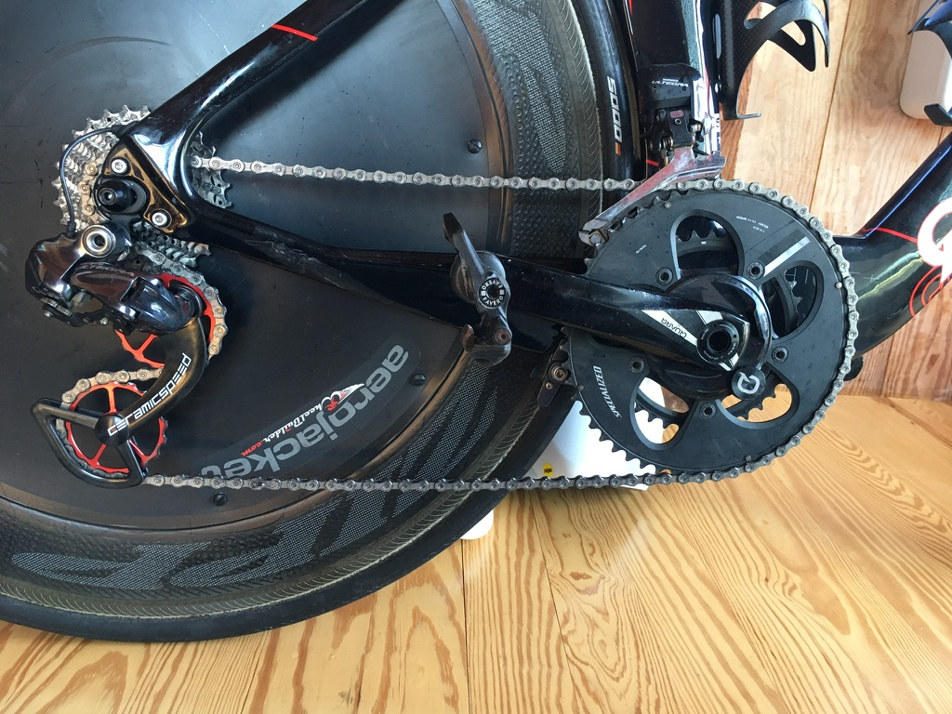
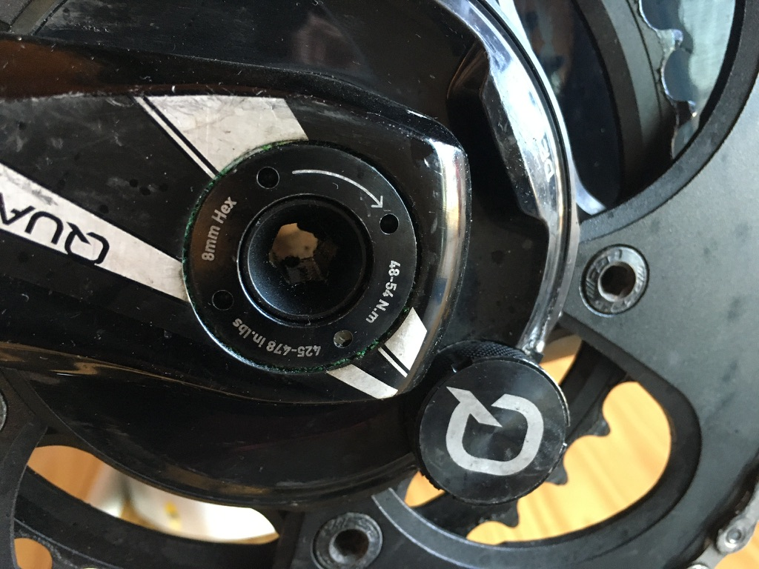
Power = energy flow,
measured in joules/sec = watts

Slide 14
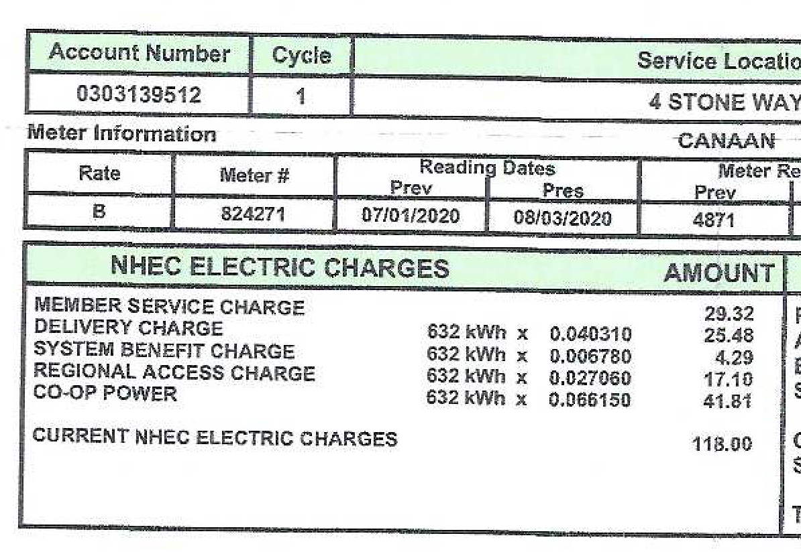
NH Electric Coop buys/sells energy @ 6.6 cents/kWh.
It provides me power service up to 96 kilowatts.
incl Power service -->
Transmission -->
Grant programs-->
Transmission -->
Energy -->

Slide 15
Power = energy flow, measured in joules/sec = watts
Dumb answers to real questions:
Q: How far away is Burlington?
A: 65 miles per hour
Q: How much energy is stored in world batteries?
A: 180 megawatts
Next: California’s grid operator and largest newspaper print such nonsense.

Slide 16
"As of September 2019, global tracked energy storage totalled nearly 188 GW"
https://www.caiso.com/Documents/EnergyStorage-PerspectivesFromCalifornia-Europe.pdf
"The U.S. has about 1,400 megawatts of battery storage — equivalent to the output of two natural-gas-fired power plants"
https://www.latimes.com/business/story/2020-03-04/solar-batteries-banks

Slide 17
Notation assistance: (t) (e)
Heat flow and power both measured in watts (joules/sec)
kW(t) = kilowatts thermal (3600 x 1000 joules/sec)
kW(e) = kilowatts electrical (3600 x 1000 joules/sec)

Slide 18
Notation assistance: heat(t) electricity(e)
Heat flow and power both measured in watts (joules/sec)
kW(t) = kilowatts thermal (3600 x 1000 joules/sec)
kW(e) = kilowatts electrical (3600 x 1000 joules/sec)
Heat and useful energy both measured in joules (watt-seconds)
kWh(t) = kilowatt hours thermal (3600 x 1000 joules)
kWh(e) = kilowatt hours electrical (3600 x 1000 joules)

Slide 19
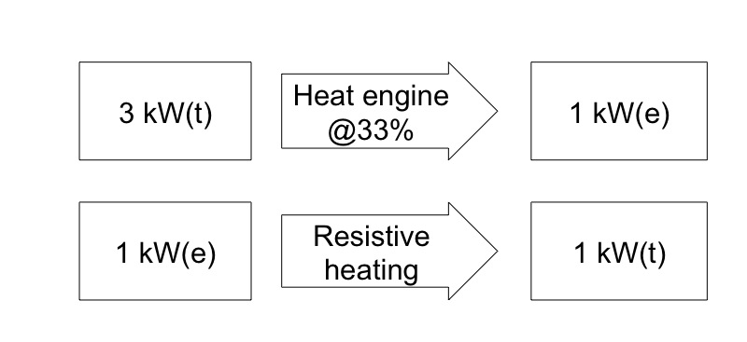
Typical efficiency.

Slide 20
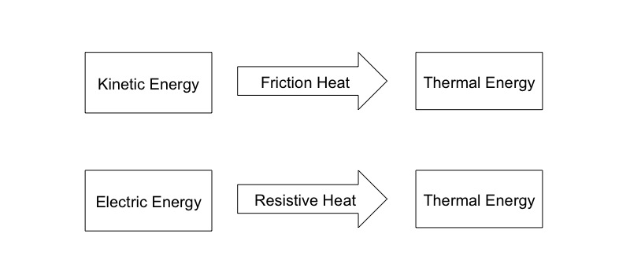
Useful energy decays to heat. [2nd Law]
kWh(e)
kWh(t) heat

Slide 21
Useful energy decays to heat. [2nd Law]
kWh(e)
kWh(t) heat
Never add Wh(t) and Wh(e) and call it "total energy".
It’s like adding Miles + Kilometers, calling it Distance!

Slide 22
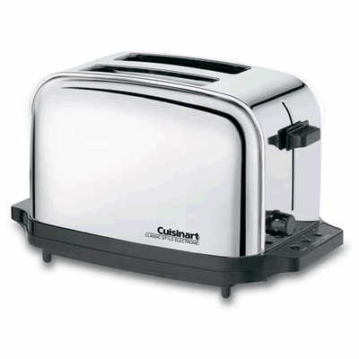
Examples: energy, flowing (power) to energy
Lithium ion battery
Electric car
200 kW electric power
Chemical potential energy
Kinetic energy
Hydro power plant
Toaster
1000 W electric power
Gravitational potential energy
Thermal energy
Notes:
http://www.conceptcarz.com/vehicle/z17377/Tesla-Roadster.aspx
http://www.toaster-oven.net/browseproducts/Cuisinart-Classic-Toaster.HTML

Slide 23
2 Basics of energy and power
Useful energy
Heat
Work from heat
Power
Fission is in Fashion

