Slide 1
14 Energy policy
#1 Educate people and politicians about fission energy.
#2 Technologies deserving of public and private investment.
#3 Lift regulatory roadblocks.
#4 Prioritize low energy costs through free competition.
#5 Proffer low cost energy first, use mandates and taxes last.
Fission is in Fashion

Slide 4
Russia Energy Policy (Putin’s 1997 economics thesis)
1. Mineral and raw materials represent the most important potential for the economic development of the country.
2. The main reserve for transforming Russia in the relatively near-term future into a leading economic power with a high standard of living for the majority of the population is comprehensive assistance to the development of the national processing industries based upon the extraction industries.
3. The analysis of the economic processes taking place in the world requires comprehensive state support and the creation of large financial-industrial corporations which span several industries on the basis of the resource-extracting enterprises, which could compete as equals with the transnational corporations of the West.
4. The development of the extracting complex should be regulated by the state using purely market methods; moreover the state must assist the development of processing industries based upon the extraction industries in every way.
https://www.theatlantic.com/daily-dish/archive/2008/08/putins-thesis-raw-text/212739/

Slide 5
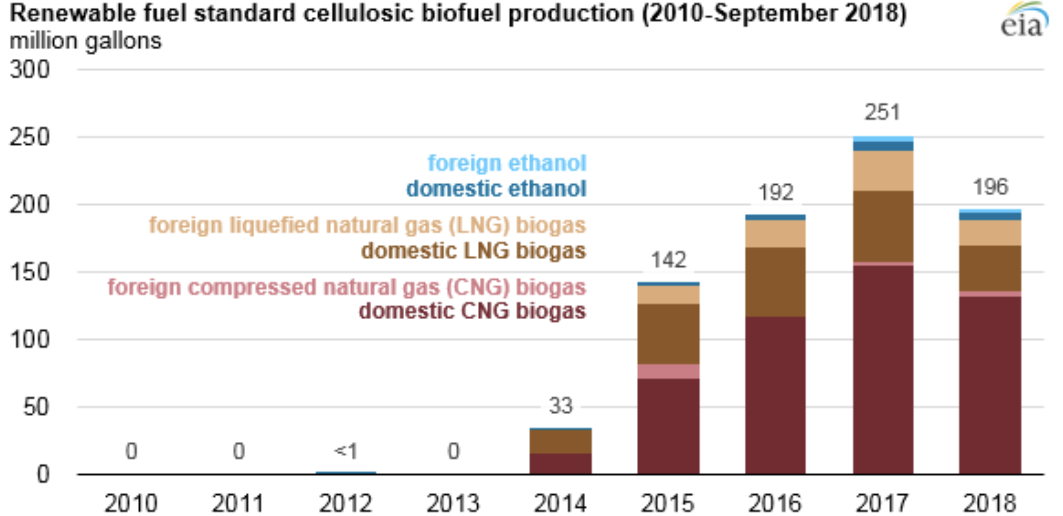
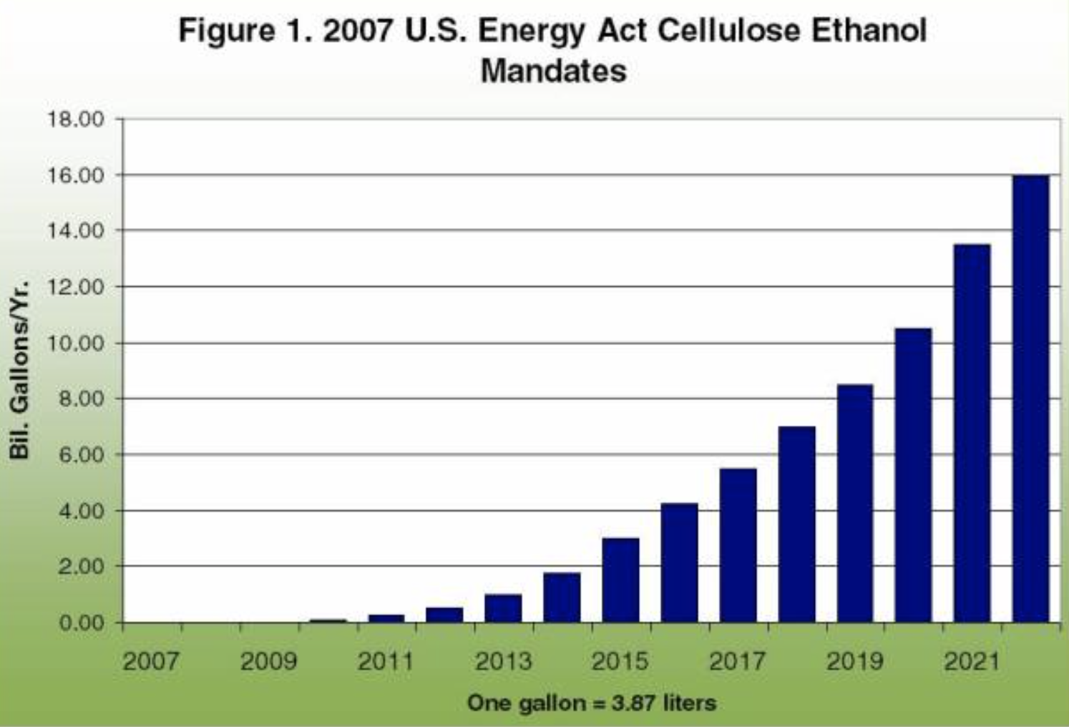
Mandate carefully. Mandates often don't work; for example:
Renewable Fuel Standard
EIA reports: "About 10 million gallons of cellulosic ethanol was used to comply with the RFS in 2017, about half of which was produced domestically. A 2014 final rule expanded EPA’s definition of cellulosic biofuel to include certain types of biogas."
US Congress mandated cellulosic ethanol: 5.5 billion gallons (2017)
https://www.agmrc.org/renewable-energy/renewable-energy-climate-change-report/renewable-energy-climate-change-report/september-2009-newsletter/cellulosic-ethanol-will-the-mandates-be-met
https://www.eia.gov/todayinenergy/detail.php?id=37712

Slide 6
Make NRC competent in fission, energy, and engineering.
Hanson earned master's degrees from Yale Divinity School and Yale School of Forestry and Environmental Studies, where he focused on ethics and natural resource economics. He earned a Bachelor of Arts degree in Religious Studies from Valparaiso University in Valparaiso, Indiana.
Commissioner Baran earned a bachelor’s degree and a master’s degree in political science from Ohio University. He holds a law degree from Harvard Law School.
Commissioner Wright received a bachelor's degree in political science from Clemson University.
https://www.nrc.gov/about-nrc/organization/commfuncdesc.html

Slide 7
#1 Educate people and politicians about fission energy.
Problems
Unawareness of costs of intermittent wind/solar/battery energy.
Even most French people think their fission power plants emit CO2.
Many fear fission power plants might blow up like a bomb.
People (even doctors) are taught all radiation is carcinogenic.
Pompous advisory organs substitute fear and doubt for evidence and science.
Solutions
Science education; young people are more open minded.
Public communications: ample, cheap, clean energy for health and prosperity.
Rebranding as "fission" avoids nuclear weapons mindset.
Political leaders endorse fission and blame all who continued the ALARA fraud.
Frame fission energy as the feedstock for a clean, prosperous economy.

Slide 8
#2 Technologies deserving of public and private investment.
Liquid fission electricity, cheap, 24x7
Hydrogen electrolysis
Vehicle batteries
Fuel cells, SOEC/SOFC
Ammonia synthesis
Ammonia combustion engines
Hydrogen fueled trucks, buses
Resonant inductive highway charging
Hydrogen enhanced biofuels
CO2 from seawater or air to jet fuel
High speed trains, public transportation
Buildings, codes, cooling, heating
Iron ore electrolysis, H2 reduction
Cement production, alternatives
Shipping
Building factories with shipyards

Slide 9
#3 Lift regulatory roadblocks.
End ALARA/LNT policy, which keeps fission energy costs high. Government agencies now appease activists, accede to politicians, ignore science.
Base environmental protection on science, not the precautionary principle.
Permits take decades and billions. Fund and speed up reviews.
Speed up obtaining rights of way for power lines, pipe lines, rail lines.
Overhaul fractured responsibility for electric power grid regulation (in US).
Limit activist, special-interest intervenor, stakeholder delays.

Slide 10
#4 Prioritize low energy costs through free competition.
Sunset all stimulus subsidies.
End directive technology preferences.
Open competition beyond 'certified' suppliers.
End tariffs; enable imports from all international suppliers.
Use multiple, diverse suppliers for energy security.
Remove selective taxes on assets, revenues, and income.

Slide 11
#5 Proffer low cost energy first, use mandates and taxes last.
Imposing global CO2 taxes is not feasible; noncompliance creates economic benefits. Developing nations need energy, have highest, growing CO2 emissions.
Deploy liquid fission electricity cheaper than from coal or LNG. - eliminate over 1/3 of energy CO2 emissions, without mandates or taxes.
Electrified transportation can be cheaper than petroleum fueled transportation. - eliminate almost 1/3 of energy CO2 emissions, with few mandates or taxes.
For buildings, market energy cost savings; support district heating; mandate building codes.
Industry. Assist, subsidize, cajole, bully, threaten, tax; then mandate.

Slide 12
14 Energy policy
#1 Educate people and politicians about fission energy.
#2 Technologies deserving of public and private investment.
#3 Lift regulatory roadblocks.
#4 Prioritize low energy costs through free competition.
#5 Proffer low cost energy first, use mandates and taxes last.
Fission is in Fashion

