Slide 1
13 Industry
3200 GWt power today
Cement
Plasma arc temperatures
Iron reduction, electrolysis
Aluminum, solid electricity
Shipyard building factories
Fission is in Fashion

Slide 2
Energy to change industrial processes
2500 GW
Heating
Cheap, 24x7
liquid fission electricity 12,000 GW
intermediate
Hydrogen 3,000 GW
2700 GW
Light industry
1700 GW
Building ops
1800 GW
Heavy industry
300 GW
Electric vehicles
C-synfuel 400 GW
300 GW
1600 GW
Heavy transport
200 GW
400 GW
Airplanes
Ammonia 700 GW
800 GW
400 GW
Shipping
Biomass
400 GW
300 GW
1700 GW
Food

Slide 3
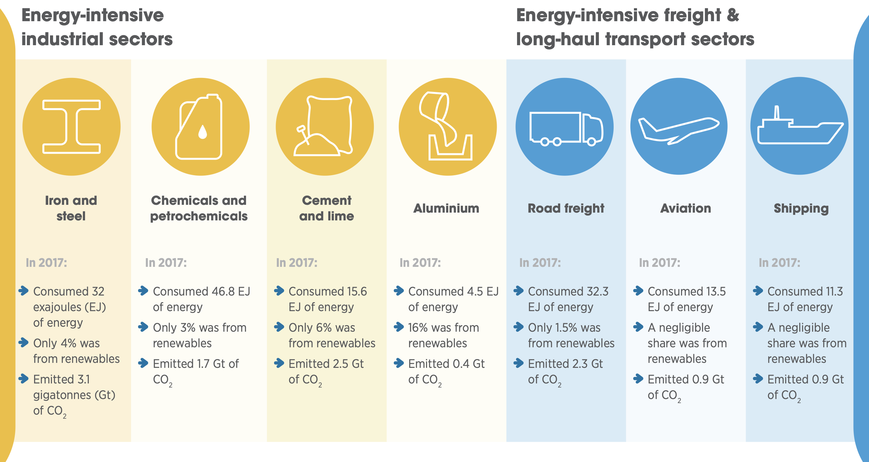
IRENA has industry power use estimates.
Some of 1500 GW of chemical and petrochemical power consumption related to fuel refining will not be needed.
1000 GW
1500 GW
500 GW
150 GW
1000 GW
400 GW
400 GW
3 Gt/y
2 Gt/y
3 Gt/y
<1 Gt/y
2 Gt/y
1 Gt/y
1 Gt/y
https://www.irena.org/-/media/Files/IRENA/Agency/Publication/2020/Sep/IRENA_ReachingZero_Summary_2020.pdf

Slide 4
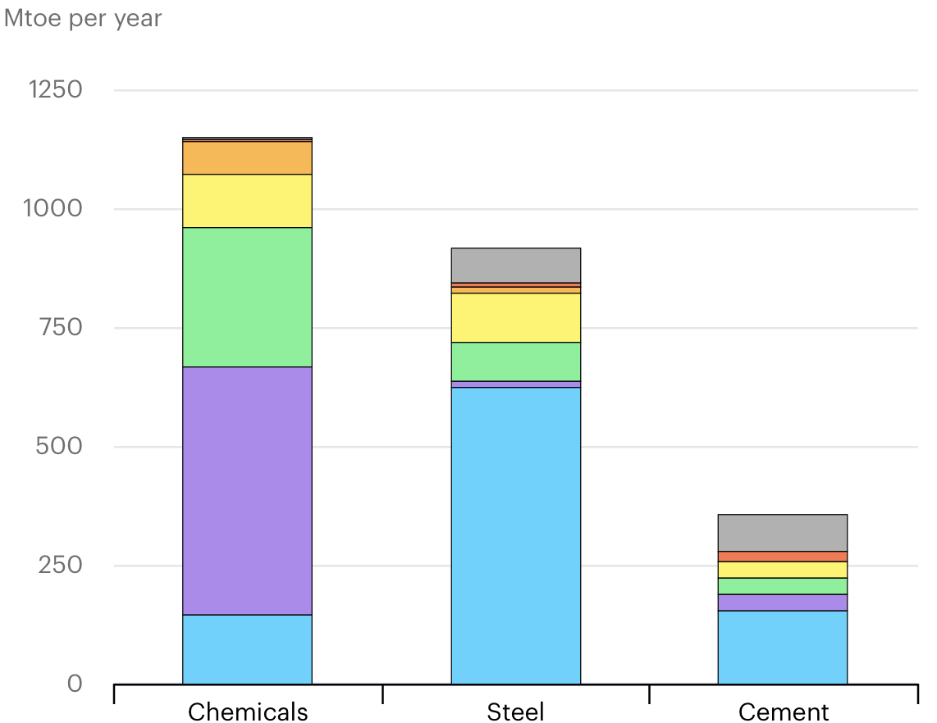
IEA has similar power use data.
Text block
1800 GW
1300 GW
600 GW
https://www.iea.org/articles/the-challenge-of-reaching-zero-emissions-in-heavy-industry

Slide 5
GREAT BOOK FREE at http://www.withbotheyesopen.com/read.php?c=9

Slide 6
Sustainable Materials with Both Eyes Open
Top 5 materials produced
Power
444 GWt
1553 GWt
583 GWt
247 GWt
377 GWe
http://www.withbotheyesopen.com/read.php

Slide 7
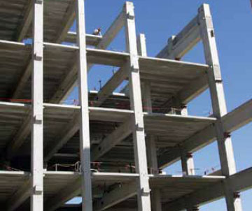
Cement is critical for infrastructure construction.
Annual cement use | M tonnes
US consumption | 106
China consumption | 1800
World consumption | 3300
circa 2010
http://http://www.prlog.org/10048173-world-asphalt-forecasts-for-2011-2016.html
http://en.wikipedia.org/wiki/Cement

Slide 8
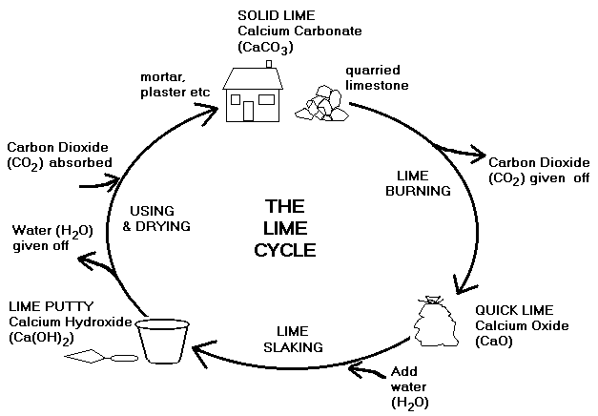
Making cement by heating limestone drives off CO2 that is reabsorbed later.
http://www.stratis.demon.co.uk/lime.htm
Notes:
Carbon neutral

Slide 9
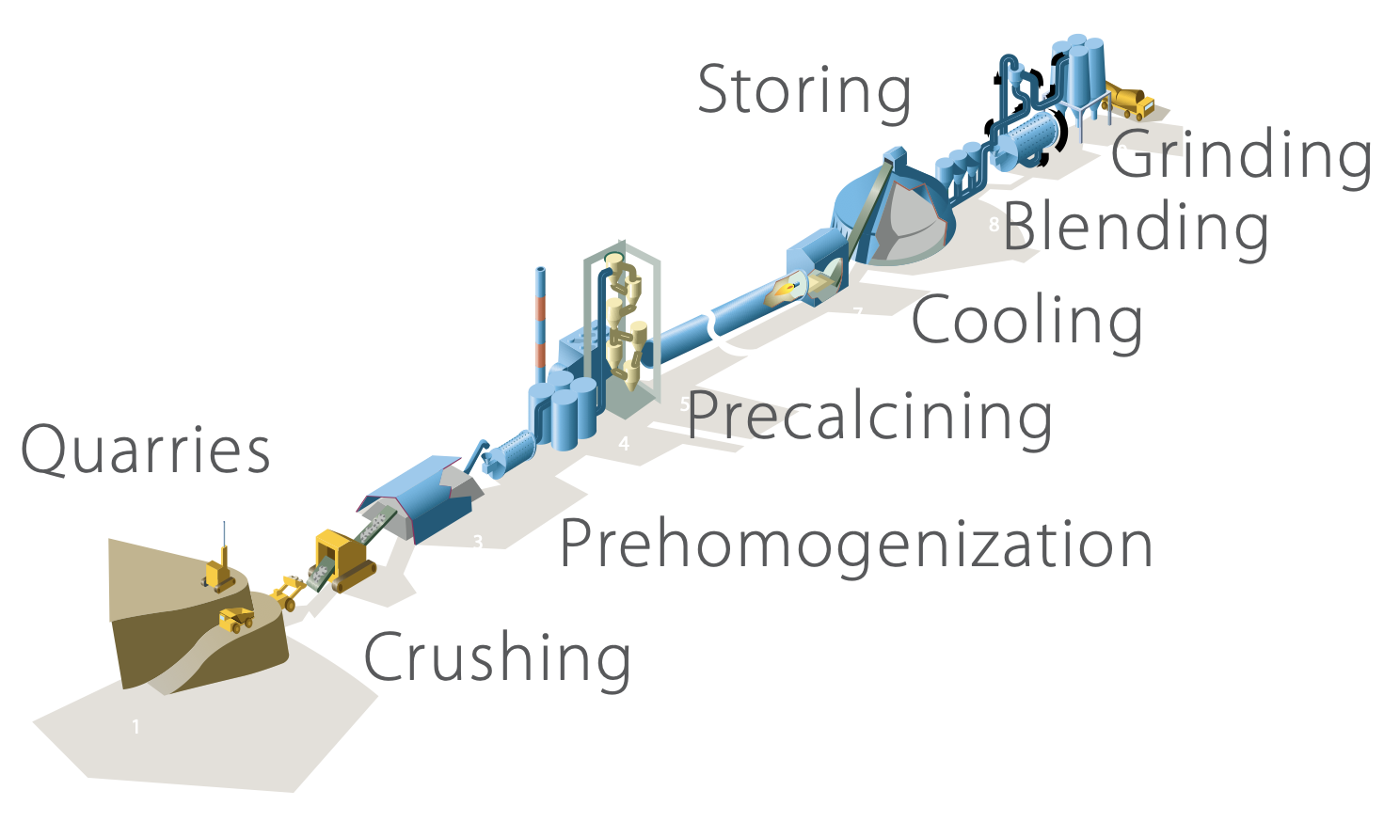
Cement energy use and emissions can be improved.
Sustainable Materials with Both Eyes Open
Method | Energy use GJ/t
Theory | 1.8
Best practice | 2.9
Average | 5.0
Fission-powered plasma arc heating to 1500°C for cement?
http://www.withbotheyesopen.com/read.php

Slide 10
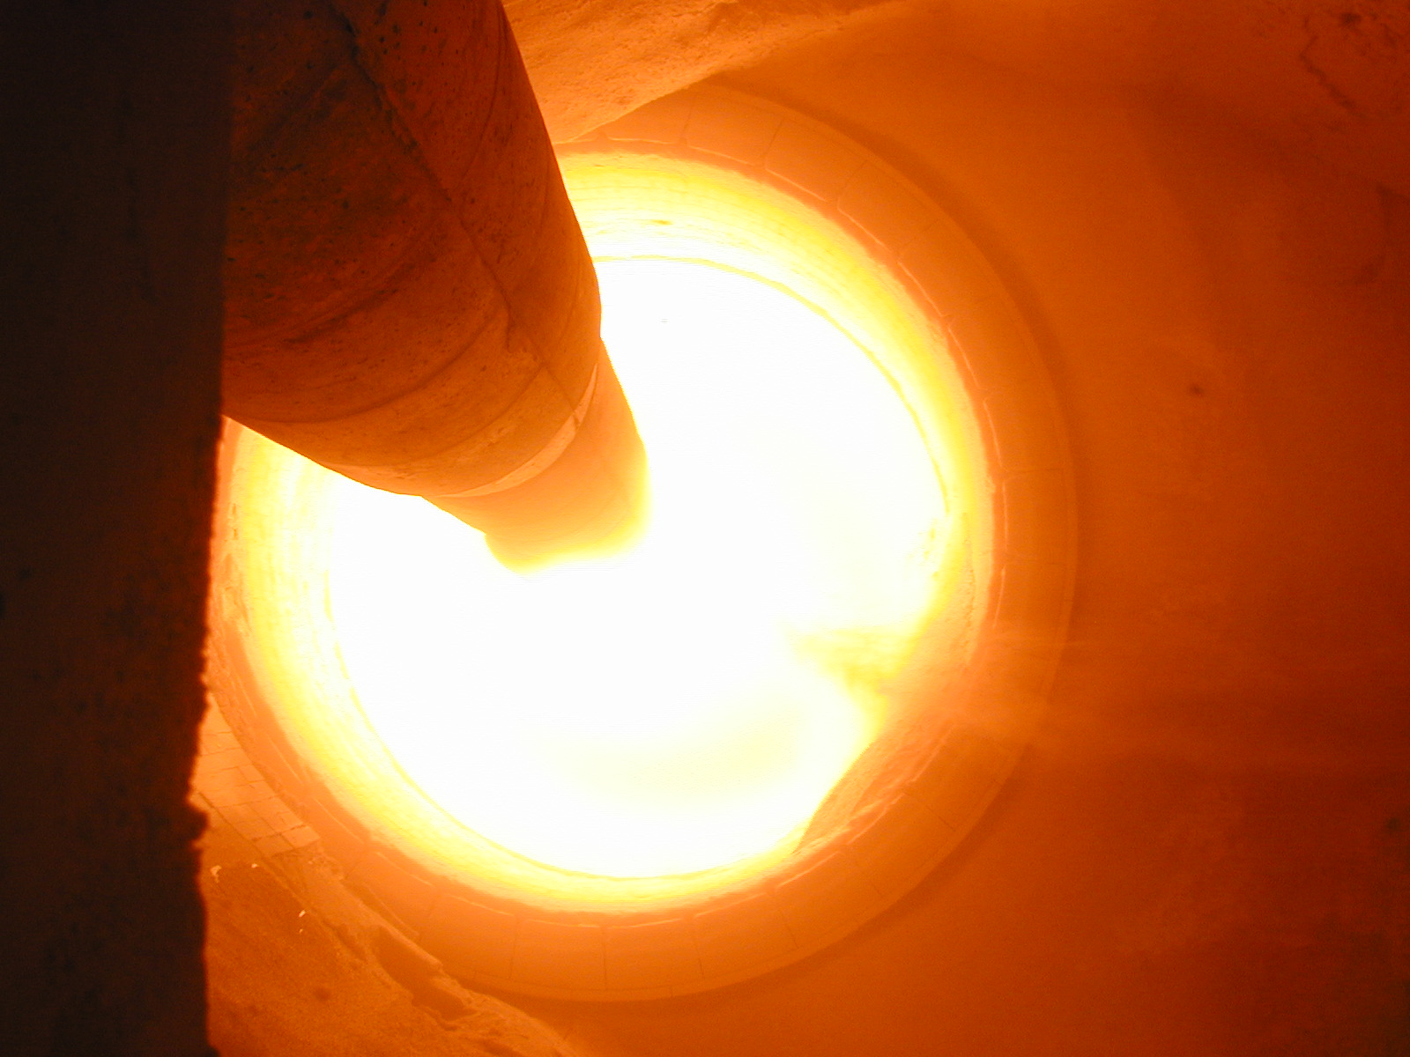
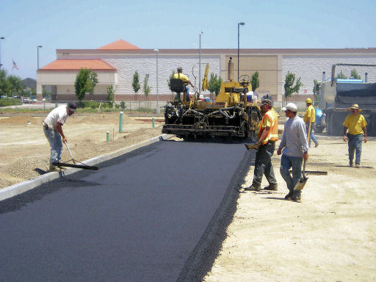
Alternatives to Ca-Si cement? to road surfaces?
CO2 emissions avoided | M tonnes
Cement production | 829
Production emissions | 35
Asphalt production | 124
Future oxidation | ~400
WORLD TOTAL | 1264
http://www.soci.org/News/~/media/Files/Conference%20Downloads/Asphalt%20carbon%20footprint%20Mar%2009/Lancaster.ashx

Slide 11
1400 Mt of steel are used every year.
Sustainable Materials with Both Eyes Open
http://www.withbotheyesopen.com/read.php

Slide 12
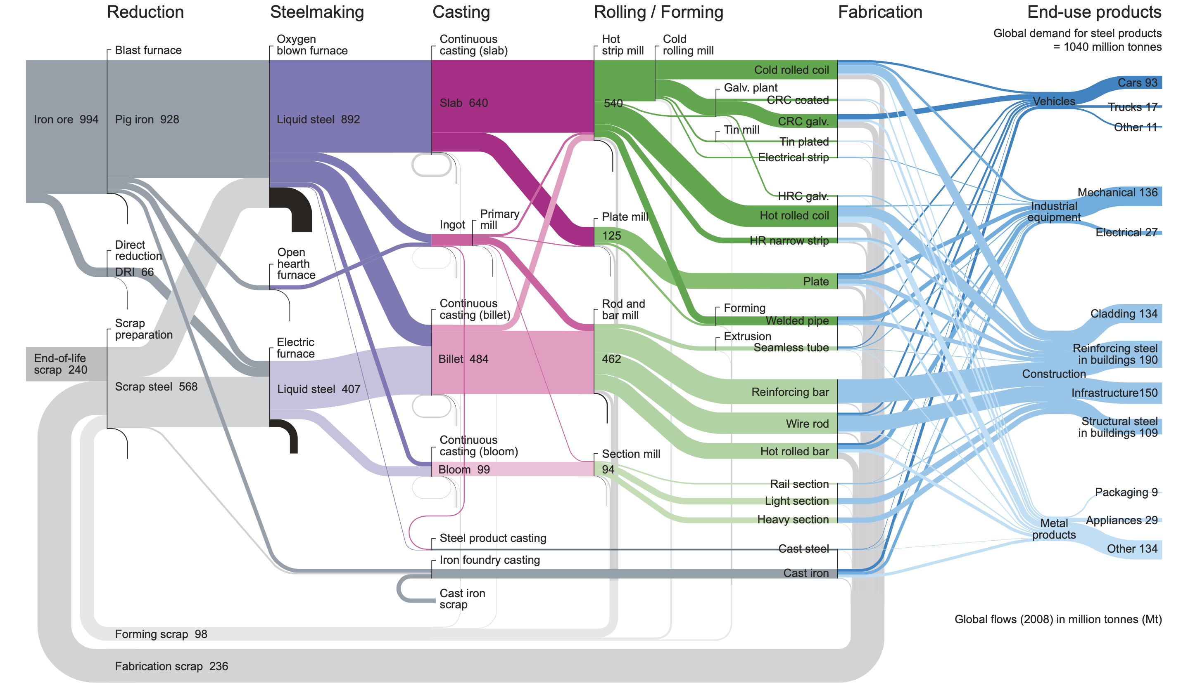
Sankey steel flow
Sustainable Materials with Both Eyes Open
http://www.withbotheyesopen.com/read.php

Slide 13
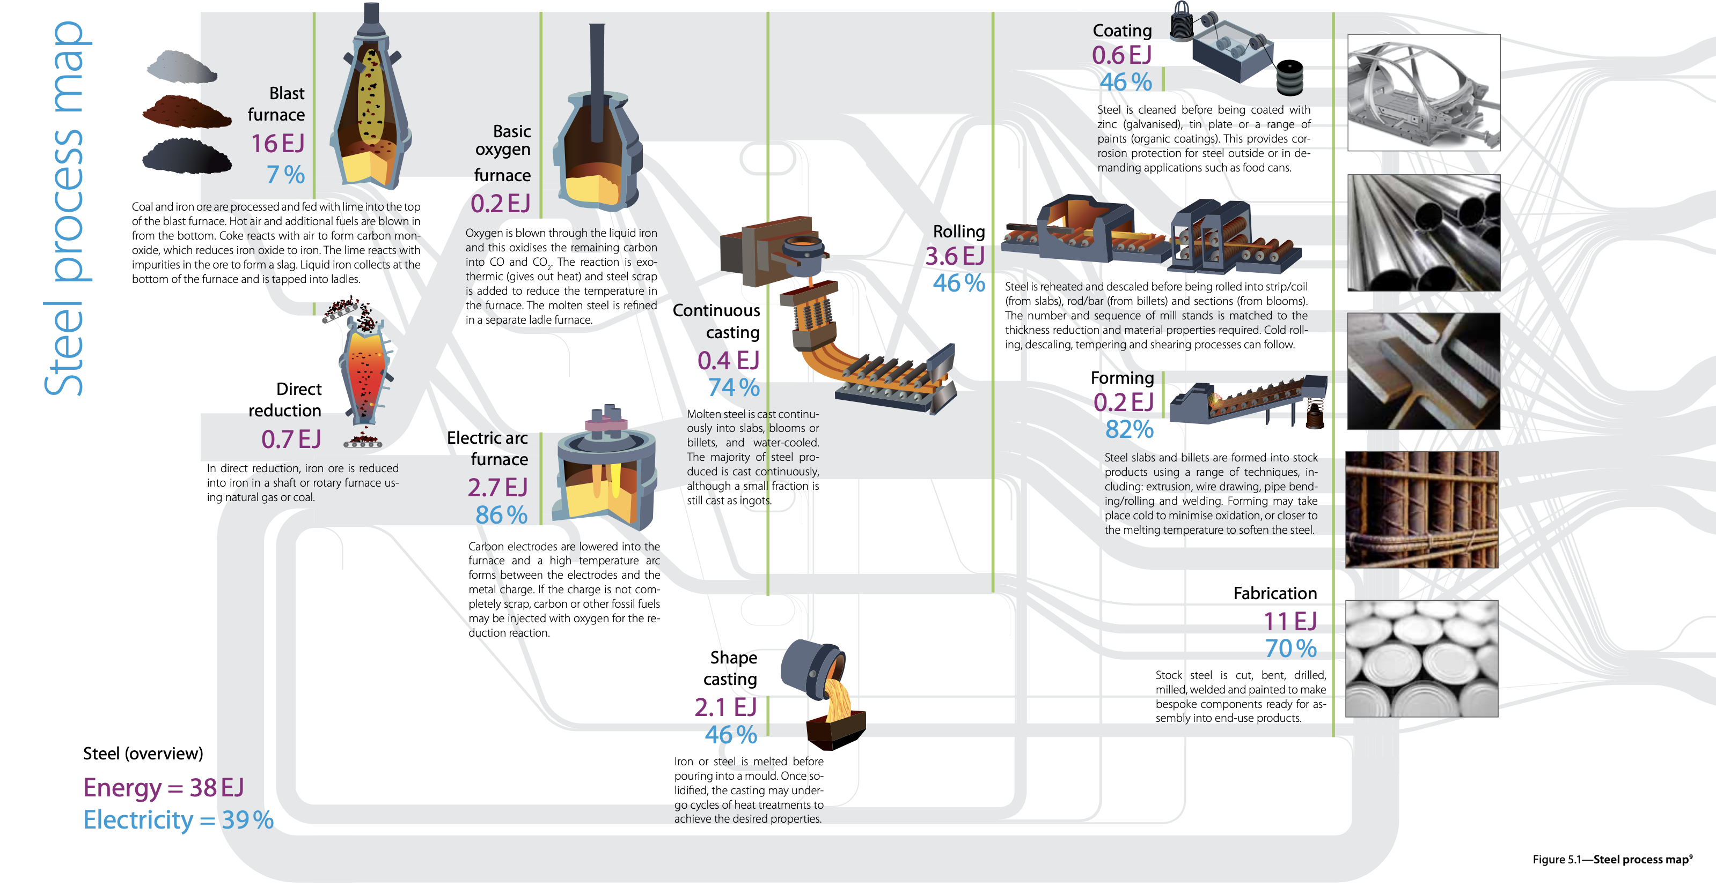
Steelmaking uses 900 GW(t) plus 600 GW(e).
Sustainable Materials with Both Eyes Open
http://www.withbotheyesopen.com/read.php

Slide 14
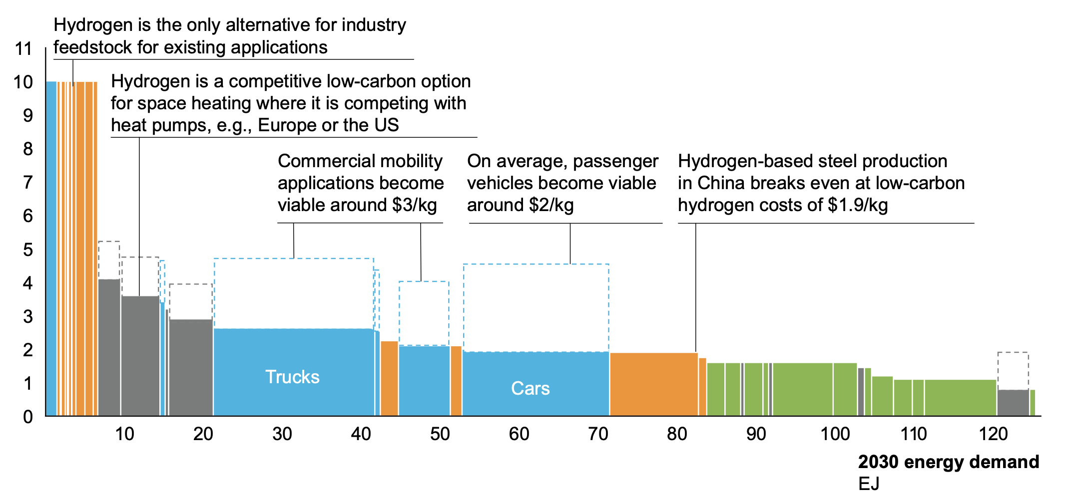
Hydrogen based steel production may be viable at $1.9/kg-H2.
(Hydrogen Council)
H2 $/kg
https://hydrogencouncil.com/wp-content/uploads/2020/01/Path-to-Hydrogen-Competitiveness_Full-Study-1.pdf

Slide 15
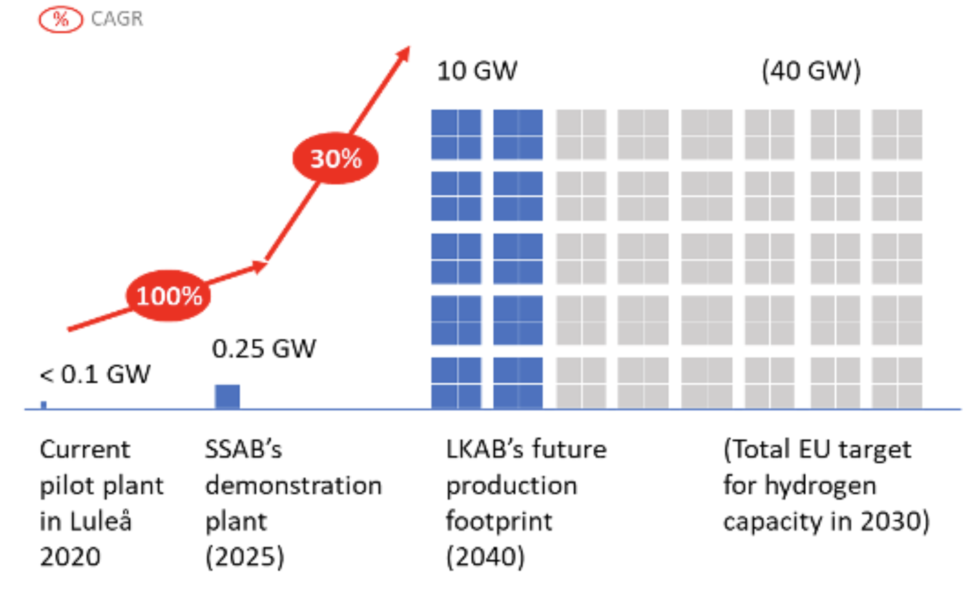
RMI estimates 10 GW of H2 use for LKAB project to remove oxygen from iron oxide using H2 reduction.
https://rmi.org/wp-content/uploads/2020/12/steel-hydrogen-graphic-TKB.png

Slide 16
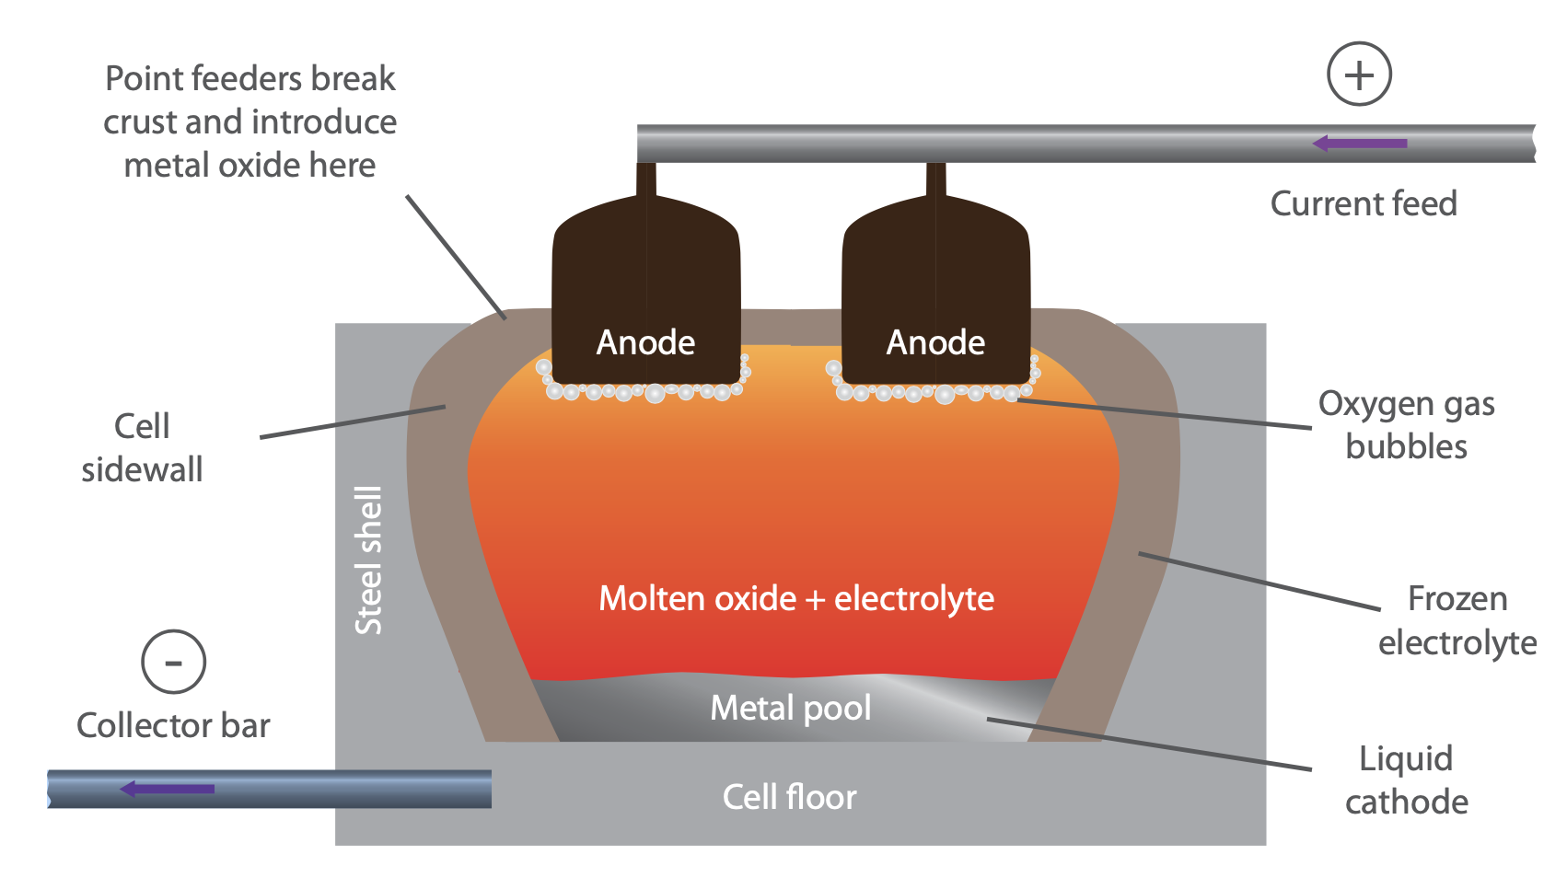
Iron may be freed from oxide ore by electrolysis.
Sustainable Materials with Both Eyes Open
http://www.withbotheyesopen.com/read.php

Slide 17
Iron reduced by electrolysis eliminates CO2 emissions.
https://www.youtube.com/watch?v=-pYNzxorJs0&feature=emb_logo

Slide 18
45 Mt of aluminum are used each year.
Sustainable Materials with Both Eyes Open
http://www.withbotheyesopen.com/read.php

Slide 19
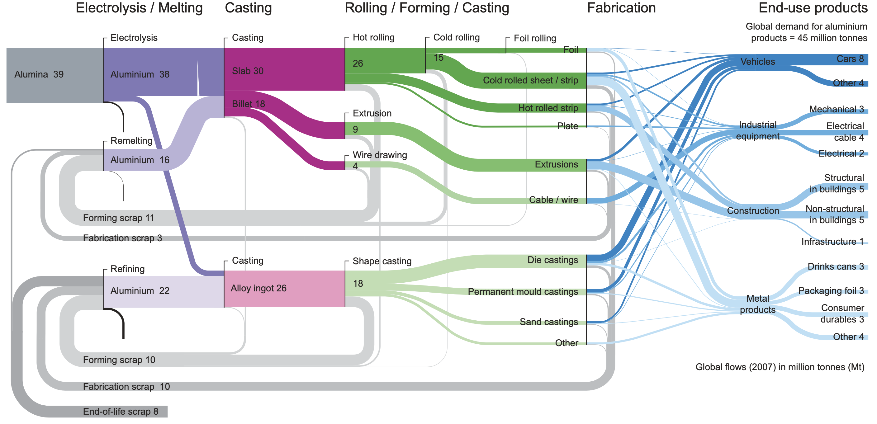
Sustainable Materials with Both Eyes Open
Sankey aluminum flow
http://www.withbotheyesopen.com/read.php

Slide 20
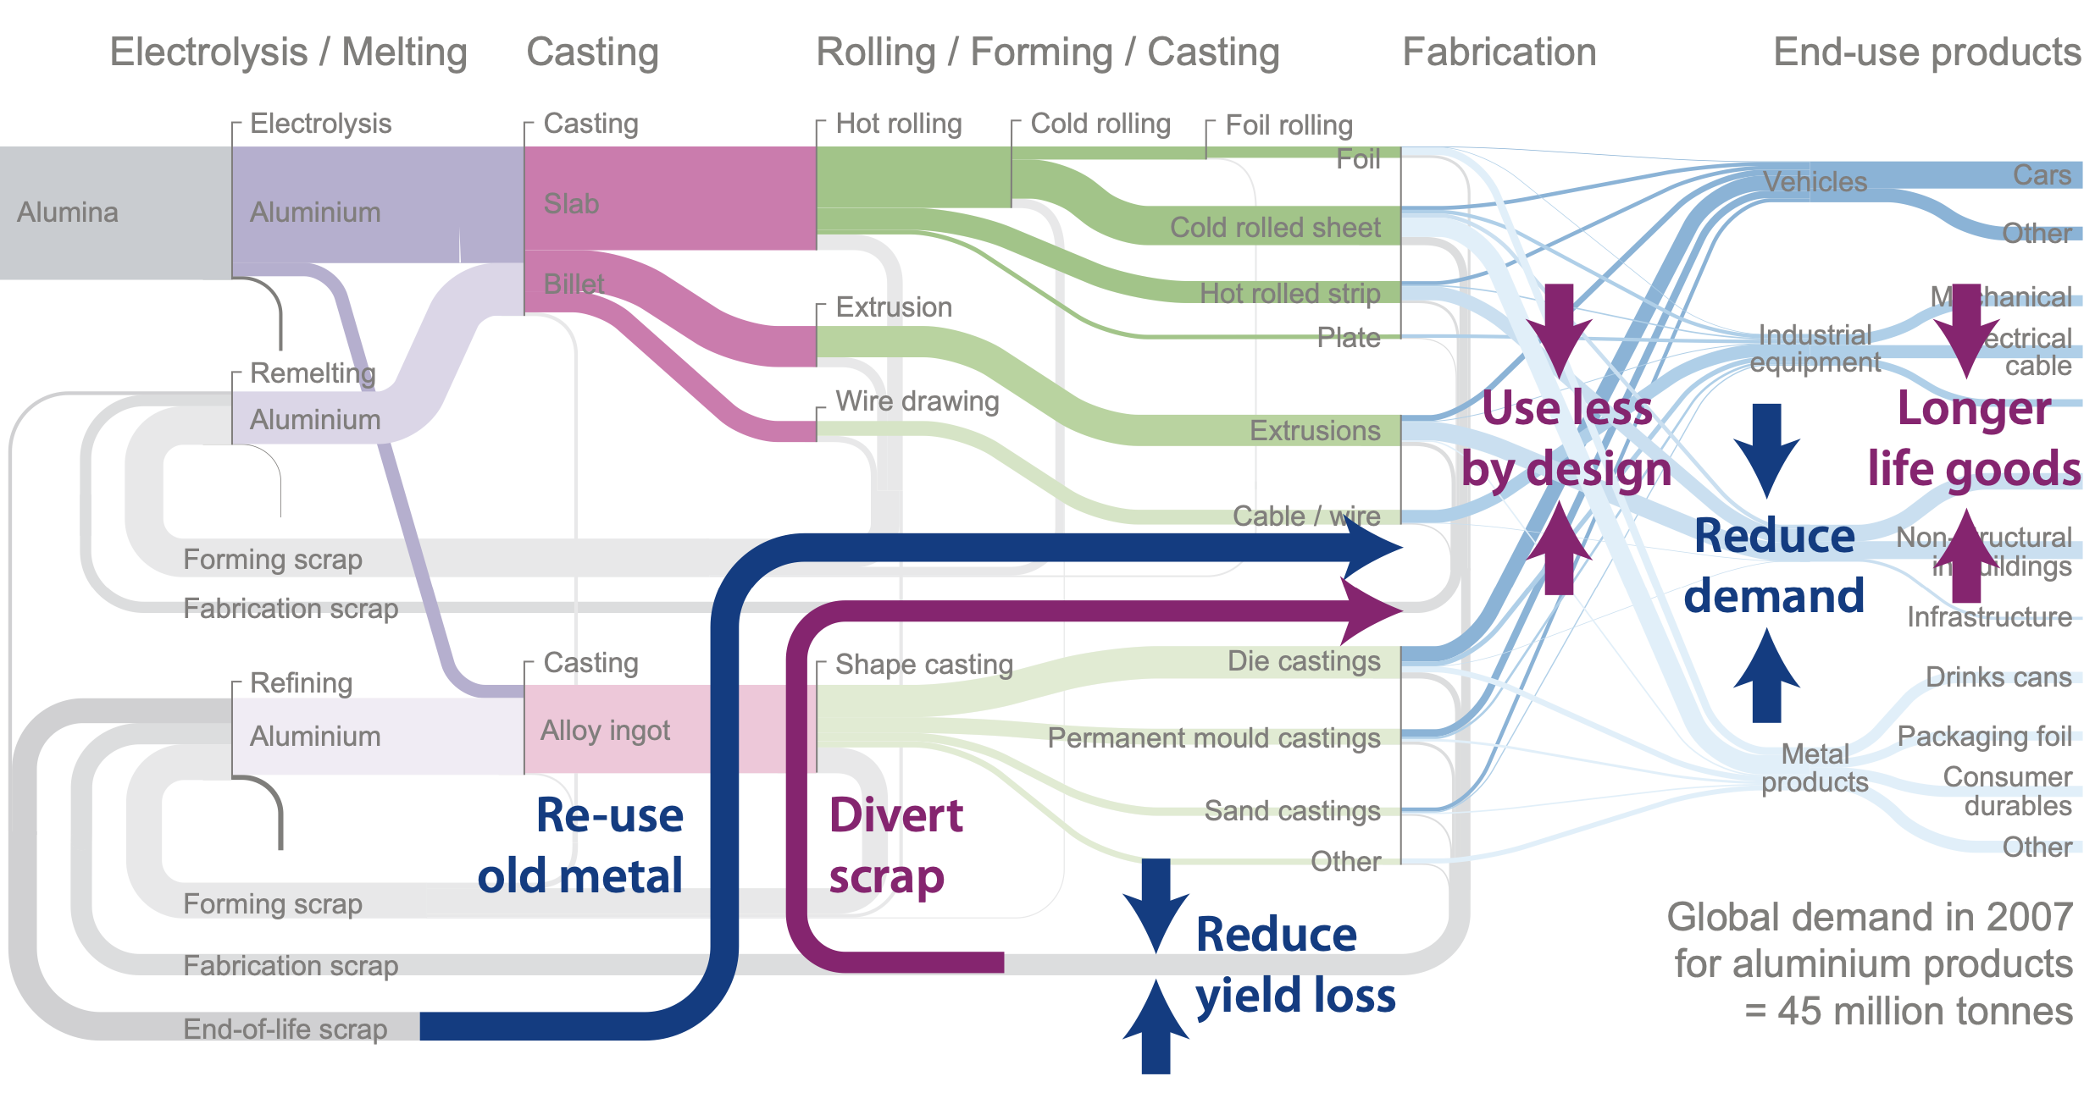
What else? Re-engineer the materials processes.
Text block

Slide 21
Shipbuilding technology for whole new factories.
Shell's natural gas liquifaction plant larger than 5 aircraft carriers.
https://en.wikipedia.org/wiki/Floating_production_storage_and_offloading
https://www.abc.net.au/news/2020-08-21/worlds-largest-floating-lng-factory-remains-in-shutdown/12565490

Slide 22
13 Industry
3200 GWt power today
Cement
Plasma arc temperatures
Iron reduction, electrolysis
Aluminum, solid electricity
Shipyard building factories
Fission is in Fashion

