Slide 1
12 Buildings
Cooling
Heating
Insulation
Co-generation
Fission is in Fashion

Slide 2
Electrified world power flow
2500 GW
Heating
Cheap, 24x7
liquid fission electricity 12,000 GW
intermediate
Hydrogen 3,000 GW
2700 GW
Light industry
1700 GW
Building ops
1800 GW
Heavy industry
300 GW
Electric vehicles
C-synfuel 400 GW
300 GW
1600 GW
Heavy transport
200 GW
400 GW
Airplanes
Ammonia 700 GW
800 GW
400 GW
Shipping
Biomass
400 GW
300 GW
1700 GW
Food

Slide 3
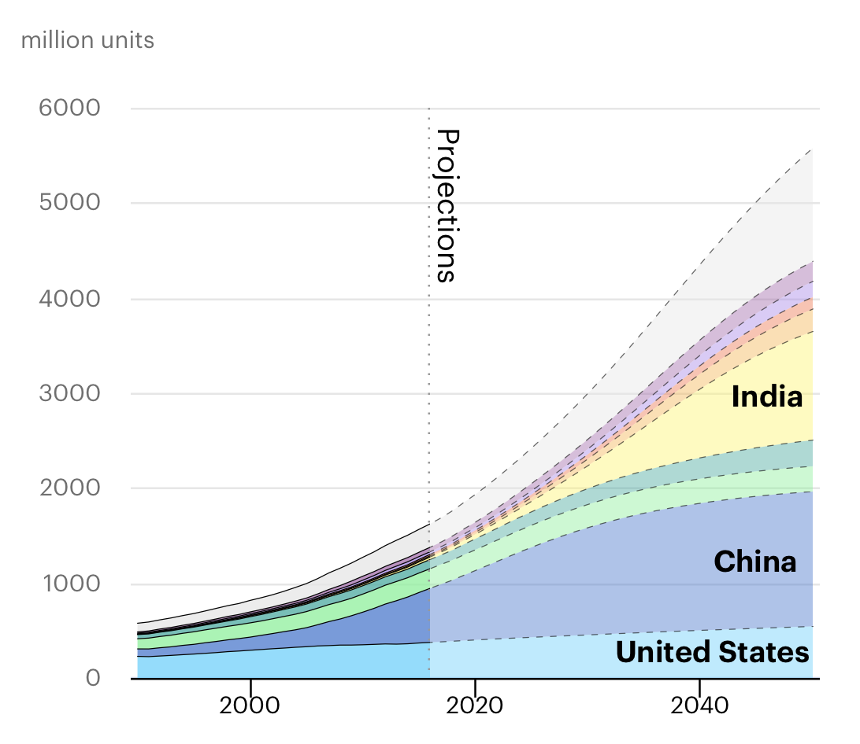
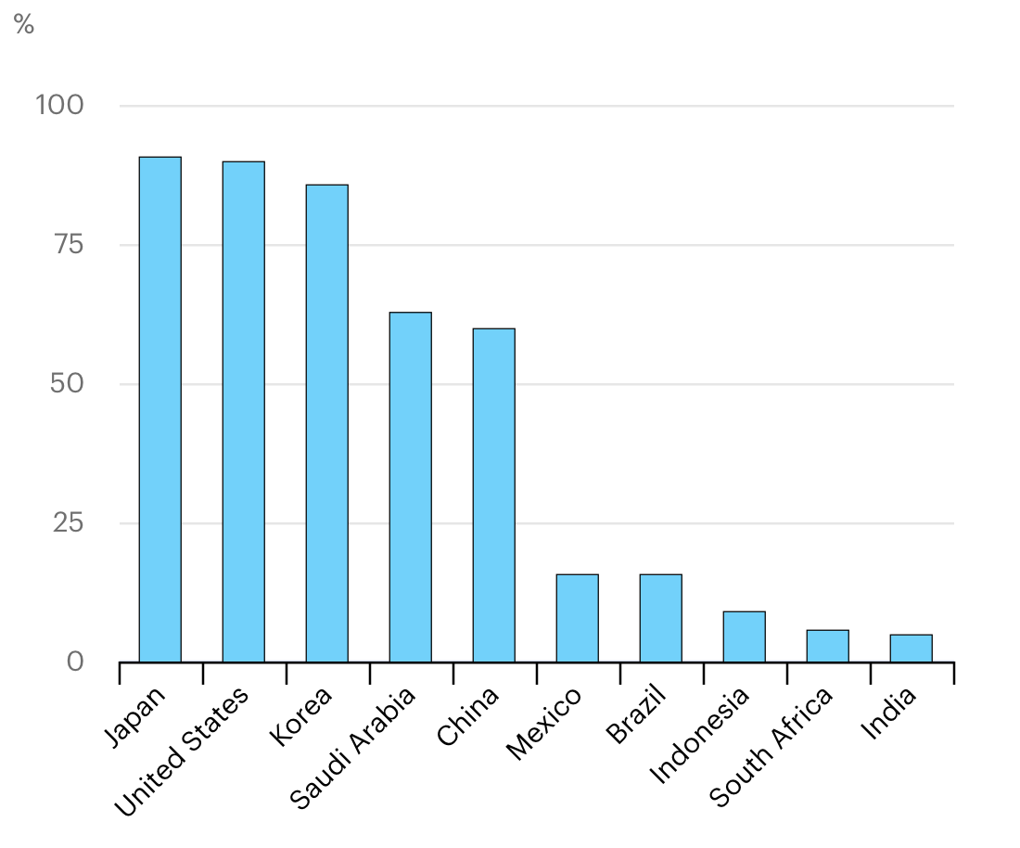
Cooling consumes > 8% of all electricity.
Responsible for 1 Gt CO2 emissions.
2 billion units in operation use 250 GW.
Unit sales increasing 10-15% per year.
Ave COP efficiency could double, to 6.
Air conditioning units will triple, with electricity consumption of 700 GW by 2050.
Percentage of home with air conditioning
https://www.iea.org/reports/the-future-of-cooling
https://www.technologyreview.com/2020/09/01/1007762/air-conditioning-grid-blackouts-california-climate-change/

Slide 4
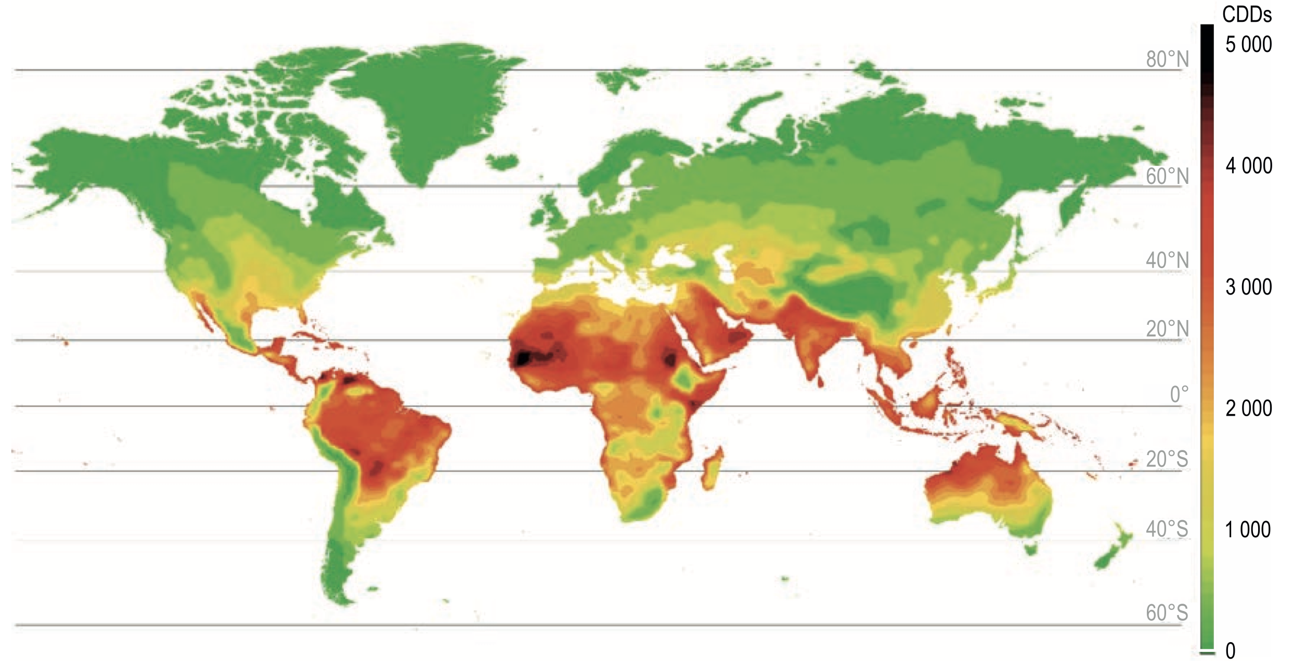
Annual cooling degree days portend high GW demand as developing nations prosper (and global warming persists).
https://webstore.iea.org/download/direct/1036

Slide 5
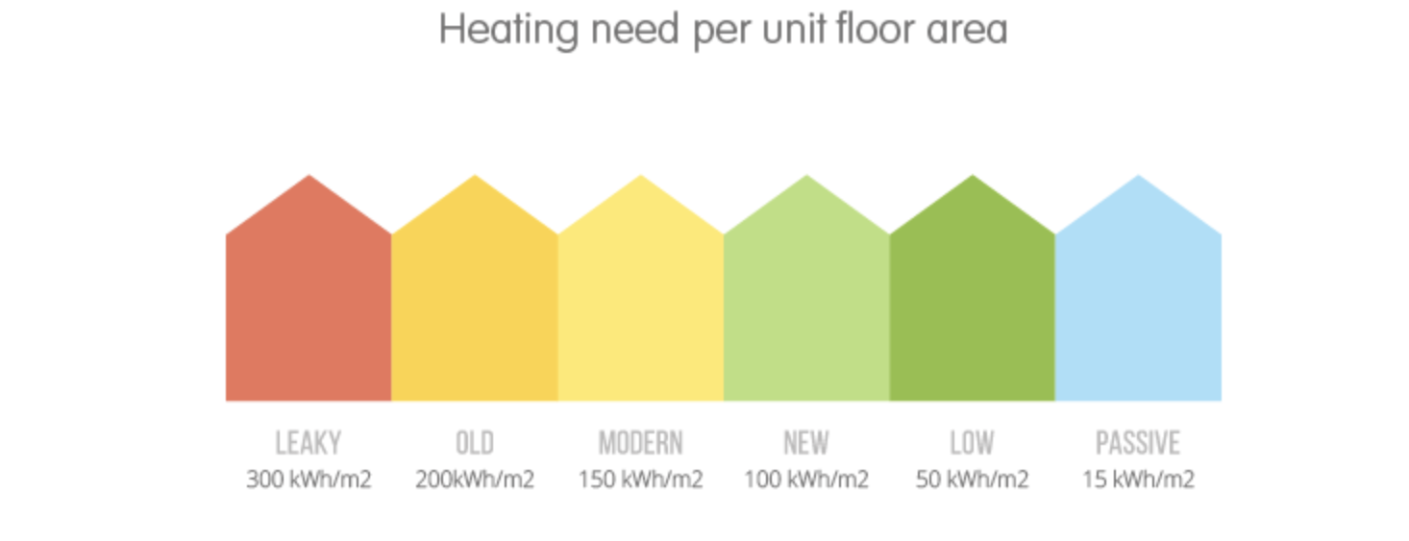
Home heating demand varies by 20:1
https://www.ovoenergy.com/guides/energy-guides/how-much-heating-energy-do-you-use.html

Slide 6
Well insulated buildings are #1 priority to reduce heat demand.
Example specification: well sealed, well insulated Vermont 2000 sq ft home)
Passive solar features
R40 walls
R60 ceiling
R20 basement
R7 triple-glazed windows
R8 doors
Air in-leakage less than 1.0 air changes per hour at 50 pascal.
HVAC whole-house, forced-air ventilation of 0.5 air changes per hour.
Air-to-air heat recovery exchanger.
Space heating demand at -10°F, 6 kW(t).
Willem Post, P.E.

Slide 7
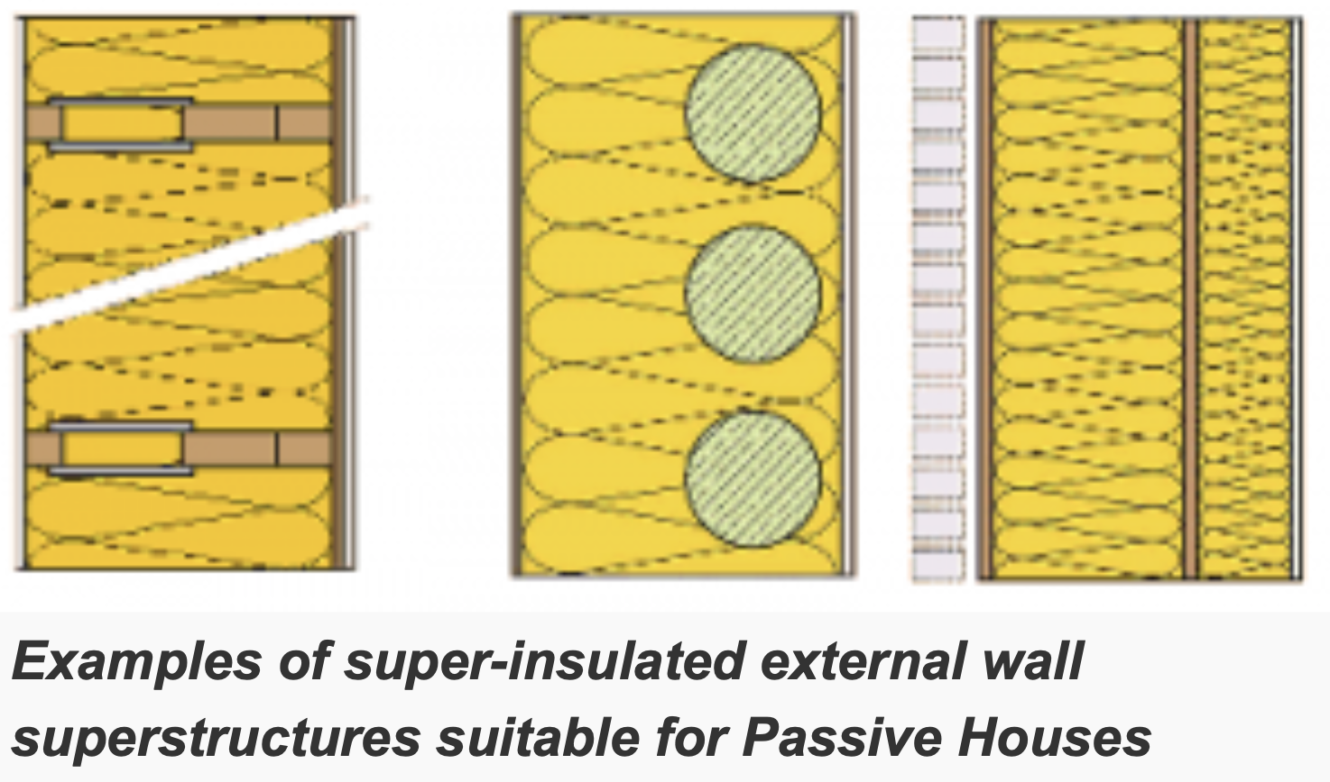
LEED, Passivehaus can be $$$ certification regimes.
Making Passive House homes affordable
THE UN-CERTIFIED BUT 'DAMN NEAR' PASSIVE HOUSE.
One of the first steps was to convince people to pay more for the construction of the building, instead of a cheaper building with higher energy bills.
https://passipedia.org/planning/thermal_protection/integrated_thermal_protection
https://www.ecohome.net/guides/1482/the-un-certified-but-damn-near-passive-house/

Slide 8
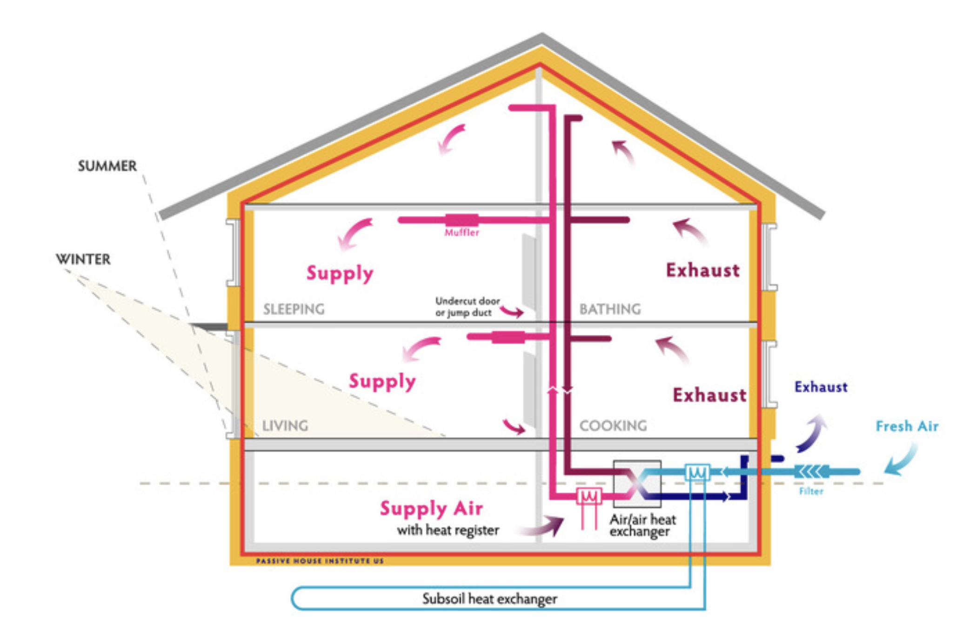
Ground source heat pump, air/air heat exchanger in air-tight home.
https://www.phius.org/what-is-passive-building/passive-house-principles

Slide 9
Electric resistance heating is common in UK (and Quebec).
https://www.open.edu/openlearn/ocw/mod/oucontent/view.php?printable=1&id=21281

Slide 10
Air source heat pumps can do both heating and cooling.
Coefficient of Performance = kW(t) output / kW(e) input
Gov’t: HSPF (BTU/Wh) = 3.41 x COP
Heating COP drops with temperature.
Utilities burn more natural gas as electricity demand goes up.
Below 20-35°F home furnaces use less natural gas than utility would.
Near 0°F COP ~1, like resistive heat.
Hybrid heating: keep gas or oil furnace for backup, for lower CO2.
https://www.linkedin.com/pulse/lets-run-towards-hybrid-heat-pumps-benefits-climate-harvey-michaels/

Slide 11
Well insulated buildings are #1 priority to reduce heat demand.
Example specification: well sealed, well insulated Vermont 2000 sq ft home)
Passive solar features
R40 walls
R60 ceiling
R20 basement
R7 triple-glazed windows
R8 doors
Air in-leakage less than 1.0 air changes per hour at 50 pascal.
HVAC whole-house, forced-air ventilation of 0.5 air changes per hour.
Air-to-air heat recovery exchanger.
Space heating demand at -10°F, 6 kW(t).
Caveats for air source heat pumps in Vermont:
At 44°F Mitsubishi heat pump delivers 6 kW(t), uses < 2 kW(e); but at -10°F delivers nil.
Home might survive -10°F with 6 kW(e) resistive heating (2 stovetop burners plus oven).
Propane heater and tank are rational backup for power failure or extreme cold.
Willem Post, P.E.

Slide 12
Ground source heat pumps cost more.
HDPE tubing has ~50 year lifetime.
Suited to college campuses.
Harvard’s 19, 1500-foot-deep wells provide partial heating/cooling for 6 buuildings.
Economics? “…’simple payback’ is often a misleading metric…”
https://www.nwf.org/~/media/PDFs/Campus-Ecology/Reports/Geothermal%20Guide%20FINAL%203-1-11.ashx

Slide 13
District heating can bypass thermal-electric, electric-thermal conversions.
Efficiency ~ 33%
COP ~ 3
Thermal plant
Steam turbine generator
Heat pump
Steam turbine generator
Heated building
Fuel
Heat
Electricity
Heat
~ $1,000/kW
~ $1,500/kW
Thermal plant
Hot water
Heated building
Fuel

Slide 14
District heating reactors will be located in China cities.
CGN – The NHR200-II reactor is a low-temperature district heating reactor. Its design is described by CGN as “mature”, having passed National Nuclear Safety Administration review in the 1990s. In February 2018 it was announced that CGN and Tsinghua University were carrying out a feasibility study on constructing China’s first district heating nuclear plant using the NHR200-II design.
CNNC – The District Heating Reactor-400 (DHR-400) or ‘Yanlong’ is a low-temperature 400 MW pool-type reactor. It is designed to provide heat at 90°C for up to 200,000 three-bedroom apartments. The reactor prototype achieved 168 hours of continuous heat supply in November 2017 – seen by its developers, CNNC, as the first major step towards commercialization of the design.
SPIC – The Advanced Happy200 is similar to the Yanlong, 200 MW and producing hot water at 110°C. Pre-feasibility studies suggest first commissioning in 2022. In February 2019, SPIC contracted to build the Baishan Nuclear Energy Heating Demonstration Project in Jilin province.

Slide 15
District heating reactor
https://aris.iaea.org/Publications/SMR-Book_2018.pdf

Slide 16
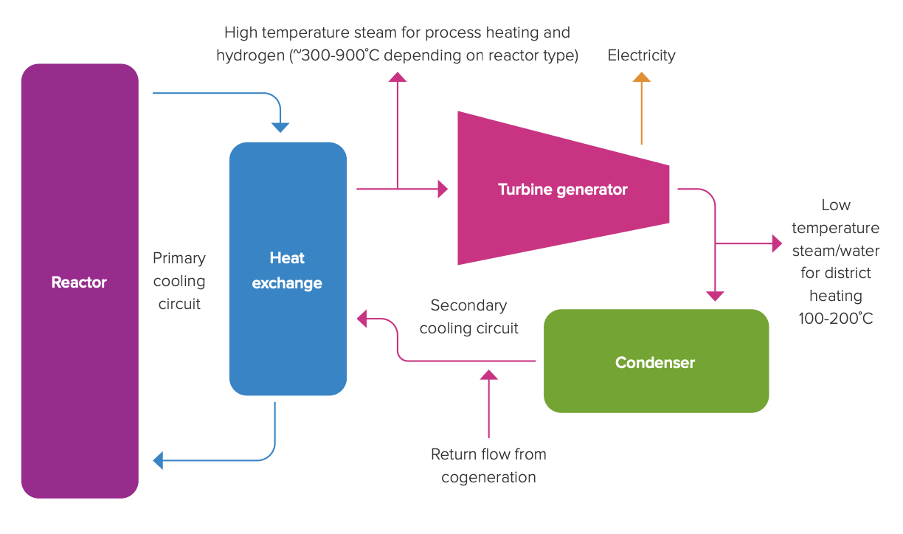
Co-generation uses rejected heat from steam turbine for district heating.
https://royalsociety.org/-/media/policy/projects/nuclear-cogeneration/2020-10-7-nuclear-cogeneration-policy-briefing.pdf

Slide 17
Do both! China is using two Westinghouse AP1000 power reactors for district heating.
Haiyang 1&2 could heat 30 million square metres…
eventually provide heating to more than 200 million square metres of housing within 100 km
avoiding the use of about 6.62 million tonnes of coal.
Up to six CAP1000 units are planned for the Haiyang plant.
Haiyang
population 350,000
https://www.neimagazine.com/news/newssecond-phase-of-chinas-haiyang-nuclear-heating-project-begins-operation-9267335
Up to six CAP1000 units are planned for the Haiyang plant. SPIC says it will actively explore larger-scale, higher-efficiency, and longer-distance heating

Slide 18
Nuclear option to heat the campus
Valley News July 5, 2021
The University of Illinois is planning to heat its Urbana campus with a new, underground nuclear reactor with a fuel cartridge that lasts 20 years. The university is working with Seattle-based Ultra Safe Nuclear Corp. to partially replace a coal-fired plant, seeking Department of Energy funding and preparing a Nuclear Regulatory Commission license application.
Dartmouth College has already rebuilt its hot-water circulating district heating system in anticipation of plans for a wood chip burning plant, now dropped. Dartmouth continues to burn 3.5 million gallons of No. 6 fuel oil annually as it seeks a better energy source. The Ultra Safe Nuclear Corp. reactor generates 15 megawatts of heat, approximately the demand from the Dartmouth campus.
ROBERT HARGRAVES
https://www.vnews.com/Forum-July-5-41265620

Slide 19
April 27, 2022
https://www.purdue.edu/newsroom/releases/2022/Q2/purdue-and-duke-energy-to-explore-potential-for-clean,-nuclear-power-source-for-campus.html

Slide 20
12 Buildings
Cooling
Heating
Insulation
Co-generation
Fission is in Fashion

