Slide 1
10 Ammonia
Green revolution
Feeds nearly half the world
Shipping use 7% of oil
Ammonia combustion engines
Solid oxide synthesis cells
Fission is in Fashion

Slide 2
Ammonia for fertilizer and for fuel
2500 GW
Heating
Cheap, 24x7
liquid fission electricity 12,000 GW
intermediate
Hydrogen 3,000 GW
2700 GW
Light industry
1700 GW
Building ops
1800 GW
Heavy industry
300 GW
Electric vehicles
C-synfuel 400 GW
300 GW
1600 GW
Heavy transport
200 GW
400 GW
Airplanes
Ammonia 700 GW
800 GW
400 GW
Shipping
Biomass
400 GW
300 GW
1700 GW
Food

Slide 3
Century-old Haber-Bosch process makes NH3 (ammonia) from CH4 (natural gas).
CH4 + O2 → CO2 + 2H2 N2 + 3H2 → 2NH3
https://www.thechemicalengineer.com/features/cewctw-fritz-haber-and-carl-bosch-feed-the-world/

Slide 4
Ammonia fertilizer: basis of the Green Revolution, feeds nearly half the world.
The knife slices the soil and injects the fertilizer 6 to 8 inches into the soil.
The ammonia (NH3) ions react with moisture in the soil and convert to ammonium (NH4).
Ammonium ions are bonded to negatively charged soil particles like clay and organic matter.
These ammonium ions can be taken in by plants and used directly in proteins.
In time they convert to nitrate (NO3) fertilizer.
https://iowaagliteracy.wordpress.com/2019/03/20/why-do-they-do-that-anhydrous/
Notes:
Green Revolution built on fertilizer
Made from natural gas, today.

Slide 5
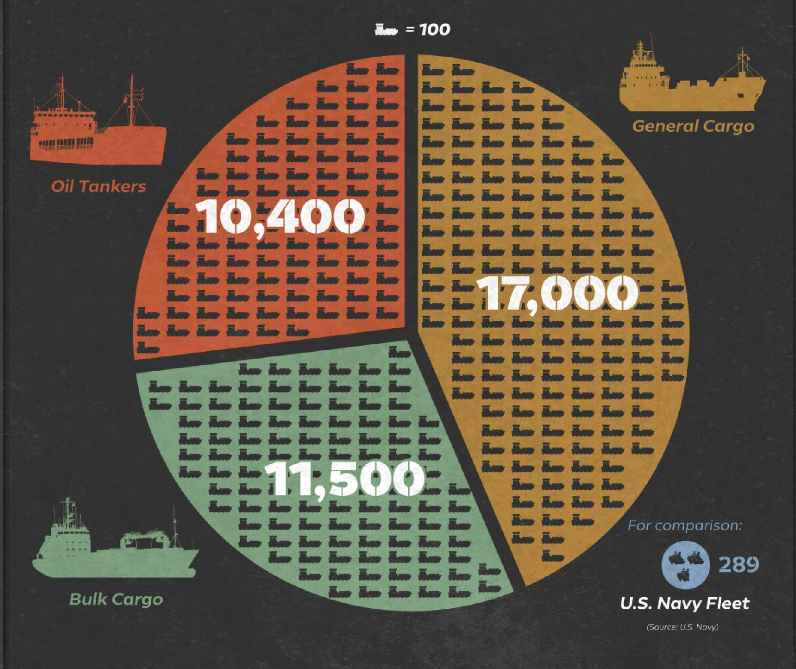
Global trade depends on this massive fleet of commercial ships.
https://www.visualcapitalist.com/imo-2020-the-big-shipping-shake-up/

Slide 6
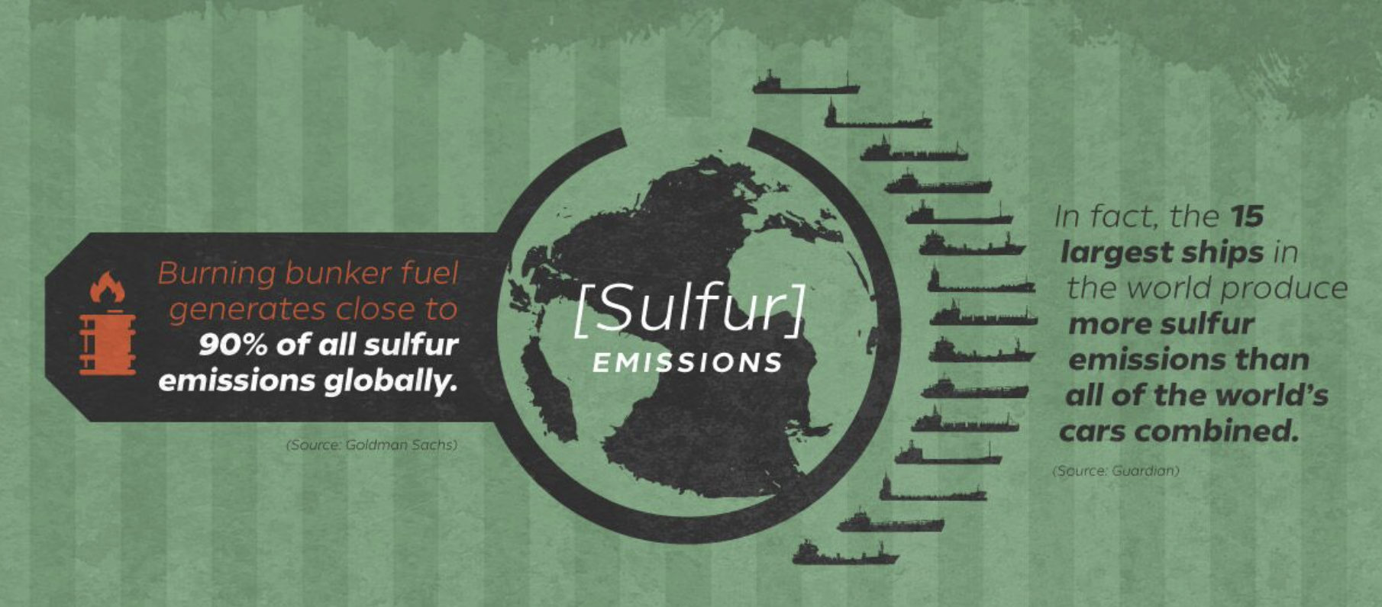
Shipping uses 7% of oil production, emitting SOx.
2020 IMO changed SOx cap from 3.5% to 0.5%.
https://www.visualcapitalist.com/imo-2020-the-big-shipping-shake-up/

Slide 7
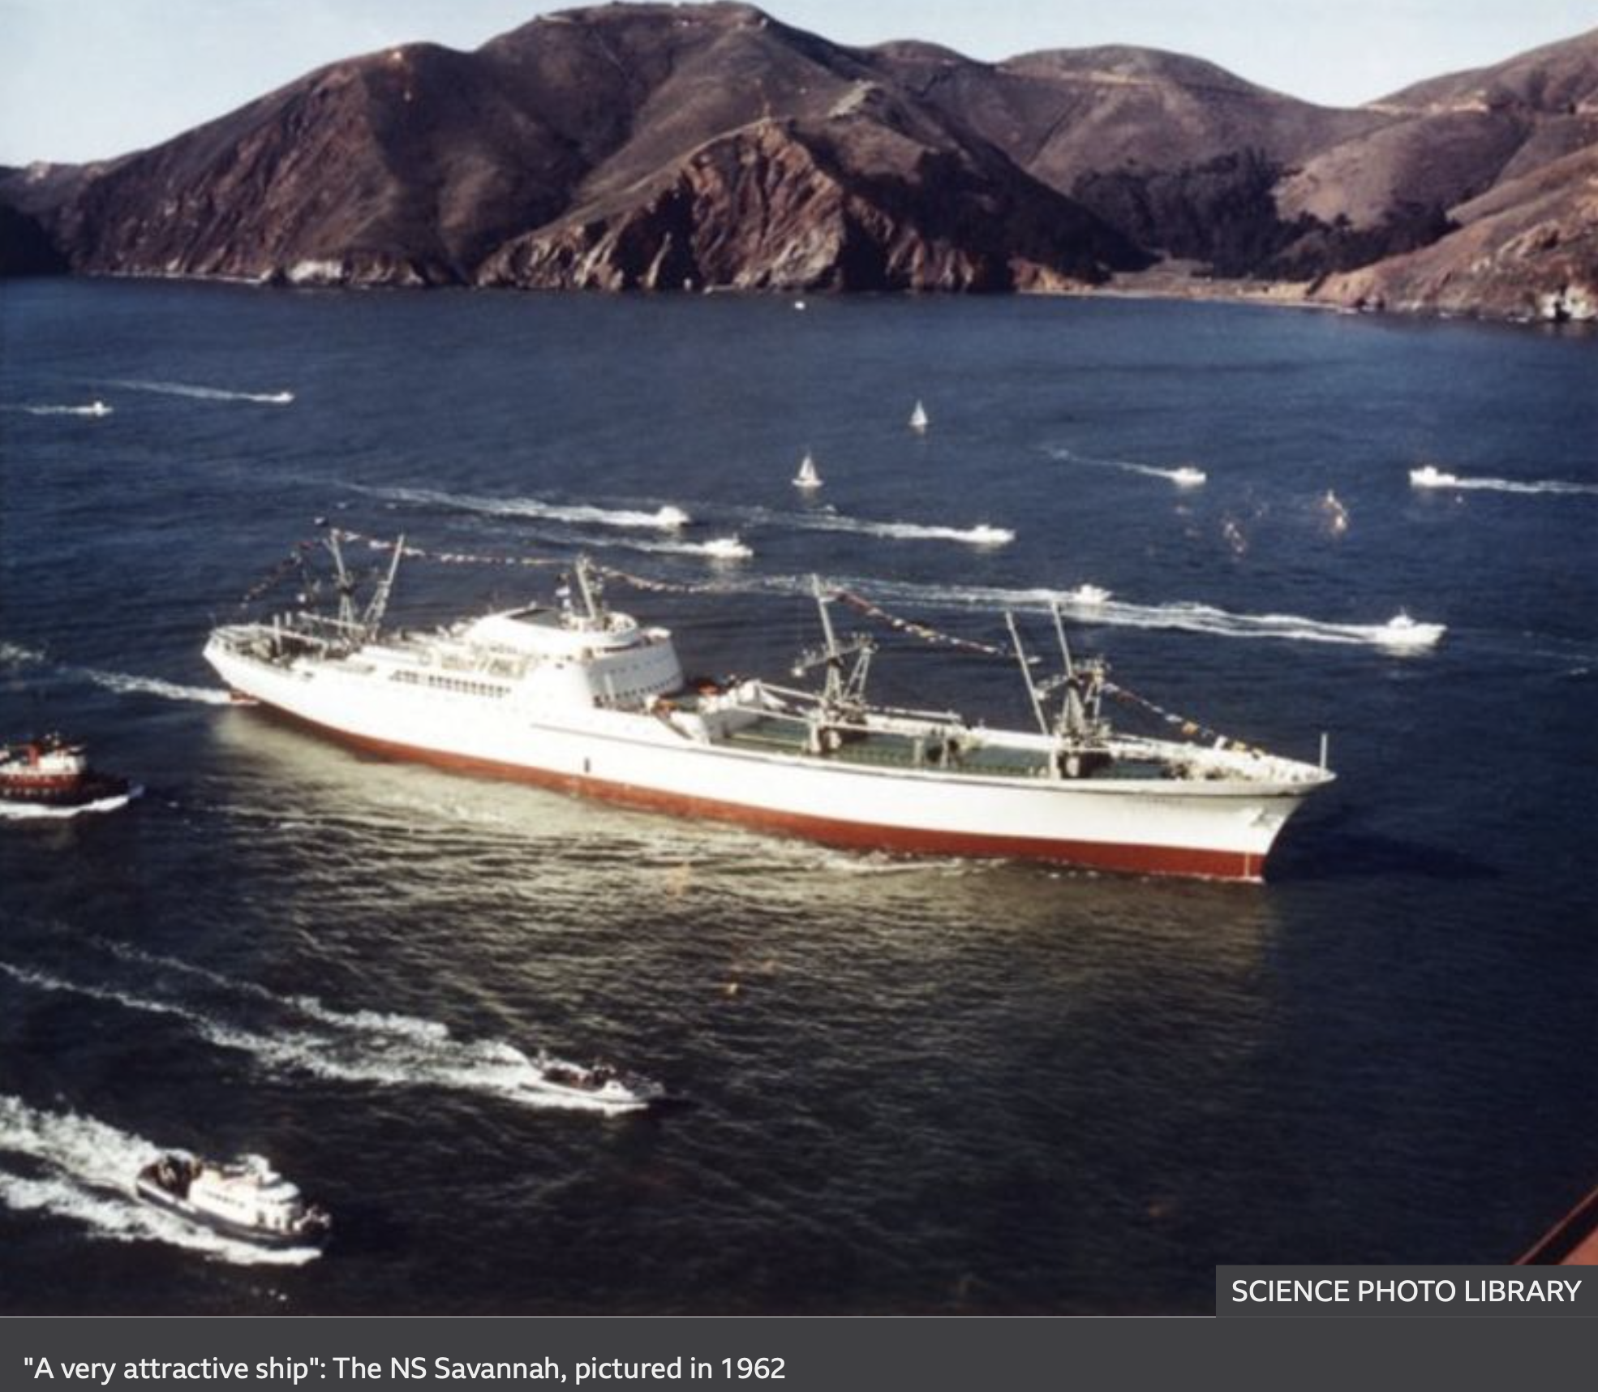
More nuclear reactors in ships than power plants in 1990 ! US built just one nuclear powered merchant ship.
Mirai, Japan
Otto Hahn, Germany
Dozen icebreakers,
Russia
11 carriers, 100+ submarines, US
Fission powered shipping is a good emissions solution, ignored.
https://www.bbc.com/news/magazine-28439159

Slide 8
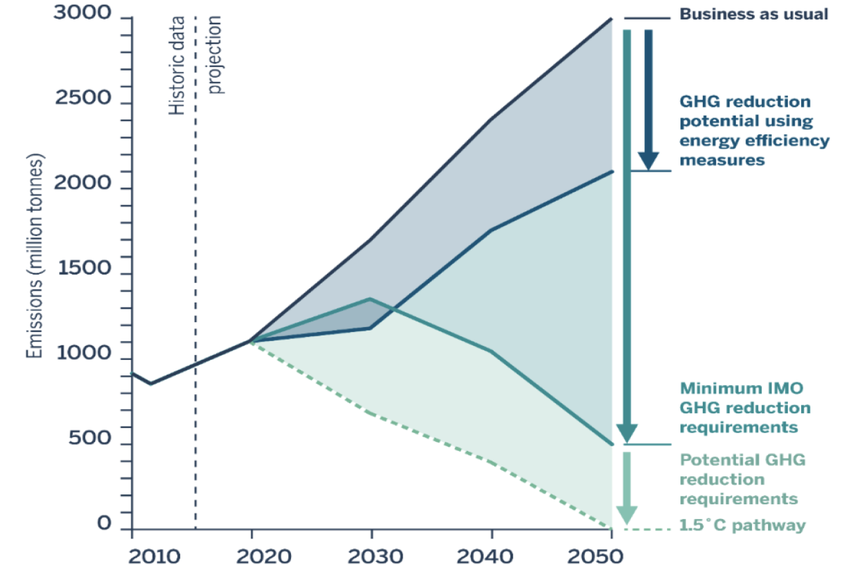
Clean Air Task Force recommends NH3 ammonia fuel for shipping.
2 Gt / year shipping emissions level!
https://www.energy.senate.gov/services/files/33CE21D8-F2C6-409F-A3DB-49DF7BFCE2A7

Slide 9
Ammonia, NH3
Nitrogen is 78% of the atmosphere.
Ammonia stored in pressurized tanks, ~15 bar, like propane.
11.5 MJ/liter energy density, 1/3 that of diesel.
High octane, low flame temperature can enable high-compression ICE with little NOx emissions.
Household ammonia is NH3 in H2O.
https://www.energy.gov/sites/prod/files/2015/01/f19/fcto_nh3_h2_storage_white_paper_2006.pdf

Slide 10
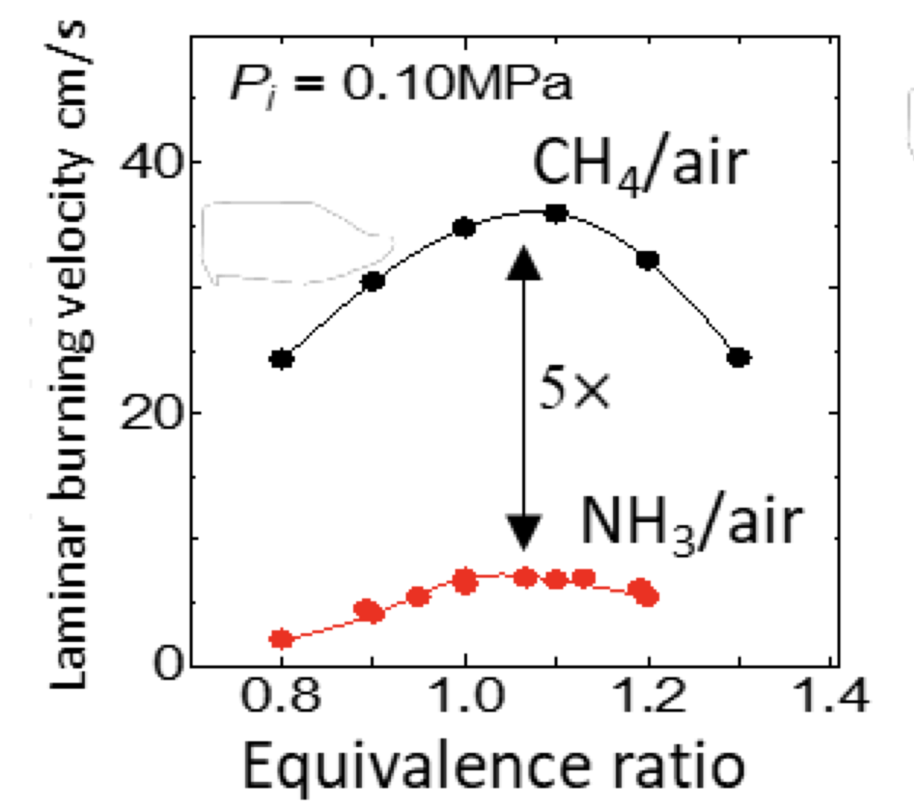
NYK ammonia tanker will use ammonia in its fuel mix.
NH3 speed of combustion is low, compared to CxHy fuels.
https://www.ammoniaenergy.org/wp-content/uploads/2019/08/20191112.1408-NH3FuelConf_Okafor1.pdf
https://www.ammoniaenergy.org/articles/japans-nyk-and-partners-to-develop-ammonia-fueled-and-fueling-vessels/

Slide 11
H2 might be a combustion accelerator for a ship's ammonia engine.
Cracking (heating) NH3 yields H2 accelerant.
25:1 compression ratio allows NH3 compression ignition.
Emerging technology
Big (diesel) engine example - 80 MW power (100,000 hp) - < 120 rpm
https://www.ammoniaenergy.org/articles/ammonia-powered-internal-combustion-engines/

Slide 12
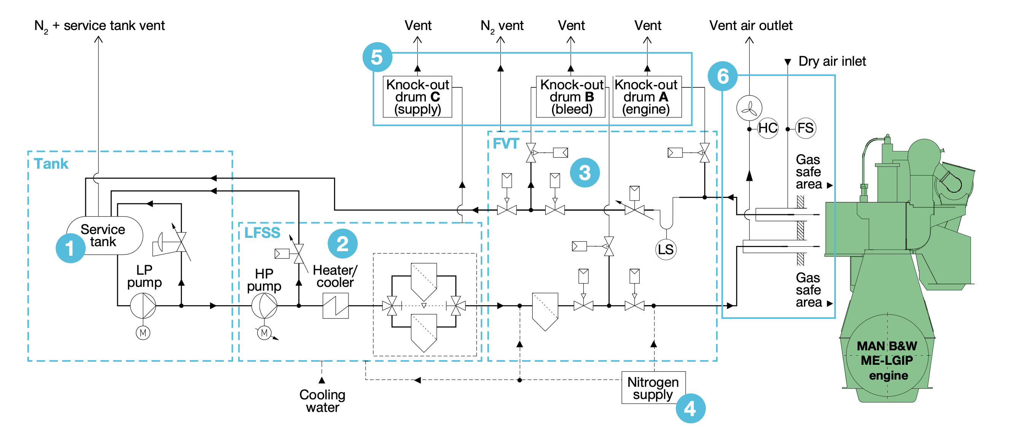
MAN ES expects to deliver its first marine ammonia engine in 2024, retrofits in 2026.
https://fathom.world/wp-content/uploads/2020/05/engineeringthefuturetwostrokegreenammoniaengine1589339239488.pdf

Slide 13
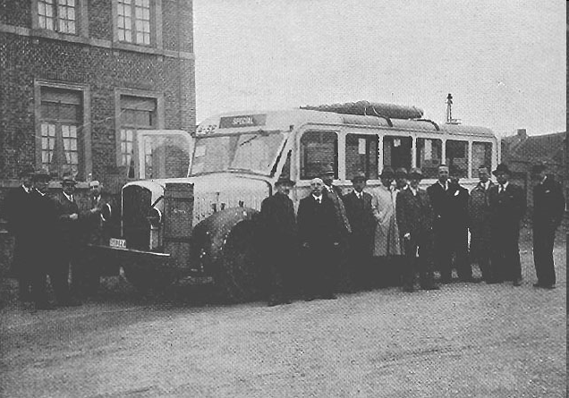
Ammonia fueled Belgium motor-buses.

Slide 14
The X-15 used ammonia fuel to set speed and altitude records in the 1960s.

Slide 15
Trucks can run on ammonia fuel.

Slide 16
Internal combustion engines can run on ammonia fuel.
Marangoni Toyota G86 Eco Explorer
180 km on 30 litres NH3 @ $0.20 ~19 miles/$

Slide 17
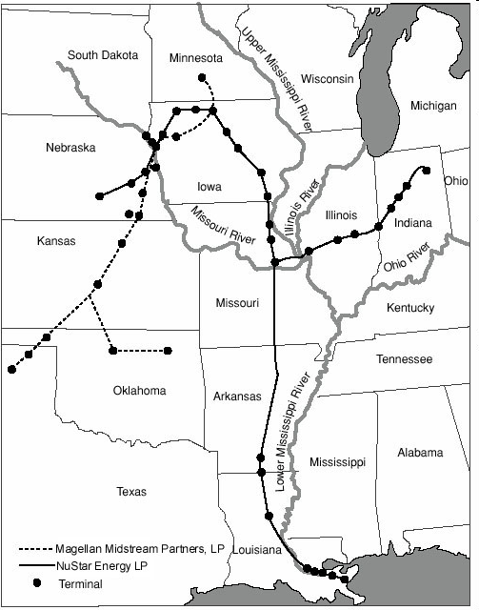
Experience with producing, transporting, using ammonia.
2nd most common chemical in use
130 Mt/year
3000 miles of US pipelines
No corrosion or embrittlement problems
4.5 Mt of large-tank ammonia storage

Slide 18
Ammonia can be handled safely.
Vehicle pressure tanks ammonia 14 bar propane 12 bar natural gas 200 bar
Spill danger alerting odor lighter than air difficult to ignite; ignition temperature 650º C fire extinguished with plain water
Toxicity safety experience: 2nd most common industrial chemical inhalation of 500 ppm is dangerous humans and mammals process NH3 in urea cycle (but not fish)
About as dangerous as gasoline
Limit use to trained truck drivers and ship crews?
Notes:
100 F temperature
About the same danger as gasoline

Slide 19
Solid state ammonia synthesis can make NH3 from H2O, N2, and electricity.
Like a solid oxide fuel cell, in reverse
Proton conducting ceramic membrane
Advantages · Never any H2 gas · Low pressure · Modular scale-up
550º steam from liquid fission reheated to 650°
Safer, cheaper than Haber-Bosch
~6800 kWh / ton
http://www.energy.iastate.edu/Renewable/ammonia/ammonia/2008/Sammes_2008.pdf
http://www.energy.iastate.edu/Renewable/ammonia/ammonia/2008/Sammes_2008.pdf
Notes:
http://www.energy.iastate.edu/Renewable/ammonia/ammonia/2008/Sammes_2008.pdf
Solid state electrochemical process - works like a fuel cell in reverse
550ºC steam adsorbs and decomposes on a electrocatalyst at the anodic side of a proton conducting ceramic (PCC ) membrane
Hydrogen atoms from the decomposed steam are stripped of their electrons by an external voltage and become protons. Remaining oxygen atoms recombine and volatilize and are separated from the steam loop as a separate by-product.
The resulting protons conduct through the PCC “electrolyte” via defect hopping and then…
Chemically combine with adsorbed nitrogen on the other (cathode) side to form ammonia

Slide 20
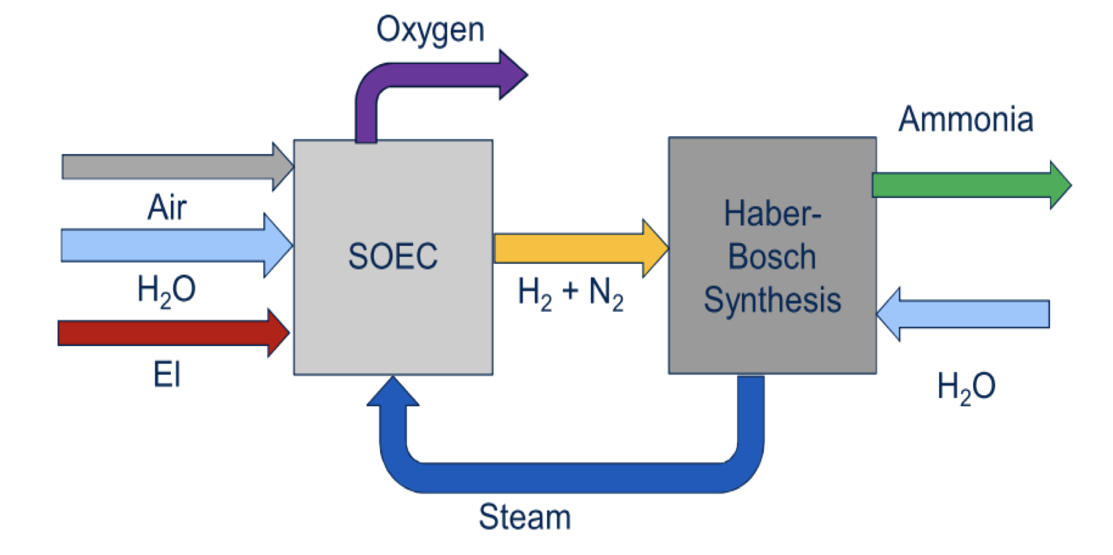
Haldor Topsoe solid oxide NH3 synthesis
https://www.ammoniaenergy.org/wp-content/uploads/2019/08/20191112.0800-NH3-Topsøe.pdf

Slide 21
NH3 solid oxide fuel cell synthesis benefits:
New Solid Oxide Electrolysis based synthesis gas process
Synergy with HB using steam from synthesis reaction
Eliminates air separation unit due SOC built-in oxygen separation
Utilize heat of air combustion to split steam
High efficiency
Ammonia is the perfect fuel for Solid Oxide Fuel Cells
No fuel processing
No carbon problems => no need for steam addition
Cooling by ammonia cracking
https://www.ammoniaenergy.org/wp-content/uploads/2019/08/20191112.0800-NH3-Topsøe.pdf

Slide 22
The Future is Here for Solid Oxide Electrolysis Cells
(Oct 22, 2020, Ammonia Energy Association, Science)
“the initial electrochemical performance of state-of-the-art SOEC single cells has more than doubled, while long-term durability has been improved by a factor of ∼100. Similar improvements in performance and durability have been achieved on the stack level.”
“unrivaled conversion efficiencies — a result of favorable thermodynamics and kinetics at higher operating temperatures.”
ability to be “operated in reverse, [so that] an SOEC functions as a solid oxide fuel cell (SOFC),”
solid oxide cells providing 1000 GW of power in fuel cell mode would require just 1 month’s worth of global ZrO2 production and 21 months’ worth of Y2O3, compared to...
1000 GW-hours from Li-ion batteries requires ∼160 years of Li production (2012), and 1000 GW-days from a PEM fuel cell system requires 53 months’ global Pt production.
https://science.sciencemag.org/content/370/6513/eaba6118
https://www.ammoniaenergy.org/articles/the-future-is-here-for-solid-oxide-electrolysis-cell-technology

Slide 23
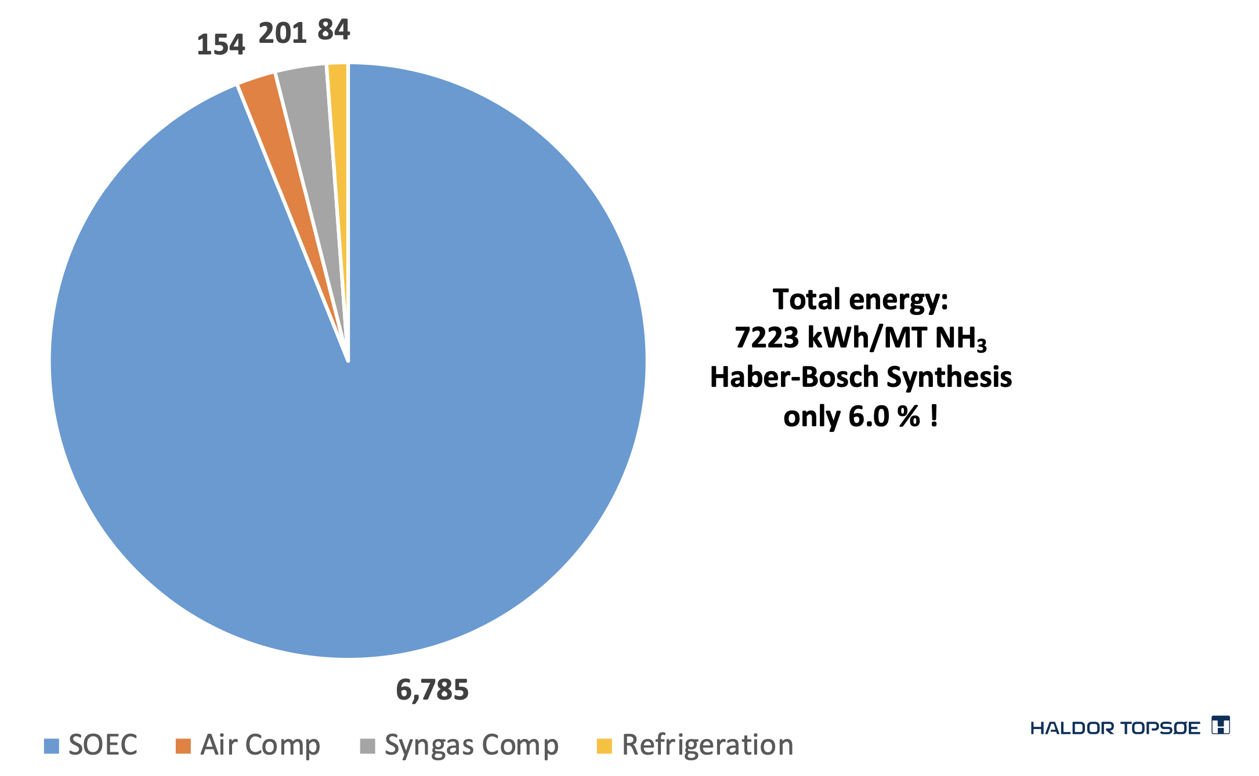
Haldor Topsoe NH3 synthesis process: 7.2 kWh/kg
At $0.03/kWh electricity
ammonia costs 22 cents/kg
Confirming Darryl Siemer's decade-old estimate.
https://www.ammoniaenergy.org/wp-content/uploads/2019/08/20191112.0800-NH3-Topsøe.pdf

Slide 24
Green Energy Oman proposes wind and sun to power hydrogen-ammonia production.
25 GW(e)
wind at night, sun in day
70% capacity factor
$30 billion
6,500 km2
10 MT/year ammonia
= 5.7 GW(t)
https://intercontinentalenergy.com/green-energy-oman

Slide 25
Ammonia for fertilizer and for fuel
2500 GW
Heating
Cheap, 24x7
liquid fission electricity 12,000 GW
intermediate
Hydrogen 3,000 GW
2700 GW
Light industry
1700 GW
Building ops
1800 GW
Heavy industry
300 GW
Electric vehicles
C-synfuel 400 GW
300 GW
1600 GW
Heavy transport
200 GW
400 GW
Airplanes
Ammonia 700 GW
800 GW
400 GW
Shipping
Biomass
400 GW
300 GW
1700 GW
Food

Slide 26
10 Ammonia
Green revolution
Feeds nearly half the world
Shipping use 7% of oil
Ammonia combustion engines
Solid oxide synthesis cells
Fission is in Fashion

