Slide 1
Fission is in Fashion
Osher @ Dartmouth
Robert Hargraves

Slide 2
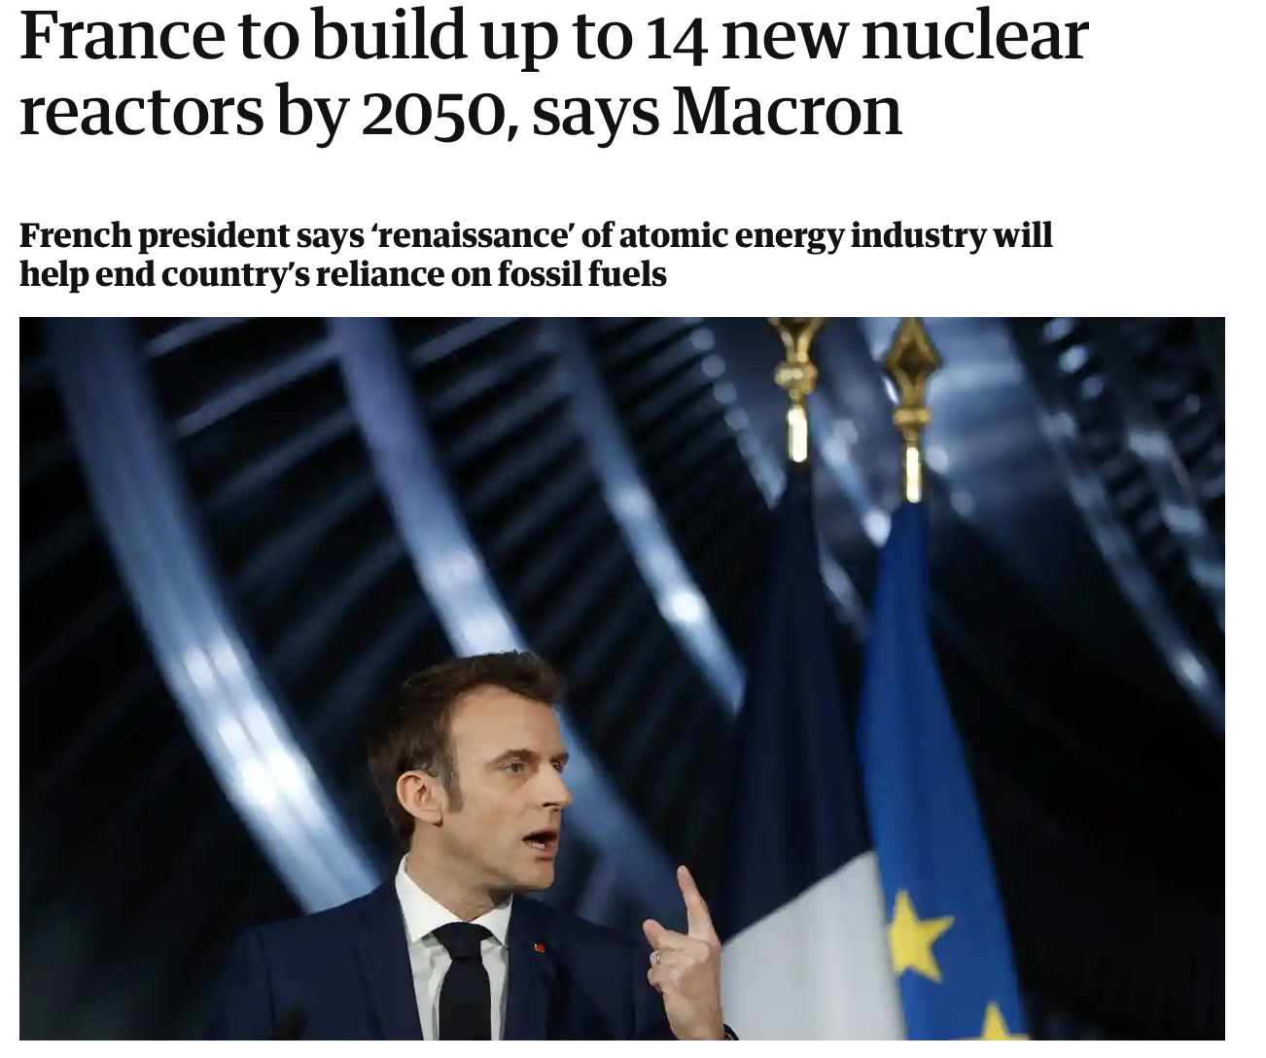
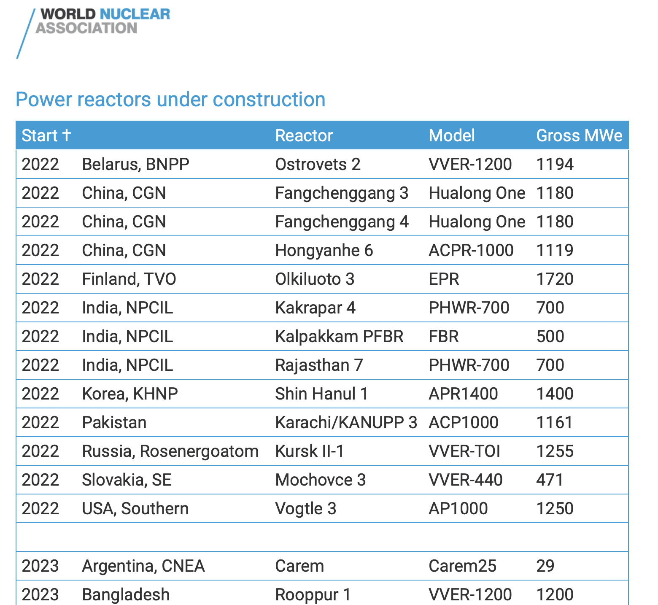
Fission is in Fashion

Slide 3
Chapters
1 Energy in the evolution of civilization
2 Basics of energy and power
3 Earth’s carbon battery
4 Energy economics
5 Wind and solar power
6 Global power
7 Fission power
8 Radiophobia
9 Hydrogen
10 Ammonia
11 Transportation
12 Buildings
13 Industry
14 Energy policy

Slide 4
1 Energy in the evolution of civilization
Population
Wealth
Heat
Electricity
Wealth dependence on energy
Fission is in Fashion

Slide 5
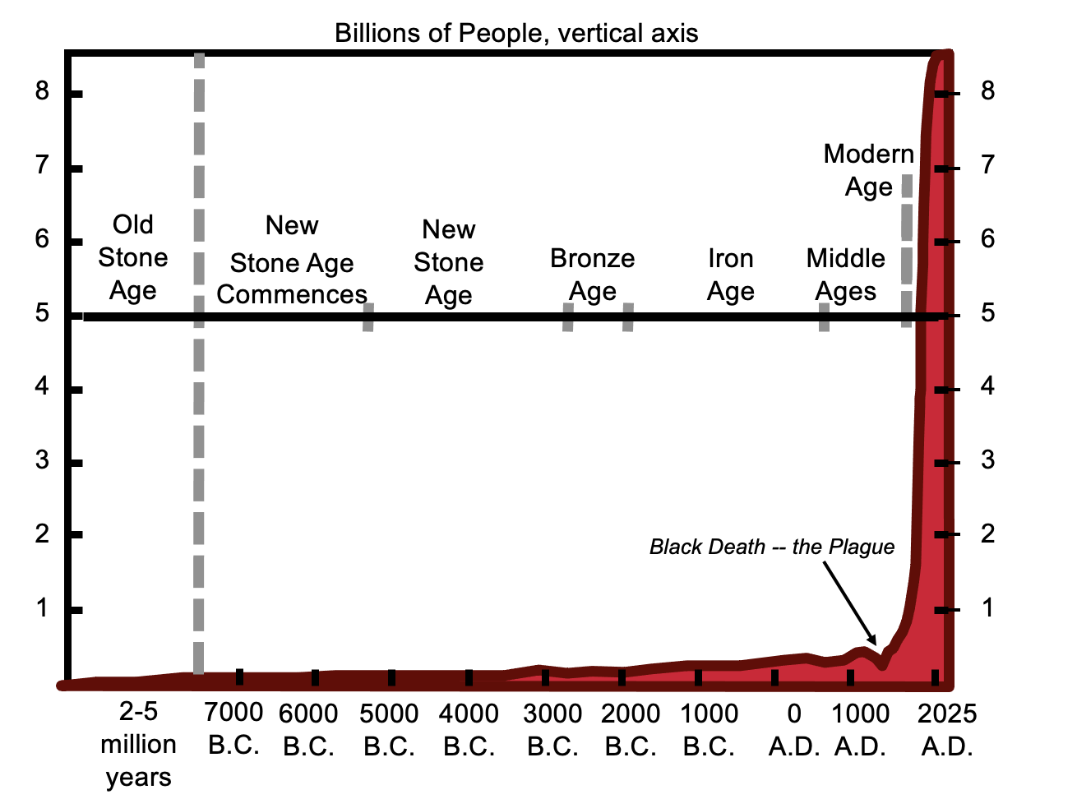
What's the value of energy to civilization?
Ayres INSEAD lecture #3

Slide 6
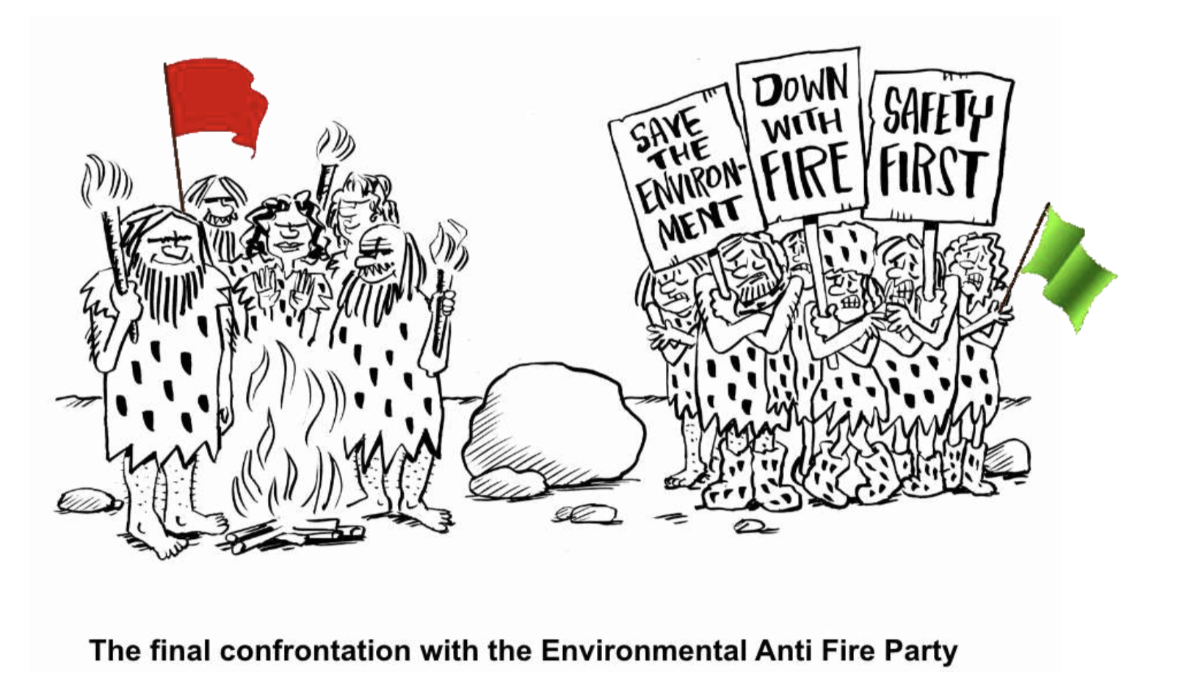
Humans harnessed fire 1.8 million years ago.
Wade Allison: When Fear Kills

Slide 7
Cooking with heat energy.
Cooking food saved time and energy. Primates still spend half their day chewing raw food.
By switching to cooked, softer, more energetically rich food homo erectus was able to devote time to more productive activities, making tools, farming, and interacting socially
Reduced kinetic energy demands for metabolism permitted evolution of the human’s large brain, which consumes a quarter of the body’s energy.
Fossil records show evolution to larger brains and smaller guts, jaws, and teeth.
Hargraves THORIUM: energy cheaper than coal

Slide 8
Climate warming in 10,000 BC enabled agriculture.
Earlier stone age roving bands subsisted on hunting animals and gathering food.
Productive agriculture of cereals enabled storage of food and free time to make tools, build shelters, develop writing, and advance civilization.
Stored food was wealth.
https://en.wikipedia.org/wiki/Neolithic_Revolution#Social_change

Slide 9
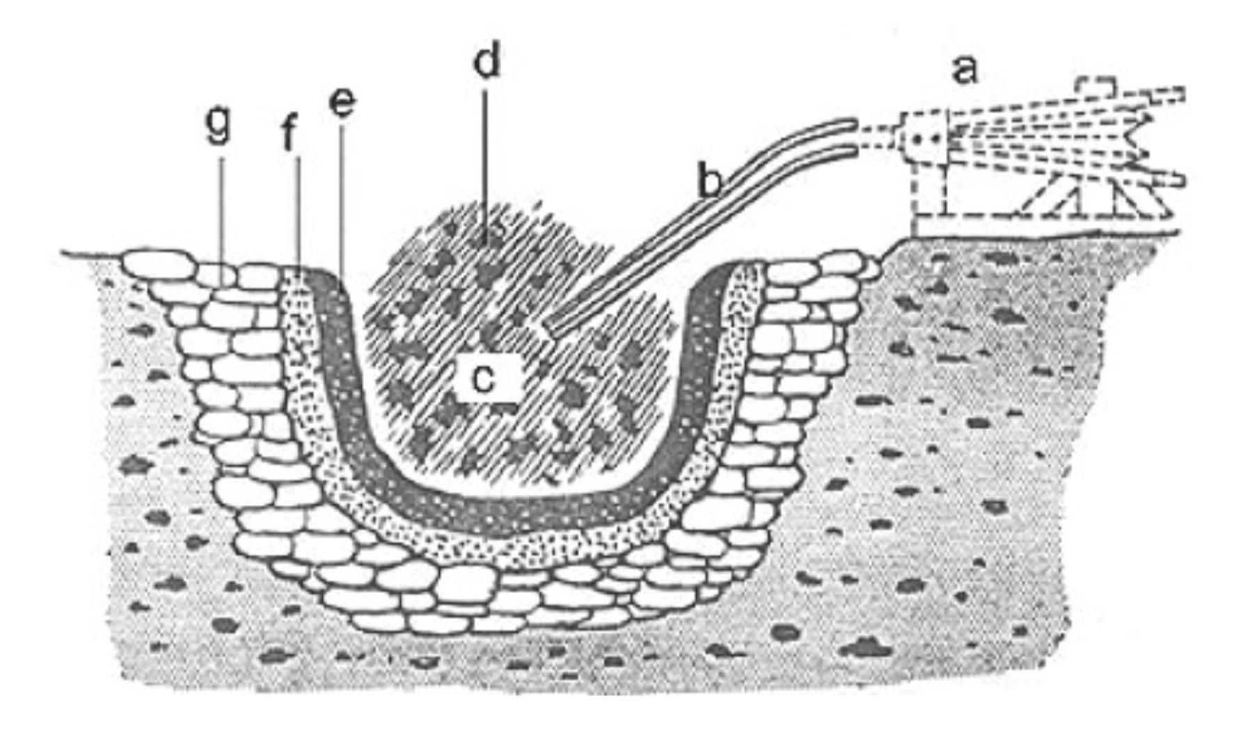
Bronze Age 3000 BC 1100°C furnace for melting copper and tin
a-Smile
b-nozzle
c-charcoal (wood?)
d-fine "grind" of copper and tin ore
e-lining of clay
f-priming with pen
g-stone lining
https://www.researchgate.net/publication/233731071_The_investigation_of_microstructure_and_hardness_of_archaeological_alloys/figures?lo=1

Slide 10
Iron Age 1200 BC; 1250-1535°C heat needed.
Iron ore is plentiful, inexpensive.
1250°C to reduce iron ore to iron bits that could be pounded together, forged, to form “wrought iron”.
African hardwood fuel burns hotter, as does charcoal.
1535°C to melt iron to form “cast iron”.
Adding carbon lowers iron melting point to 1150°C, but iron is brittle.
Killick A well-preserved tall (2.2 m) natural draft iron smelting furnace in the Kasungu National Park, Malawi
https://www.researchgate.net/publication/298801110_A_global_perspective_on_the_pyrotechnologies_of_Sub-Saharan_Africa/figures?lo=1

Slide 11
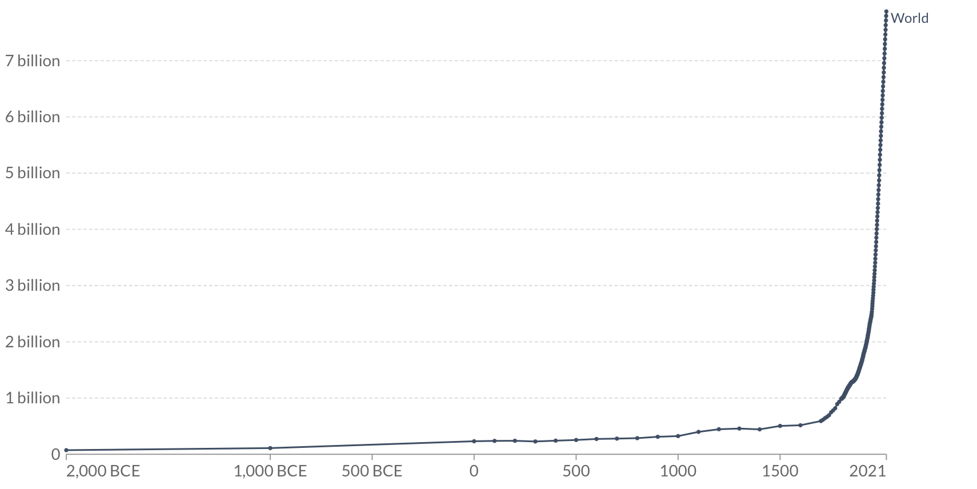
World population 2000 BC to present
Fossil fuels
Iron Age
https://ourworldindata.org/grapher/population?time=-2000..latest

Slide 12
Jim Kennedy, Vaclav Smil, BP, valuing 1 kW electricity as 2.6 kW heat

Slide 13
https://youtu.be/kSZzVm3nT50
https://youtu.be/kSZzVm3nT50

Slide 14
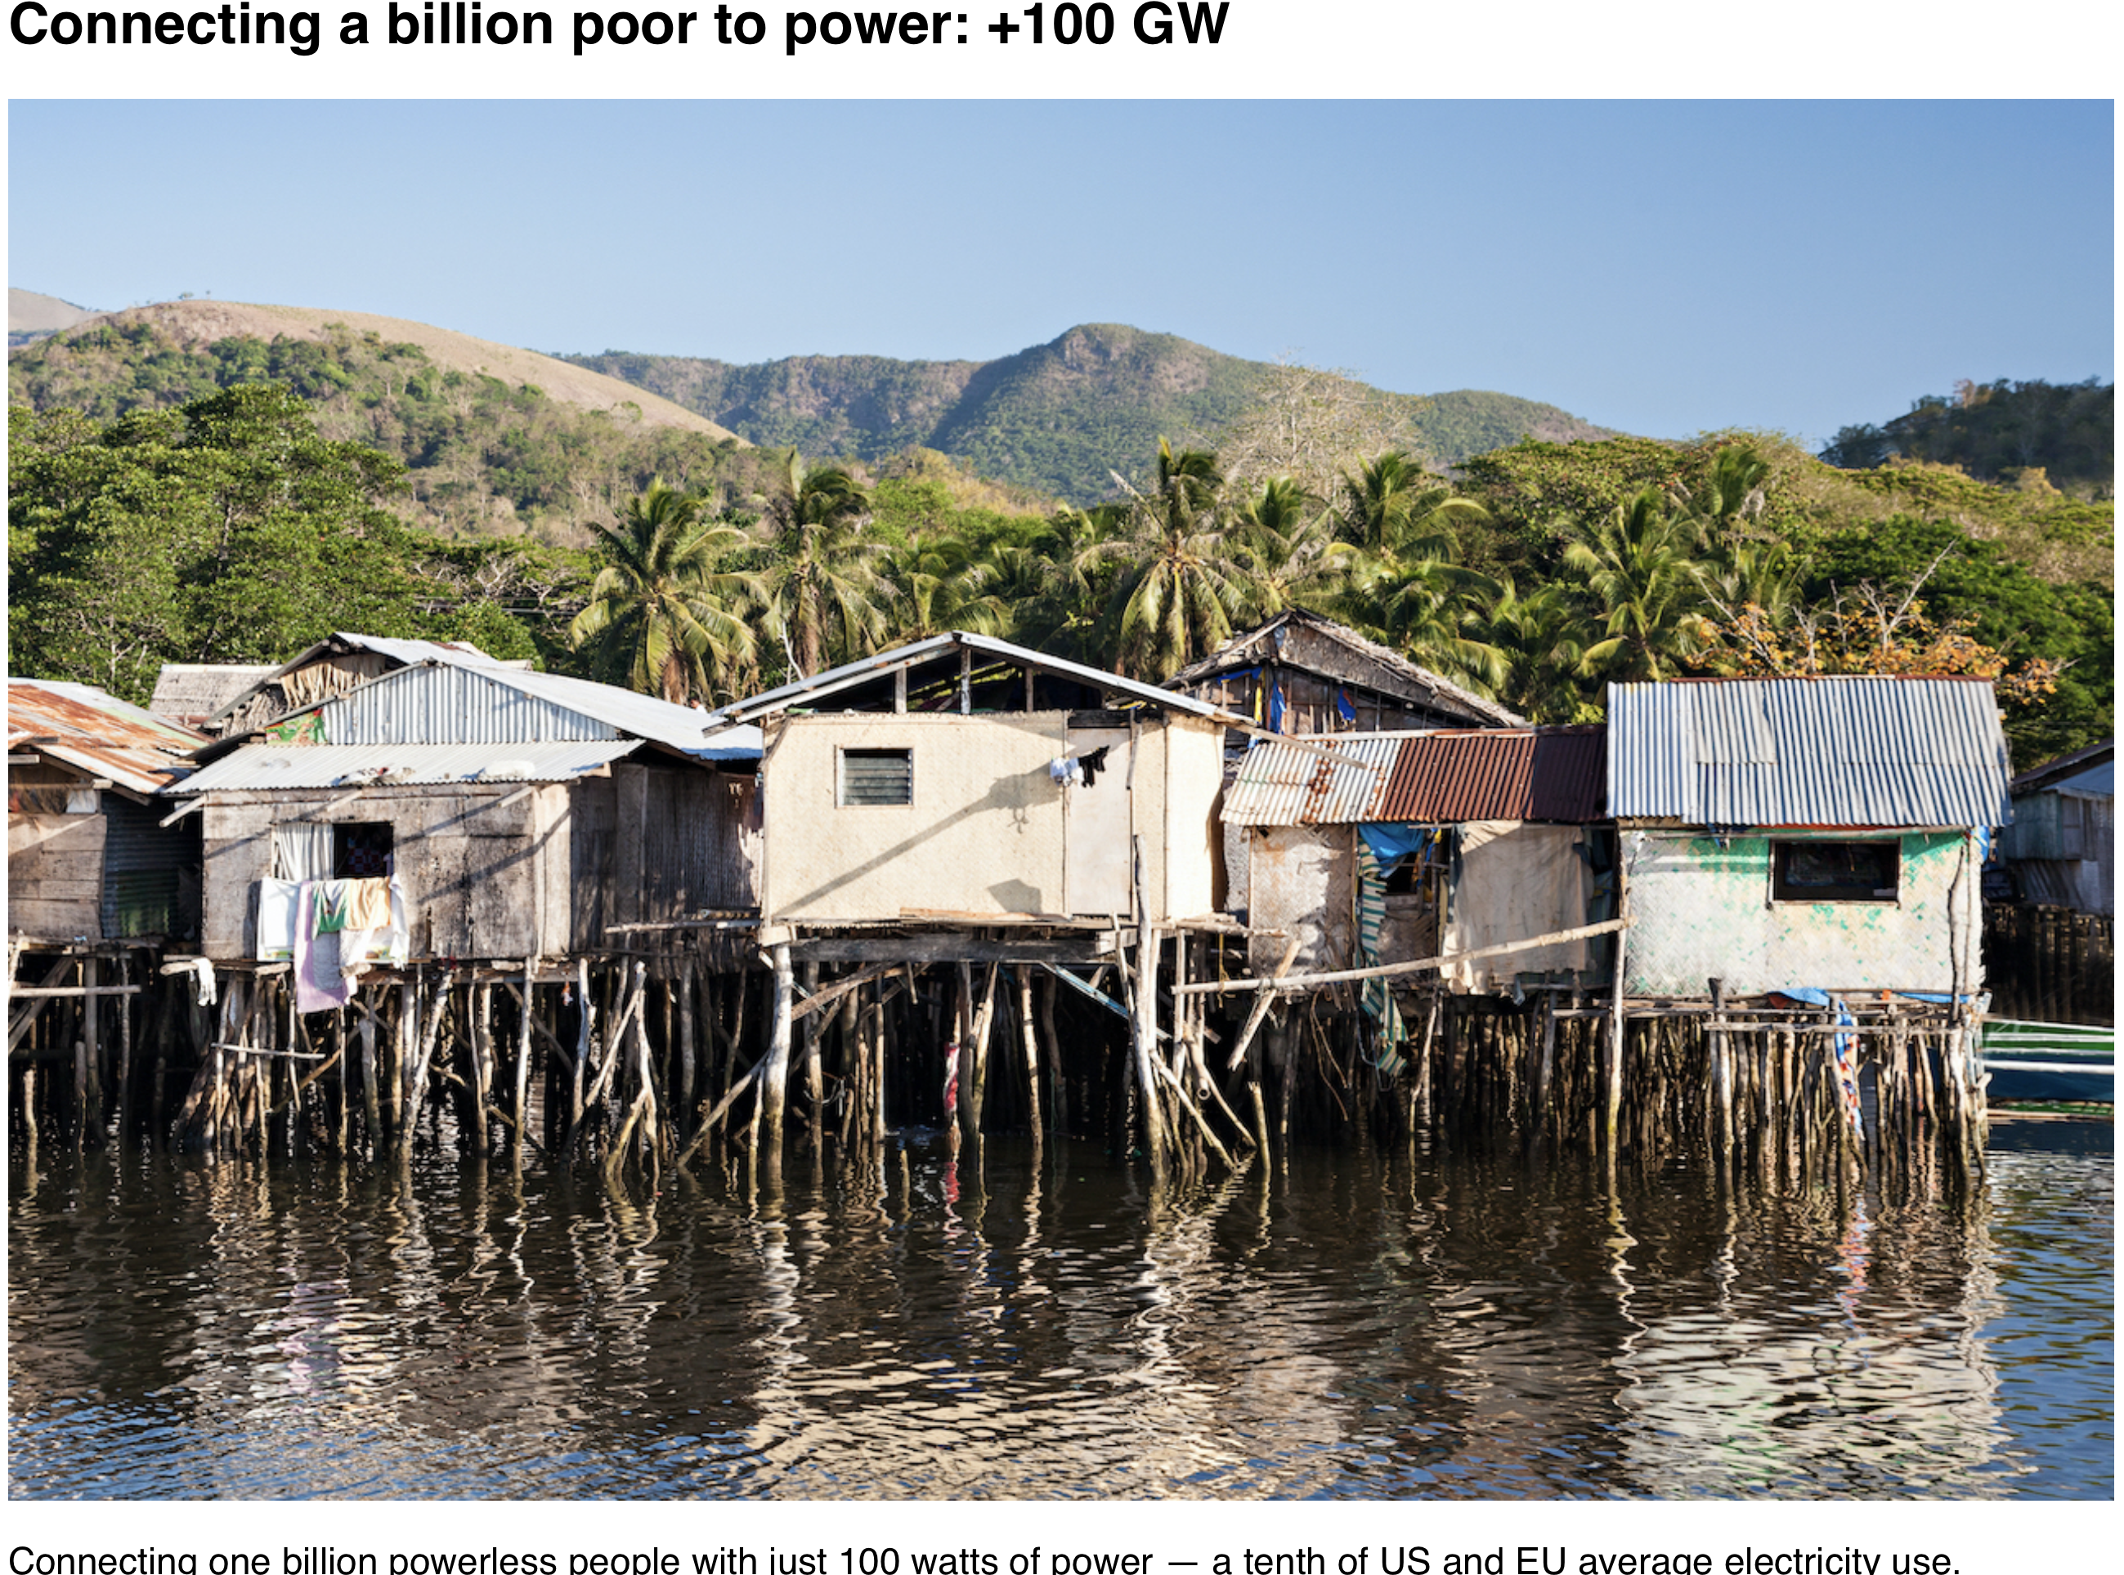
Connecting a billion poor to power by 2030: +100 GW (at only 100 W/person)

Slide 15
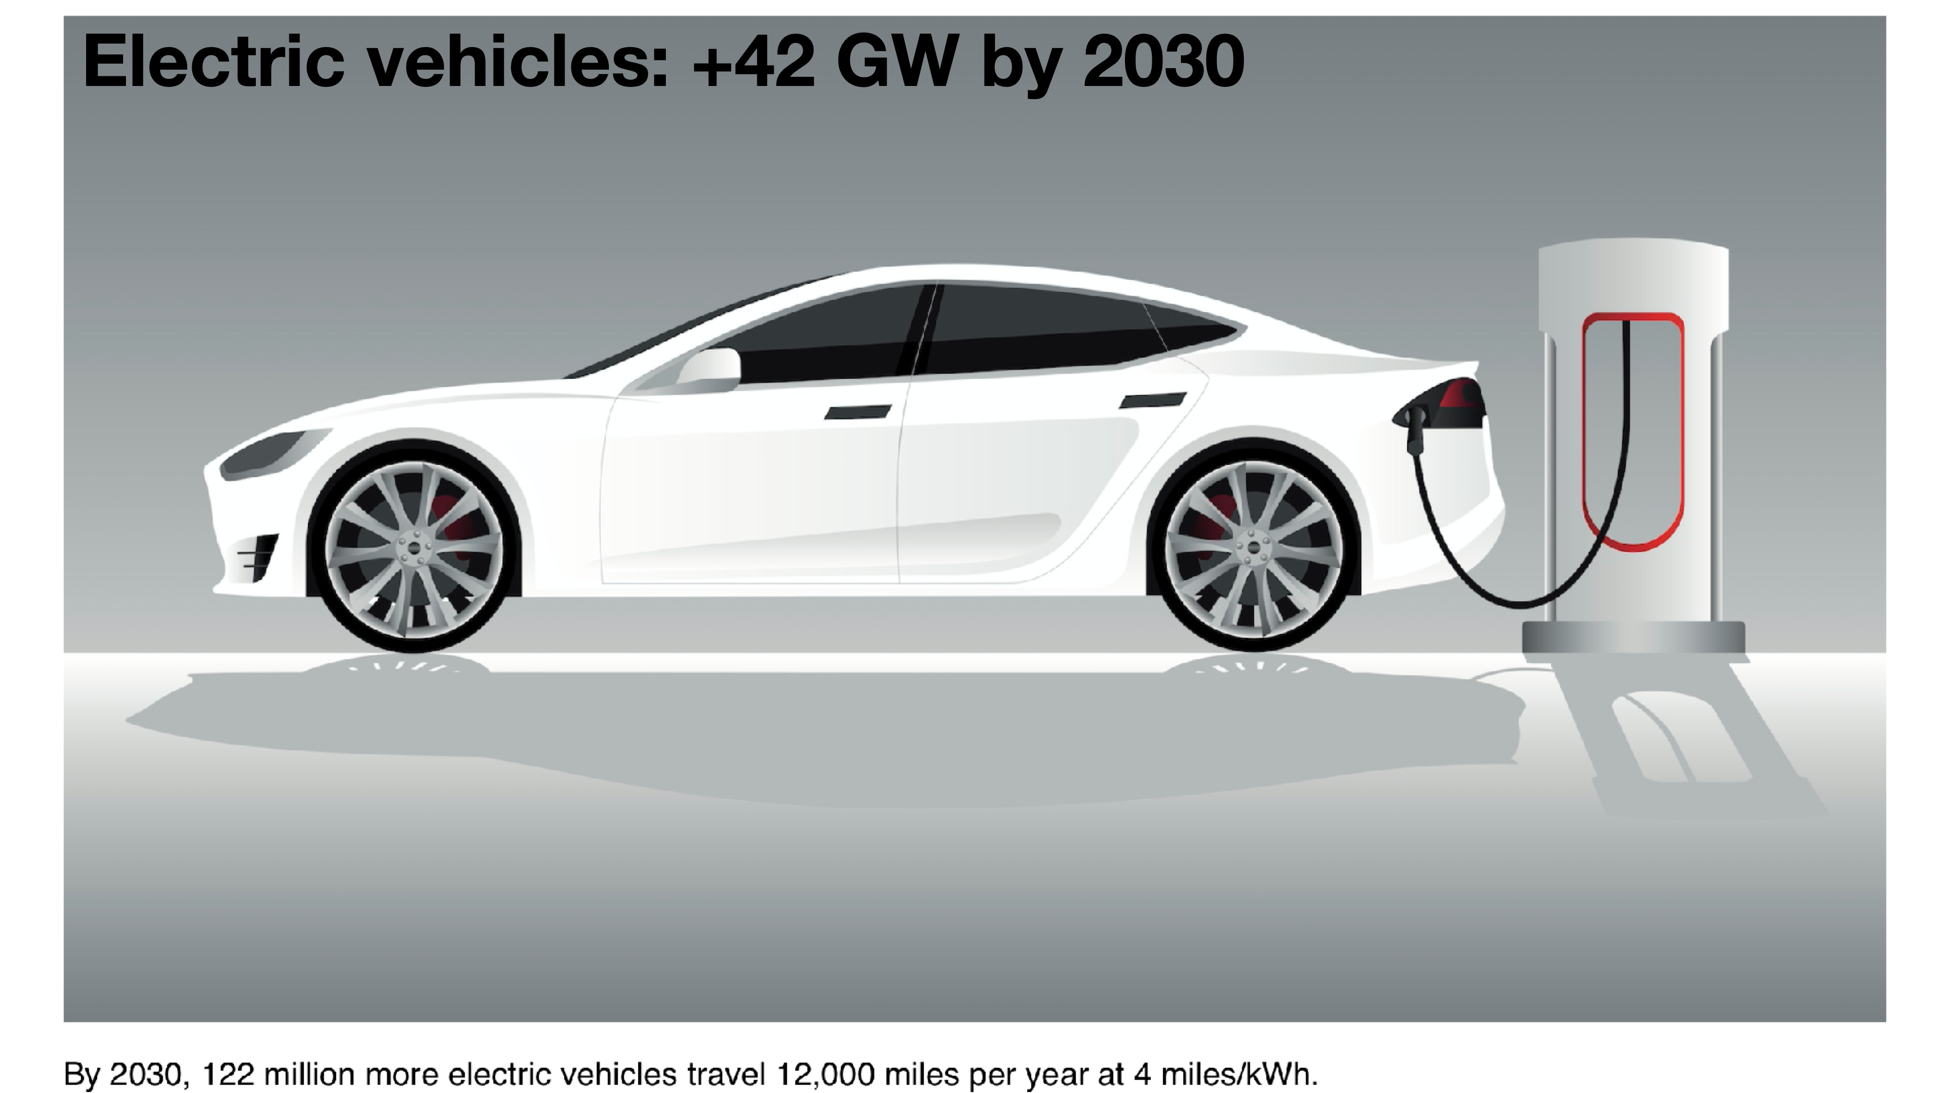
2030 GW growth +42 +62 +100 +300 +100 ....

Slide 16
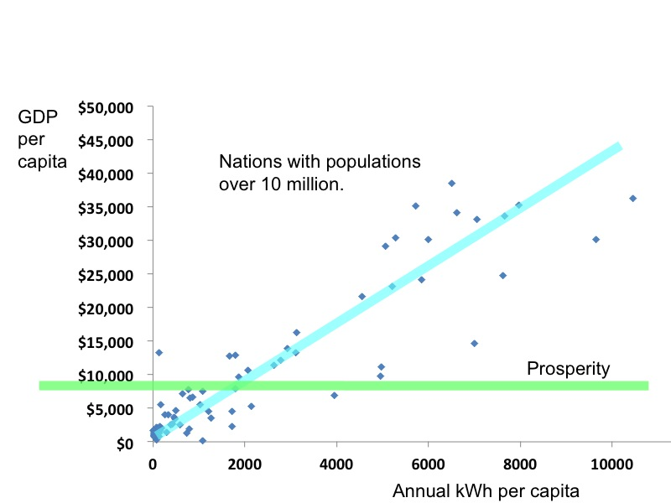
Nations achieve prosperity with electricity over ~250 watts per person.
https://www.cia.gov/library/publications/the-world-factbook/docs/rankorderguide.html

Slide 17
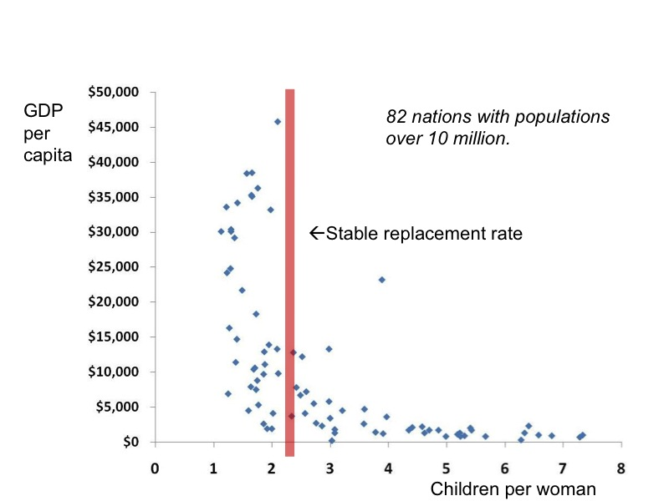
Prosperous people have fewer children.

Slide 18
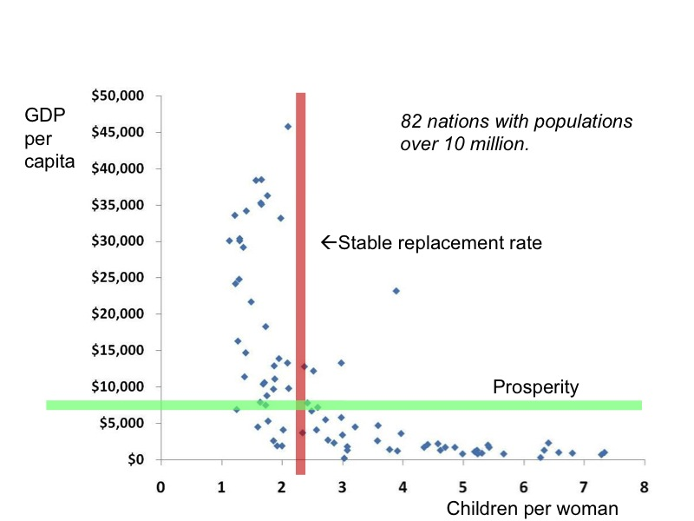
Fewer birthed people, with adequate energy, compete for finite world resources.

Slide 19
Fewer birthed people, with adequate energy, compete for finite world resources.

Slide 20
1 Energy role in the evolution of civilization
Population
Wealth
Heat
Electricity
Wealth dependence on energy
Fission is in Fashion

